Slide 1
UX Scenario Document File Version 4.4
Quallenkino for Jellyfin
Submission Date | 2026 / 10 / 18
App Ver. | 1.0.1
App Developer | Name: DrdotHouse2106 E-mail address: quallenkino.lg@ulber.me

Slide 2
Table of Contents
1. Basic Information
2. Document History
3. Page Description (Guideline)
4. Detailed Login Information
5. Main Page Description
6. Sub Page Description
7. Paid Content
8. In-App Ad

Slide 3
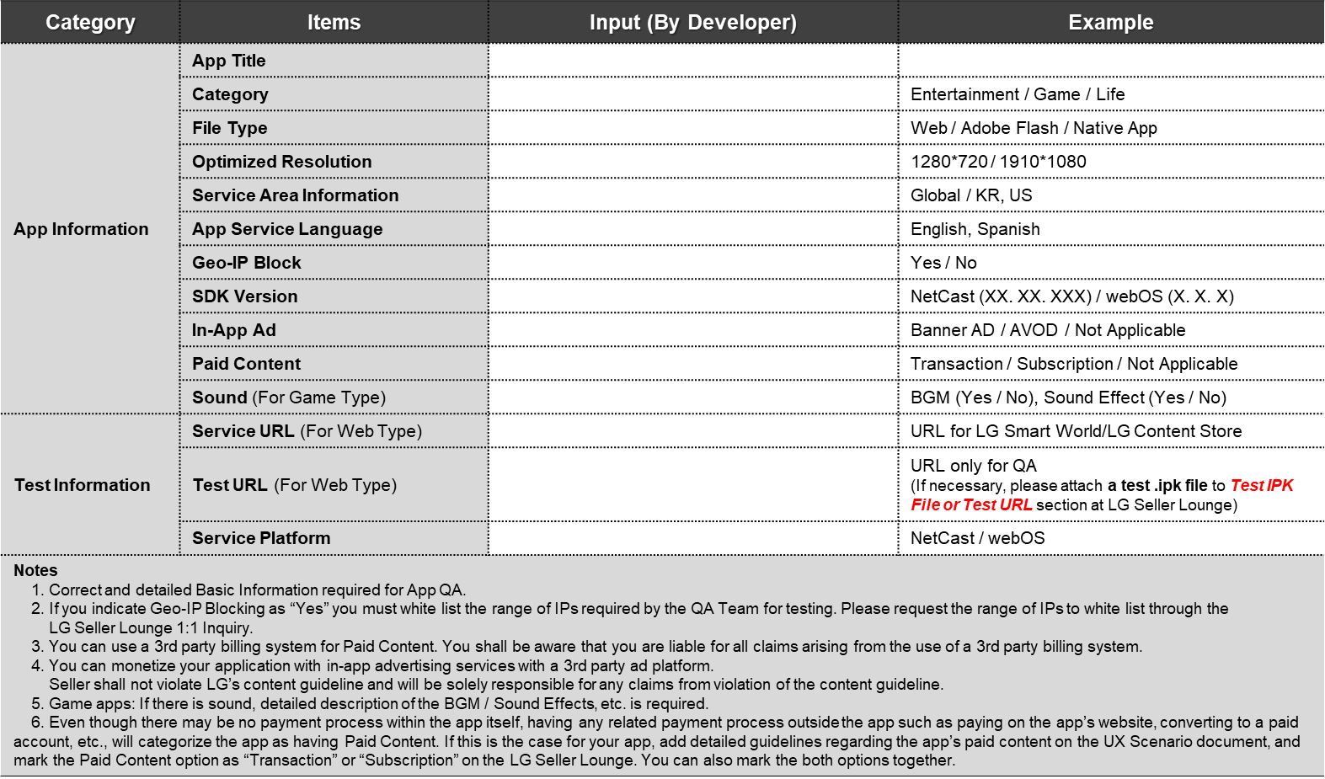
1. Basic Information
Quallenkino for Jellyfin
Entertainment
Web (webOS web app)
1920*1080
As set in Seller Lounge
German (UI)
No
webOS TV (tested on webOS 23)
Not Applicable
Not Applicable
N/A (not a game)
N/A (packaged app)
N/A – IPK uploaded
webOS

Slide 4
2. Document History
No. | Sent | Version | File Name | Contents
1 | 18.10.2026 | 1.0.1 | Quallenkino-webOS-UX-Scenario | Initial document

Slide 5
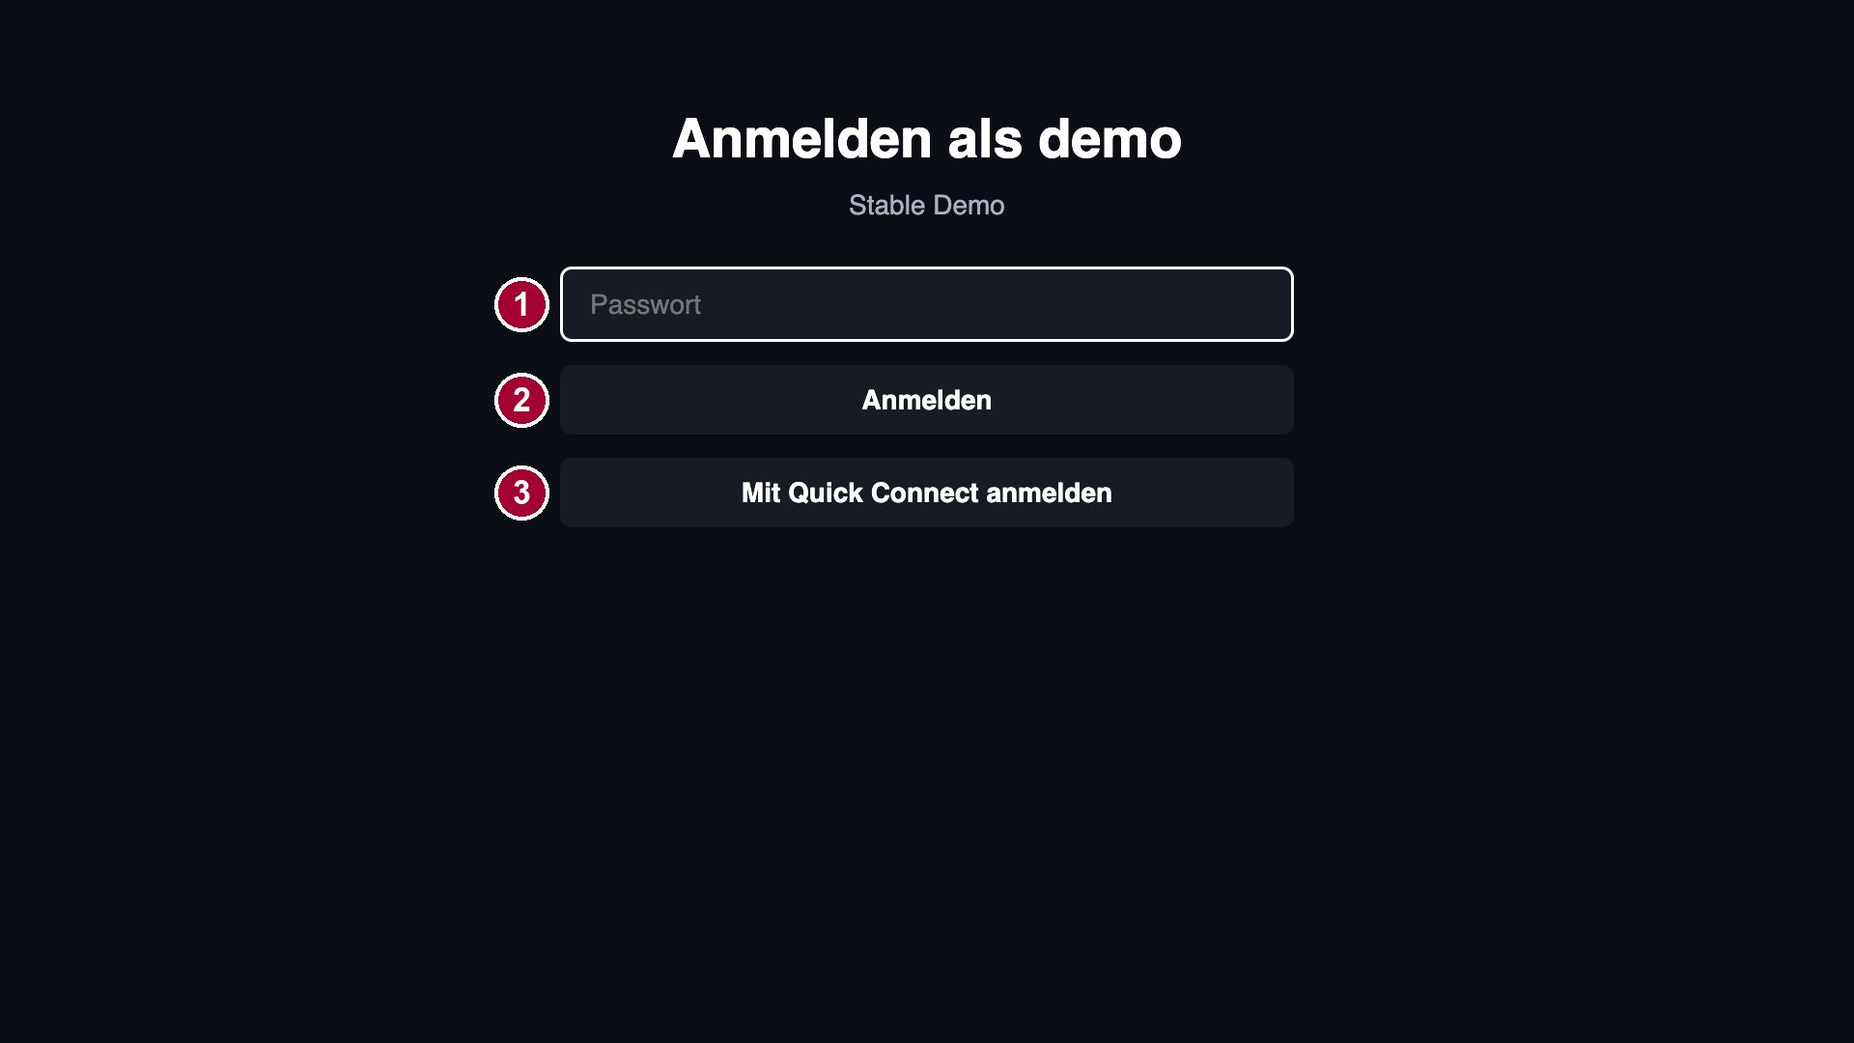
4. Detailed Login Information
Description
1 | Password field („Passwort“). Demo server: leave empty.
2 | „Anmelden“ = Sign in. ③ „Mit Quick Connect anmelden“ = sign in with a code (optional).
Test Accounts (ID / PW)
1 | Server: demo.jellyfin.org/stable ID (demo) / PW (empty)
2
3
Activation Codes
1 | Not applicable
2
3
Detailed Information
- The app needs a Jellyfin media server. Please use the public Jellyfin demo server: start page → address field → „demo.jellyfin.org/stable“ → „Verbinden“ (Connect).
- On „Wer schaut gerade?“ (Who’s watching?) select the profile „demo“, leave the password empty and select „Anmelden“ (Sign in). The sign-in is remembered (stays signed in after restart).
- No activation code, no account limit per device.

Slide 6
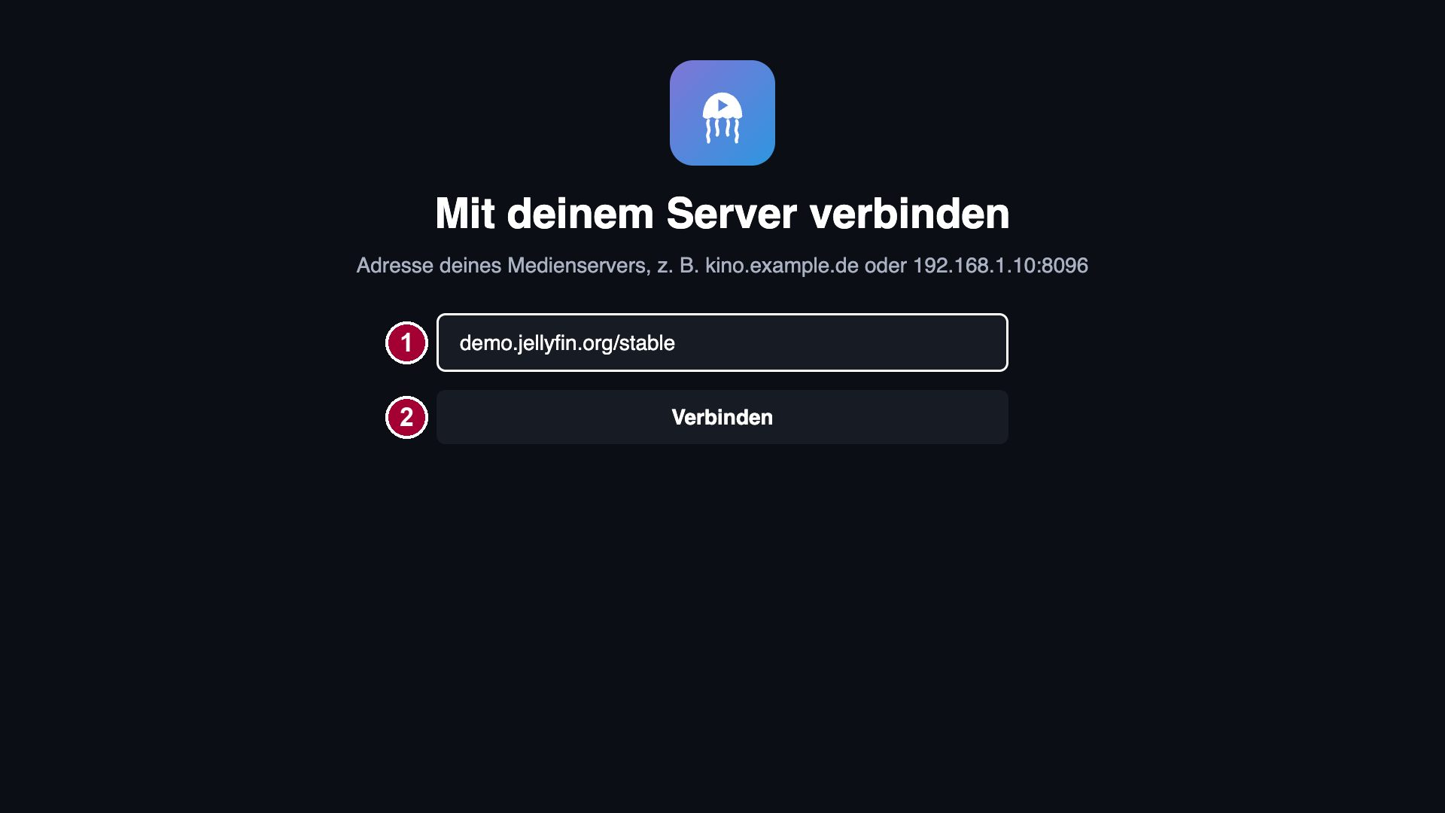
5. Main Page Description
1. Start Page – Connect to server
Description
1 | Server address field („Server-Adresse“). Press OK to open the LG keyboard. Test: demo.jellyfin.org/stable
2 | „Verbinden“ = Connect. The app tries https/http and the standard Jellyfin ports by itself.
Detailed Information
Title: „Mit deinem Server verbinden“ = Connect to your server. Shown on first start or after „Server wechseln“ (change server). BACK on this page closes the app.

Slide 7
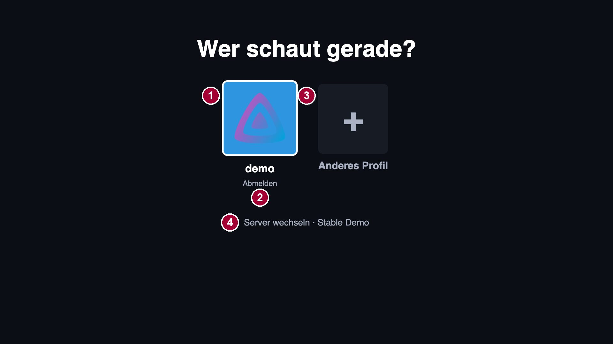
5. Main Page Description
2. Who’s watching? – Profile selection
Description
1 | Profile tile of the server user („demo“). OK opens the sign-in page; a remembered profile signs in directly.
2 | „Abmelden“ = Sign out (only below profiles that are signed in on this TV; DOWN from the tile).
3 | „Anderes Profil“ = Other profile: sign in with user name and password.
4 | „Server wechseln“ = Change server (back to the start page).
Detailed Information
Title: „Wer schaut gerade?“ = Who’s watching? Shows the users of the Jellyfin server; the sign-in is remembered per profile.

Slide 8
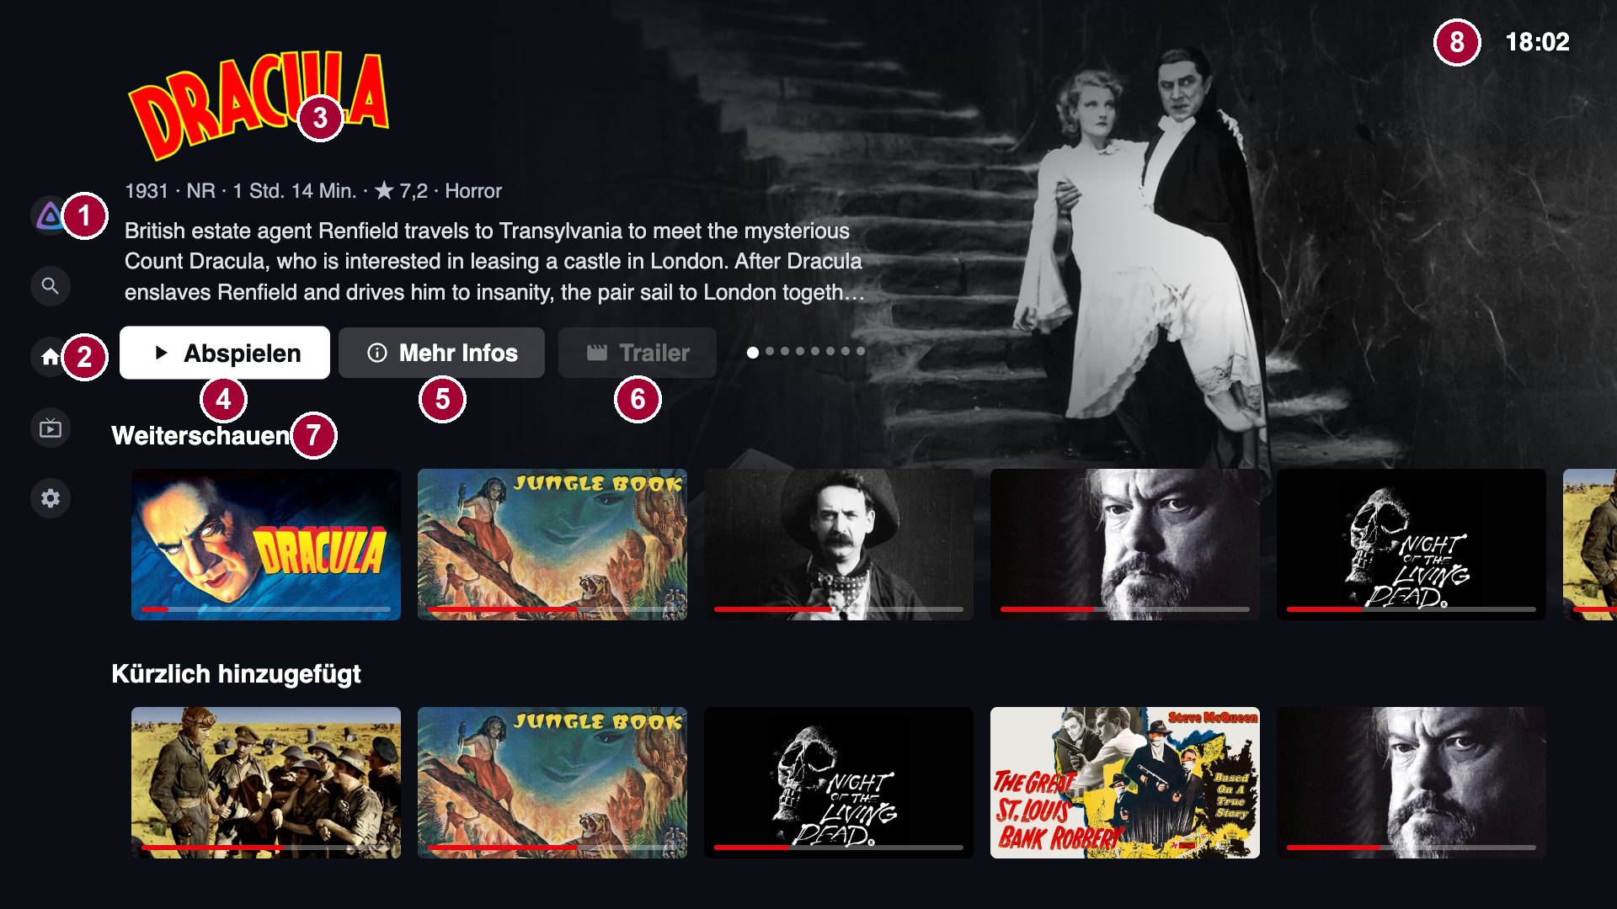
5. Main Page Description
3. Home Screen
Description
1 | Left menu (opens with LEFT): Profile, Search, Home, Live TV, Settings (see sub page 1).
2 | Menu item „Startseite“ = Home (current page).
3 | Info area (billboard) of the focused title: logo, year, rating, description. Rotates through suggestions.
4 | „Abspielen“ = Play the title.
5 | „Mehr Infos“ = More info: opens the detail page.
6 | „Trailer“: plays the trailer (greyed out if the title has none).
7 | Rows: „Weiterschauen“ = Continue watching, „Als Nächstes“ = Next up, „Kürzlich hinzugefügt“ = Recently added, (*) recommendations, Worlds, Top 10. UP/DOWN between rows, LEFT/RIGHT inside a row, OK opens the title.
8 | Clock.
Detailed Information
BACK on the home screen opens the exit dialog (sub page 9). Rows marked (*) need the optional server plugin „Local Recommendations“ and do not appear on the demo server (see sub page 11).

Slide 9
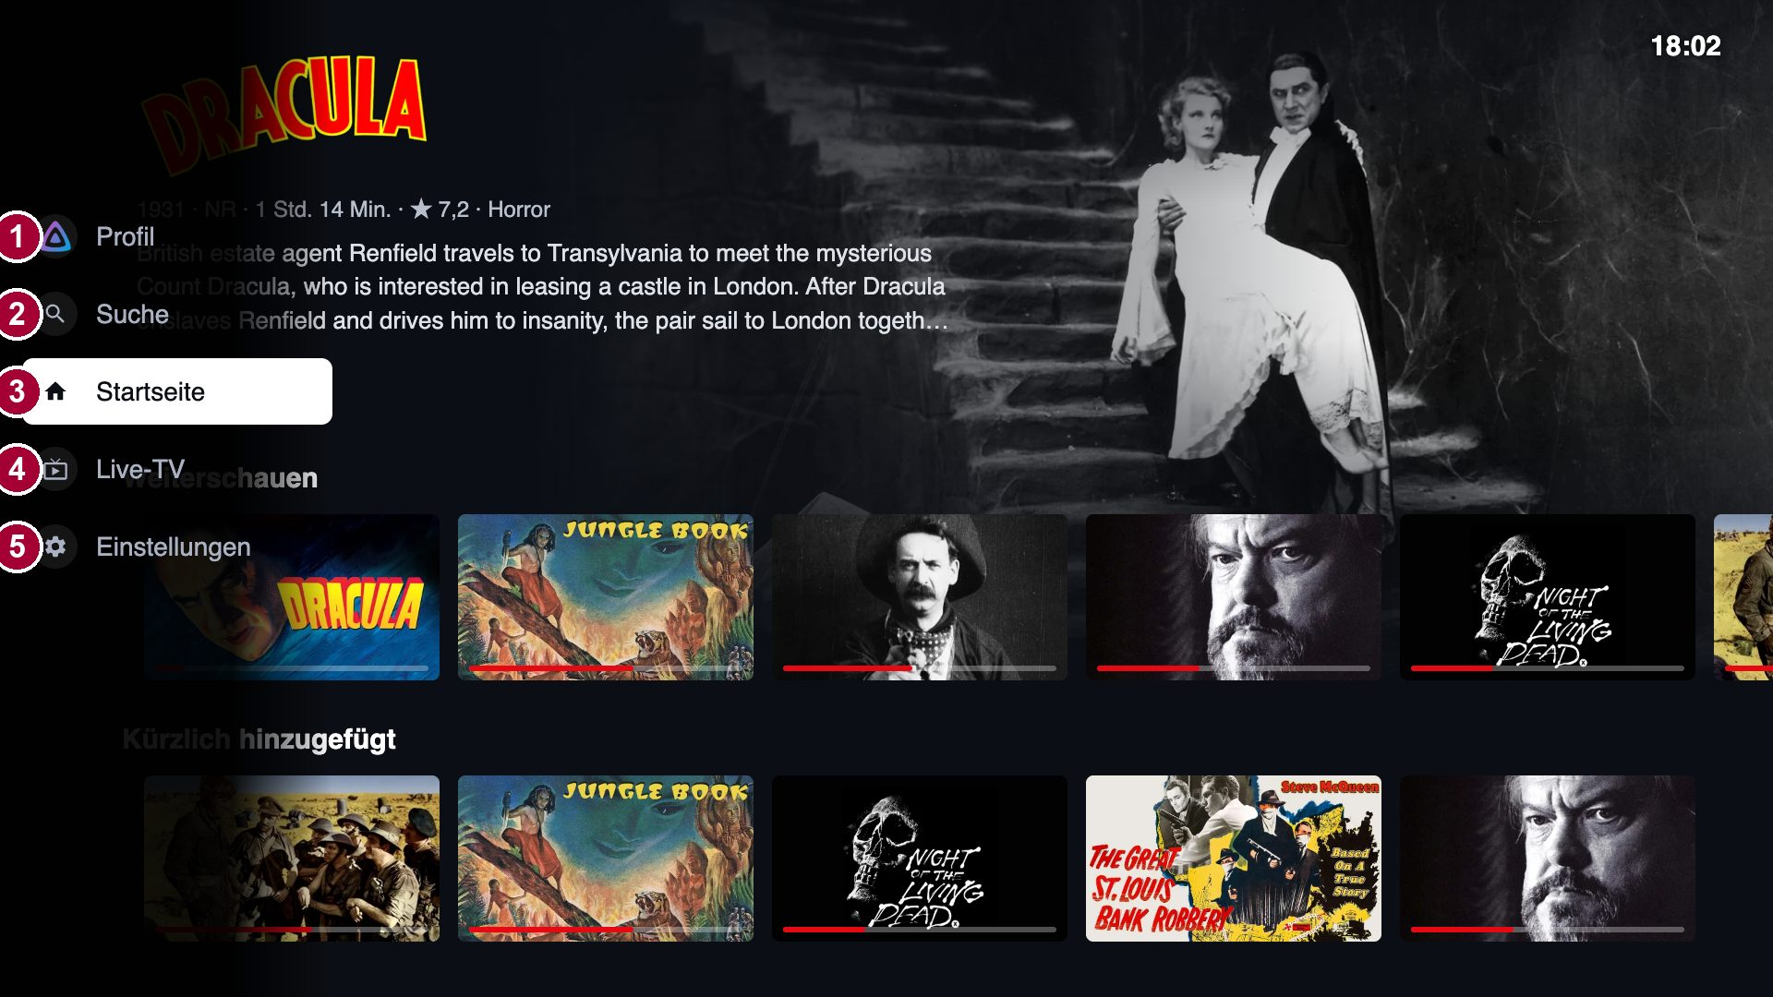
6. Sub Page Description
1. Left Menu
Description
1 | „Profil“ = Profile: dialog with Switch profile / Sign out / Cancel (sub page 2).
2 | „Suche“ = Search (sub page 6).
3 | „Startseite“ = Home.
4 | „Live-TV“: program guide (only if the server has TV tuners; sub page 11).
5 | „Einstellungen“ = Settings (sub page 7). On servers with Jellyseerr an item „Entdecken“ = Discover & request appears.
Detailed Information
The menu opens with LEFT from the content and closes with RIGHT or BACK. The demo server has no Jellyseerr, so „Entdecken“ is not shown there.

Slide 10
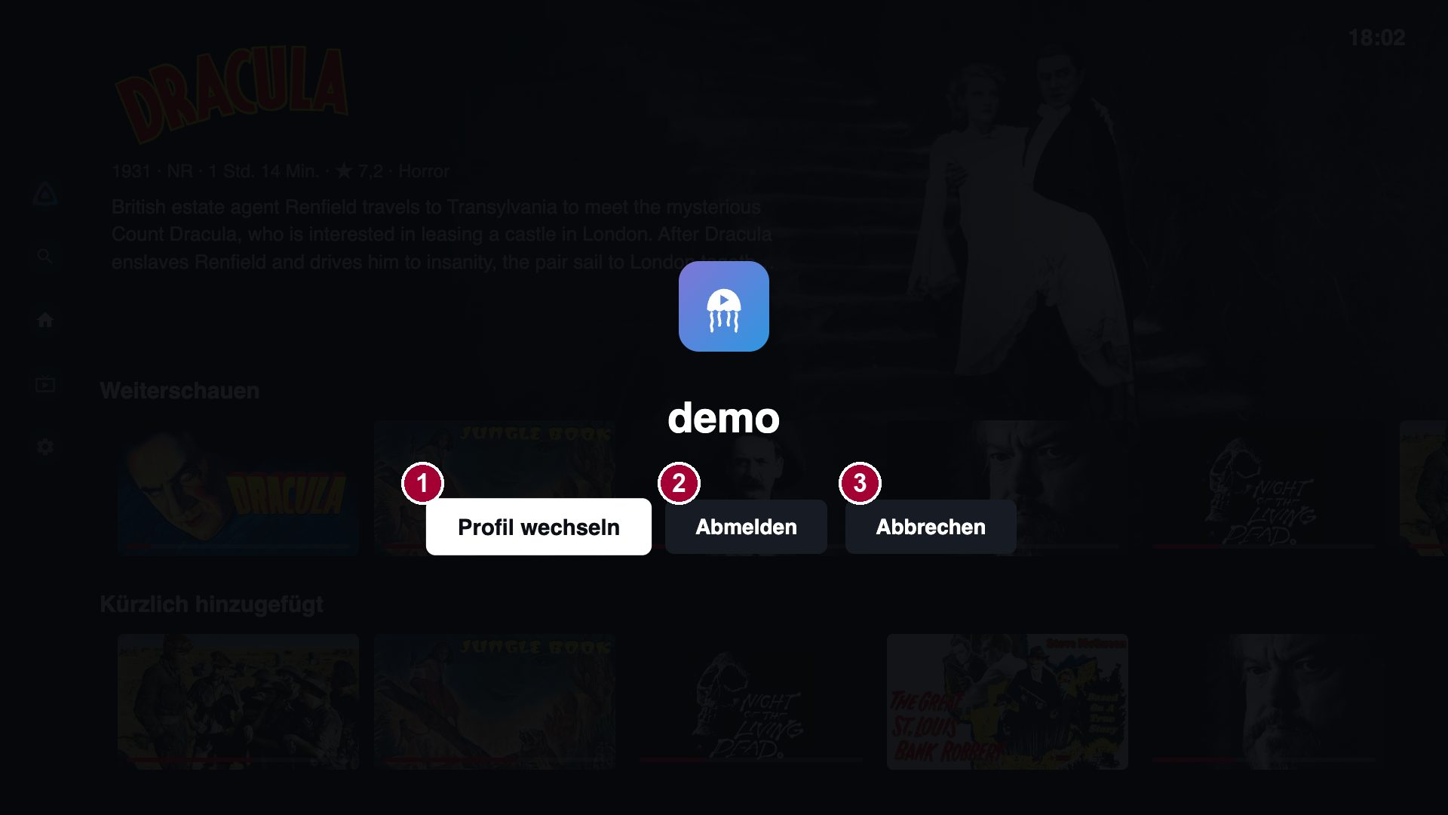
6. Sub Page Description
2. Profile Dialog
Description
1 | „Profil wechseln“ = Switch profile: back to „Who’s watching?“.
2 | „Abmelden“ = Sign out: removes the sign-in of this profile from the TV.
3 | „Abbrechen“ = Cancel (also BACK).
Detailed Information
Opened from „Profil“ in the left menu.

Slide 11
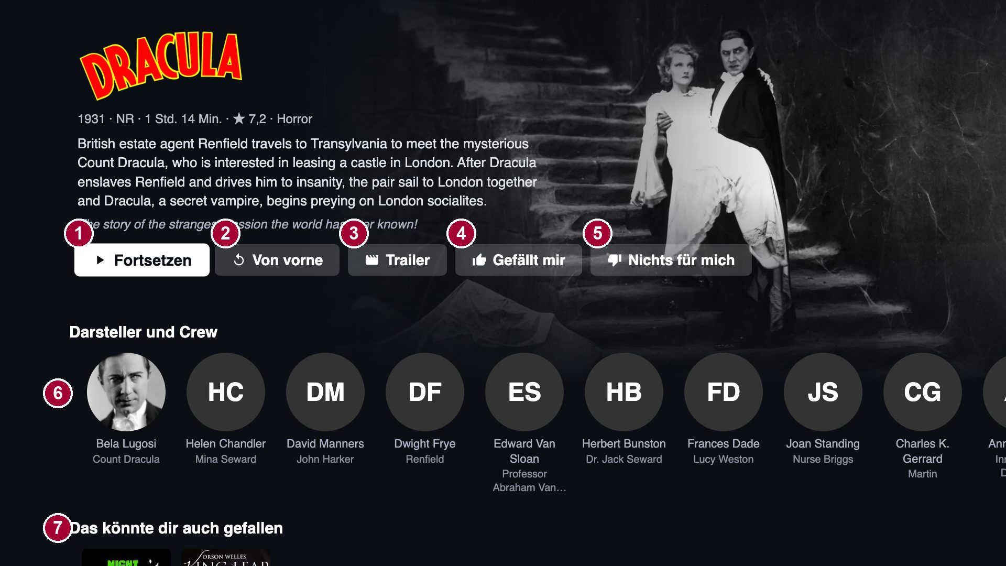
6. Sub Page Description
3. Detail Page
Description
1 | „Abspielen“ / „Fortsetzen“ = Play / Resume (if there is playback history).
2 | „Von vorne“ = Play from the start (only with playback history).
3 | „Trailer“: local trailer or official YouTube player.
4 | „Gefällt mir“ = Thumbs up (improves recommendations; selected state is highlighted).
5 | „Nichts für mich“ = Thumbs down.
6 | „Darsteller und Crew“ = Cast & crew. OK opens the person page.
7 | „Das könnte dir auch gefallen“ = Similar titles.
Detailed Information
For series the page also shows seasons and episodes. BACK returns to the previous page.

Slide 12
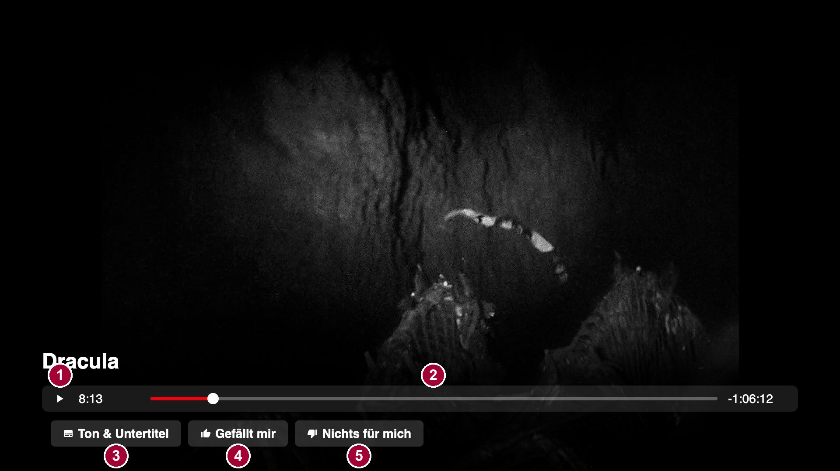
6. Sub Page Description
4. Player
Description
1 | Play/Pause (OK on the progress bar; also PLAY/PAUSE keys of the remote).
2 | Progress bar with position and remaining time. LEFT/RIGHT and ◀◀/▶▶ keys seek.
3 | „Ton & Untertitel“ = Audio & subtitles (sub page 5).
4 | „Gefällt mir“ = Thumbs up.
5 | „Nichts für mich“ = Thumbs down.
Detailed Information
OK shows the controls, they hide after a few seconds. BACK closes the controls, a second BACK stops playback (position is saved). For episodes, „Intro überspringen“ = Skip intro and the countdown „Nächste Folge“ = Next episode appear when the server provides the data.

Slide 13
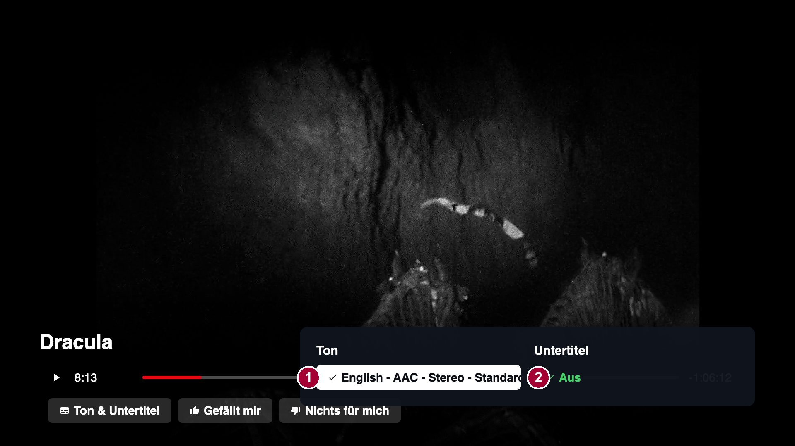
6. Sub Page Description
5. Audio & Subtitles
Description
1 | „Ton“ = Audio track: list of the audio tracks of the file.
2 | „Untertitel“ = Subtitles: „Aus“ = Off or one of the subtitle tracks.
Detailed Information
Both lists are in one window; the selected entry has a check mark. BACK closes the window.

Slide 14
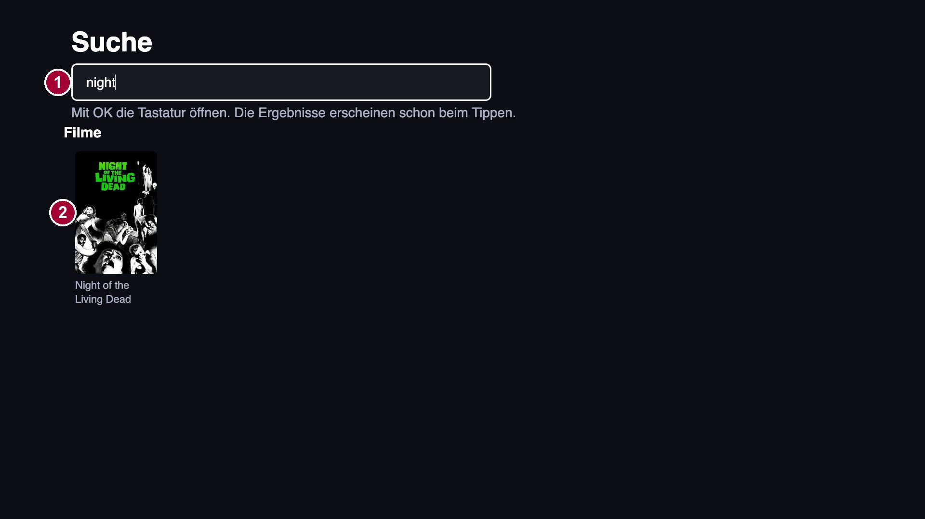
6. Sub Page Description
6. Search
Description
1 | Search field. OK opens the LG keyboard; results appear while typing.
2 | Results grouped by „Filme“ = Movies, „Serien“ = Shows, people. OK opens the title.
Detailed Information
Hint text: „Mit OK die Tastatur öffnen. Die Ergebnisse erscheinen schon beim Tippen.“ = Press OK to open the keyboard. Results appear while you type.

Slide 15
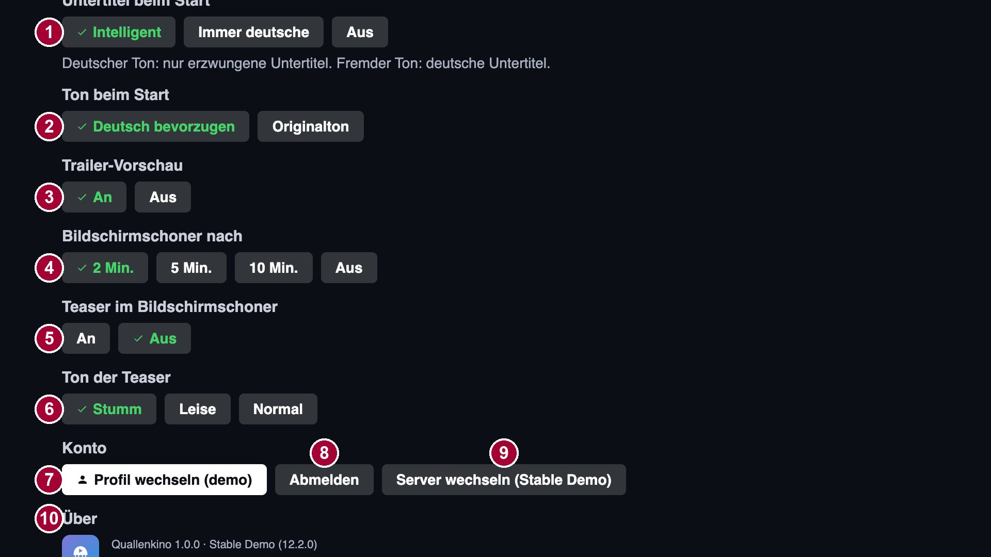
6. Sub Page Description
7. Settings
Description
1 | „Untertitel beim Start“ = Subtitles at start: Smart / Always German / Off.
2 | „Ton beim Start“ = Audio at start: prefer German / original.
3 | „Trailer-Vorschau“ = Trailer preview on/off.
4 | „Bildschirmschoner nach“ = Screensaver after 2 / 5 / 10 min / off.
5 | „Teaser im Bildschirmschoner“ = Trailers in the screensaver on/off.
6 | „Ton der Teaser“ = Trailer volume: mute / quiet / normal.
7 | „Profil wechseln“ = Switch profile.
8 | „Abmelden“ = Sign out (RIGHT from „Profil wechseln“).
9 | „Server wechseln“ = Change server.
10 | „Über“ = About: app version, server version, TMDB notice.
Detailed Information
Each setting is a row of buttons (UP/DOWN between rows, LEFT/RIGHT inside a row, OK selects). The selected value is green with a check mark.

Slide 16

6. Sub Page Description
8. Screensaver
Description
1 | Logo or title of the shown movie/show (backdrops of the user’s library change every few seconds).
2 | Hint „OK: Details · andere Taste: zurück“ = OK: details · any other key: back.
3 | Clock.
Detailed Information
Starts after the time set under „Bildschirmschoner nach“ (default 2 minutes). OK opens the detail page of the shown title, any other key closes the screensaver. While it is enabled the app asks webOS (tvpower service) to hold back the TV’s own screensaver; if it is set to off, the TV screensaver works as usual.

Slide 17
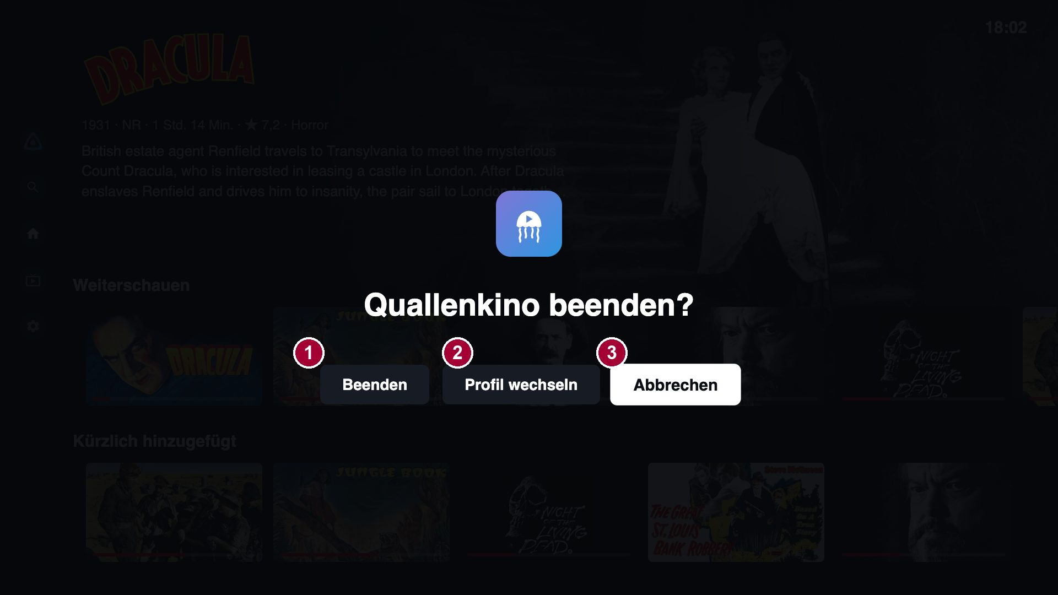
6. Sub Page Description
9. Exit Dialog
Description
1 | „Beenden“ = Exit: closes the app.
2 | „Profil wechseln“ = Switch profile.
3 | „Abbrechen“ = Cancel (default focus; also BACK).
Detailed Information
Appears when BACK is pressed on the home screen: „Quallenkino beenden?“ = Exit Quallenkino?

Slide 18
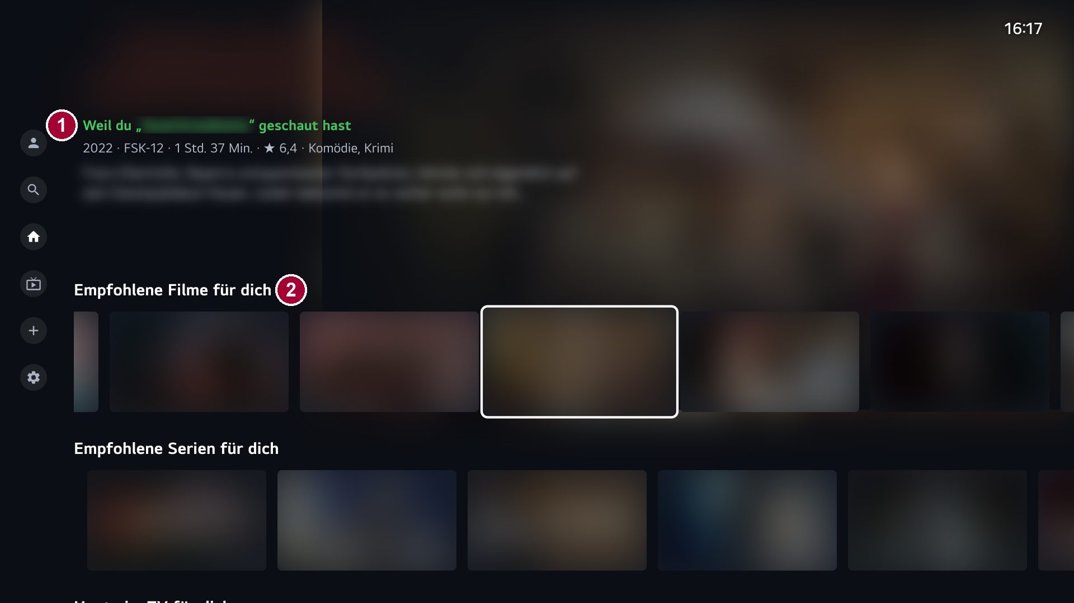
6. Sub Page Description
10. Recommendation with reason (*)
Description
1 | Reason for the recommendation, e.g. „Weil du „…“ geschaut hast“ = Because you watched „…“.
2 | „Empfohlene Filme/Serien für dich“ = Recommended movies/shows for you.
Detailed Information
(*) Needs the optional server plugin „Local Recommendations“; not visible on the demo server. Screenshot from the developer’s own server; artwork and titles are blurred for copyright reasons.

Slide 19
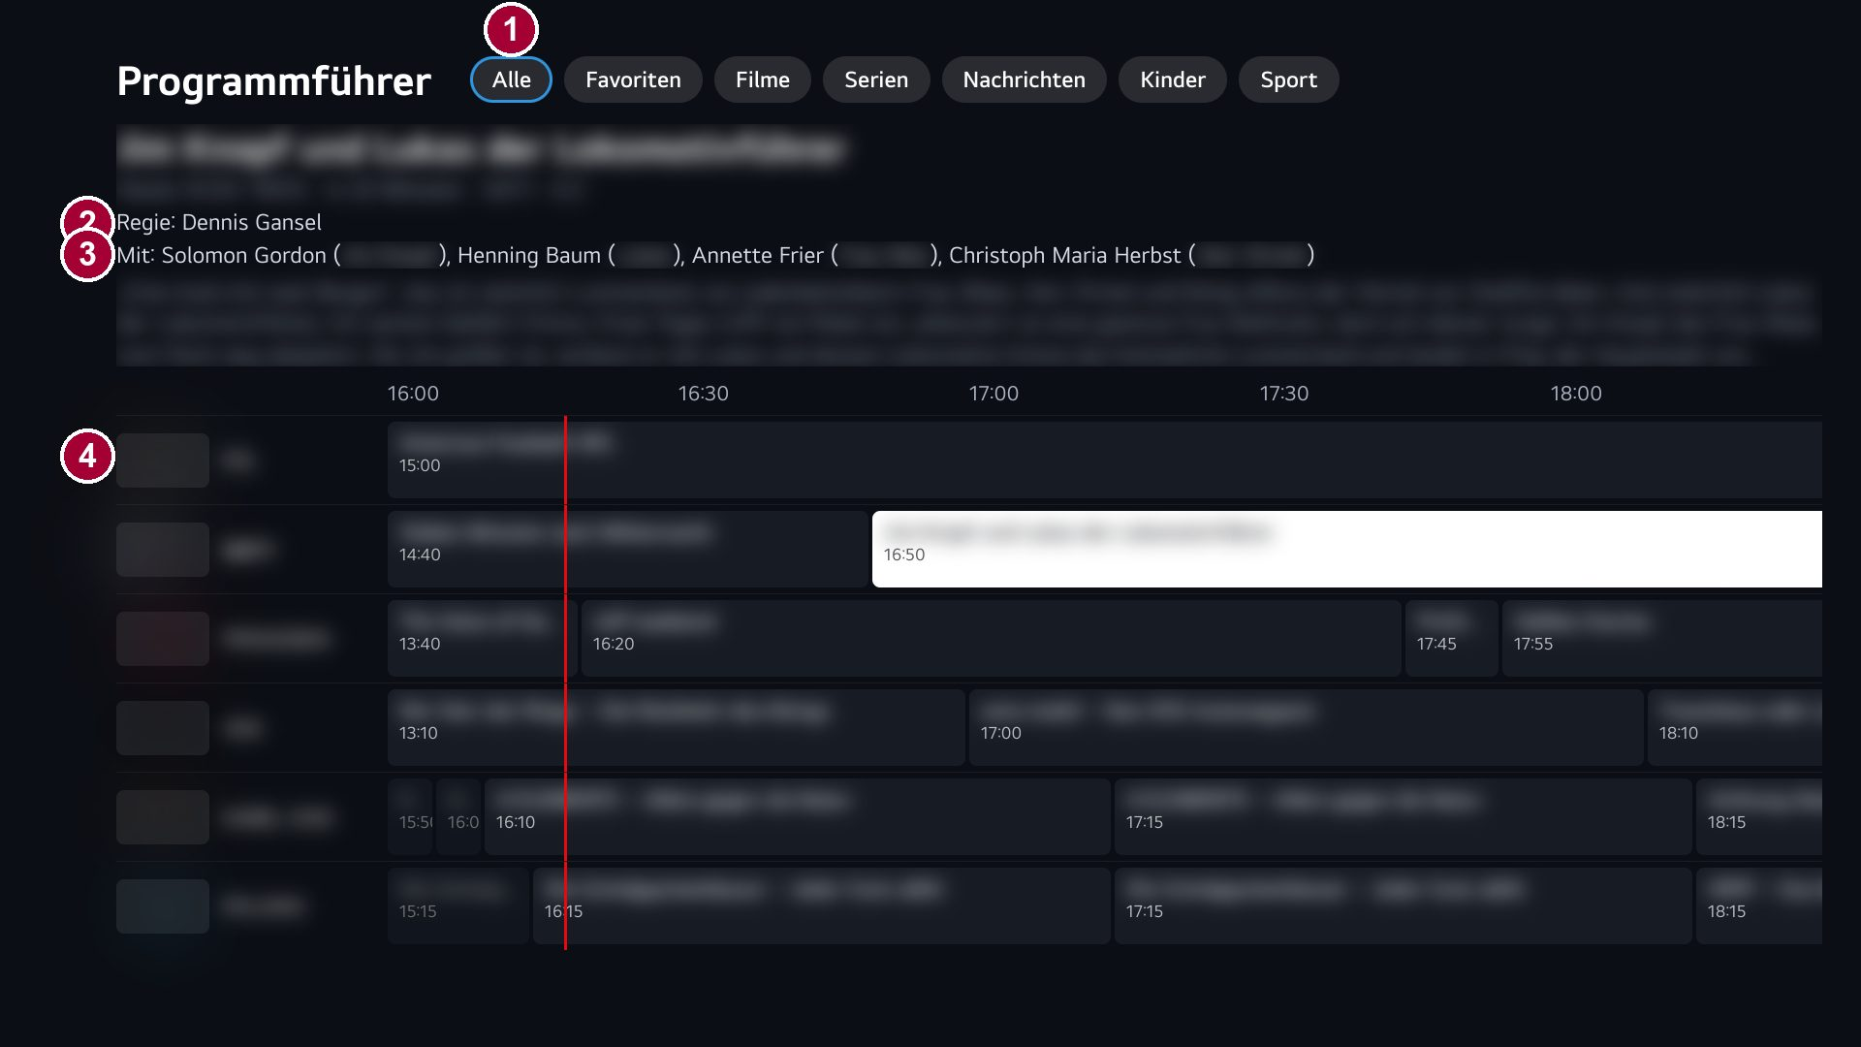
6. Sub Page Description
11. Live TV guide with cast (*)
Description
1 | Filters: „Alle“ All, „Favoriten“ Favourites, „Filme“ Movies, „Serien“ Shows, „Nachrichten“ News, „Kinder“ Kids, „Sport“.
2 | „Regie“ = Director of the focused programme.
3 | „Mit“ = Cast (with roles).
4 | Guide grid: channels and programmes; OK on a running programme starts the channel, on a future one opens its details.
Detailed Information
(*) Needs TV tuners on the server (cast from the plugin „Local Recommendations“); not available on the demo server. Screenshot from the developer’s own server, blurred.

Slide 20
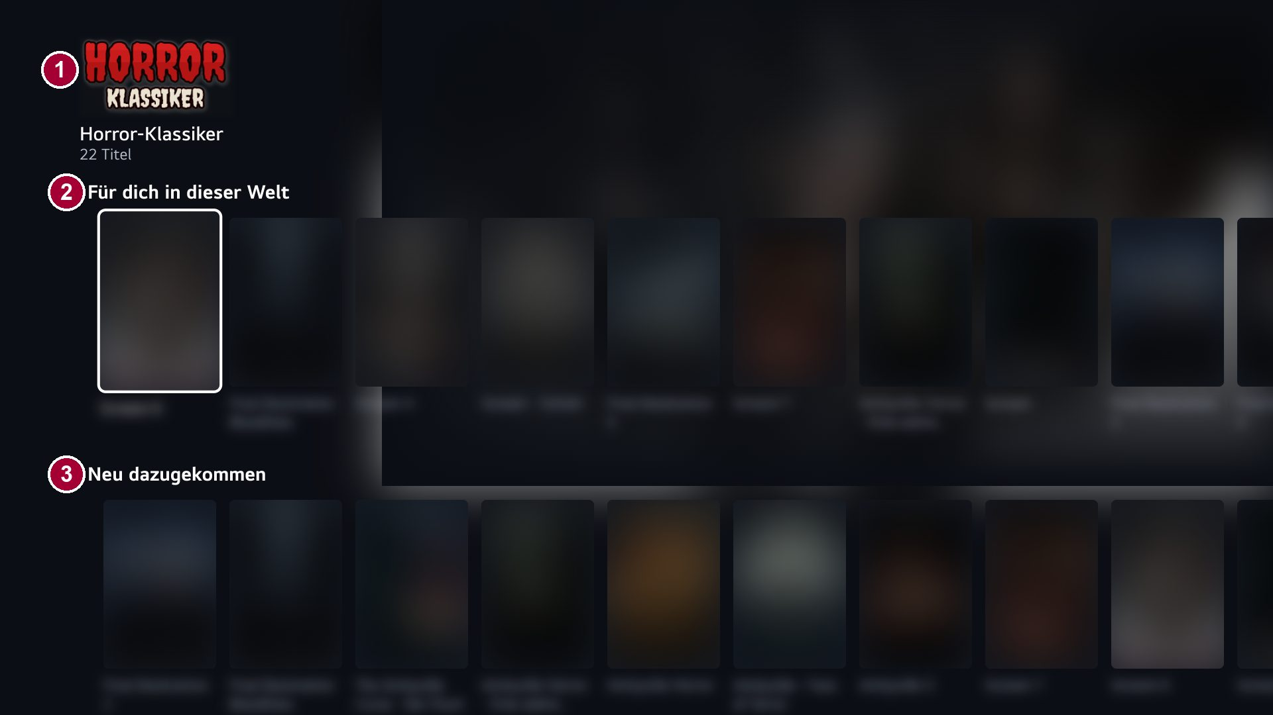
6. Sub Page Description
12. Worlds (*)
Description
1 | Logo and name of the world (film series or studio) with number of titles.
2 | „Für dich in dieser Welt“ = For you in this world.
3 | „Neu dazugekommen“ = Newly added.
Detailed Information
(*) Needs the plugin „Local Recommendations“. Screenshot from the developer’s own server, blurred.

Slide 21
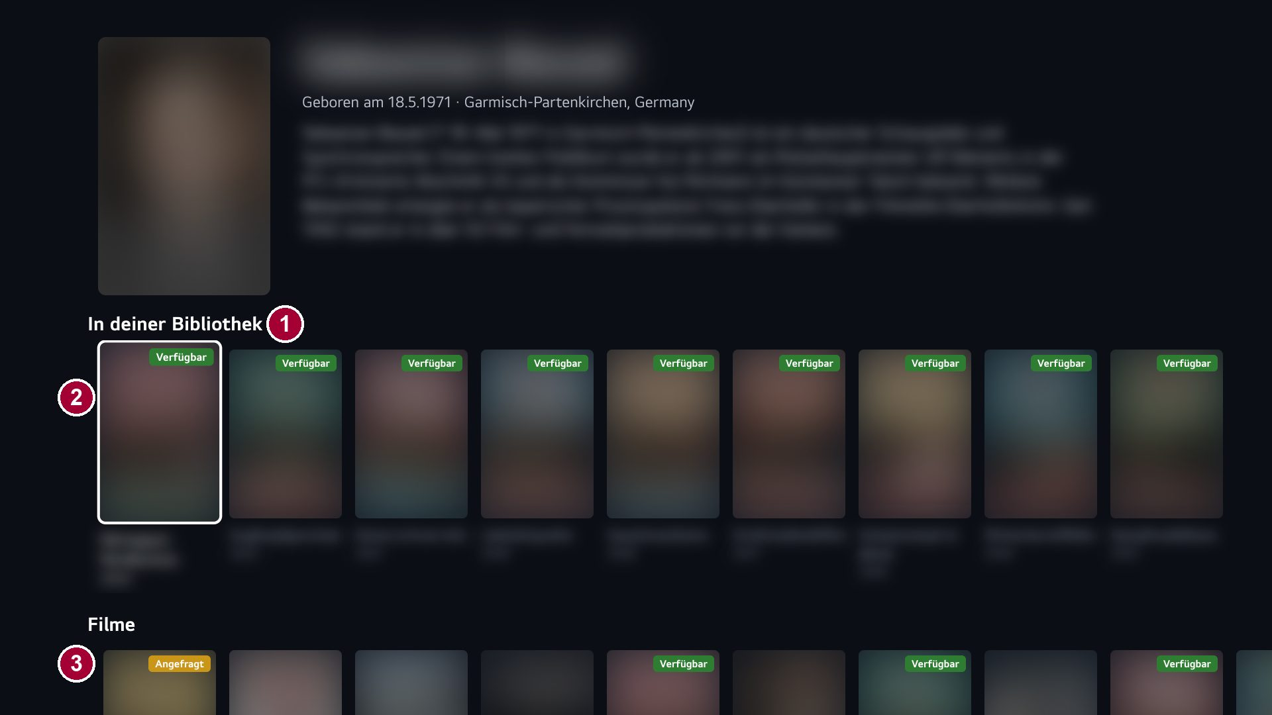
6. Sub Page Description
13. Person page (*)
Description
1 | „In deiner Bibliothek“ = In your library: titles of this person on the server.
2 | Badge „Verfügbar“ = Available.
3 | Badge „Angefragt“ = Requested (via Jellyseerr).
Detailed Information
Opened with OK on a cast member on the detail page. Badges need Jellyseerr on the server. Screenshot from the developer’s own server, blurred.

Slide 22
7. Paid Content
Detailed Information
Not applicable – the app has no paid content, no in-app purchases and no external payment (free app).

Slide 23
8. In-App Ad
Detailed Information
Not applicable – the app contains no advertising (no banner ads, no AVOD).

Slide 24
[Appendix]
- The user interface is German; all labels are translated in the tables above.
- Controls: arrow keys, OK, BACK of the standard remote; the Magic Remote pointer focuses on hover and opens on click. Mouse wheel and colour keys are not used.
- YouTube trailers use the official YouTube player, embedded from https://drdothouse2106.github.io/Quallenkino-webOS/yt.html (the app runs under file://, where YouTube does not embed directly). The player is neither covered nor cropped.
- Features marked (*) need the optional Jellyfin plugin „Local Recommendations“, TV tuners or Jellyseerr on the server and cannot be shown on the demo server.
- Privacy policy: https://github.com/DrdotHouse2106/Quallenkino-webOS/blob/main/PRIVACY.en.md
- Source code (GPL v2): https://github.com/DrdotHouse2106/Quallenkino-webOS

