Slide 1
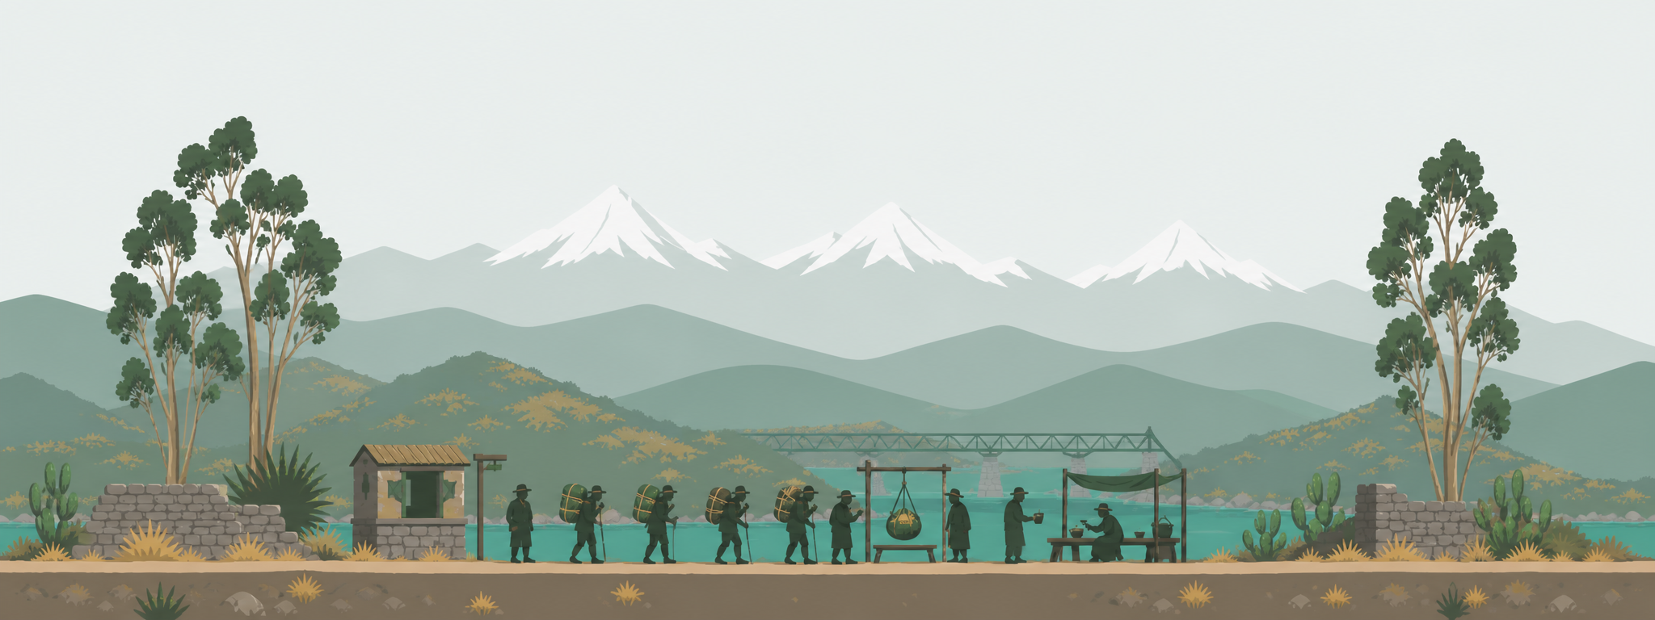
CORTADITO NEWS
Pasos
Una aventura a pie
Turn everyday steps into a journey along the world’s most iconic trails. Every 2,000 steps ≈ 1 mile down a real route — starting with the Inca Trail to Machu Picchu.
Product overview · for the team

Slide 2
THE CONCEPT
The idea, in one breath
Walking is the most accessible exercise on earth — and one of the most boring to keep up.
Pasos fixes that by giving every step a destination, a story, and a companion. You don’t just hit 8,000 steps — you cross Dead Woman’s Pass and get a little closer to Machu Picchu.
Habit + narrative A real destination and daily milestones turn an abstract goal into a trip you won’t abandon.
Real places, real facts Genuine routes with real stops, distances, elevation and cultural notes — aspirational and quietly educational.
An emotional companion A coffee mascot + a chosen coach react as you progress, so it feels like someone walks with you.
Grounded in science The 8,000-step target comes from research, so the game rewards genuinely healthy behavior.

Slide 3
MECHANICS
How it works
1
Pick a route
2
Steps → distance
3
Reach stops → Pasaporte
A real long-distance trail split into named stops.
2,000 steps ≈ 1 mile (from a health app or manual entry).
Each stop is stamped with a fact and a celebratory line.
4
Earn a daily rank
5
Your coach reacts
6
Maps + smart ETA
Today’s steps map to 10 ranks: Debutante → Maestro/a.
One of 7 personalities greets you and cheers you on.
Aerial + elevation maps, and days-to-finish at your real pace.

Slide 4
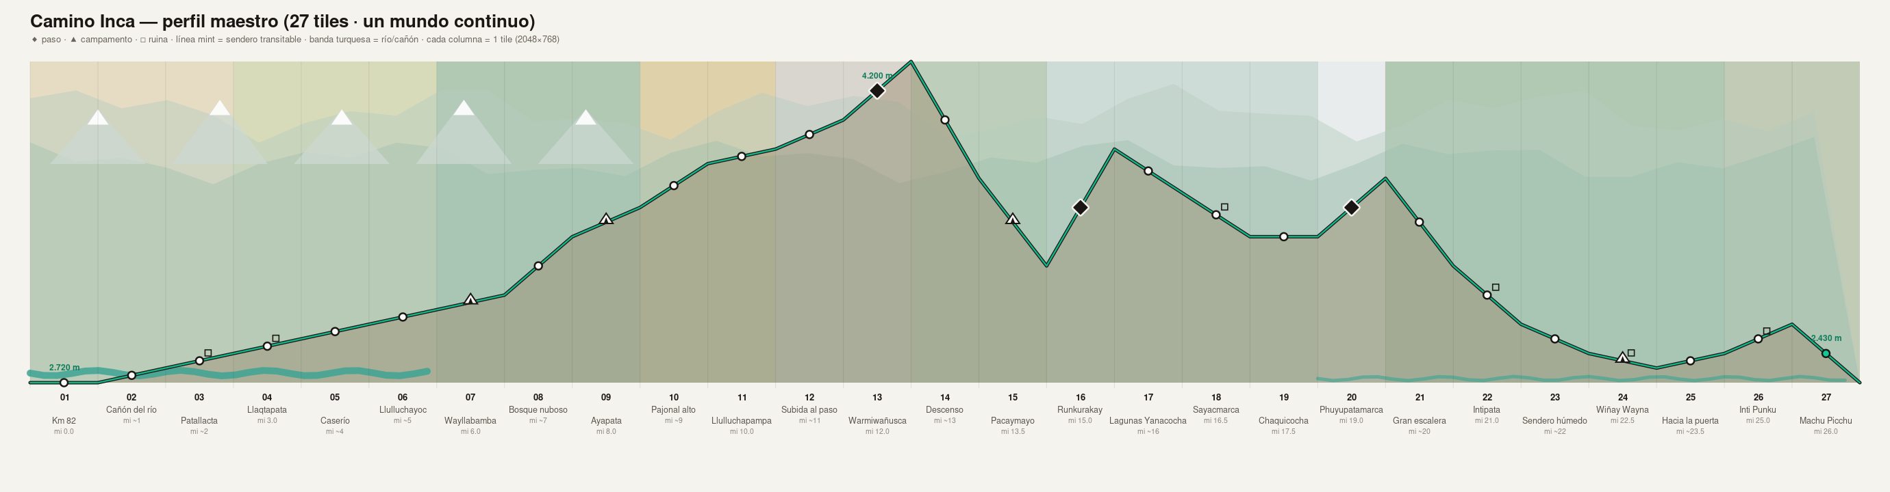
CONTENT
Six real routes ship today
Sendero Inca
26 mi
Gratis
Perú · Km 82 → Machu Picchu
Campo Base del Everest
39 mi
Club
Nepal · Lukla → Base Camp
Eje Cafetero
62 mi
Club
Each route re-themes the whole app — accent colors, maps and the walking avatar all change per place.
Colombia · Manizales → Cocora
Camino de Santiago
485 mi
Club
Francia · España (Francés)
Carretera Central
534 mi
Club
Cuba · La Habana → Santiago
Ruta 66
2,278 mi
Club
EE. UU. · Chicago → Santa Mónica

Slide 5
ENGAGEMENT
A fresh goal, every single day
10
8,000
10k / 12k
daily ranks
= top rank
secret tiers
Debutante → Maestro/a
the science-based target
Medalla de Plata · Día de Leyenda
Your daily step total earns a rank — an attainable win every day, independent of overall route progress. Default personal goal is 6,000 steps (editable).

Slide 6




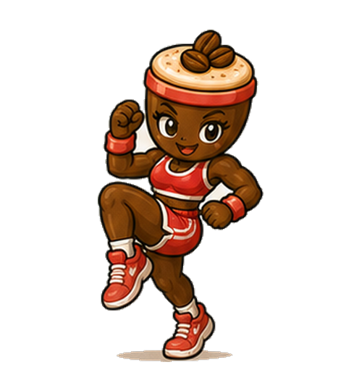
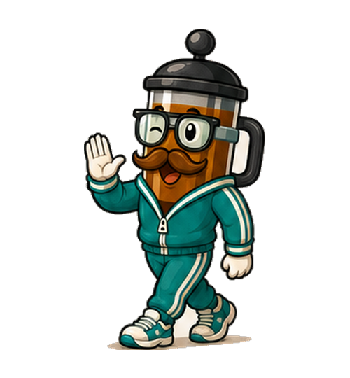

THE COMPANIONS
Meet the coaches
Seven coffee-character coaches, each a distinct personality and voice. Pick one — they greet you and drop voice-matched lines as you walk.
Ristretto
Puchi
Togo
Granito
Moka
Franco
Nata
El capitán atleta
La dulce y positiva
El ritmo urbano
El más juguetón
La determinada
El mentor tranquilo
La calma y equilibrio
Energetic · competitive
Sweet · positive
Musical · cool
Playful · curious
Determined · proud
Wise · calm
Serene · balanced

Slide 7
THE ART
One continuous world — and the hard part
As you walk, a long side-scrolling panorama of the real trail moves beneath your companion — flat, Alto’s-Odyssey-style art. Above is the master blueprint of the whole Inca Trail: 27 tiles climbing to Dead Woman’s Pass (4,200 m) and back down to Machu Picchu.
Generating this seamlessly is the project’s central technical challenge (next slide).

Slide 8
BUSINESS
Opportunities & monetization
Subscription (Club)
Coffee-brand integration
Sponsored / branded routes
Free Inca route as the front door; all other routes + premium coaches unlock with a plan. Tiering already exists.
The whole brand IS coffee. Sponsorships, co-branded routes, real rewards (finish a route → coffee discount).
Tourism boards (Peru, Colombia, the Camino) pay to feature a route with their landmarks.
Corporate wellness (B2B)
Cosmetics
Affiliate & commerce
Team step-challenges along a shared route, billed per seat. High-margin and recurring.
Per-route avatars & coach skins are already swappable assets — a natural cosmetic store.
High-intent: “you just walked the Inca Trail — want to do it for real?” Gear, treks, travel.

Slide 9
REALITY CHECK
Where it stands — honest view
The art won’t stitch reliably yet The core unsolved problem: building one seamless scrolling world per route from AI tiles. Seams don’t always line up — the main blocker to adding routes fast.
Only the Inca route has real art The other five run on placeholder visuals until their tiles are produced.
Health sync is a demo Step sync is simulated. Real Apple Health needs a native wrapper; Google Fit / Fitbit need OAuth + a small backend.
No accounts or cloud Progress is stored on-device only — no cross-device sync, no social yet.
Content is expensive Each route needs research, ~15 stops, a map, an elevation profile and ~27 art tiles — gated by the stitching problem.

Slide 10
ROADMAP
What’s next
1
Crack the stitching pipeline (the “master blueprint” method) so route art can be produced fast — this unblocks everything.
2
Ship one real health integration (start with a single provider) to replace the demo sync.
3
Add accounts + cloud sync, then social challenges.
4
Turn on the subscription and land a first sponsor / coffee partner.
Pasos · una aventura a pie · Cortadito News

