Slide 1
Foundations of Data Science & Analytics DSCI 633, Fall 2021
Lecture 9
(material sources cited in the last slide)
Nidhi Rastogi
Assistant Professor, GCCIS, RIT
September 21, 2021

Slide 2
Course Information
GitHub link - https://github.com/aiforsec/RIT-DSCI-633-FDS
Assignment 3 was due today at 7:59 am
Reach out to the TA/ Instructor during office hours, via Slack, or email for any questions, suggestions, concerns, or general chat about data science.

Slide 3
This Lecture
An end-to-end machine learning model pipeline
Classification, Clustering, Anomaly detection, …
Performance Measures
Error Analysis
Training Models – Linear
Linear Regression
Gradient Descent
Polynomial Regression
Regularized Linear Models
Logistic Regression

Slide 4
Lecture Agenda
K-Nearest Neighbors
Theory: 40-45 mins
Online code demo – 15-20 mins
Pop-quiz - 10 mins
Office hours until 10:15am

Slide 5
Classification Models
Base classification models
Linear Regression (covered in previous class)
Decision Tree
Instance-based (Nearest-neighbor)
Rule-based
Naïve Bayes and Bayesian Belief Networks
Support Vector Machines
Neural Networks and Deep Learning
Ensemble Classifiers
Boosting, Bagging, Random Forests

Slide 6
Classification Problem
So far studied learning problems
using linear classifier
Class 1
x2
Class 2
x1

Slide 7
Introduction: Instance-based Learning
Recall : Linear regression is an example of a parametric approach - assumes a linear functional form for f(X).
Instance-based - Do not form a general hypothesis regarding target function
non-parametric - does not make any assumption of the data distribution. Training data is simply stored.
When new query instance (test instance) is encountered, a set of similar, related instances is retrieved from memory.
used to classify new query instance (test instance).
They simply compute classification of each new query instance, as needed

Slide 8
k-Nearest Neighbor (k-NN) approach
Simplest, most used instance-based learning algorithm
Assumes all instances are points in some n-dimensional space and defines neighbors in terms of distance
k is the number of neighbors considered

Slide 9
k-NN approach
Supervised method: Training
Record labeled instances and feature-value vectors
Goal: For each new, unlabeled instance
Identify “nearest” labeled instance
Assign same label
Assume - property is same as that of the nearest reference case.

Slide 10
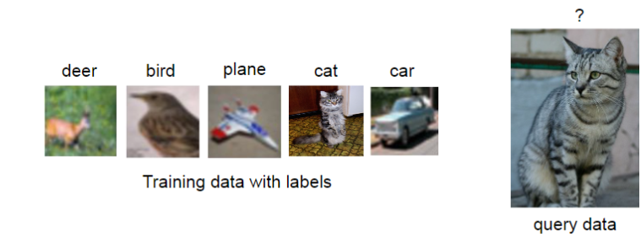
k-NN Example

Slide 11
k-NN Example
classify test object/
new query using k-nn
feature₁
feature₂

Slide 12
k-NN Example
classify image using k-nn
feature₁
feature₂

Slide 13
k-NN – Basic Idea
Given a query, assign majority category label of its k nearest training samples

Slide 14
k-NN Algorithm
For each training instance t = (x, f(x))
Add t to the set of tr_instances
Given a query instance q (or test instance) to be classified
Let x₁, …, x_{k} be the k training instances in tr_instances nearest to q
return
where, v is the finite set of target class values
δ(a,b)=1 if a=b, and 0 otherwise (Kronecker function)

Slide 15
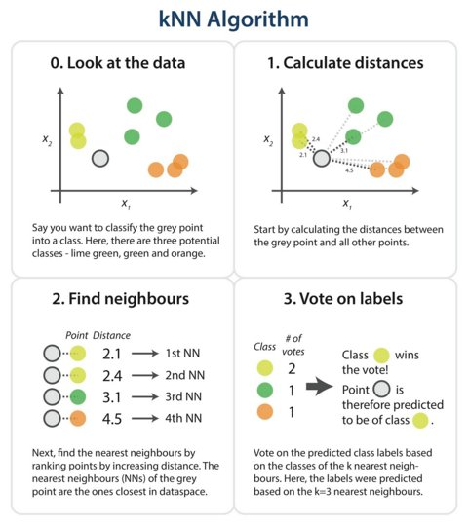
k-NN Algorithm (on twitter)
k=4
https://twitter.com/dataiku/status/798981230960246785/photo/1

Slide 16
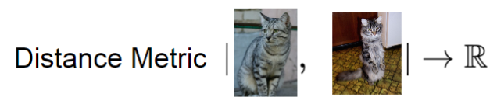
k-NN Example
find k-nearest neighbors -> how to measure “nearest”

Slide 17
Distance Metric
find k-nearest neighbors -> how to measure “nearest”
feature₁
(a₁, a₂)
(b₁, b₂)
feature₂

Slide 18
Common Approaches
Measuring “nearest”
Standard Euclidean distance metric
- two-dimensional:
dist(a,b) = sqrt((a₁ – b₁)² + (a₂ – b₂)²)
- n-dimensional:
dist(a,b) = sqrt(Σ_{i} (a_{i} – b_{i})²)
(a₁, a₂)
(b₁, b₂)

Slide 19
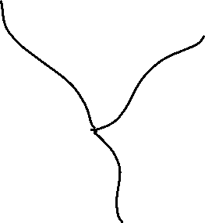
k-NN decision boundaries
Where are decision boundaries for k-NN?
k-NN gives locally defined decision boundaries between classes
feature₁
feature₂

Slide 20
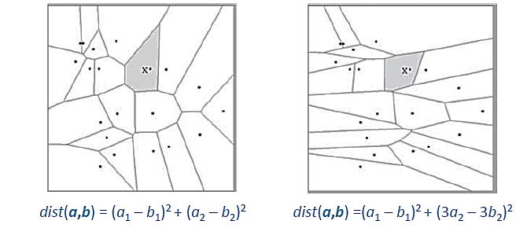
k-NN decision boundaries
Can be changed by different distance metrics
Becomes more complex as more examples are stored

Slide 21
k-NN decision boundaries
To classify instance x :
Find k nearest neighbors of x
Choose as label the majority label within k nearest neighbors
How do we choose k?

Slide 22
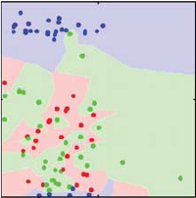
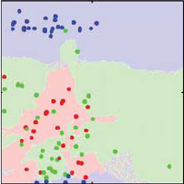
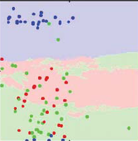
Impact of k
Role of k?
How does it relate to overfitting and underfitting?
k= 1 k= 3 k=31

Slide 23
Impact of k
Choosing k
Often data-dependent and heuristic-based
Common heuristic – choose odd number (3,5,7..)
Use validation data instead of using only train/test
Avoid too small or too large values of k
feature₁
feature₂

Slide 24
Variant of k
Weighted k-NN
Instead of treating all examples equally, weight “vote” of examples
Closer examples to have more vote/weight
feature₁
feature₂

Slide 25
Weighted kNN
Normalized data looks like:
[id = 0, 0.32, 0.43, class = 0]
[id = 0, 0.52, 0.23, class = 4]
…
[id = 29, 0.71, 0.22, class = 2]
Nearest Neighbors (k=6) to (0.62, 0.35):
Id: 9 (0.61 0.42) class = 0, distance = 0.0707
Id: 7 (0.55 0.32) class = 0, distance = 0.0762
Id: 7 (0.55 0.41) class = 1, distance = 0.0922
Id: 7 (0.64 0.24) class = 2, distance = 0.1118
Id: 7 (0.49 0.32) class = 0, distance = 0.1334
Id: 7 (0.71 0.22) class = 2, distance = 0.1581
Weights (inverse distance techniques)
0.2323
0.2157
0.1782
0.1469
0.1231
0.1039
Predicted class [0] 0.5711
[1] 0.1782
[2] 0.2508

Slide 26
Weighted k-NN
Weighted Euclidean distance: Once we have some idea of the relative importance of each variable, we can weight them:
WAS (non-weighted):
- n-dimensional:
dist(a,b) = sqrt(Σ_{i} (a_{i} – b_{i})²)
Weighted distance
- n-dimensional:
dist(a,b) = sqrt(Σ_{i} w_{k}(a_{i} – b_{i})²)

Slide 27
Issues with Distance Metrics
Most distance measures were designed for linear/real-valued attributes
Two important questions in the context of machine learning:
How best to handle nominal attributes
What to do when attribute types are mixed

Slide 28
Scale Effects
Different features may have different measurement scales
E.g., patient weight in kg (range [50,200]) vs. blood protein values in ng/dL (range [-3,3])
Consequences
Patient weight will have a much greater influence on the distance between samples
May bias the performance of the classifier

Slide 29
Other distance measures
Measuring “nearest”
Binary-valued features
Hamming distance dist(a,b) = Σ_{i} I(a_{i} ≠ b_{i})
Counts number of features where two examples disagree
Mixed feature types (some real, some binary, some nominal)
Mixed distance measures
E.g. Euclidean for real part, hamming for binary
Can also assign weights to features
dist(a,b) = Σ_{i} w_{i} .d(a_{i} ,b_{i})
(a₁, a₂)
(b₁, b₂)

Slide 30
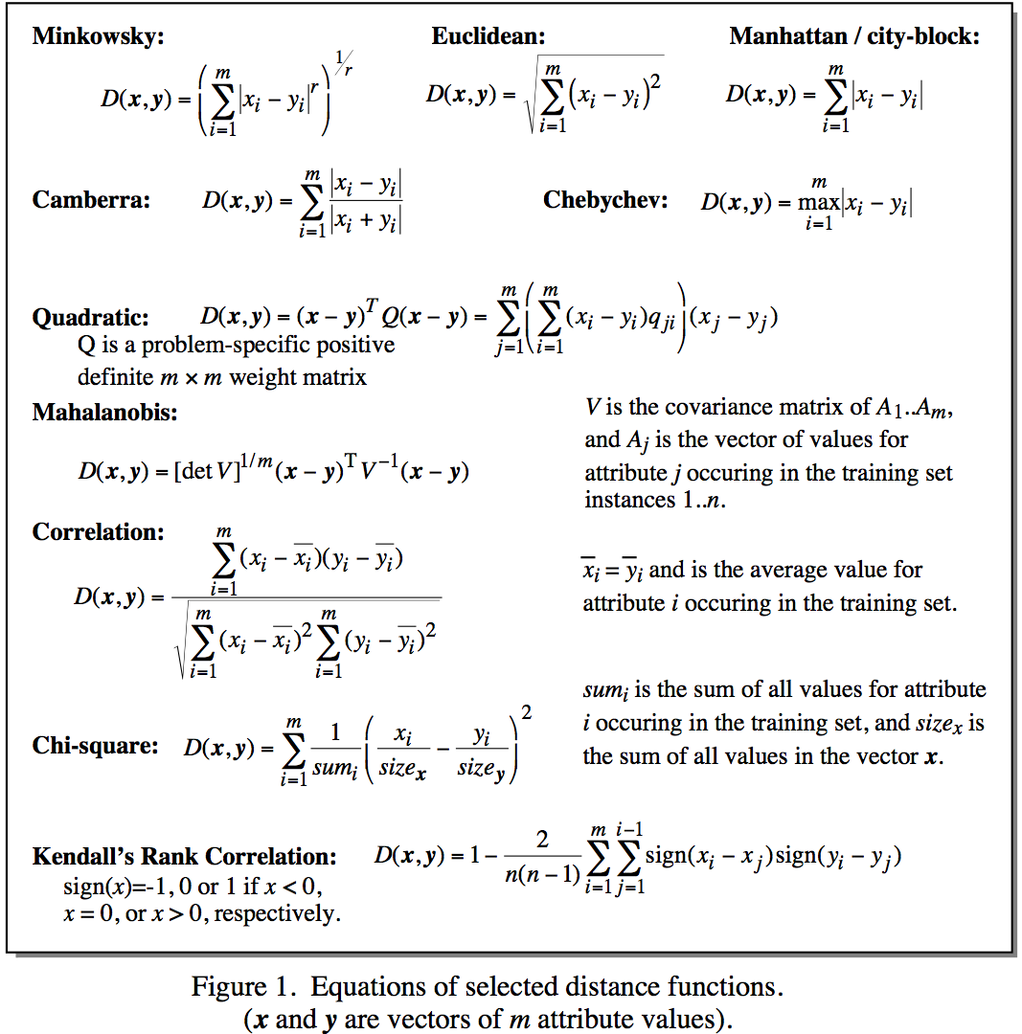
Cheat-sheet of distance metrics
Notes:
Minkowsky = l-norm

Slide 31
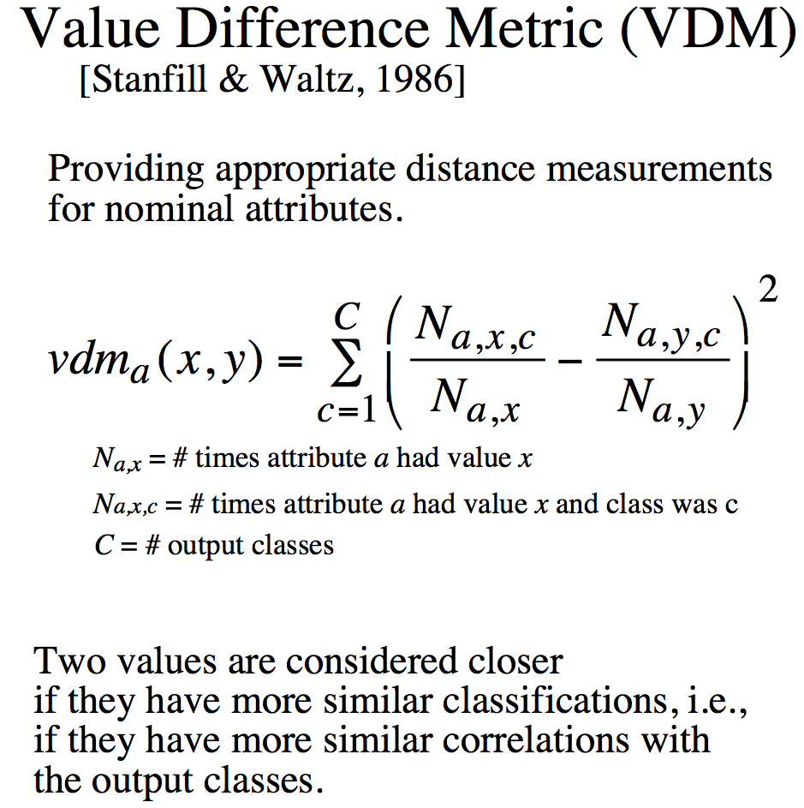
Distance for Nominal Attributes
Notes:
Do a single example here. Shape (Round, Square) 6/10 and 3/5

Slide 32
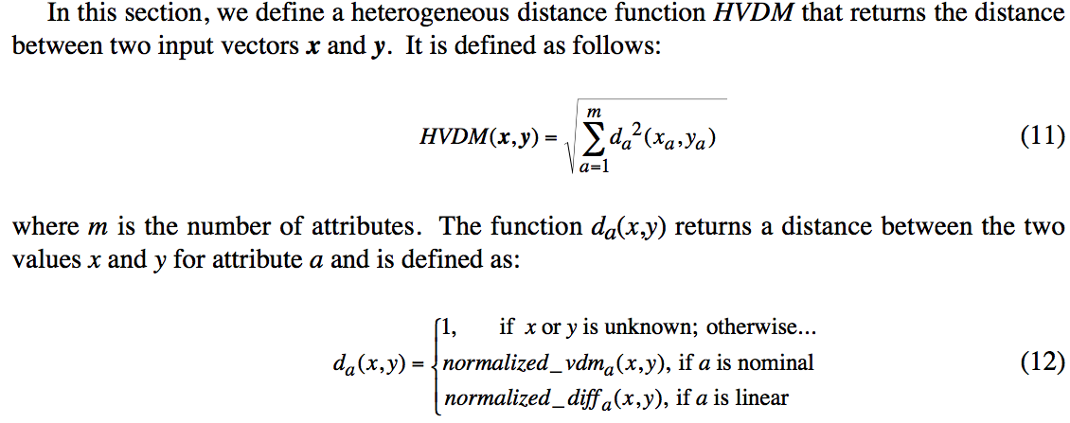
Distance for Heterogeneous Data
Wilson, D. R. and Martinez, T. R., Improved Heterogeneous Distance Functions, Journal of Artificial Intelligence Research, vol. 6, no. 1, pp. 1-34, 1997

Slide 33
Accuracy of k-NN

Slide 34
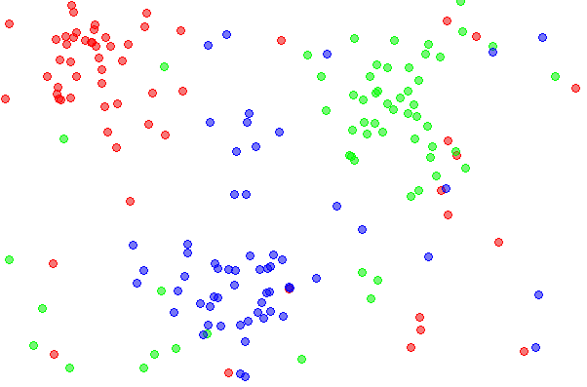
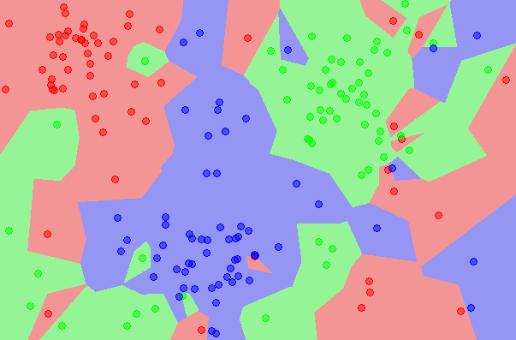
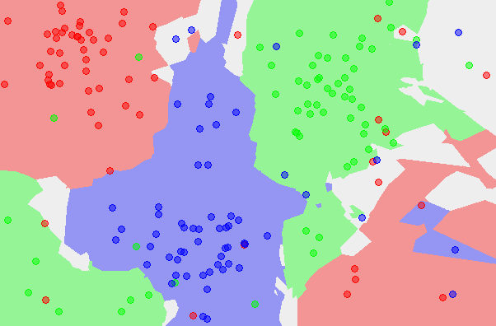
Accuracy of k-NN
What is the accuracy of the k-nearest neighbor classifier on the training data?

Slide 35
Accuracy of kNN
What is the best distance to use?
What is the best value of k to use?
i.e. how do we set the hyperparameters?

Slide 36
Accuracy of kNN
- Bias and Variance are prediction errors
- Tradeoff between a model’s ability to minimize bias and variance.
Bias
Average Prediction - Actual
Model with high bias pays very little attention to the training data and oversimplifies the model.
High bias leads to high error on training and test data.
Also a function of called model complexity and flexibility
More complex models have low bias, consider several features

Slide 37
Accuracy of kNN
- Bias and Variance are prediction errors
- Tradeoff between a model’s ability to minimize bias and variance.
Variance:
Variability of model prediction for a given data point or a value which tells us spread of our data.
Models with high variance pays a lot of attention to training data and does not generalize on the data which it hasn’t seen before.
As a result, such models perform very well on training data but has high error rates on test data.

Slide 38
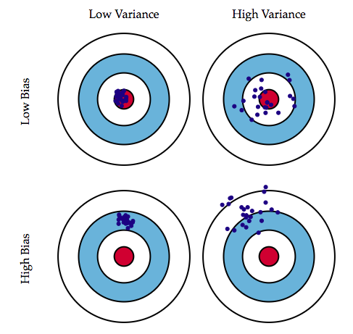
Accuracy of kNN
- Bias and Variance are prediction errors
- Tradeoff between a model’s ability to minimize bias and variance.
When we are tuning Parameter controls, we are
trying to make the model more flexible.
bias
bias
variance
variance
tuning parameters

Slide 39
Discussion: kNN (Bias vs Variance)
Increasing k in the kNN algorithm should have what effect on:
Bias: ?
Variance: ?

Slide 40
Discussion: kNN (Bias vs Variance)
Increasing k in the kNN algorithm should have what effect on:
Bias: Should increase.
Variance: ?

Slide 41
Discussion: kNN (Bias vs Variance)
Increasing k in the kNN algorithm should have what effect on:
Bias: Should increase.
Variance: Should decrease

Slide 42
Discussion: kNN (Bias vs Variance)
Compared to simpler (fewer parameters), complex models have what kind of Bias and Variance?:
Bias: ?
Variance:?

Slide 43
Discussion: kNN (Bias vs Variance)
Compared to simpler (fewer parameters), complex models have what kind of Bias and Variance?:
Bias: ? Lower, because complex models can better model local variation.
Variance:?

Slide 44
Discussion: kNN (Bias vs Variance)
Compared to simpler (fewer parameters), complex models have what kind of Bias and Variance?:
Bias: Lower, because complex models can better model local variation.
Variance:Higher, because the parameters are generally more sensitive to few data values.

Slide 45
Discussion: kNN (Bias vs Variance)
What is the best distance to use?
What is the best value of k to use?
i.e. how do we set the hyperparameters?
Very problem-dependent.
Must try them all out and see what works best.

Slide 46
Coding Exercise

Slide 47
Attributions: Some of these slides are based on slides prepared by Fei-Fei Li, Wikipedia, Eric Eaton, Andrew Moore, towardsdatascience articles, and searches on the Internet!
Coding exercise is from Kaggle.com

Slide 48
Open Floor

