Slide 1
Foundations of Data Science & Analytics DSCI 633, Fall 2021
Lecture 10
(material sources cited in the last slide)
Nidhi Rastogi
Assistant Professor, GCCIS, RIT
September 23, 2021

Slide 2
Course Information
GitHub link - https://github.com/aiforsec/RIT-DSCI-633-FDS
Assignment 4 will be due at 11:59 pm on 09/30. No extensions.
Reach out to the TA/ Instructor during office hours, via Slack, or email for any questions, suggestions, concerns, or general chat about data science.

Slide 3
This Lecture
An end-to-end machine learning model pipeline
Classification, Clustering, Anomaly detection, …
Performance Measures
Error Analysis
Training Models – Linear
Linear Regression
Gradient Descent
Polynomial Regression
Regularized Linear Models
Logistic Regression

Slide 4
Classification Models
Base classification models
Linear Regression (covered in previous class)
Decision Tree
Instance-based (Nearest-neighbor)
Rule-based
Naïve Bayes and Bayesian Belief Networks
Support Vector Machines
Neural Networks and Deep Learning
Ensemble Classifiers
Boosting, Bagging, Random Forests

Slide 5
Lecture Agenda
Artificial Neural Networks
Theory: 1 hour mins
Online code practice + Questions – 15-20 mins
Pop-quiz - 10 mins

Slide 6
Artificial Neural Networks (ANNs)

Slide 7
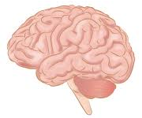

Inspiration for ANN
The Brain
Pattern Recognition
Association
Complexity
Noise Tolerance
The Machine
Calculation
Precision
Logic

Slide 8

Contrast in architecture
The Brain
- uses many slow unreliable processors acting in parallel
The Machine
The Von Neumann architecture uses a single processing unit
Tens of millions of operations per second
Absolute arithmetic precision

Slide 9
Features of the Brain
Ten billion (10¹⁰) neurons
On average, several thousand connections
Hundreds of operations per second
Die off frequently (never replaced)
Compensates for problems by massive parallelism

Slide 10
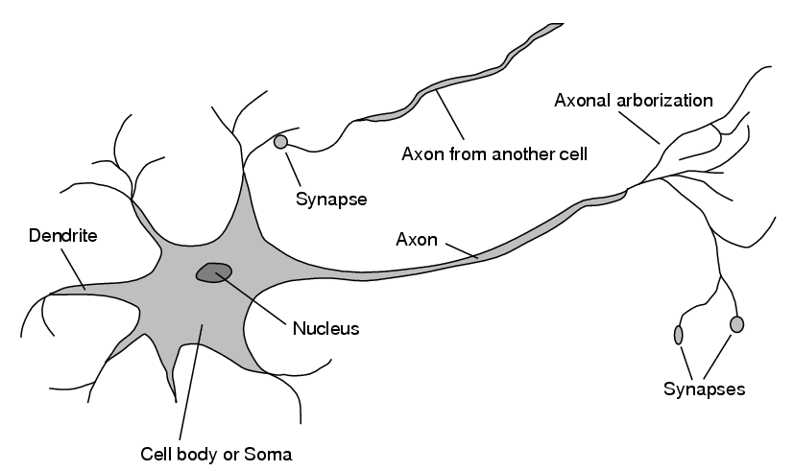
The biological inspiration
Single “percepts” distributed among many neurons
Localized parts of the brain are responsible for certain well-defined functions (e.g. vision, motion).
Structure of a neuron

Slide 11
The Structure of a Neuron
A neuron has a cell body
a branching input structure – dendrite
a branching output structure – axon
Structure of a neuron

Slide 12

The Structure of a Neuron
Axons connect to dendrites via synapses
Structure of a neuron

Slide 13
The Structure of a Neuron
Electro-chemical signals are propagated from the dendritic input, through the cell body, and down the axon to other neurons
Structure of a neuron

Slide 14
The Structure of a Neuron
A neuron only fires if its input signal exceeds a certain amount (the threshold) in a short time period.
Synapses vary in strength
Good connections allowing a large signal
Slight connections allow only a weak signal.
Structure of a neuron

Slide 15
The Artificial Neuron (Perceptron)
w₀
w₁
Inputs
w₂
Output
.
.
.
w_{n}

Slide 16
A Simple Model of a Neuron (Perceptron)
Each neuron has a threshold value
Each neuron has weighted inputs from other neurons
The input signals form a weighted sum
If the activation level exceeds the threshold, the neuron “fires”
w₀
w₁
Inputs
w₂
Σ
Output
.
.
.
w_{n}

Slide 17
An Artificial Neuron
Each hidden or output neuron has weighted input connections from each of the units in the preceding layer.
The unit performs a weighted sum of its inputs, and subtracts its threshold value, to give its activation level.
Activation level is passed through a sigmoid activation function to determine output.
w₀
w₁
Inputs
w₂
Σ
f(x)
Output
.
.
.
w_{n}

Slide 18
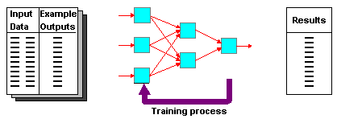
Supervised Learning

Slide 19
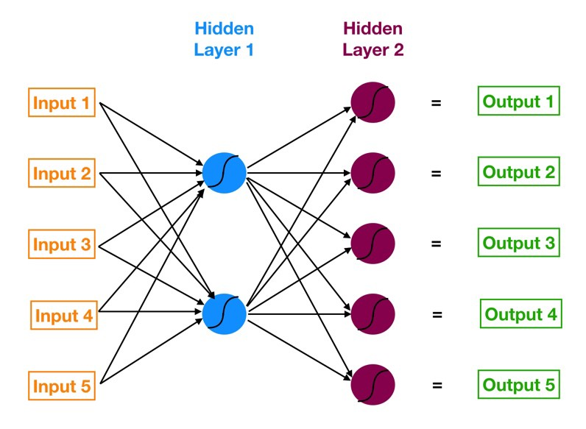
ANN
Neural networks are multi-layer networks of neurons (blue, red nodes)
Used for Classification, make predictions
ANN has 3 layers of neurons:
Input layer in orange
First hidden layer in blue
Second hidden layer in red
Output layer in green
Neural network with two hidden layers

Slide 20
ANN
Neural networks are multi-layer networks of neurons (blue, red nodes)
Used for Classification, make predictions
Arrows:
Shows how neurons are interconnected
Direction of data flow from i/p to o/p layer
Neural network with two hidden layers

Slide 21
ANN
Goal: To make a good predictions
w₀
w₁
Inputs
w₂
Σ
f(x)
Output
.
.
.
w_{n}

Slide 22
Logistic Regression can also make good predictions!!!

Slide 23
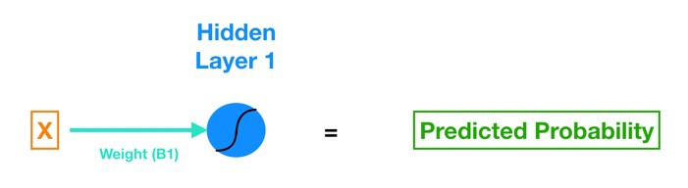
Simple ANN
A simple ANN can be written as a single feature logistic regression
give the model only one X variable
can be expressed through a neural network.
Let’s rewrite logistic regression equation using ANN color codes.
Y
= Y
Logistic regression (with only one feature) implemented via a neural network
Logistic Regression

Slide 24
Simple ANN
X, single input feature for the classification model
B1, weight of X. connects the input X to the blue neuron in Hidden Layer 1
B0, bias term. key difference: in NN, every neuron has its own bias term (while in regression, the model has a singular bias term).
, blue neuron includes a sigmoid activation function (denoted by the curved line)
Apply sigmoid function to (B1*X + B0) and get the prediction
Y
= Y
Logistic regression (with only one feature) implemented via a neural network
Logistic Regression

Slide 25
So let’s recap. A super simple neural network consists of just the following components:
A connection (though in practice, there will generally be multiple connections, each with its own weight, going into a particular neuron), with a weight “living inside it”, that transforms your input (using B1) and gives it to the neuron.
A neuron that includes a bias term (B0) and an activation function (sigmoid in our case).
And these two objects are the fundamental building blocks of the neural network. More complex neural networks are just models with more hidden layers and that means more neurons and more connections between neurons. And this more complex web of connections (and weights and biases) is what allows the neural network to “learn” the complicated relationships hidden in our data.

Slide 26
Adding complexity to the simple ANN

Slide 27
Not so simple ANN
The first hidden layer consists of two neurons.
To connect all five inputs to the neurons in Hidden Layer 1, we need ten connections.

Slide 28
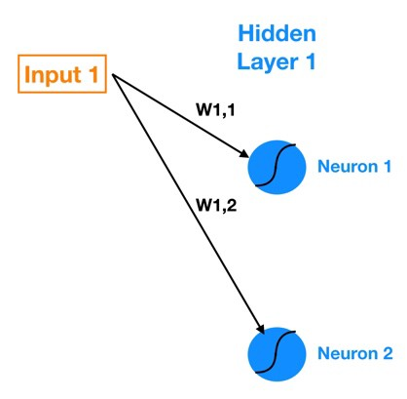
Not so simple ANN
Zooming into connections between Input 1 and Hidden Layer 1.
W_{1,1} : Weight that lives in connection between Input 1 and Neuron 1
W_{1,2} : Weight that lives in connection between Input 1 and Neuron 2
General notation: W_{a,b} is weight on connection between Input a (or Neuron a) and Neuron b.

Slide 29
Output for each Neuron
Computing Output of each neuron in Hidden Layer 1 (known as the activations):
Z1 = W1*In1 + W2*In2 + W3*In3 + W4*In4 + W5*In5 + Bias_Neuron1
Neuron 1 Activation = Sigmoid(Z1)
where, W denotes weight, In denotes input
Each neuron in the hidden layer has is own bias constant

Slide 30
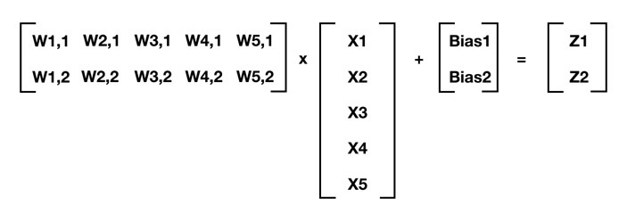
Output for each neuron (matrix)
In Matrix format,
Input 1
Input 2
Input 3
Input 4
Input 5

Slide 31
Output for each neuron (matrix)
In Matrix format,

Slide 32
Generalizing
In an ANN, Layer 1 has m Neurons. Next layer, Layer 2 has n Neurons
This generalizes to:
[W] . [X] + [Bias] = [Z]
where,
[W] is n x m matrix of weights of connections between previous and current layer
[X] is m x 1 matrix of either starting inputs or activations from previous layer
[Bias] is n x 1 matrix of neuron biases
[Z] is n x 1 matrix of intermediate outputs.
. denote matrix multiplication
Next, apply activation function (sigmoid in our case) to each element of [Z]
This gives us our neuron outputs (activations) for current layer

Slide 33
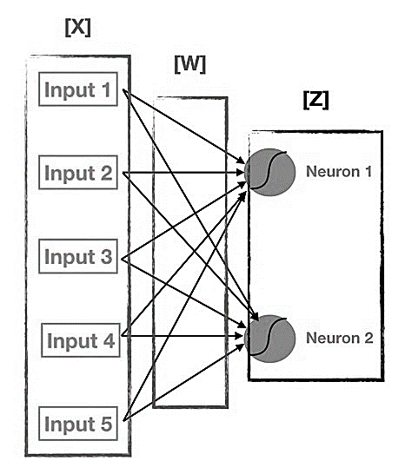
Simplifying Activation Function
Move from Input to Output:
- Repeatedly calculate [Z]
Apply activation function to [Z] for each successive layer
This process is known as Forward Propagation.
Visualizing [W], [X], and [Z]

Slide 34
Evaluating quality of Outputs Training ANN

Slide 35
Training ANN (cost function)
Similar to other classification models
Define a cost function.
Use gradient descent optimization to minimize cost function.
How to minimize cost function when training ANN model?

Slide 36
Training ANN (minimize cost function)
INTUITION
In traditional regression - Change beta in isolation without impacting other beta coefficients.
In ANN - apply small isolated shocks to each beta coefficient
measure its impact on the cost function
figure out in which direction to move to reduce and eventually minimize cost function.

Slide 37
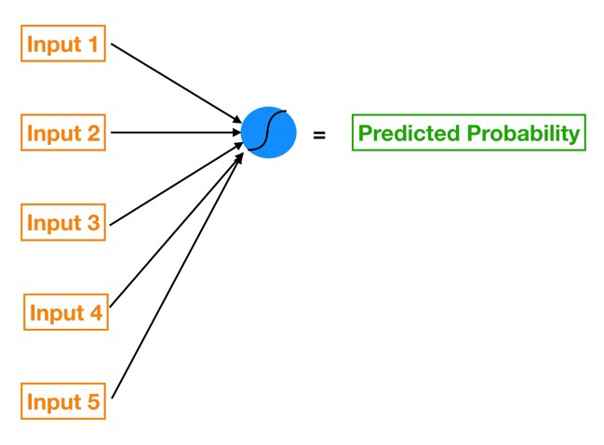
Training ANN (weights)
Each neuron in a neural network is like its own little model.
Tuning weight of any one connection (or bias of a neuron) has a reverberating effect across all other neurons and their activations in subsequent layers
Example: for a five feature logistic regression, we could express it through a neural network using just a singular neuron!

Slide 38
Training ANN (weights)
Each hidden layer can be viewed as a stack of models
where,
each individual neuron acts like its own model
whose outputs feed into even more models further downstream
(each successive hidden layer of the neural network holds yet more neurons).

Slide 39
Training ANN
Objective: Given a set of training inputs (our features) and outcomes (the target we are trying to predict):
Find the set of weights and biases that minimize the cost function
where, cost function is an approximation of how wrong our predictions are relative to target outcome.

Slide 40
Cost Function
Cost Function : Mean Squared Error (MSE)
MSE = Sum [ ( Prediction - Actual )² ] x (1 / num_observations)
Which cost function for ANN?

Slide 41


Gradient Descent (GD)
Intuition for GD - tweak parameters iteratively in order to minimize a cost function.
For logistic regression:
Assume model has only two parameters: weight w and bias b.
1. Initialize weight w and bias b to any random numbers.
2. Pick a value for learning rate α (size of step in each iteration).
small α - long time to converge , computationally expensive.
large α – model may fail to converge, overshoot minimum.
minimum

Slide 42
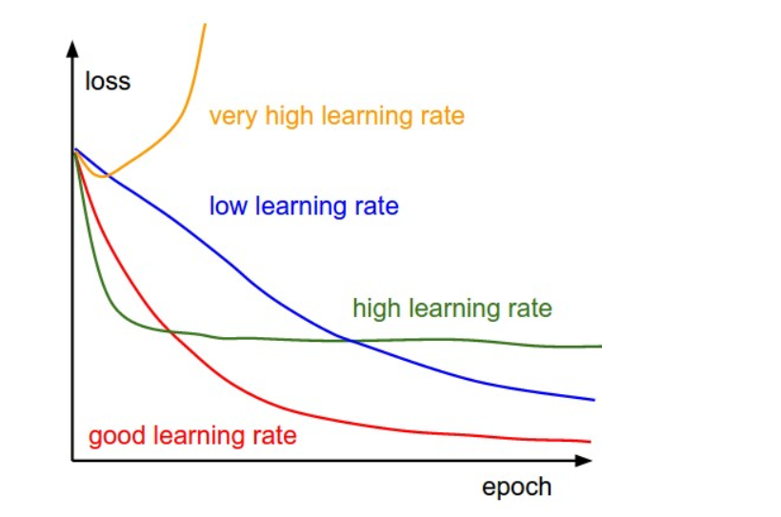
Gradient Descent (GD)
Intuition for GD - tweak parameters iteratively in order to minimize a cost function.
most commonly used rates are : 0.001, 0.003, 0.01, 0.03, 0.1, 0.3.
minimum

Slide 43
Gradient Descent (GD)
Intuition for GD - tweak parameters iteratively in order to minimize a cost function.
For logistic regression:
Assume model has only two parameters: weight w and bias b.
3. scale the data if it’s on a very different scales
4. Scale data to have μ = 0 and σ = 1. For each example:
minimum

Slide 44
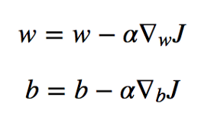
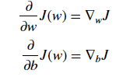
Gradient Descent (GD)
Intuition for GD - tweak parameters iteratively in order to minimize a cost function.
For logistic regression:
Assume model has only two parameters: weight w and bias b.
5. On each iteration, take the partial derivative of the cost function J(w) w.r.t each parameter (gradient):
minimum

Slide 45
Gradient Descent (GD)
For ANN, to minimize cost function – use gradient descent
Pre-requisite:
know gradient of cost function
vector that points in the direction of greatest steepness (we want to repeatedly take steps in the opposite direction of the gradient to eventually arrive at the minimum)

Slide 46
Challenge with using GD in ANN
Changeable weights and biases that are all interconnected
How to calculate gradient in this scenario?

Slide 47
Computing Cost Function for ANN
Compute gradient of our “current location” (calculate the gradient using current parameter values)
Modify each parameter by an amount proportional to its gradient element and in opposite direction of its gradient element.
Example, if partial derivative of our cost function with respect to
B0 is positive but tiny, B1 is negative and large
→ decrease B0 by a tiny amount and increase B1 by a large amount to lower cost function.
Recompute gradient using new tweaked parameter values
Repeat previous steps until we arrive at minimum cost

Slide 48
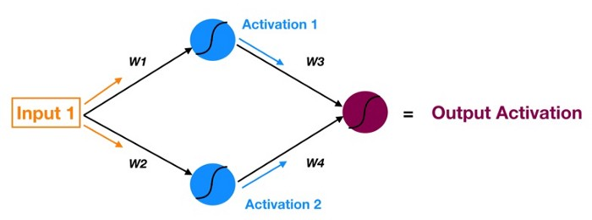
Recall Forward Propagation
Process of moving forward through the neural network (from inputs to the ultimate output or prediction).

Slide 49
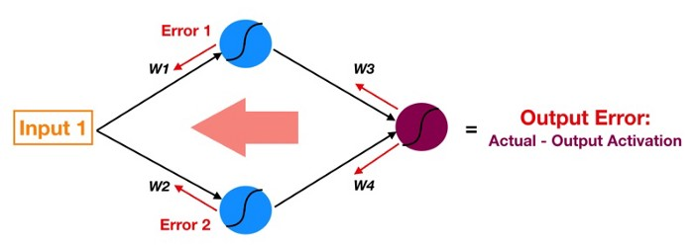
Backpropagation
- Reverse of Forward Propagation
- Except instead of signal, we are moving error backwards through our model.

Slide 50
Backpropagation
Follow red arrows –
- Start at output of red neuron - output activation (used for prediction) - the ultimate source of error in a model
- Move this error backwards through the model via the same weights and connections used for forward propagating the signal (instead of Activation 1, now we have Error1 — the error attributable to top blue neuron).

Slide 51
Backpropagation
Goal of forward propagation - calculate neuron activations layer by layer until we get to the output
Goal of backpropagation ?

Slide 52
Discussion
Why is error for each neuron important?
2 building blocks of an ANN –
connections that pass signals into a particular neuron (with a weight living in each connection)
Neuron itself (with a bias)
Tuning Parameters : weights and biases
Magnitude of error of a specific neuron is directly proportional to impact of that neuron’s output (a.k.a. activation) on cost function.

Slide 53
Discussion
Error of each neuron is a proxy for partial derivative of the cost function with respect to that neuron’s inputs.
If a particular neuron has a much larger error
tweaking weights, bias of this neuron will have a greater impact on model’s total error than fiddling with any other neurons
Partial derivatives with respect to each weight and bias are the individual elements that compose the gradient vector of our cost function. So basically backpropagation allows us to calculate the error attributable to each neuron and that in turn allows us to calculate the partial derivatives and ultimately the gradient so that we can utilize gradient descent.

Slide 54
Discussion
Where complex mappings learned from inputs to outputs, based solely on samples
Difficult to analyze: firm predictions about neural network behavior difficult;
Require limited understanding from trainer, who can be guided by heuristics.

Slide 55
Training NN for reading pixels
feedforward network
trained using Back- propagation

Slide 56
Coding Exercise

Slide 57
Attributions: Some of these slides are based on material on towardsdatascience by Tony Yiu, Geoffrey Hinton,
Coding exercise is from Kaggle.com

Slide 58
Open Floor

