Slide 1
Foundations of Data Science & Analytics DSCI 633, Fall 2021
Lecture 11
(material sources cited in the last slide)
Nidhi Rastogi
Assistant Professor, GCCIS, RIT
September 28, 2021

Slide 2
Course Information
GitHub link - https://github.com/aiforsec/RIT-DSCI-633-FDS
Assignment 4 will be due at 11:59 pm on 09/30. No extensions.
Reach out to the TA/ Instructor during office hours, via Slack, or email for any questions, suggestions, concerns, or general chat about data science.

Slide 3
This Lecture
An end-to-end machine learning model pipeline
Classification, Clustering, Anomaly detection, …
Performance Measures
Error Analysis
Training Models – Linear
Linear Regression
Gradient Descent
Polynomial Regression
Regularized Linear Models
Logistic Regression

Slide 4
Classification Models
Base classification models
Linear Regression (covered in previous class)
Decision Tree
Instance-based (Nearest-neighbor)
Rule-based
Naïve Bayes and Bayesian Belief Networks
Support Vector Machines
Neural Networks and Deep Learning
Ensemble Classifiers
Boosting, Bagging, Random Forests

Slide 5
Lecture Agenda
Ensemble Classifiers
Theory: 40-45 mins
Online code practice + Questions – 15-20 mins
Pop-quiz - 10 mins

Slide 6
Ensemble Classifiers

Slide 7
Goal of Supervised Learning?
Minimize the probability of model prediction errors on future data
Two Competing Methodologies
Build one really good model
Traditional approach
Build many models and average the results
Ensemble learning (more recent)

Slide 8
Ensemble Philosophy
Build many models and combine them.
Only through averaging do we get at the truth!
It’s too hard (impossible?) to build a single model that works best
Two types of approaches:
Models that don’t use randomness
Models that incorporate randomness

Slide 9
Scenario 1 – Buy a Car
How do I research for the right car?

Slide 10
Scenario 1 – Buy a Car
Browse a few automobile websites and check for options
Check reviews
Check prices, other factors..
Ask your friends and colleagues for their opinion
….

Slide 11
Scenario 1 – Buy a Car
Make an informed decision!!

Slide 12
Ensemble learning
Ensemble models combine decisions from multiple models to improve the overall performance.

Slide 13
Scenario 2– Build health app
You’ve built a health app
Wish to receive critical feedback
Close down potential loopholes

Slide 14
Scenario 2– Build health app
Options:
Take opinion of family and friends
Take opinion of classmates
Launch a beta version of the app
receive feedback from web development community and non-biased users

Slide 15
Scenario 2– Build health app
What did you just do?

Slide 16
Scenario 2– Build health app
Took multiple opinions from several people and made an informed decision based on the opinions

Slide 17
Scenario 2– Build health app
Ensemble models combine decisions from multiple models to improve the overall performance.

Slide 18
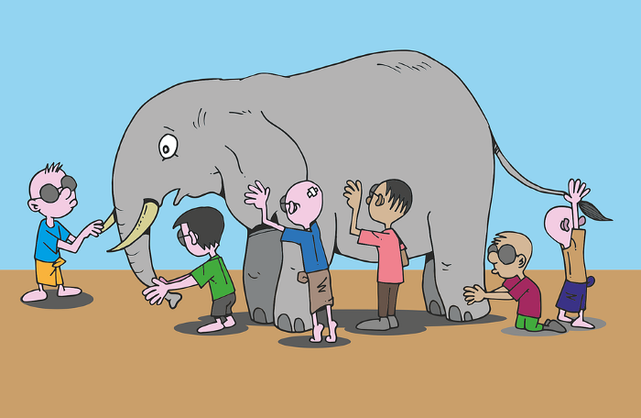
Scenario 3– Guess the animal
Blindfolded kids playing “touch and tell”

Slide 19
Scenario 3– Guess the animal
Each has a (somewhat) different version of how an elephant looks like

Slide 20
Scenario 3– Guess the animal
Grouping every kids version of how an elephant looks like can collectively give an accurate description of an elephant.

Slide 21
Scenario 3– Guess the animal
Ensemble methods employ a group of models where the combined result out of them is almost always better in terms of prediction accuracy as compared to using a single model.

Slide 22
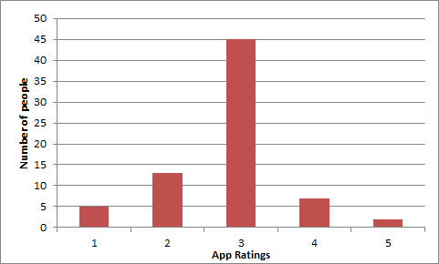
Simple Ensemble techniques
Taking mode of the results- most frequently occurring number in a set of numbers
Multiple models used to make predictions for each data point
Example - rating beta version of health and
fitness app from the user community
Assume each user as a model
Output, Mode =3 (majority people voted this)

Slide 23
Simple Ensemble techniques
Taking average of the results- average of predictions from all the models and use it to make the final prediction
AVERAGE= sum(Rating*Number of people)/Total number of people
= (1*5)+(2*13)+(3*45)+(4*7)+(5*2)/72 = 2.833
~=3
Output = 3

Slide 24
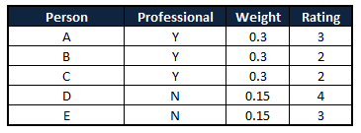
Simple Ensemble techniques
Taking weighted average of the results
All models assigned different weights defining the importance of each model for prediction
Pro app developers get higher weight
WEIGHTED AVERAGE
= (0.3*3)+(0.3*2)+(0.3*2)+(0.15*4)+(0.15*3)
= 3.15
~= 3

Slide 25
Ensemble Approaches
Bagging
Bootstrap aggregating
Stacking
Boosting
Random Forests (Separate Class)

Slide 26
Ensemble Approaches
Bagging:
fitting many decision trees on different samples of same dataset
averaging their predictions.
Stacking
fitting many different models types on the same data
using another model to learn how to best combine the predictions
Boosting
adding ensemble members sequentially that correct the predictions made by prior models and outputs a weighted average of the predictions

Slide 27
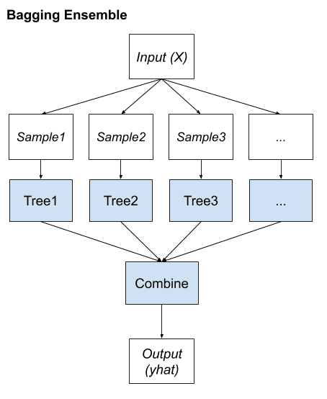
Bagging Ensemble Learning
Comes from the term - Bootstrap AGGregatING.
Uses a single machine learning algorithm
almost always an unpruned decision tree
Trains each model on a different sample of the same training dataset.
Predictions made by the ensemble members are then combined using simple statistics, such as voting or averaging

Slide 28
Bagging Ensemble Learning
Main Assumption behind prediction:
Combining many unstable predictors to produce an ensemble (stable) predictor.
Unstable Predictor: small changes in training data produce large changes in the model.
e.g. Neural Nets, trees
Stable Predictor: SVM (sometimes), Nearest Neighbor.

Slide 29
The Bagging Algorithm
Given data:
For m = 1:M
Obtain bootstrap sample D_{m} from the training data D
Build a model G_{m}(x) from bootstrap data, D_{m}

Slide 30
Bagging Details
Examples (rows) are drawn from dataset at random, although with replacement
Called bootstrap samples
Bootstrap sample of N instances is obtained by drawing N examples at random, with replacement.
On average each bootstrap sample has 63% of instances
Encourages predictors to have uncorrelated errors
This is why it works

Slide 31
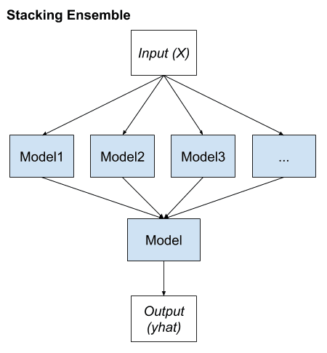
Bagging vs Stacking

Slide 32
Stacking
Seeks a diverse group of members
varies model types fit on training data
uses a model to combine predictions
1 learner trained to combine individual learners

Slide 33
Stacking
Seeks a diverse group of members
varies model types fit on training data
uses a model to combine predictions
1 learner trained to combine individual learners
First-level
learners
Second-level
learner OR meta learner

Slide 34
Stacking
2 level hierarchy most common approach
Any ML model can be used to aggregate the predictions
Common to use linear regression for regression and logistic regression for binary classification
simple models to learn how to harness the variety of predictions made
model complexity resides at lower-level ensemble member models

Slide 35
Stacking - dataset
Dataset – same for all models
Diversity comes from various different machine learning models
Use models that are learned in different ways
ensures they make different predictions
have less correlated prediction errors

Slide 36
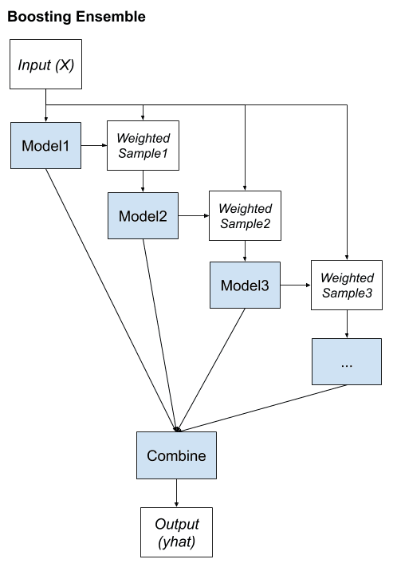
Bagging vs Stacking vs Boosting

Slide 37
Boosting
Main Assumption:
Combining many weak predictors to produce an ensemble predictor
training dataset for each subsequent classifier increasingly focuses on instances misclassified by previously generated classifiers.
Notes:
Weak learners - models that are only slightly better than random guessing, such as small decision trees

Slide 38
Boosting
Models are fit and added to the ensemble sequentially
Second model attempts to correct the predictions of the first model, the third corrects the second model, and so on…
Weights: contributions are weighed proportional to their performance or capability

Slide 39
Boosting
Final Classifier
Each classifier G_{m}(x) is trained from a weighted sample of training data
Biased training sample
Instances (training examples) with high error are weighted higher than those with lower error
Difficult instances get more attention
This is the motivation behind boosting
G_{m}(x)
Weighted Sample
.
.
.
G₃(x)
Weighted Sample
G₂(x)
Weighted Sample
G₁(x)
Training Sample

Slide 40
Boosting
Final Classifier
Objective: develop a “strong-learner” from several “weak-learners”
Training dataset remains same.
G_{m}(x)
Weighted Sample
.
.
.
G₃(x)
Weighted Sample
G₂(x)
Weighted Sample
G₁(x)
Training Sample

Slide 41
Boosting
Final Classifier
Popular boosting approaches:
AdaBoost (canonical boosting)
Gradient Boosting Machines
Stochastic Gradient Boosting (XGBoost and similar)
G_{m}(x)
Weighted Sample
.
.
.
G₃(x)
Weighted Sample
G₂(x)
Weighted Sample
G₁(x)
Training Sample

Slide 42
Boosting
Popular boosting approaches:
AdaBoost (canonical boosting): among first successful boosting methods
Gradient Boosting Machines
Stochastic Gradient Boosting (XGBoost and similar): most effective techniques for classification and regression on tabular (structured) data

Slide 43
AdaBoost - Motivation
Remember decision trees?
House has <=5 bedrooms
A possible Decision
Y
N
Lot size <= 8500sqft.
Lot size <= 12000sqft
Y
N
Y
N
Predicted price: $140,000
Predicted price: 180,000
Predicted price: 170,000
Predicted price: 230,000

Slide 44
AdaBoost - Motivation
A tree made using AdaBoost
House has <=5 bedrooms
Y
N
Just a node and two leaves
Lot size <= 8500sqft.
Lot size <= 12000sqft

Slide 45
AdaBoost - Motivation
A tree made using AdaBoost
House has <=5 bedrooms
Y
N
Just a node and two leaves = STUMPS
Lot size <= 8500sqft.
Lot size <= 12000sqft

Slide 46
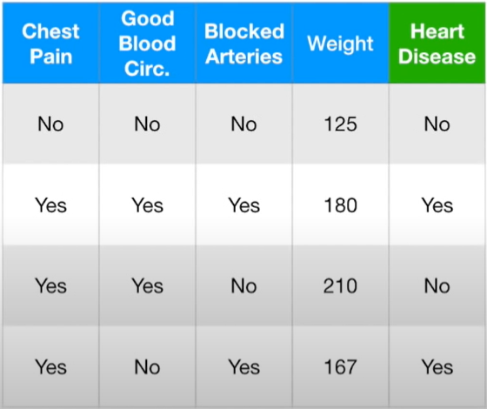
AdaBoost - Motivation
STUMPS bad at classification
Example dataset – for classifying patients with heart disease

Slide 47
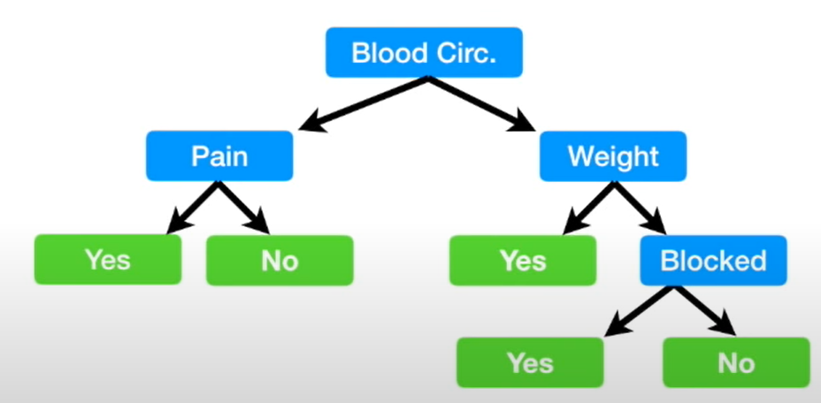
AdaBoost - Motivation
Example dataset – for classifying patients with heart disease
Full sized decision tree

Slide 48
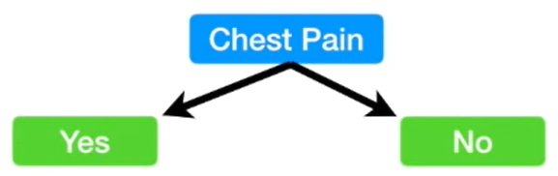
AdaBoost - Motivation
Example dataset – for classifying patients with heart disease
Stump uses only one variable to make a decision
Weak learners!

Slide 49
AdaBoost - Motivation
Example dataset – for classifying patients with heart disease
Stump uses only one variable to make a decision
Weak learners!
Basis of AdaBoost!

Slide 50
AdaBoost
Each weak classifier trained on a random subset of total training set.
Subsets can overlap
AdaBoost assigns weight to each training example.
Weight determines probability of of each example to occur in training set

Slide 51
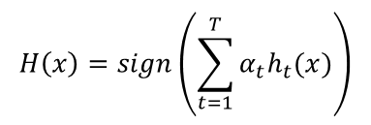
AdaBoost
Increases weight of misclassified training example
These examples make up a larger part of the next classifier’s training set.
Output:

Slide 52
AdaBoost
T = weak classifiers
h_t(x) = output of weak classifier, t
alpha = weight applied to classifier t
H(x) = linear combination of all classifiers
Final decision: looking at sign of this sum

Slide 53
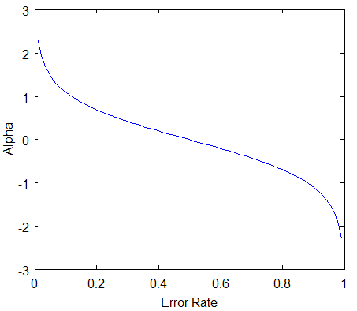
AdaBoost, errors
classifier’s error rate, ‘e_t’: number of misclassifications over the training set / training set size.
Intuition about error rate:
Classifier weight grows exponentially as the error approaches 0. Better classifiers are given exponentially more weight.
Classifier weight =0 if the error rate is 0.5. A classifier with 50% accuracy is no better than random guessing, so we ignore it.
Classifier weight grows exponentially negative as error approaches 1. We give a negative weight to classifiers with worse than 50% accuracy. “Whatever that classifier says, do the opposite!”.

Slide 54
Coding Exercise

Slide 55
Attributions: Some of these slides are based on material on towardsdatascience, machinelearning.com
Coding exercise is from Kaggle.com

Slide 56
Open Floor

