Slide 1
Foundations of Data Science & Analytics DSCI 633, Fall 2021
Lecture 14
(material sources cited in last slide)
Nidhi Rastogi
Assistant Professor, GCCIS, RIT
October 07, 2021

Slide 2
Course Information
GitHub link - https://github.com/aiforsec/RIT-DSCI-633-FDS
Assignment 4 due at 11:59 pm on 09/30. No extensions.
Reach out to TA/ Instructor during office hours, via Slack, or email for any questions, suggestions, concerns, or general chat about data science.

Slide 3
Lecture Agenda
Feature Engineering
Theory: 40-45 mins
Online code practice + Questions – 10-15 mins
Pop-quiz - 10 mins

Slide 4
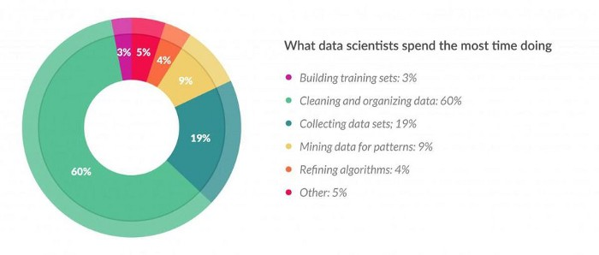
Introduction
Reality of a Data Scientist Job – a lot of time spent in feature engineering
https://www.forbes.com/sites/gilpress/2016/03/23/data-preparation-most-time-consuming-least-enjoyable-data-science-task-survey-says/#1594bda36f63

Slide 5
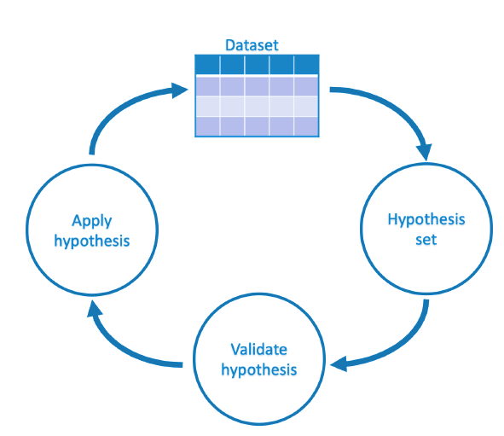
Feature Engineering cycle
Not Feature Engineering
data collection
creating target variable
removing duplicates
fixing mislabeled classes.

Slide 6
Feature Engineering cycle
How?
Domain knowledge
Prior experience in defining problem
Exploratory Data Analysis (EDA)
ML model feedback
Notes:
Space of possible hypotheses for mapping inputs to outputs that can be searched, often constrained by how problem is framed, choice of mode, model parameters.

Slide 7
Feature Engineering (FE) cycle
How?
Cross-validation
Performance Measurement
Avoid leakage

Slide 8
FE is challenging
Powerful feature transformations (like target encoding) can introduce leakage when applied wrong
Usually requires domain knowledge about how features interact with each other
Time-consuming, may need to run thousands of experiments
Why Feature Engineering matters
Extract more new gold features, remove irrelevant or noisy features
Simpler models with better results

Slide 9
Key Elements of FE
Target Transformation
Feature Extraction
Feature Encoding

Slide 10
Key Elements of FE
Target Transformation
Feature Extraction
Feature Encoding

Slide 11
Target Transformation
Manual or Automatic
Fit transform on training dataset
Apply to train and test. Invert transform on prediction
Use it when variable shows a skewed distribution make residuals more close to “normal distribution” (bell curve)
Can improve model fit
e.g., log(x), log(x+1), sqrt(x), sqrt(x+1), etc.

Slide 12
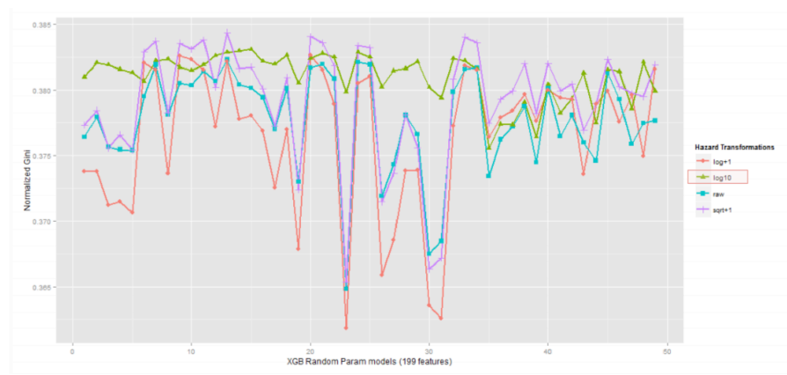
Target Transformation
Different transformations might lead to different results

Slide 13
Key Elements of FE
Target Transformation
Feature Extraction
Feature Encoding

Slide 14
Imputation
Common problem in preparing data: Missing Values
Why we have missing values?
Human errors
Interruptions in data flow
Privacy concerns
What to do?

Slide 15
Imputation
What to do?
• Simple solution: drop row/column
• Preferable option: Imputation

Slide 16
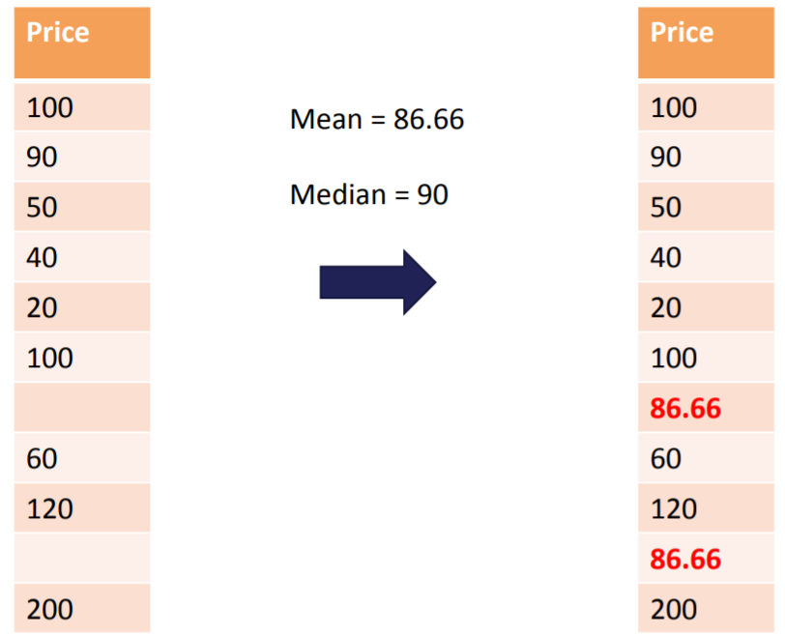
Imputation
Numerical Imputation – better than dropping since it preserves data size
Assing zero
Assing NA
Which one to pick?
Default value or medians of columns (Note that averages are sensitive to outlier values)

Slide 17
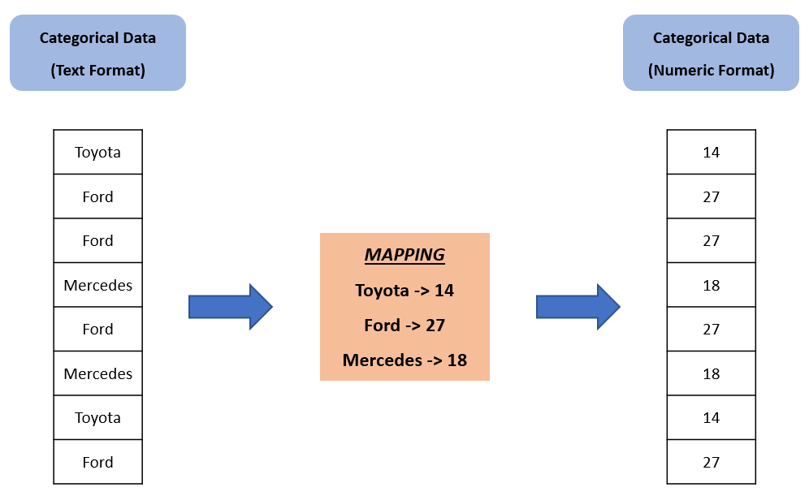
Imputation
Categorical Imputation
Maximum occurred value
There is not a dominant value, imputing a category like “Other”
Text -> numeric format

Slide 18
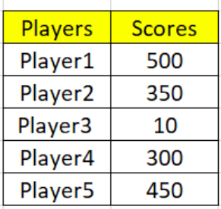
Outliers
Mistake?
Variance?

Slide 19
Outlier/Anomaly detection
Outlier: A data object that deviates significantly from normal objects as if it were generated by a different mechanism
Outliers are different from noise data
Noise is random error or variance in a measured variable
Noise should be removed before outlier detection
Outliers are interesting: It violates mechanism that generates normal data
Outlier detection vs. novelty detection: early stage, outlier; but later merged into model
Applications?

Slide 20
Outlier/Anomaly detection
Applications:
Credit card fraud detection
Telecom fraud detection
Customer segmentation
Medical analysis

Slide 21
Types of Outliers
Global, contextual and collective outliers
Global outlier (or point anomaly)
Object is O_{g} if it significantly deviates from rest of data set
Ex. Intrusion detection in computer networks
Issue: Find an appropriate measurement of deviation

Slide 22
Types of Outliers
Contextual outlier (or conditional outlier)
Object deviates significantly based on a selected context
Ex. 80degree F in Rochester: outlier? (depending on summer or winter?)
Attributes of data objects should be divided into two groups
Contextual attributes: defines context, e.g., time & location
Behavioral attributes: characteristics of object, used in outlier evaluation, e.g., temperature
Can be viewed as a generalization of local outliers—whose density significantly deviates from its local area
Issue: How to define or formulate meaningful context?

Slide 23
Types of Outliers
Collective Outliers
A subset of data objects collectively deviate significantly from whole data set, even if individual data objects may not be outliers
Applications: E.g., intrusion detection:
When a number of computers keep sending denial-of-service packages to each other
Detection of collective outliers
Consider not only behavior of individual objects, but also that of groups of objects
Need to have background knowledge on relationship among data objects, such as a distance or similarity measure on objects.
A data set may have multiple types of outlier
One object may belong to more than one type of outlier

Slide 24
Finding Outliers
To ease discovery of outliers, we have plenty of methods in statistics:
Discover outliers with visualization tools or statistical methodologies
Box plot
Scatter plot
Z-score
IQR score

Slide 25
Box Plot
Wikipedia: In descriptive statistics, a box plot is a method for graphically depicting groups of numerical data through their quartiles. Box plots may also have lines extending vertically from boxes (whiskers) indicating variability outside upper and lower quartiles, hence terms box-and-whisker plot and box-and-whisker diagram. Outliers may be plotted as individual points.

Slide 26
Box Plot
Definition suggests, that if there is an outlier it will plotted as point in
boxplot but other population will be grouped together and display as boxes.

Slide 27
Box Plot
Three points between 10 to 12, these are outliers as there are
not included in box of other observation i.e no where near quartiles.
• Here we analyzed uni-variate outlier i.e. we used DIS column only to check outlier.
Three points between 10 to 12, these are outliers as there are not included in box of other observation i.e no where near quartiles.
Here we analyzed uni-variate outlier

Slide 28
Scatter Plot
Wikipedia: A scatter plot , is a type of plot or mathematical diagram using Cartesian coordinates to display values for typically two variables for a set of data. data are displayed as a collection of points, each having value of one variable determining position on horizontal axis and value of other variable determining position on vertical axis.

Slide 29
Scatter Plot
Definition suggests, scatter plot is collection of points that shows values for two variables.
Most of data points are lying bottom left side but there are points which are far from population like top right corner.

Slide 30
Standard Deviation
Wikipedia: In statistics, standard deviation (SD, also represented by lower case Greek letter sigma σ for population standard deviation or Latin letter s for sample standard deviation) is a measure of amount of variation or dispersion of a set of values.
If a value has a distance to average higher than x * standard deviation, it can be assumed as an outlier. Then what x should be?
Usually, a value between 2-4

Slide 31
Z-score
Wikipedia: Z-score is signed number of standard deviations by which value of an observation or data point is above mean value of what is being observed or measured.
Intuition: describe any data point by finding their relationship with Standard Deviation and Mean of group of data points.
Z-score is finding distribution of data where mean is 0 and standard deviation is 1 i.e. normal distribution.

Slide 32
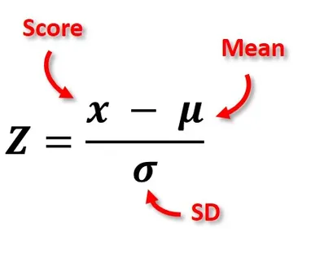
Z-score
While calculating Z-score we re-scale and center data and look for data points which are too far from zero. These data points which are way too far from zero will be treated as outliers. In most of cases a threshold of 3 or -3 is used i.e if Zscore value is greater than or less than 3 or -3 respectively, that data point will be identified as outliers.

Slide 33
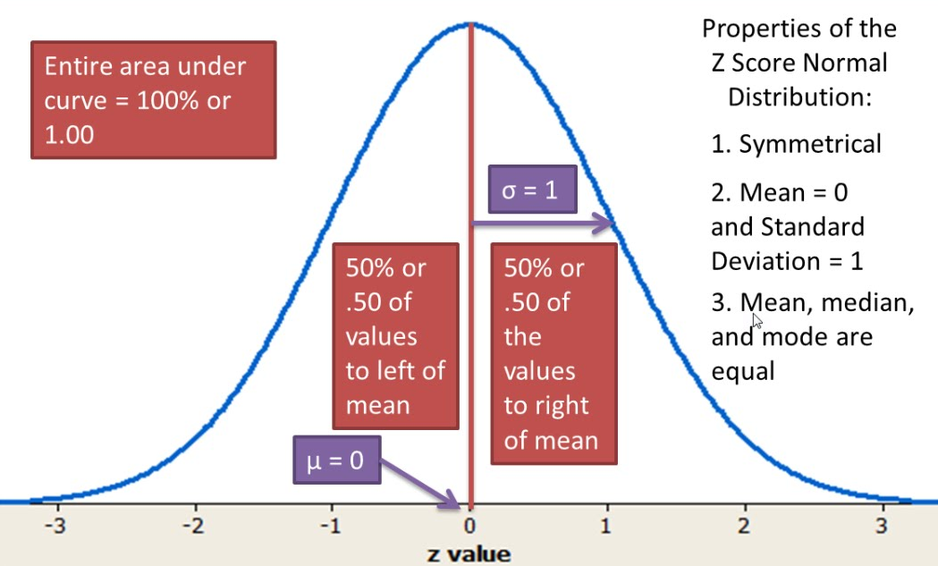
Z-Score

Slide 34
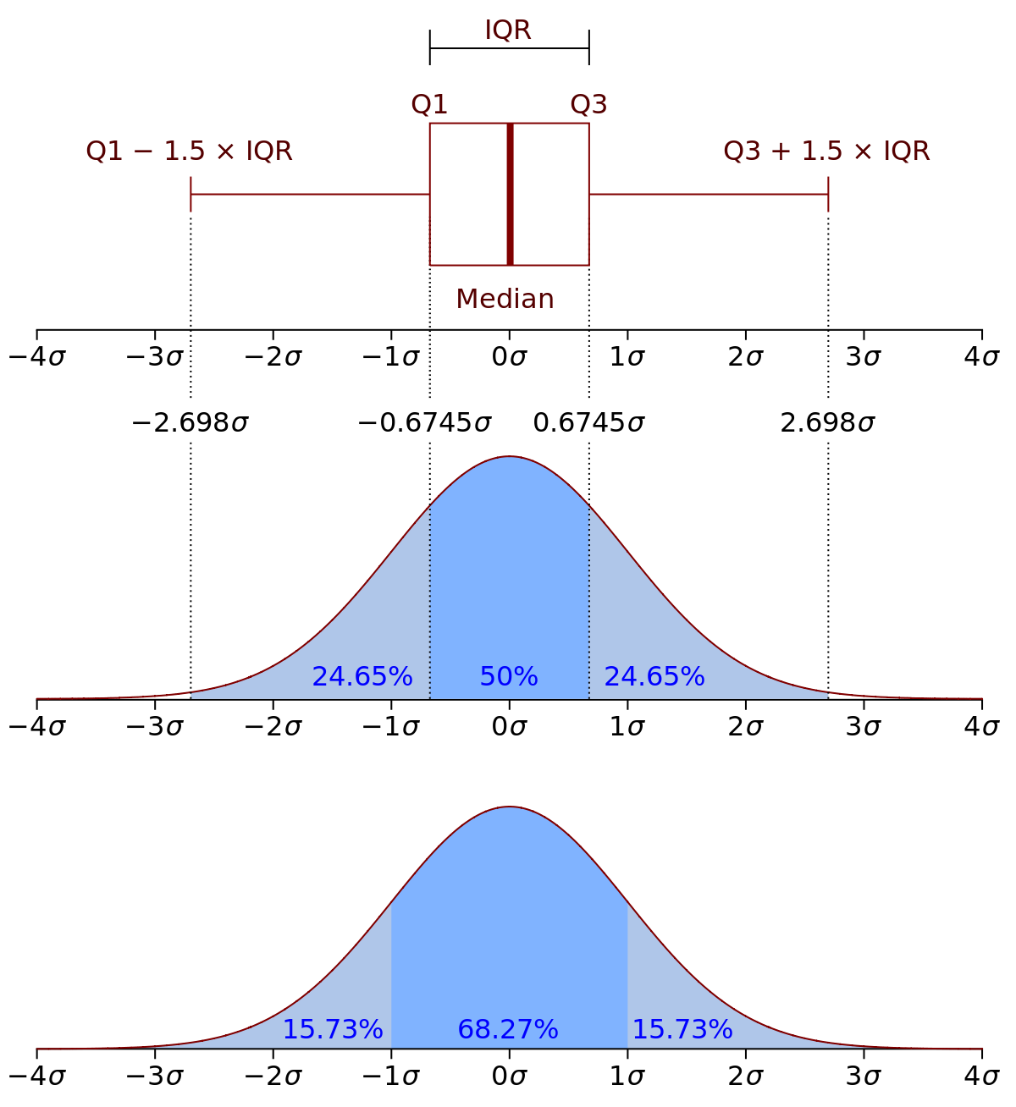
IQR Score
Wikipedia: interquartile range (IQR), also called midspread or middle 50%, or technically H-spread, is a measure of statistical dispersion, being equal to difference between 75th and 25th percentiles, or between upper and lower quartiles,
IQR = Q3 − Q1.
Measure of dispersion similar to standard deviation or variance, but is much more robust against outliers.

Slide 35
Percentiles
assume a certain percent of value from top or the
bottom as an outlier.
A common mistake is using percentiles according to range
of data
e.g., if data ranges from 0 to 100; top 5% is not values between 96 and 100.
Top 5% means values that are out of 95th percentile of data.

Slide 36
Handling Outliers
An Outlier Dilemma: Drop or Cap
Correcting
Removing
Z-score
IQR Score

Slide 37
Binning
Binning – can be applied on both categorical and numerical data
Example

Slide 38
Binning
Motivation: make model more robust and prevent overfitting
Has a cost to performance.
Key point : Trade-off between performance and overfitting
Numerical binning: binning might be redundant due to its effect on model
performance.
• Categorical binning: labels with low frequencies may affect robustness negatively.
Assigning a general category to these less frequent values helps to keep robustness of model.

Slide 39
Log Transformation
Helps handle skewed data and after transformation, distribution becomes more approximate to normal
.
Usually, magnitude order of data changes within range of data.
Also decreases effect of outliers, due to normalization of magnitude differences and model become more robust.

Slide 40
Log Transformation
Helps handle skewed data and after transformation, distribution becomes more approximate to normal
.
Usually, magnitude order of data changes within range of data.
Also decreases effect of outliers, due to normalization of magnitude differences and model become more robust.

Slide 41
Log Transformation
Pre-req to apply log transformation - Data should be only positive, lest error
You can add 1 to make data positive across the feature

Slide 42
Grouping
Tidy data: dataset where each row is an instance, each column is a feature
Datasets that are not tidy can use groupings. Like transactions
Key Point: Decide aggregation function

Slide 43
Grouping
Aggregating categorical columns:
Highest frequency: the max operation for categorical columns
Make a Pivot table: This would be a good option if you aim to go beyond binary flag columns and merge multiple features into aggregated features, which are more informative.
Apply one-hot encoding

Slide 44
Grouping
Numerical columns are mostly grouped using:
• Sum
• Mean

Slide 45
Splitting
Usually, dataset violates tidy data principles
Split function is a good option,
however, there is no one way of splitting features

Slide 46
Scaling
In most cases, the numerical features of the dataset do not have a
certain range and they differ from each other.
age and income columns cannot have same range
from ML pov, how to compare the 2 columns?
It is important for algorithms that work based on distance: such as k-NN or k-Means
there are two common ways of scaling: Normalization, and Standardization

Slide 47
Normalization
Or min-max normalization, scale all values in a fixed range between 0 and 1.
Transformation does not change distribution of features
NOTE: Due to decreased standard deviations, effects of outliers increases. So before normalization, it is recommended to handle outliers.

Slide 48
Normalization
Example:

Slide 49
Standardization
Standardization (or z-score normalization) scales the values while taking
into account standard deviation.
mean is shown as μ and standard deviation is shown as σ.
If standard deviation of features is different, range would also differ from each other.
Reduces effect of outliers in features

Slide 50
Standardization
Example:

Slide 51
Key Elements of FE
Target Transformation
Feature Extraction
Feature Encoding
(next lecture)

Slide 52
Coding Exercise

Slide 53
Attributions
Some of these slides are based on material on from a DS class taught in MILA, Montreal which was adapted from towardsdatascience. Some material is from Hands-On machine learning ed. 2.
Coding exercise is from Kaggle.com (it’s best place to practice!)

Slide 54
Open Floor

