Slide 1
Foundations of Data Science & Analytics DSCI 633, Fall 2021
Lecture 16
(material sources cited in last slide)
Nidhi Rastogi
Assistant Professor, GCCIS, RIT
October 19, 2021

Slide 2
Course Information
GitHub link - https://github.com/aiforsec/RIT-DSCI-633-FDS
Assignment 6 assigned. Due at 11:59 pm on 10/26. No extensions. Project starts 10/28.
Reach out to TA/ Instructor during office hours, via Slack, or email for any questions, suggestions, concerns, or general chat about data science.

Slide 3
Data Balancing

Slide 4
Data Balancing
from sklearn.model_selection import train_test_split
train_set, test_set = train_test_split(housing, test_size=0.2, random_state=42)
So far, we’ve seen examples of random distribution of training dataset
Today, we will study classification problems where the classes are skewed (more records from one class than another)

Slide 5
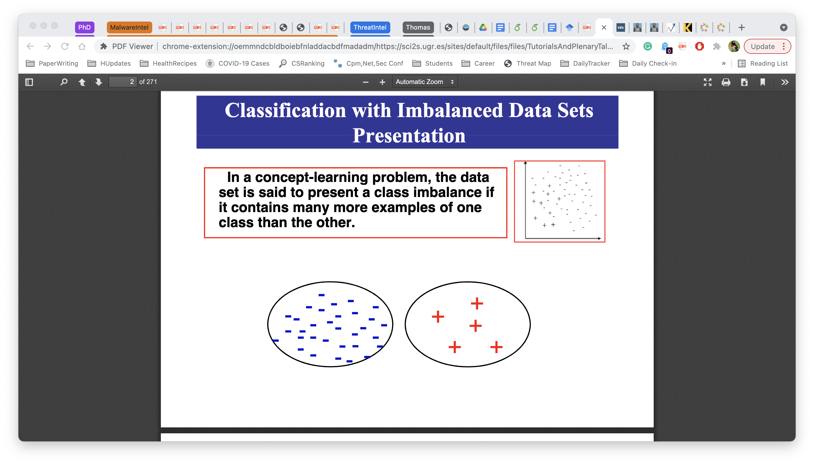
Data Balancing
A dataset is said to present a class imbalance if it contains more examples of one class than the other.

Slide 6
Data Balancing
Many domains do not have a balanced data set.
A lot of problems have the most important knowledge residing in minority class.
Detection of uncommon diseases present in imbalanced data
Few sick people, lots of healthy people
Fraudulent credit card transactions
Learning word pronunciation
Detection of melanomas
Insurance risk modeling

Slide 7
Data Balancing
Unbalanced data can be challenging for typical classifiers
E.g. decision trees
Such models are designed to optimize overall accuracy without taking into account the relative distribution of each class.
Classifiers tend to ignore small classes
Concentrate on classifying large ones accurately.ß

Slide 8
Why Data Imbalance is a problem?
: 3
: 30

Slide 9
Why Data Imbalance is a problem?
Error: 3
Accuracy:
30 / 33 = 91%
Precision : 0%
Recall : 0%

Slide 10
Resolving Imbalance problem
Train a balanced model:
Balance training data via sampling in preprocessing
Modify model learning
Evaluate performance on rare classes:
Later in Evaluation

Slide 11
Data Balancing
Under sample the majority class data
Oversample the minority class data
Both

Slide 12
Data Balancing
Undersample
Random sampling without replacement
Error: 10
Accuracy:
23 / 33 = 70%
Precision :
3 / 13 = 23%
Recall : 100%

Slide 13
Data Balancing
Oversample
Duplicate 10 X in the same location
Error: 4
Accuracy:
29 / 33 = 88%
Precision :
3 / 7 = 43%
Recall : 100%
10 X

Slide 14
Data Balancing
Oversample
Random sample 30 with replacement
Error: 4
Accuracy:
29 / 33 = 88%
Precision :
3 / 7 = 43%
Recall : 100%

Slide 15
Data Balancing
Oversample
Synthetic points
Error: 4
Accuracy:
29 / 33 = 88%
Precision :
3 / 7 = 43%
Recall : 100%

Slide 16
Synthetic Minority Oversampling TEchnique (SMOTE)
(x1,y1) and (x2,y2)
--> (xs, ys)
xs = (x2-x1)*a+x1 = a*x2+(1-a)*x1
ys = b*y2+(1-b)*y1
0<a<1
0<b<1
(x1,y1)
(x2,y2)

Slide 17
Balanced model learning
Penalize more on False Negatives (misclassifying a minority class data as the majority class)
By putting different weights on False Positives and False Negatives
Actually works the same as oversampling (duplicate minority class data X times ==
w of FN = X times w of FP)
But can take non-integer X values.

Slide 18
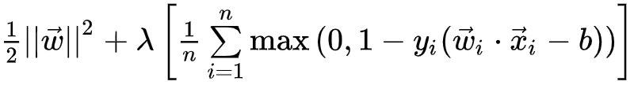
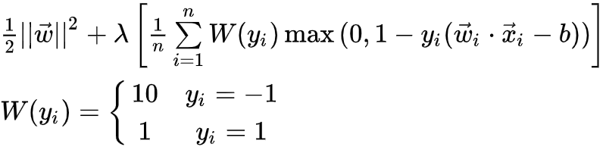
Balanced model learning
Soft-margin linear SVM

Slide 19
Attributions
Some of these slides are based on material from Prof Zhe Yu@ RIT.
Coding exercise is from Kaggle.com (it’s best place to practice!)

