Slide 1
Foundations of Data Science & Analytics DSCI 633, Fall 2021
Lecture 15
(material sources cited in last slide)
Nidhi Rastogi
Assistant Professor, GCCIS, RIT
October 14, 2021

Slide 2
Course Information
GitHub link - https://github.com/aiforsec/RIT-DSCI-633-FDS
Assignment 6 will be assigned tomorrow. Due at 11:59 pm on 10/26. No extensions. Last assignment. Project starts 10/28.
Reach out to TA/ Instructor during office hours, via Slack, or email for any questions, suggestions, concerns, or general chat about data science.

Slide 3
Lecture Agenda
Feature Engineering contd..
Theory: 40-45 mins
Online code practice + Questions – 10-15 mins

Slide 4
Comparing FS, FEx, FE, FL
Feature Selection | Feature Extraction | Feature Engineering | Feature Learning
Create Feature subset | Create new features when we could not use raw features | Create new features when we could have used new features | Constructing features automatically
Using Correlation with the dependent variable | From mages to RB values. Automatic methods such as PCA | Creating a new dummy variable for working days | Supervised NN, independent component analysis
Example
Requires domain knowledge

Slide 5
Features
Reminder: Feature Selection is a process that chooses an optimal subset of features according to a certain criterion.
Why work on Feature Selection:
to improve performance (in terms of speed, predictive power, simplicity of the model).
to visualize the data for model selection.
to reduce dimensionality and remove noise.

Slide 6
Key Elements of Feature Engineering
Target Transformation
Feature Extraction
Feature Encoding
(this lecture)

Slide 7
Feature Encoding
Turn categorical features into numeric features
provide more fine-grained information
Categorical Features

Slide 8
Categorical Features
Represent Categories or labels
Four Seasons, Favorite Player, Type of Industry (Oil, Travel, technology)
Usually finite in a real-world dataset
unlike other numeric variables, the values of a categorical variable cannot be ordered with respect to one another. (Oil is neither greater than nor less than travel as an industry type.) They are called nonordinal.
Values may be represented numerically

Slide 9
Categorical Features
Litmus test for whether something should be a categorical variable
“Does it matter how different two values are, or only that they are different?”
A stock price of $500 is five times higher than a price of $100. So, stock price should be represented by a continuous numeric variable.
Industry of the company (oil, travel, tech, etc.) should probably be categorical.

Slide 10
Categorical Features
Large categorical variables common in transactional records.
Example: many web services track users using an ID, which is a categorical variable
Like using IP address of an internet transaction
categorical variable even though user IDs and IP addresses are numeric
Magnitude is usually not relevant to the task at hand
For instance, IP address relevant when doing fraud detection on individual transactions
some IP addresses or subnets may generate more fraudulent transactions
But one IP is not inherently more fraudulent than the other

Slide 11
Feature Encoding
Turn categorical features into numeric features
provide more fine-grained information
Help explicitly capture non-linear relationships and interactions between the values of features
Algorithm can understand the format.
Most of machine learning tools only accept numbers as their input e.g., xgboost, gbm, glmnet, libsvm, liblinear, etc.

Slide 12
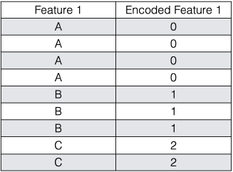

Encoding Categorical
Labeled Encoding
Interpret the categories as ordered integers (mostly wrong)
Python scikit-learn: LabelEncoder
OK for tree-based methods

Slide 13
Encoding Categorical
One Hot Encoding
Transform categories into individual binary (0 or 1) features
Python scikit-learn: DictVectorizer, OneHotEncoder
OK for K-means, Linear Regression, NNs, etc.
One of the most common encoding methods in ML

Slide 14
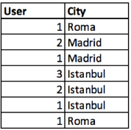
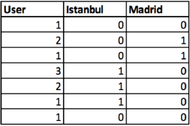
One Hot Encoding
Spreads values in a column to multiple flag columns
assigns 0 or 1 to them.
Binary values express relationship between grouped and encoded column.
Mathematically, one can write this constraint as “the sum of all bits must be equal to 1”:
One hot encoding example of City column

Slide 15
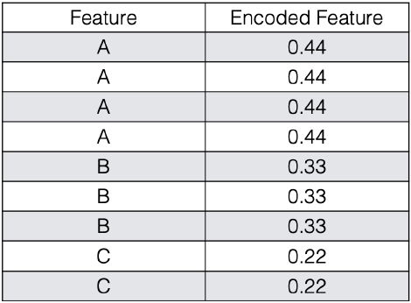
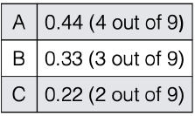
Frequency Encoding
Encoding of categorical levels of feature to values between 0 and 1 based on their relative frequency

Slide 16
Target mean encoding
Substitutes category of k-th training example with one numeric feature equal to some target statistic (e.g. mean, median or max of target).
Different types of target encoding
Greedy
Holdout
K-fold
Ordered (not used commonly)

Slide 17
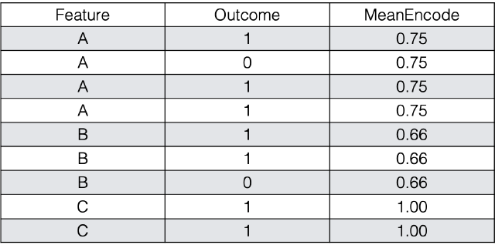

Target mean encoding
Instead of dummy encoding of categorical variables and increasing the number of features we can encode each level as the mean of the response.
To read more: https://docs.h2o.ai/h2o/latest-stable/h2o-docs/data-science/target-encoding.html

Slide 18
Target mean Encoding
Works for both binary classification and regression
For multiclass classification:
encode the categorical variable with m-1 new variables, where m is the number of classes.
Limitations?

Slide 19
Target mean Encoding
Limitations
Some of the categories have few training examples
Mean target value for these categories may assume extreme values
….
Encoding these values with mean may reduce model performance
Solution: Target mean for the category mixed with marginal mean of the target variable

Slide 20
Target mean Encoding
Solution: Target mean for the category mixed with marginal mean of the target variable
weights are close to one for the categories with many training examples and close to zero for rare categories.

Slide 21
Target mean Encoding smoothing
Intuition: Imagine a new movie is posted on IMDB and it receives three ratings. Taking into account the three ratings gives the movie an average of 9.5. This is surprising because most movies tend to hover around 7, and the very good ones rarely go above 8. The point is that the average can’t be trusted because there are too few values. The trick is to “smooth” the average by including the average rating over all movies. In other words, if there aren’t many ratings we should rely on the global average rating, whereas if there enough ratings then we can safely rely on the local average.

Slide 22
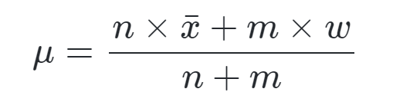
Target mean Encoding smoothing
Mathematically this is equivalent to:
where
μ is the mean we’re trying to compute (the one that’s going to replace our categorical values)
n is the number of values you have
x¯ is your estimated mean
m is the “weight” you want to assign to the overall mean
w is the overall mean

Slide 23
Target mean Encoding
What type of encoding did we just study?
- Greedy

Slide 24
Target mean Encoding
Next
Greedy
Hold Out

Slide 25
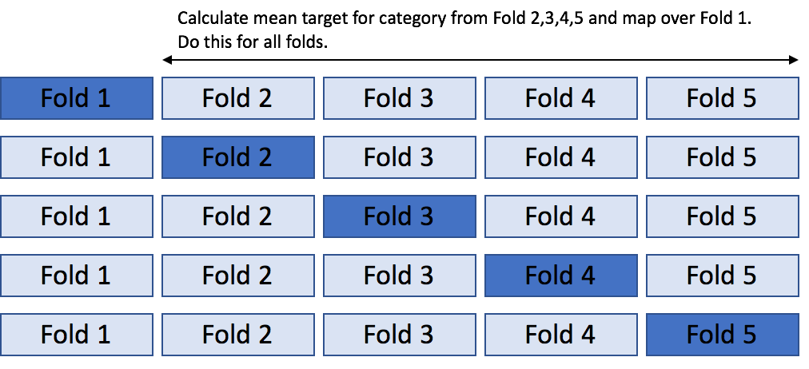
Target mean encoding
K – hold out
Most commonly used approach
Solves issue of overfitting on the training data (“mostly”, not always)
Idea similar to k-fold cross validation.
Divide the data in K- stratified or random folds
Replace observations present in (k-1)_th fold with mean target of data from all others except (k-1)_th fold.

Slide 26
Target mean encoding leave-one-out schema
To avoid overfitting we could use leave-one-out schema
Special case of Hold-Out
K-fold when K=2
used when we have small dataset
calculate target statistic for each observation by using labels from all except that particular observation.

Slide 27
Target mean encoding leave-one-out schema
To avoid overfitting we could use leave-one-out schema

Slide 28
Target mean encoding leave-one-out schema
To avoid overfitting we could use leave one out schema

Slide 29
Target mean encoding leave-one-out schema
To avoid overfitting we could use leave one out schema

Slide 30
Target mean encoding leave-one-out schema
To avoid overfitting we could use leave one out schema

Slide 31
Target mean encoding leave-one-out schema
To avoid overfitting we could use leave one out schema

Slide 32
Weight of Evidence and Information Value
Weight of evidence
To avoid division by zero
Information Value

Slide 33
Weight of Evidence and Information Value
Weight of evidence: tells the predictive power of an independent variable in relation to the dependent variable.
Information Value: most useful technique to select important variables in a predictive model. It helps to rank variables on the basis of their importance. The IV is calculated using the following formula :

Slide 34
Weight of Evidence and Information Value
0.221

Slide 35
Weight of Evidence and Information Value

Slide 36
Coding Exercise

Slide 37
Attributions
Some of these slides are based on material on from a DS class taught in MILA, Montreal which was adapted from towardsdatascience. Some material is from Hands-On machine learning ed. 2.
Coding exercise is from Kaggle.com (it’s best place to practice!)

Slide 38
Open Floor

