Slide 1
Foundations of Data Science & Analytics DSCI 633, Fall 2021
Lecture 8
Nidhi Rastogi
Assistant Professor, GCCIS, RIT
September 16, 2021

Slide 2
Course Information
GitHub link - https://github.com/aiforsec/RIT-DSCI-633-FDS
Assignment 3 due next Tuesday at 7:59 am
Reach out to the TA/ Instructor during office hours, via Slack, or email for any questions, suggestions, concerns, or general chat about data science.

Slide 3
This Lecture
An end-to-end machine learning model pipeline
Classification, Clustering, Anomaly detection, …
Performance Measures
Error Analysis
Training Models – Linear
Linear Regression
Gradient Descent
Polynomial Regression
Regularized Linear Models
Logistic Regression

Slide 4
Lecture Agenda
Support Vector Machines (SVM)
Theory
Online code demo

Slide 5
Classification Models
Base classification models
Linear Regression (covered in previous class)
Decision Tree
Instance-based (Nearest-neighbor)
Rule-based
Naïve Bayes and Bayesian Belief Networks
Support Vector Machines
Neural Networks and Deep Learning
Ensemble Classifiers
Boosting, Bagging, Random Forests

Slide 6
Classfication Problem
Consider a two-class, linearly separable classification problem
Don’t eat Pizza
x2
Eat Pizza
x1
Notes:
Perceptron learning rule can be used to find any decision boundary between class 1 and class 2

Slide 7
What is a good Decision Boundary?
Many decision boundaries!
Are all decision boundaries equally good?
x2
Any of these would be fine..
..but which is best?
Data: <x_{i},y_{i}>, i=1,..,l
x_{i} ∈ R^{d}
y_{i} ∈ {-1,+1}
x1
Notes:
Perceptron learning rule can be used to find any decision boundary between class 1 and class 2

Slide 8
Classifier Margin
Define the margin of a linear classifier as the width that the boundary could be increased by before hitting a datapoint.
x1
Data: <x_{i},y_{i}>, i=1,..,l
x_{i} ∈ R^{d}
y_{i} ∈ {-1,+1}
x2

Slide 9
Maximum Margin
The maximum margin linear classifier is the linear classifier with the maximum margin.
This is the simplest kind of SVM (Called an LSVM)
x1
Data: <x_{i},y_{i}>, i=1,..,l
x_{i} ∈ R^{d}
y_{i} ∈ {-1,+1}
x2
Linear SVM

Slide 10
feature₁
feature₂

Slide 11

Maximum Margin
Support Vectors are those datapoints that the margin pushes up against
The maximum margin linear classifier is the linear classifier with the maximum margin.
This is the simplest kind of SVM (Called an LSVM)
x1
Data: <x_{i},y_{i}>, i=1,..,l
x_{i} ∈ R^{d}
y_{i} ∈ {-1,+1}
x2
Linear SVM

Slide 12
Why Maximum Margin?
Intuitively this feels safest.
If we’ve made a small error in the location of the boundary (it’s been jolted in its perpendicular direction) this gives us least chance of causing a misclassification.
Empirically it works very very well.
Support Vectors are those datapoints that the margin pushes up against
The maximum margin linear classifier is the linear classifier with the, um, maximum margin.
This is the simplest kind of SVM (Called an LSVM)
x1
Data: <x_{i},y_{i}>, i=1,..,l
x_{i} ∈ R^{d}
y_{i} ∈ {-1,+1}
x2
Linear SVM

Slide 13


Large-margin Decision Boundary
x1
f(x)
m
Data: <x_{i},y_{i}>, i=1,..,l
x_{i} ∈ R^{d}
y_{i} ∈ {-1,+1}
x2

Slide 14
All hyperplanes in R^{d} are parameterized by a vector (w) and a constant b.
Can be expressed as w*x+b=0 (equation for a hyperplane)
Our aim is to find such a hyperplane f(x)=sign(w*x+b), that
correctly classify our data.
m
f(x)

Slide 15
Selection of a Good Hyper-Plane
Objective: Select a `good' hyper-plane using
only the data!
Intuition:
(Vapnik 1965) - assuming linear separability
(i) Separate the data
(ii) Place hyper-plane `far' from data
x1
x2
x1
x2

Slide 16

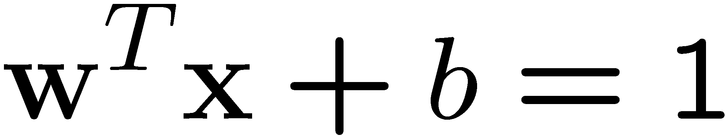
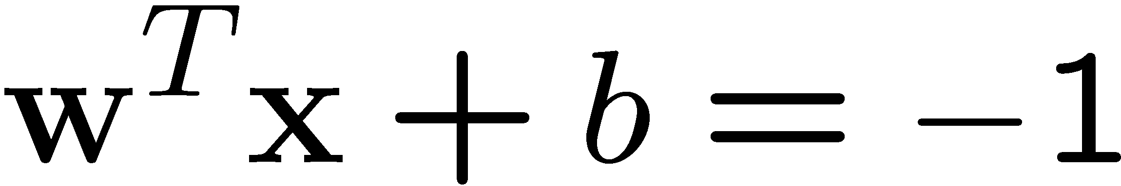
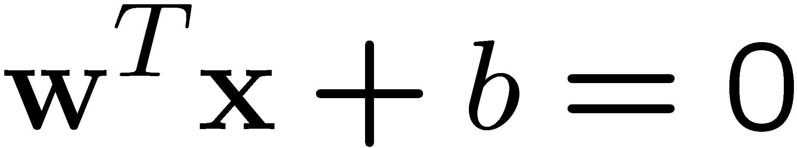
Definitions
H
Define the hyperplane H such that:
x_{i}•w+b ≥ +1 when y_{i} =+1
x_{i}•w+b ≤ -1 when y_{i} =-1
H1
H2
d⁺
H1 and H2 are the planes:
H1: x_{i}•w+b = +1
H2: x_{i}•w+b = -1
The points on the planes H1 and H2 are the Support Vectors:
d_
m
d+ = the shortest distance to the closest positive point
d- = the shortest distance to the closest negative point
The margin of a separating hyperplane is d⁺ + d⁻.
Notes:
Calle hyperplane because SVM can be used in hih dimensional datasets and data points are reffered to as vectors.

Slide 17
Finding the Decision Boundary
H
H1
We want a classifier with as big margin as possible.
H2
d⁺
Recall the distance from a point(x₀,y₀) to a line:
Ax+By+c = 0 is|A x₀ +B y₀ +c|/sqrt(A²+B²)
d_
The distance between H and H1 is:
|w•x+b|/||w||=1/||w||
m
The distance between H1 and H2 is: 2/||w||

Slide 18
Finding the Decision Boundary
H
H1
In order to maximize the margin, we need to minimize ||w||. With the
condition that there are no datapoints between H1 and H2:
x_{i}•w+b ≥ +1 when y_{i} =+1
x_{i}•w+b ≤ -1 when y_{i} =-1
H2
d⁺
d_
Can be combined into y_{i}(x_{i}•w) ≥ 1
m

Slide 19
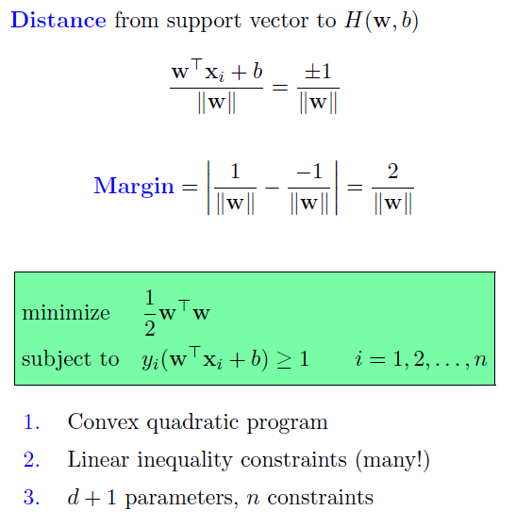
Optimization Problem
Distance
Margin

Slide 20
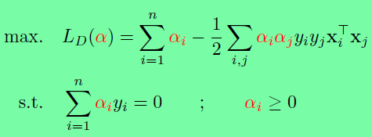
The Lagrangian Trick
Reformulate the optimization problem:
A ”trick” often used in optimization
Reformulate the problem as a Lagrangian problem.
Constraints replaced by constraints on Lagrangian multipliers.
Training data will only occur as dot products

Slide 21
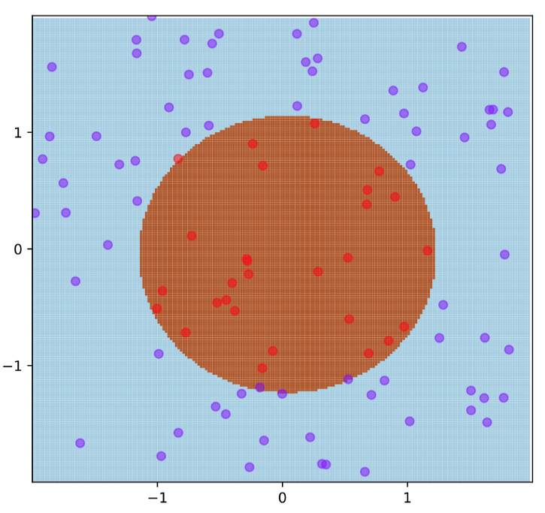
Limitation of LSVM
What if the decision function is not linear?
Impossible to use a single line to separate the 2 classes

Slide 22

Non-linear SVM
Use a polynomial function to transform data to high dimensional space.
Big challenge with this:
COMPUTATIONALLY EXPENSIVE
x²
x
H

Slide 23
The Kernel trick
R^{d}
x²
φ
H
- Kernel trick reduces the computational cost.
φ takes vectors in the original space and returns dot product of vectors in the feature space.
Every point is mapped to a higher dimensional space via a transformation.
x

Slide 24
The Kernel trick
R^{d}
x²
φ
H
- Kernel trick reduces the computational cost.
φ takes vectors in the original space and returns dot product of vectors in the feature space.
Every point is mapped to a higher dimensional space via a transformation.
x

Slide 25
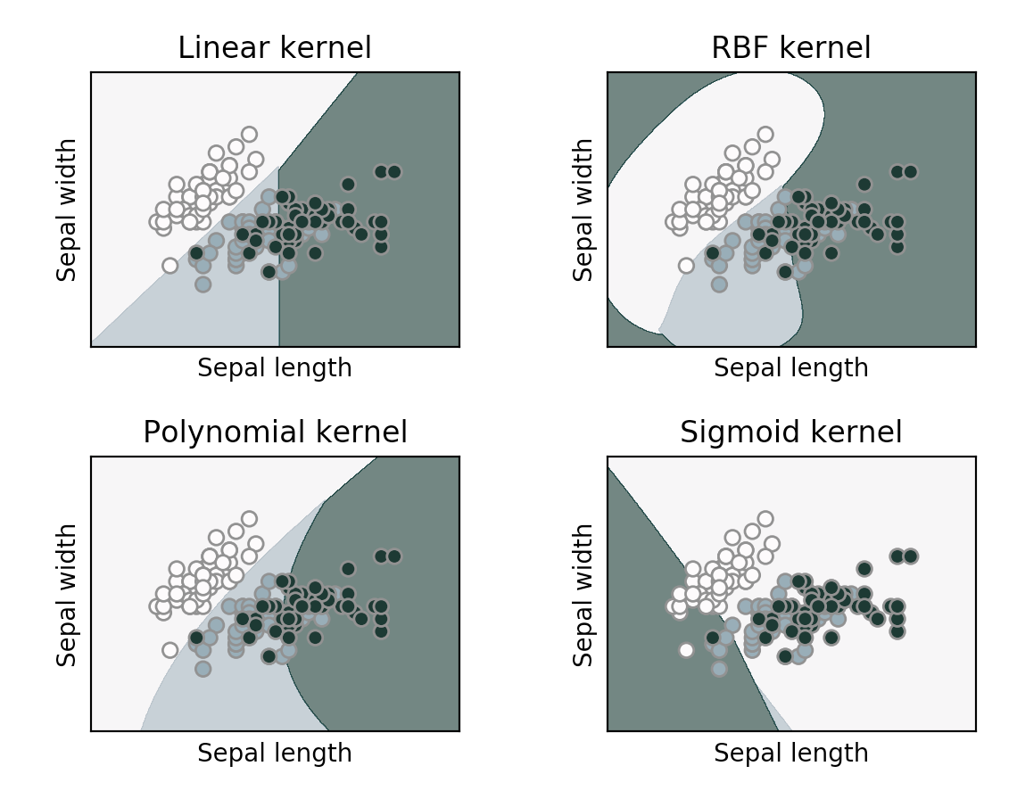
Popular Kernel Types
Linear Kernel
Polynomial Kernel
Gaussian Kernel/ Radius basis function (RBF) kernel
Sigmoid Kernel
Exemplar hyperplanes for different kernel functions. Dataset – famous iris dataset. Features, x = sepal length and sepal width.

Slide 26
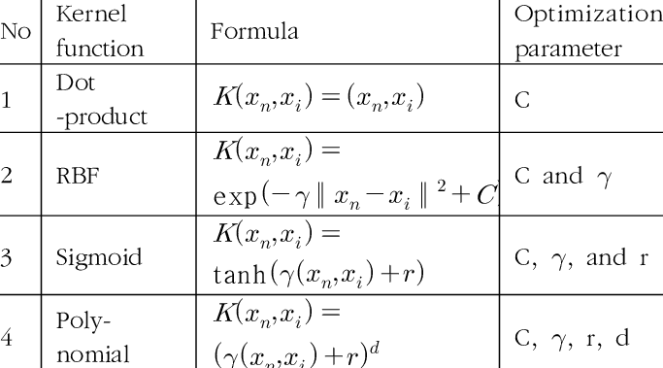
Popular Kernel Types
Linear Kernel
Polynomial Kernel
Gaussian Kernel/ Radius basis function (RBF) kernel
Sigmoid Kernel
Notes:
C: Inverse of the strength of regularization ( process of adding information in order to solve an ill-posed problem or to prevent overfitting).
Behavior: As the value of ‘c’ increases the model gets overfits.
As the value of ‘c’ decreases the model underfits.
2. γ : Gamma (used only for RBF kernel)
Behavior: As the value of ‘ γ’ increases the model gets overfits.
As the value of ‘ γ’ decreases the model underfits.

Slide 27
Choosing Kernel Parameters
Parameter tuning technique - K-fold cross validation
Addresses overfitting

Slide 28
Performance measure
Test data
Predictions
TP
SVM
+1
FP
-1
TN
=+1
=-1
FN
For a given kernel function, how many vectors we correctly labelled out of all the vectors? Accuracy = (TP+TN)/(TP+FP+FN+TN) = ?

Slide 29
Performance measure
Test data
Predictions
TP
SVM
+1
FP
-1
TN
=+1
=-1
FN
For a given kernel function, how many vectors we correctly labelled out of all the vectors? Accuracy = (TP+TN)/(TP+FP+FN+TN) = 8/16 = 0.5, for some kernel function

Slide 30
Coding Exercise

Slide 31
Attribution: Some of these slides are based on slides prepared by Henry Kautz, Pierre Donnes, Longin Jan Latecki, and some youtube videos!

Slide 32
Open Floor

