Slide 1



The Technology Value Stream
CREATED BY: Andres Melendez DATE: 12 January 2025

Slide 2
What is the Technology Value Stream?
Definition: The Technology Value Stream represents the sequence of steps taken to deliver value to customers through technology solutions.
Focuses on identifying and eliminating bottlenecks to optimize value delivery.
Key Aspects: Lead Time, Processing Time, and Deployment Cycles.

Slide 3
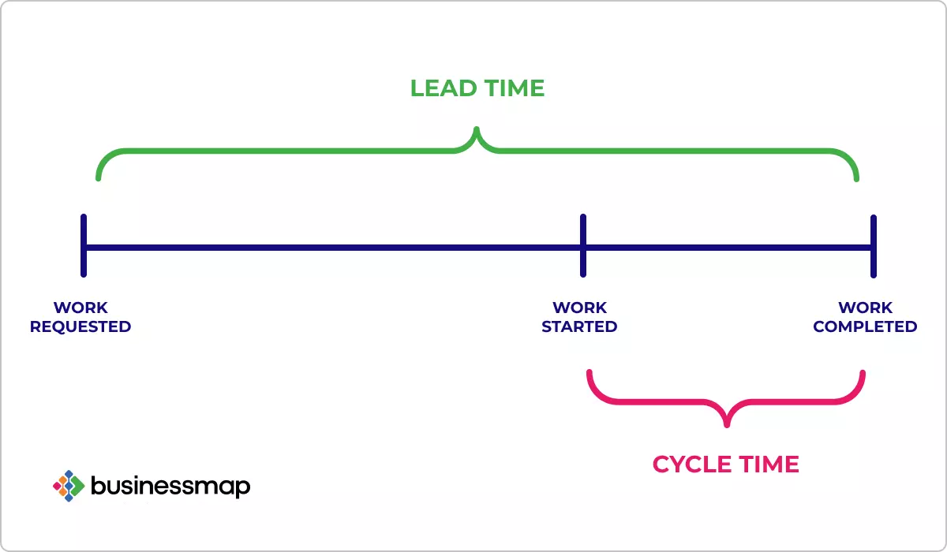
Defining Lead Time vs. Processing Time
Lead Time: Total time from a customer request to delivery of value.
Includes wait times, approvals, and processing.
Processing Time: Time actively spent working on a request or task.
Excludes delays or idle periods.
Goal: Minimize both lead and processing times to accelerate delivery.

Slide 4

The Common Scenario
Deployment Lead Times Requiring Months
Traditional software development models often have long lead times.
Causes:
Manual approval processes.
Lack of automation in testing and deployment.
Silos between development, testing, and operations.
Impact: Delayed customer value, higher risk of defects, and reduced competitiveness.

Slide 5
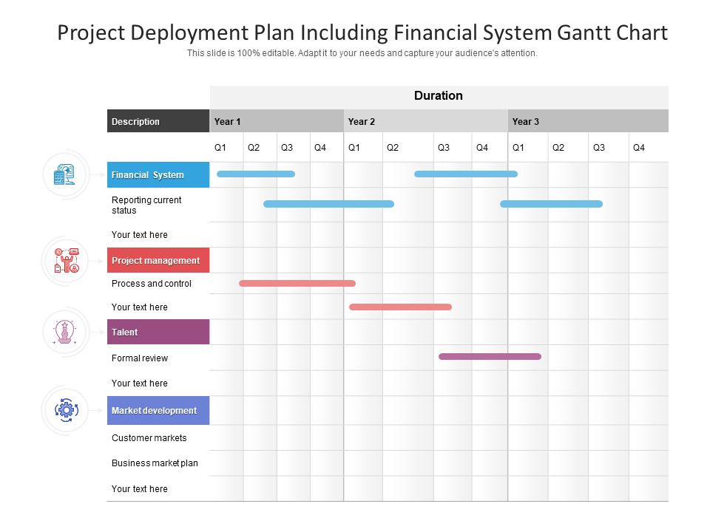
Visual Representation of the Common Scenario

Slide 6
Our DevOps Ideal
Deployment Lead Times of Minutes
Vision: Rapid, reliable, and continuous delivery.
Key Enablers:
Automation: Testing, integration, and deployment pipelines.
Collaboration: Breaking down silos between teams.
Continuous Feedback: Rapid response to defects and customer needs.
Outcome: Faster value delivery, reduced risk, and improved customer satisfaction.

Slide 7

Benefits of Optimizing the Technology Value Stream
Reduced lead times lead to:
Faster time-to-market.
Improved product quality.
Higher customer satisfaction.
Streamlined processes foster innovation and adaptability.

Slide 8

Key Takeaways
Minimizing Lead and Processing Times is critical for efficient value delivery.
DevOps practices enable Deployment Lead Times of Minutes compared to traditional models.
The Technology Value Stream is foundational to achieving business agility and resilience.

Slide 9
References
Cycle Time vs. Lead Time: Difference You Need to Know. businessmap. https://businessmap.io/kanban-resources/kanban-software/kanban-lead-cycle-time
Maitrayee (3 July 2024). Top 10 Deployment Chart Template. Slide Team. https://www.slideteam.net/blog/top-10-deployment-chart-template-with-examples-and-samples

