Slide 1
Big Data Analytics Final Project
Predict and identify a FIFA football player’s career value from skill level factors to estimate success and sustainability levels.
Professor: Chung Yung
Group Members:
Andre Freeman - 410521320
Mayibongwe Dlamini - 410421259
Diandre Ottley - 410421258

Slide 2
Abstract

Slide 3
Abstract
In the FIFA football career, a footballer undergoes vigorous and scrutinous grading during each match
For uprising or new footballers into the FIFA community, the ability to predict the future value of a player is essential not only for team development but for club player selling profit-making schemes
This project will attempt to utilize classification (in particular support vector machine) to predict using supervised learning, a players value from their skill level factor from FIFA-authorized players database records

Slide 4
Introduction

Slide 5
Introduction
Fédération Internationale de Football Association (FIFA), the governing body of football (soccer), with more than 200 members countries worldwide manages data for every footballer
Electronic Arts (EA), on behalf of FIFA, collects and regulates grading schemes not only for the very obvious data relating to match history (i.e. goal scored, fouls, goals missed etc..) but also very specific data pertaining to player’s particular skill level, primarily for making football simulation video games
This specific data collection includes attributes such as aggression, ball control, long pass, short pass, dribbling, acceleration, etc.
From these skill level attribute, this project would attempt to predict a player’s value.
This project, for the prediction process, utilizes support vector machine (SVM) for its well known robustness in accurately differentiating different classes
However, with skill level factors includes over 30 individual features, principal component analysis (PCA) is also introduced prior to the data learning process

Slide 6
Support Vector Machine (SVM)
A supervised learning approach that would try to identify/predict an unknown item based on previously known items’ attributes
The method primarily tries to establish plane(s) for separating/distinguishing known distinct items based on its attributes

Slide 7
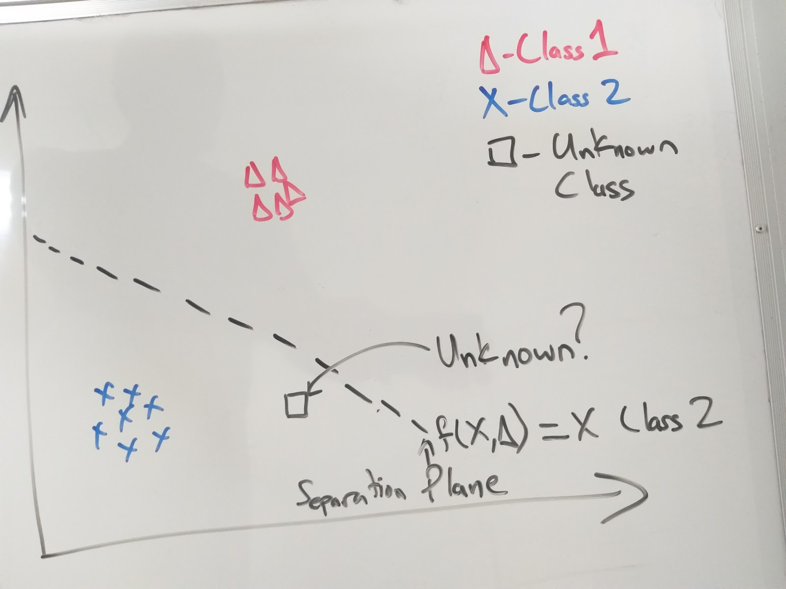
Support Vector Machine (SVM)
Figure 1.1 above demonstrates the process of supervised learning where ‘Δ’ and ‘X’ marks items class 1 and class 2 respectively
From a collection of data from both items it generates a plane (function) to best differentiate both classes
When an unknown item is introduced, the plane(functions) are used to differentiate to which class it belongs to (i.e. f(x,Δ)=class 2)
This unknown item is then predicted to be ‘class 2’ from a majority vote.
Figure 1.1 showing support vector machine (SVM) classification process between two (2) items.

Slide 8
Principal Component Analysis
This method is utilized in this project for dimensionality reduction by using orthogonal transformation to convert high dimension (a very large number of features) to correlated fewer values
However, this analysis is more greatly affected by values with greater numeric value and/or separation

Slide 9
Motivation & Research Problem

Slide 10
Motivation and Research Problem
The EA Sports FIFA series of video games is observed to function primarily on the bases of two ideas (i.e. player development and/or club development)
Player development implies the improvement of players skill factor
Club development objectifies players as a token or money bargaining chips for maximizing profit gains
Whether, for individualistic or commercial purposes this projects aim is to project a players’ value from their various skill level factors
We believe this tool can extract new information from FIFA’s player data pool and become a very dependable prediction model
Another source of motivation for this research problem is the researchers’ love for the game of football, as well as sports-related statistics
The researchers feel that sports statistics can assist with athlete training and coaching focus
It can also assist the decision-making process of sports fanatics’ personal interests in the game (e.g. wagering, fantasy sports, etc.)

Slide 11
Research Method

Slide 12
Research Method
The process of applying data science methods to predict a FIFA players’ value based on skill level factors is a long and tedious planned process
This process must broken into four (4) aspects:
Preparation
Preprocessing
Analysis
Postprocessing
PPAP?

Slide 13
Preparation
A FIFA fan-group tries to aid players and enthusiasts by promoting publishing every player’s detailed information on its website
Gathering this data was collected by the research team via web crawling methods to download data on all 15404 players shown on the website
The results of the data crawling is seen in a comma separated values (.csv) file below.
N.B. **This initial gathered data is referred to as “The complete data set” for the remaining of the report

Slide 14
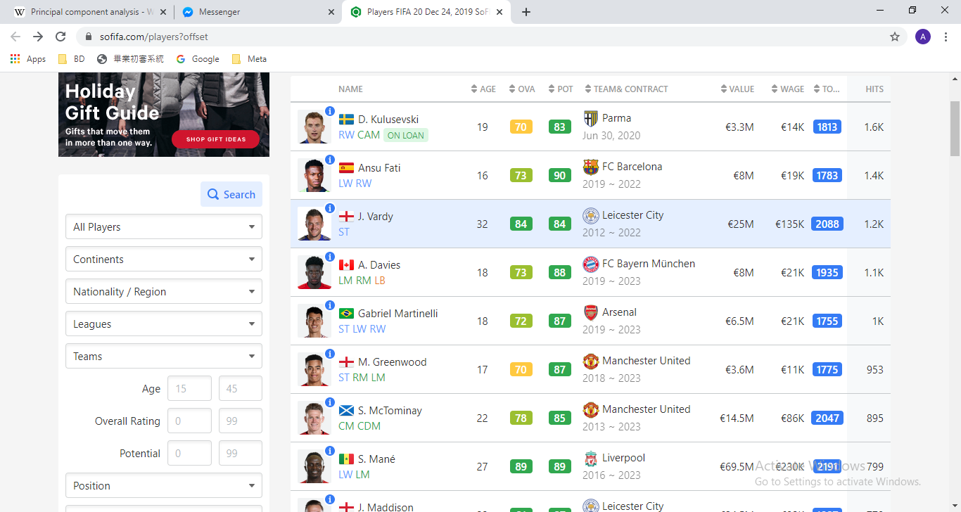
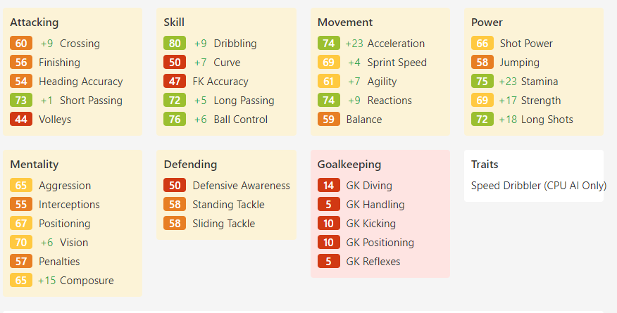
Preparation: Source Website
Figure 2.1 showing player list (left) and a player’s attributed (right) listed on the website

Slide 15
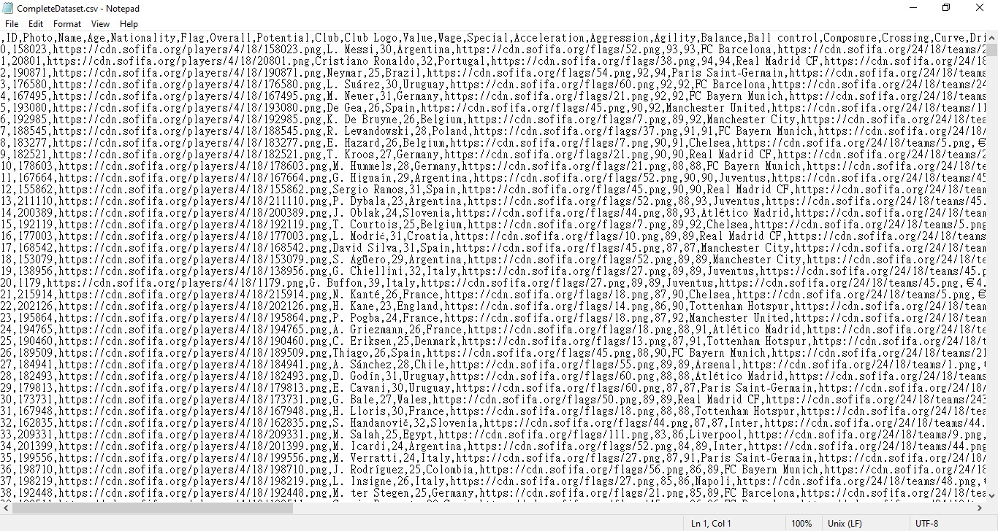
Preparation: CSV
Figure 2.2 showing the complete data set csv file after web crawling.

Slide 16
The Complete Data Set
This complete data set consists of 15404 players each having 75 distinct attributes (i.e. name, nationality, ID, value, photo, etc…)
These 75 attributes via the feature selection process is reduced to ‘metadata’, containing 36 attributes
Unrelated data (e.g. id, name, photo, club logo, etc…) is completely disregarded since they hold no merit to a player’s value

Slide 17
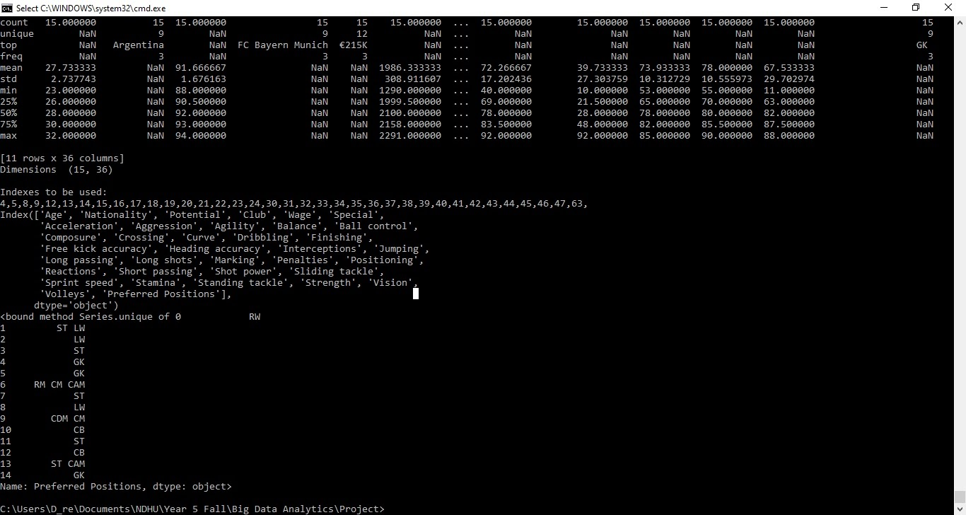
Attribute Selection
Figure 2.3 shows the attributes selected from the feature selection process.

Slide 18
Preprocessing
The metadata however, still required a few steps in terms of data cleaning and data transformation.
For example a players’ value was recorded as a string format (e.g. “£140M”) and had to be converted to numeric values (eg. 140 000 000).
Features such as ‘Club’ and ‘Nationality’ were transformed from their usual string types (e.g. “Argentina” and “Manchester” respectively) to numeric data type representation
One other very special attribute was “Preferred Position” This attribute could hold for each player one to multiple preferred position on the football field
The research team decided to select (if multiple) the first position as the most preferred thus only having one option for “Preferred Position”
As with “Club and “Nationality” attributes the “Preferred Position” attribute was also transformed into a numeric value.

Slide 19
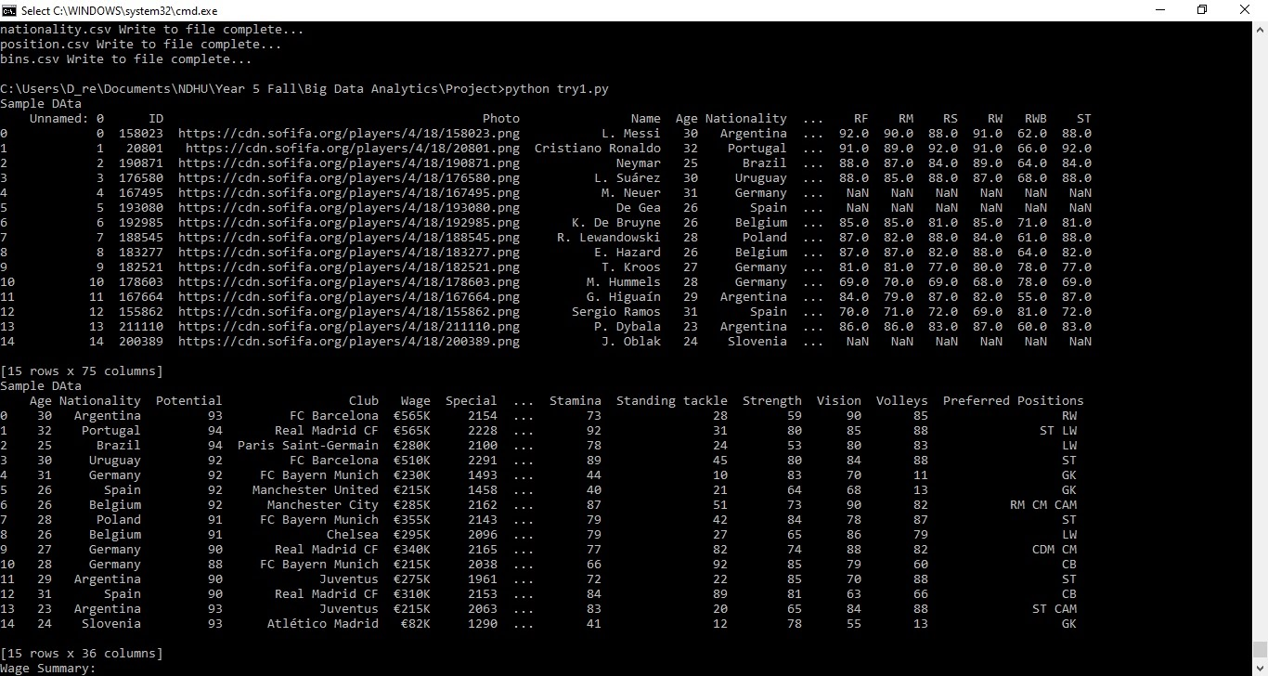
Data Cleaning and Data Transformation
Figure 2.4 showing data prior to data cleaning and transformation

Slide 20
Preprocessing
With the end goal of utilizing classification, the data was first divided into two groups
Training data (utilizing 80% of the data collected)
Testing data (the remaining 20%).
Also the players’ value was classified into 10 groups utilizing the equal binning approach
This range assignments applied to all data (i.e. testing and training data).
This class value (the 36th value or last item in the metadata) will be later used for training with the training data set and then for error calculation in the testing phase

Slide 21

Preferred Positions
Figure 2.5 showing example of 15 players preferred position(s).

Slide 22
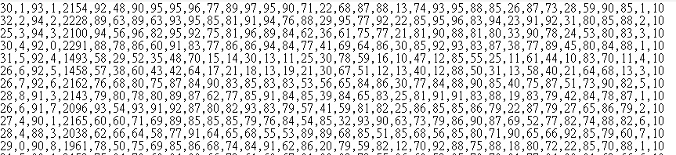
Metadata after all cleaning and transformation
Figure 2.6 showing the metadata after all data cleaning and transformation

Slide 23
Preprocessing
After observing the “metadata” with its 35 attributes, we decided to apply dimension reduction using principal components analysis (PCA) to training and testing datasets
However, only applying it to a certain specific group of attributes.
These attributes all have something in common. That is: They were ranked from 0 to 100 (e.g “Aggression”, “Ball control”, “Shot Power”, “Strength”, “Vision”, “Stamina”, “Sliding Tackle”, etc… )
With PCA incorporated, 30 features (dimensions) were reduced to 3, thus, leaving only 8 features (dimensions) for analysis

Slide 24
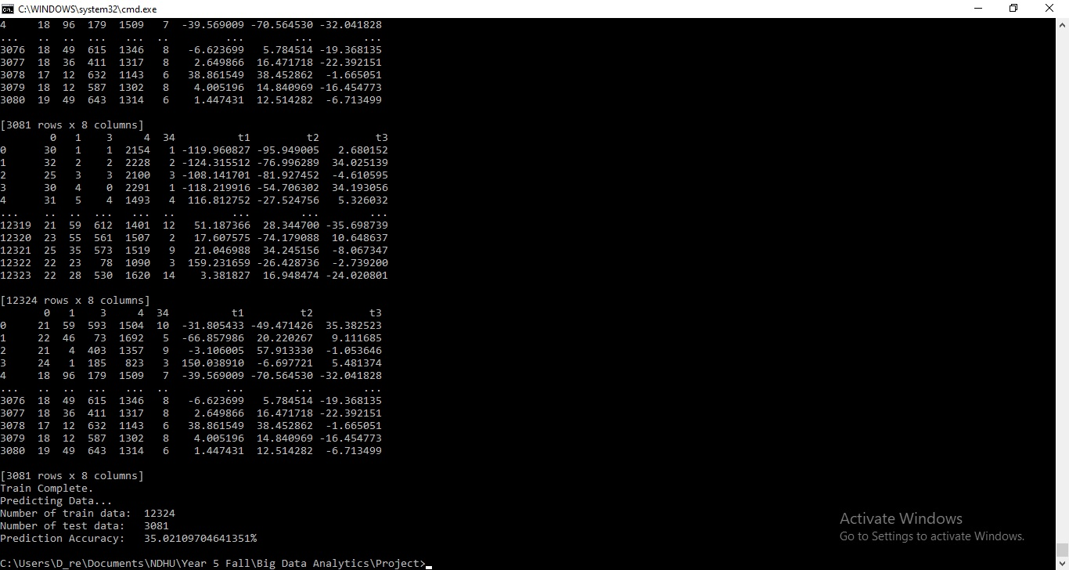
Preprocessing
Figure 2.7 showing after PCA reduction features

Slide 25
Analysis
Classification was achieved via using the robust support vector machine (SVM) learning algorithm.
Firstly, the learning phase is carried out using training data set comprising of 12324 players
From this trained model, we tried to predict using the remaining 3081 players to test the model’s accuracy

Slide 26
Results & Conclusion

Slide 27
Results
The results from the model from a complete dataset divided into 12324 players for training data and 3081 players as testing data, the model had a 35% accuracy as seen below
Figure 2.8 showing the prediction accuracy for the model

Slide 28
Conclusion
Data analysis of these massive data sets transformed the way we think about players skills and how it affects their value in the market
These analytics can enable all stakeholders to monitor players progress and scout for potential talent improving the overall quality of the game
In the future utilising other data analysis methods to predict different outcomes will help better the decision making process

Slide 29
References
SoFIFA - Players FIFA - https://sofifa.com/ - Date crawled: 20 Nov 2019
Web Crawler GITHUB- Aman Shrivastava - 20 Nov 2019 https://github.com/amanthedorkknight/fifa18-all-player-statistics
Data Analytics - Models and Algorithms for Intelligent Data Analysis - 2nd Edition - April 2016 - Thomas A. Runkler

