Slide 1


Course Project Part Two Presentation Draft
Andrea Plunkett-Jackson
HUM200

Slide 2
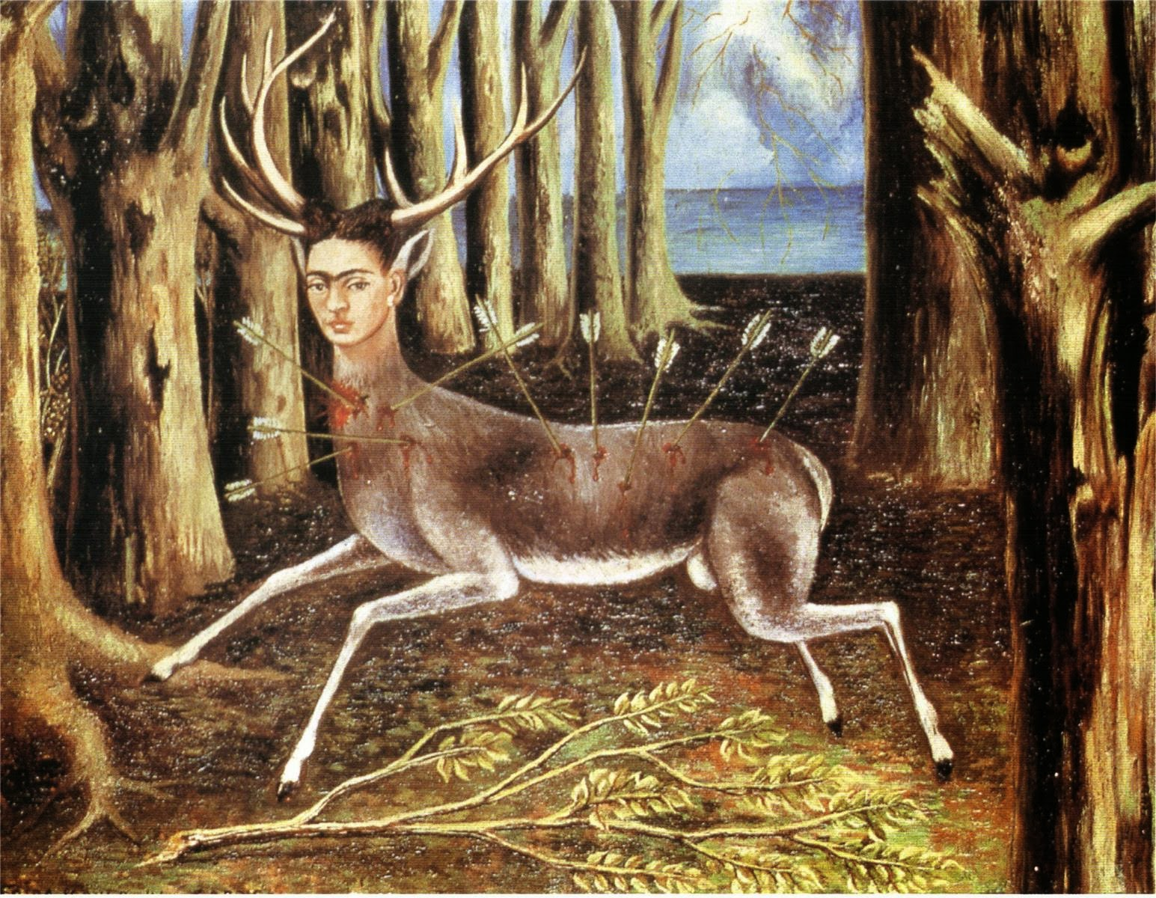

From Canvas to Stage: A Tale of Pain and Acceptance
“The Wounded Deer” by Frida Kahlo:
“Addio del Passato” from Giuseppe Verdi’s opera “La Traviata”:
Self-made surrealist painting depicting vulnerability and pain. .
The opera, with its soprano voice, is a poignant reflection of lost love and sacrifice conveying profound sorrow.
Experience of heartache captured. Common theme: Love lost resonates universally. Thesis: Lost love connects humanity across art forms
Notes:
“The Wounded Deer” by Frida Kahlo is my first chosen work of symbolism and emotion. Created in 1946, this oil painting is a powerful self-portrait of Kahlo portraying herself as a wounded deer, pierced by arrows using the surrealistic style to convey her inner emotions and struggles. The deer symbolizes vulnerability, pain, and emotional turmoil while the broken branches in the background evoke suffering and despair. Kahlo’s personal experiences, including her divorce, infuse the artwork as Kahlo uses her own face on the deer to symbolize her anguish following the end of her marriage. Using the medium of Visual art (surrealism), Kahlo invites viewers to interpret the symbolism, engaging them in her emotional journey. In the humanities, we explore the human condition, emotions, and personal narratives. Kahlo’s work invites us to consider themes of suffering, identity, and resilience. By using her own image, she connects her individual experience to universal feelings of heartbreak and vulnerability. My second piece, “Addio del Passato” from Giuseppe Verdi’s “La Traviata” is an operatic expression composed in 1856, “La Traviata” that tells the tragic story of Violetta Valery. The soprano aria “Addio del Passato” is a poignant reflection on love, sacrifice, and mortality. Violetta, a fallen woman, contemplates her life as she faces death. Verdi’s music conveys profound emotion through vocal modulation and vibrato while the composition allows the soprano’s voice to evoke warmth and despair simultaneously. Opera is a rich cultural form that combines music, drama, and emotion. Verdi’s work explores societal norms, sacrifice, and the human experience. Violetta’s sorrowful song resonates with our shared fears and the pain of lost love connecting us through a shared thread of love and loss. Despite their distinct approaches, both works explore the human experience of love and its painful aftermath. Kahlo and Verdi are storytellers, dissecting emotions and vulnerability. Their art transcends time, connecting us to universal feelings of heartbreak.
Both artifacts share this universal common theme of love lost. Whether through visual art or music, they express the profound impact of lost love. The deer and Violetta both confront their pain, inviting us into their emotional turmoil. Despite adversity, they stand resilient, symbolizing the courage to give our hearts even when we feel weak. Thesis Statement: These works demonstrate that love transcends time, medium, and circumstance. Through their voices—whether painted or sung—they remind that feelings matter, even in tragedy. In the realm of humanities, these artifacts act as mirrors reflecting our shared humanity, emotions, and resilience. Regardless how conveyed either through painting or music, these artists remind us that the impact of love endures, transcending diverse forms of expression.
As we immerse ourselves in the aria, we hear the soprano’s heartrending words:
Farewell, beautiful laughing dreams of the past, The roses of the face are already palent; I even miss Alfredo's love, Comfort, support for the weary soul. Comfort! Support! Ah, of the wayward smile at the desire; To her, oh, forgive; Accept it, O God! Ah! Everything, everything ended. Now everything, all ends!
Let the artistry envelop you, allowing your own memories to kindle your senses. This is not just a performance, but a journey into the depths of lost love and longing. As the soprano’s voice fills the air, let it resonate with your own experiences, painting a vivid picture of love, loss, and the human condition as Kahlo herself did.

Slide 3
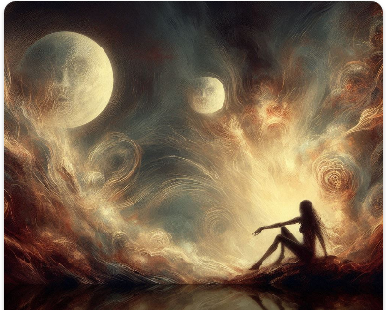
Exploring Love and Loss: Artistic Reflections
Audience:
Ideal audience values emotional depth and open-mindedness.
Willingness to connect emotionally transcends artistic medium.
Appreciation for exploring lost love theme in cultural works.
Message:
Artists need not compromise their work for the audience.
Adjust presentation or context to enhance understanding.
Authenticity and relatability breathe life into art.
Maya Angelou’s wisdom echoes: “The mirror reflects hidden emotions.”
Notes:
By delving into the theme and central idea articulated in our cultural artifacts, we can examine their potential impact on our audience: Both “The Wounded Deer” and “Addio del Passato” center around the universal experience of lost love. Whether it’s through the medium of visual art or operatic music, these masterpieces encapsulate the deep-seated effects of emotional pain and vulnerability. The imagery of the deer wounded by arrows and Violetta’s mournful aria stir emotions that are universally experienced - loss, yearning, and acceptance. Despite their different forms of expression - painting and opera - these works establish a human connection. They defy the constraints of time, prompting us to contemplate our personal encounters with love and loss. Through their shared anguish, Kahlo and Verdi underscore the significance of emotions, even amidst tragedy. The Influence on Our Audience: The emotional depth of these expressions will resonate with our audience, who values authenticity and raw emotion. As we delve into the theme, it may prompt listeners to reflect on their own experiences of heartache and vulnerability. Observing the artists’ bravery in facing their pain can serve as a source of inspiration, fostering resilience in our own lives. It’s important to remember that art reflects our humanity, mirroring our joys, sorrows, and collective experiences.

Slide 4

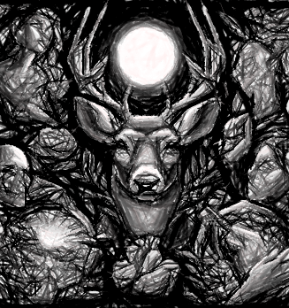
Exploring Lost Love: A Comparative Study
“The Wounded Deer” study analyzes Kahlo’s expression of lost love.
Hepokoski’s work examines Verdi’s aria, encapsulating lost love.
“La Traviata - A complete guide” provides opera’s comprehensive overview.
Resources were chosen for their authority and detail.
Sources provide specific understanding and broader context.
Credibility, depth, and relevance were key in source selection.
Notes:
A multitude of evidence confirms that both works embody the theme of lost love. The first resource, “The Wounded Deer” by Frida Kahlo - A Comprehensive Study, delivers a thorough analysis of Kahlo’s painting, which is vital for comprehending the artist’s depiction of lost love. The second resource, “Genre and content in mid-century Verdi: ‘Addio, del Passato’ (La traviata, Act III)” by J.A. Hepokoski, presents an academic exploration of Verdi’s opera, specifically the aria that encapsulates the theme of lost love. The third resource, “La Traviata - A complete guide. The story, the good, the bad,” offers a holistic overview of the opera, assisting in understanding its narrative and themes. In the process of selecting these resources, I gave precedence to authoritative and detailed sources that provide a specific understanding of the works under study and a wider context for the theme of lost love. I evaluated the trustworthiness of the sources, the depth of the information provided, and their pertinence to my project’s focus on the theme of “love lost”. Concluding, the evidence found in “The Wounded Deer” and “Addio del Passato” not only supports the theme of lost love but also demonstrates its profound impact on both the individual and collective. Seeing how Kahlo and Verdi confronted their pain and transformed it into beautiful art can encourage you and I to face our own challenges with courage and resilience.

Slide 5
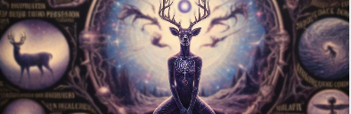
Personal Journey: Reflections on Love Lost and Self-Discovery
Artifacts reflect personal journey, resonate deeply.
Suppressed emotions found expression in art.
Self-inflicted pain mirrored in wounded deer.
Defying norms, artifacts became personal symbols.
“Living Dead Girl” years reflected in art.
Artifacts influenced personal growth, self-love journey.
Notes:
The theme of “love lost” holds a deep personal significance for me, echoing throughout my life journey. From a young age, I was conditioned to suppress my emotions, deemed overly sensitive, and thus learned to privately endure pain. This mindset profoundly impacted a treasured love I discovered in my early adulthood. The arrows that pierced the deer’s flesh in my experience were self-inflicted, as I chose pain over the belief that I was deserving of love. At 25, I faced a decision to defy societal norms and prioritize my feelings, or to sacrifice my desires for what I believed was best for my beloved and his young son, whom my fears of love brought into existence with another. This decision inflicted another wound, leading to countless tears and periods of emptiness in the ensuing decades, often describing that period of my life as “The Living Dead Girl” years. Despite the pain, I gave to those around me as much as I could bear, often from an empty cup, slowly learning to love myself and coming back to life. These experiences and sacrifices have shaped me and continue to influence my life journey, as without them, I never would have had to confront my own darkness and traumas. The very things that make us human.

Slide 6
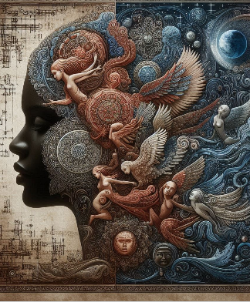
Humanities: Enhancing Understanding and Analysis
Humanities study offers personal, professional value.
Themes like “love lost” enhance understanding.
Artifacts reflect personal experiences, promote growth.
Humanities skills advantageous in data analysis.
Enhances critical thinking, communication, cultural competence.
Understanding human behavior aids accurate analysis.
Notes:
The study of humanities, particularly the theme of “love lost,” holds immense personal and professional value. It offers a broader understanding of our thoughts and alternate perspectives, crucial for comprehending human experiences. Studying these themes reminds us of our shared humanity, giving us a greater sense of the struggles and pain we all face. This understanding can benefit us personally and professionally. On a professional level, understanding how positive group identity can be created through these themes might inspire leaders in various fields. The theme of “love lost” deeply resonates with my personal journey and is beautifully encapsulated in the cultural artifacts I’ve chosen to study. “The Wounded Deer” by Frida Kahlo and Verdi’s opera “La Traviata,” specifically the aria “Addio del Passato,” are not just works of art; they are reflections of my life experiences. They have helped me understand and express my feelings, leading to personal growth and self-love. In essence, studying the humanities has provided me with both a personal and professional advantage. It has shaped me as an individual and continues to influence my journey through life, reminding us that understanding, and empathy are the keys to a more inclusive world. In the context of data analysis my field of study, studying humanities can provide significant advantages. Critical thinking skills, which are invaluable in data analysis, are honed by humanities. Effective communication, key in data analysis, is enhanced by studying humanities. Understanding human behavior, often a part of data analysis, can be improved by studying humanities, especially psychology and sociology. Ethical decision making, a frequent requirement in data analysis, can be guided by studying humanities. Cultural competence, increasingly important in today’s globalized world of diverse datasets and teams, can be developed by studying humanities. While the connection between humanities and data analysis may not seem obvious, the skills and knowledge gained from studying humanities can indeed provide a significant advantage in this field.

Slide 7
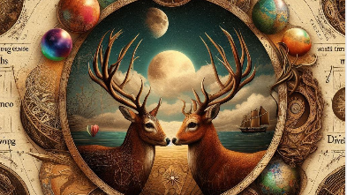
Humanities: A Bridge to Understanding and Empathy
Humanities foster understanding of human experiences.
Artifacts like “The Wounded Deer” evoke empathy.
Personal experiences shape understanding of “love lost”.
Professionally, humanities use interpretive, critical methods.
Humanities provide diverse perspectives on emotions.
They promote personal growth and societal harmony.
Notes:
The humanities are vital to society as they foster a deep understanding of human experiences, cultures, and perspectives. They help us appreciate the diversity of human experiences and cultivate empathy, tolerance, and understanding among individuals and communities. For instance, the study of humanities allows us to delve into diverse human experiences through cultural artifacts like “The Wounded Deer.” This artwork evokes empathy and provides a deeper understanding of the theme of “love lost,” a universal human experience. On a personal level, my own experiences have shaped my understanding of “love lost.” These experiences, reflected in the humanities, have led to personal growth and a better understanding of my own emotions. Professionally, the humanities use interpretive, critical methods to explore human experiences. This approach provides diverse perspectives on emotions, promoting a more inclusive and empathetic society. In conclusion, the humanities provide us with the tools to understand and appreciate our own and others’ cultures and experiences. They remind us that despite our differences, we share common human experiences and emotions. This understanding can lead to personal growth, improved interpersonal relationships, and a more harmonious society.

