Slide 1







Technology Trends & Analysis
Andrea Plunkett Jackson
03/14/2024

Slide 2



OUTLINE
Executive Summary
Introduction
Methodology
Results
Visualization – Charts
Dashboard
Discussion
Findings & Implications
Conclusion
Appendix

Slide 3

EXECUTIVE SUMMARY
Trends in programming languages and databases
Demographics Survey
Technological gap by country
Gender gap by job

Slide 4

INTRODUCTION
About : Analyzing trends in software development
Audience: HR and IT
Purpose:
Identifying skill requirements for the future
What are the top programming languages in demand?
What are the top database skills in demand?

Slide 5

METHODOLOGY
Data collection sources
Overflow 2019 Survey
Github job postings
Programming Languages Annual Salary
Data Exploration
Data Cleaning
Data Visualization
Presentation

Slide 6
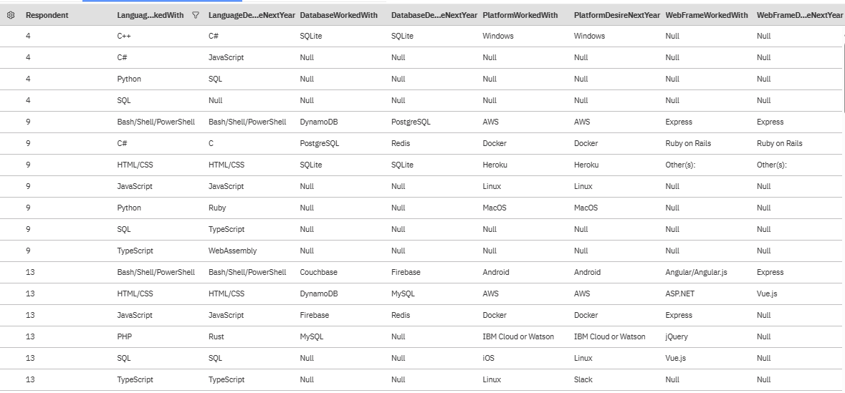
Results Based on Table Below

Slide 7
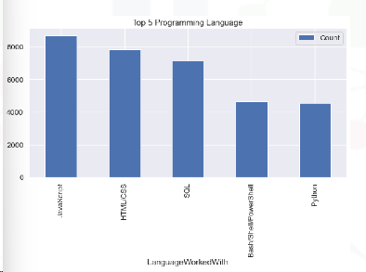
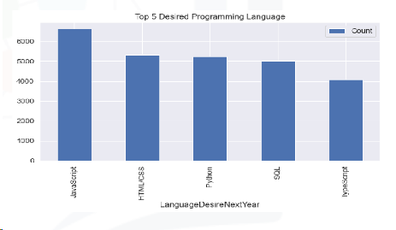
PROGRAMMING LANGUAGE TRENDS
Current Year
Next Year
<Bar chart of top 10 programming languages for the current year goes here.>
< Bar chart of top 10 programming languages for the next year goes here.>

Slide 8
PROGRAMMING LANGUAGE TRENDS - FINDINGS & IMPLICATIONS
Findings
JavaScript, HTML/CSS, SQL are top 3 this year
Python and Typescript are becoming popular next year
PowerShell will no longer be within the top five next year
Implications
Web development is still in high demand
ISQL is still required by Big Data Technology within Companies
With the rise of AI, Python is the best choice

Slide 9
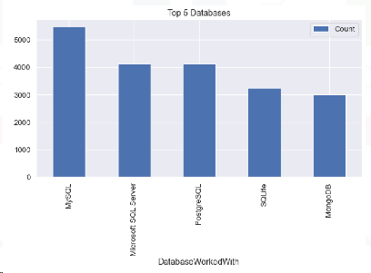
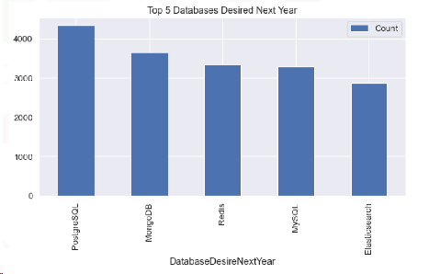
DATABASE TRENDS
Current Year
Next Year
< Bar chart of top 10 databases for the current year goes here >
< Bar chart of top 10 databases for the next year goes here.>

Slide 10
DATABASE TRENDS - FINDINGS & IMPLICATIONS
Findings
MySQL is most popular
Microsoft SQL is 2nd most popular
MongoDB and Redis are becoming favorites
New trend : Elasticsearch
Implications
Open-source databases are still preferred
NoSQL impact storing non-relational data
Redis supports abstract data types

Slide 11

DASHBOARD
DreaPlunkett/IBM-Data-Analyst-Capstone-Project: Building A Dashboard With IBM Cognos Analytics (github.com)

Slide 12
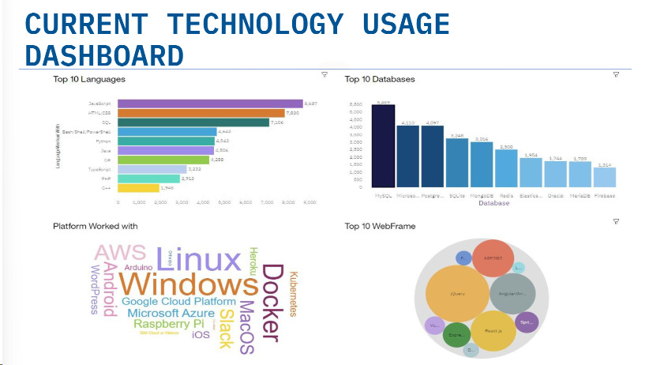
DASHBOARD TAB 1
Screenshot of dashboard tab 1 goes here

Slide 13
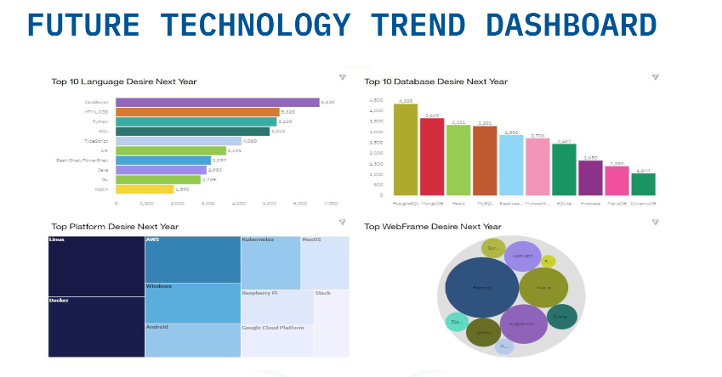
DASHBOARD TAB 2
Screenshot of dashboard tab 2 goes here

Slide 14
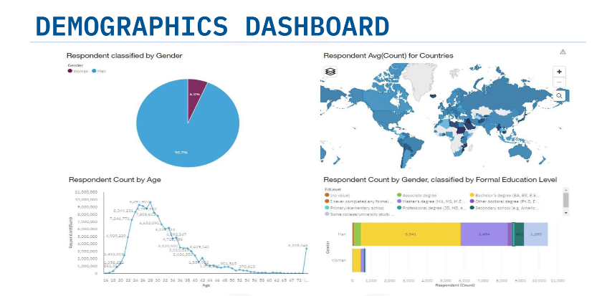
DASHBOARD TAB 3
Screenshot of dashboard tab 3 goes here

Slide 15
DISCUSSION
Technology Trends current and future
Training workers
Females in Technology Fields

Slide 16
OVERALL FINDINGS & IMPLICATIONS
Findings
Changing Technology yearly
USA and India concentration country wise
Gender gap in technology careers
Implications
Flexibility required to adjust to rapid change
Greater spread of countries required
Impact on job hiring

Slide 17

CONCLUSION
Technology trends current and future
Programming languages, database and platform overview
Demographics overview

Slide 18
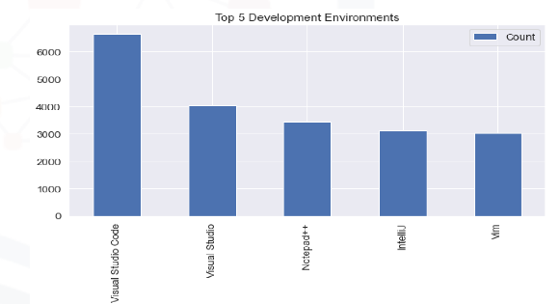

APPENDIX
Include any relevant additional charts, or tables that you may have created during the analysis phase.

Slide 19
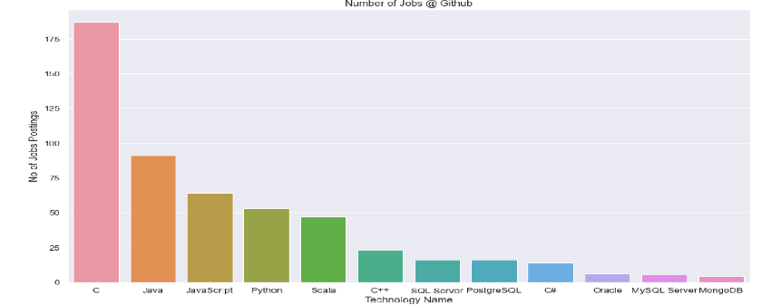
JOB POSTINGS
In Module 1 you have collected the job posting data using Job API in a file named “job-postings.xlsx”. Present that data using a bar chart here. Order the bar chart in the descending order of the number of job postings.

Slide 20
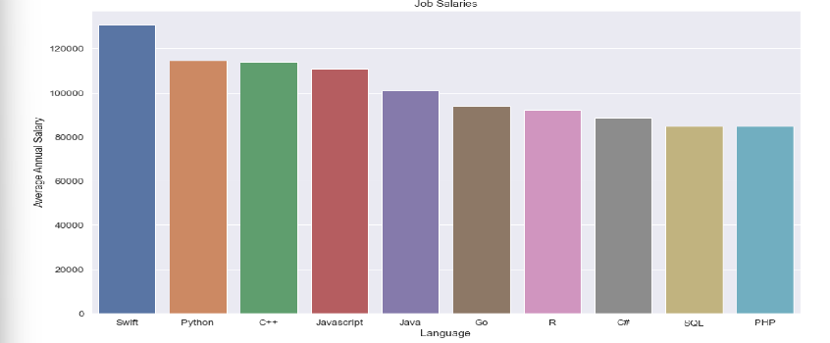
POPULAR LANGUAGES
In Module 1 you have collected the job postings data using web scraping in a file named “popular-languages.csv”. Present that data using a bar chart here. Order the bar chart in the descending order of salary.

