Slide 1
MALLORN Astronomical Classification Challenge
Rasmus Eliasson
Oskar Flodin
Many Artificial LSST Lightcurves based on Observations of Real Nuclear transients (MALLORN)
Legacy Survey of Space and Time (LSST)

Slide 2
Summary and Motivation
Tidal Disruption Events (TDEs)
Star torn apart by supermassive black hole
Recent discovery
100 TDEs observed so far
High scientific value
Prebe black hole properties and accretion
Current limitation
Small sample size
Opportunity with LSST
Huge increase in TDE detections
Requires new tools and strategies
Notes:
In particular, we’re interested in a class of objects called tidal disruption events (TDEs). These occur whenever an unlucky star is ripped apart by the immense gravitational forces it experiences as it approaches too close to a supermassive black hole. TDEs are a relatively recent astronomical discovery with a very small catalogue of observed objects (~100). However, those that we have found have proven to be tremendously scientifically valuable, particularly for investigating the properties and feeding conditions of otherwise very difficult to observe black holes. Our research capabilities are currently limited by our small sample size, but LSST provides the opportunity to solve that issue – provided we are able to make the best use of it. For more information on tidal disruption events see here(1)(2).

Slide 3
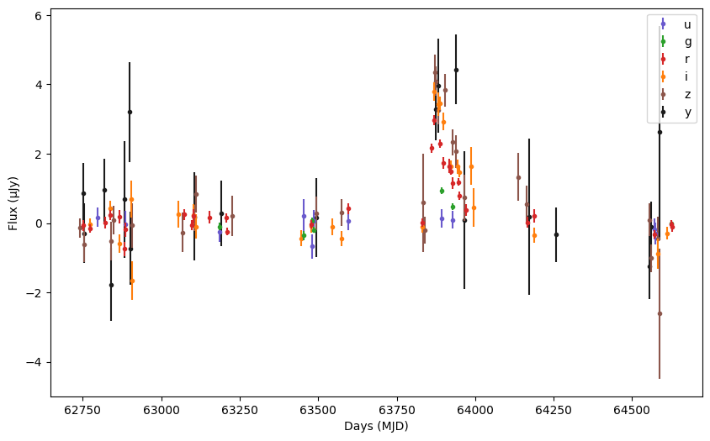
Possible challenges
Feature engineering - Create additional features from existing data.
Data split into 20 splits - Timeseries of specific stars light fluctuation
Sample plot of stars light fluctuation with different filters

Slide 4
ML algorithms planned to be Applied
Ensemble of models:
- Gradient boosted trees
- logistic regression
- Random forest
- Neural network
Max Voting or similar

Slide 5
Data and evaluations measures planned to be used
Confusion matrix and a combination between
F1 - Req from competition
Recall - Req from competition
Precision - Req from competition
Accuracy

Slide 6
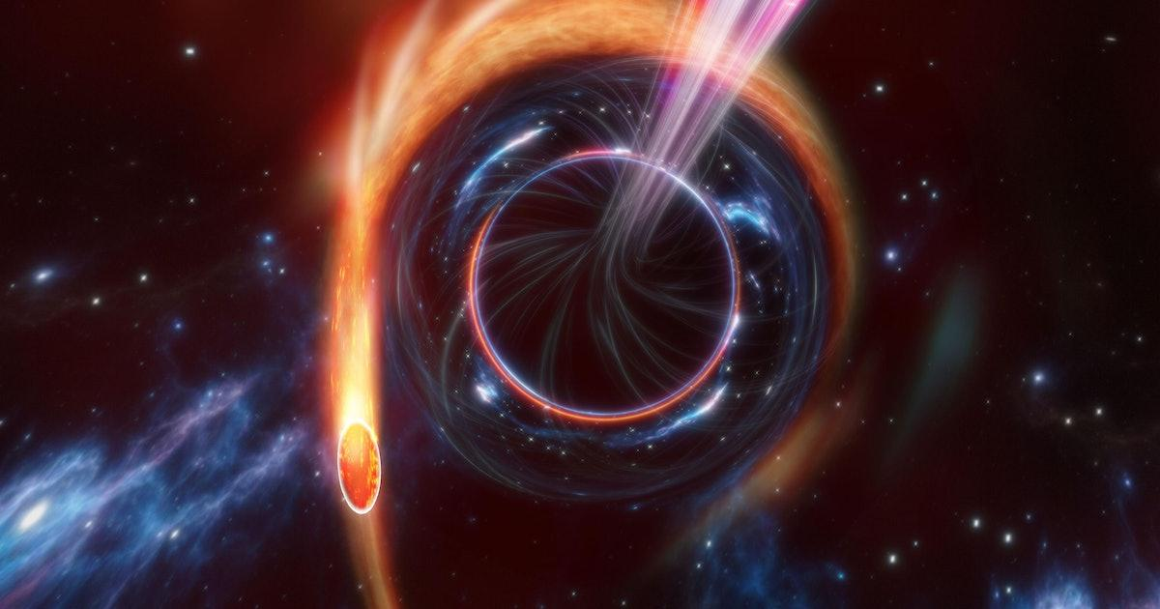
Thank you for listening
Illustration of a tidal disruption event

