Slide 1


asa
Introduction To Web Development HTML
Notes:
The UTF-8 character set has essentially every character we’ll ever use

Slide 2



Software
Visual Studio Code
Internet Browser

Slide 3
What is HTML?
HTML stands for Hypertext Markup Language.
HTML is the mark up language that defines the webpage’s content.
HTML consists of a series of elements which use opening and closing tags to define how the content of the webpage should appear and behave.

Slide 4
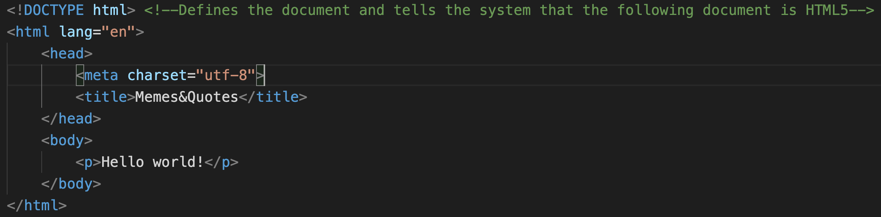
The structure of HTML
Notes:
SO il will be outlining the basic structure of an HTML document and I will be explaining what each tag does and what it means.

Slide 5
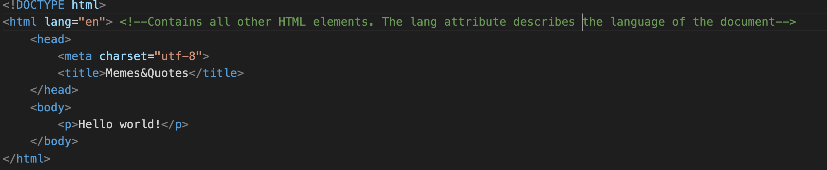
The structure of HTML

Slide 6
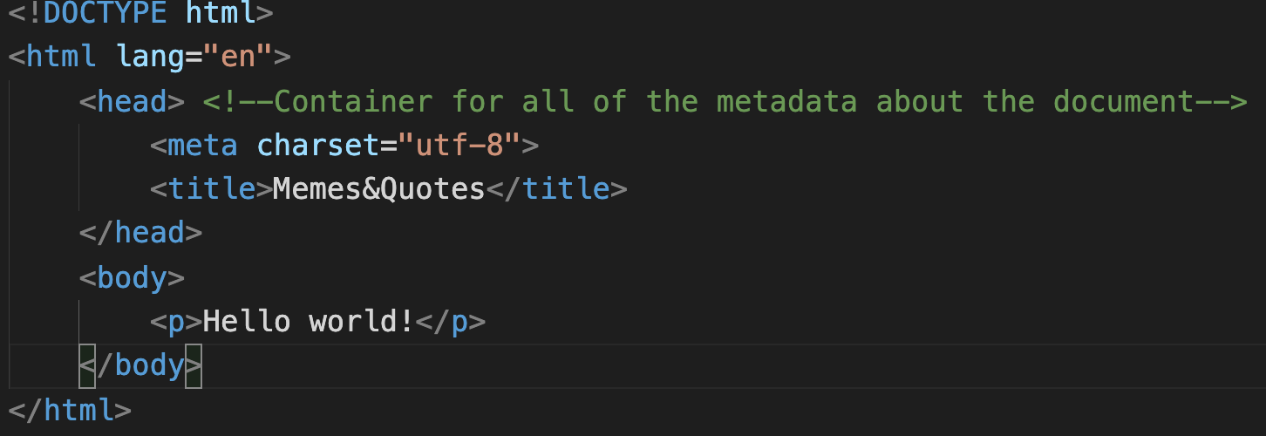
The structure of HTML
Notes:
Meta data is just data about data and it will not be displayed in the web page’s content section.

Slide 7
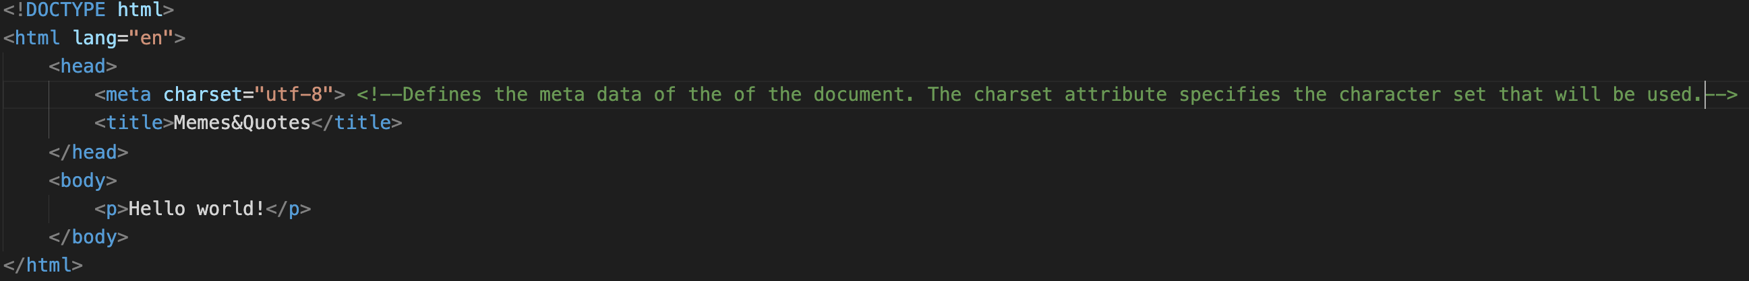
The structure of HTML
Notes:
The UTF-8 character set has essentially every character we’ll ever use

Slide 8
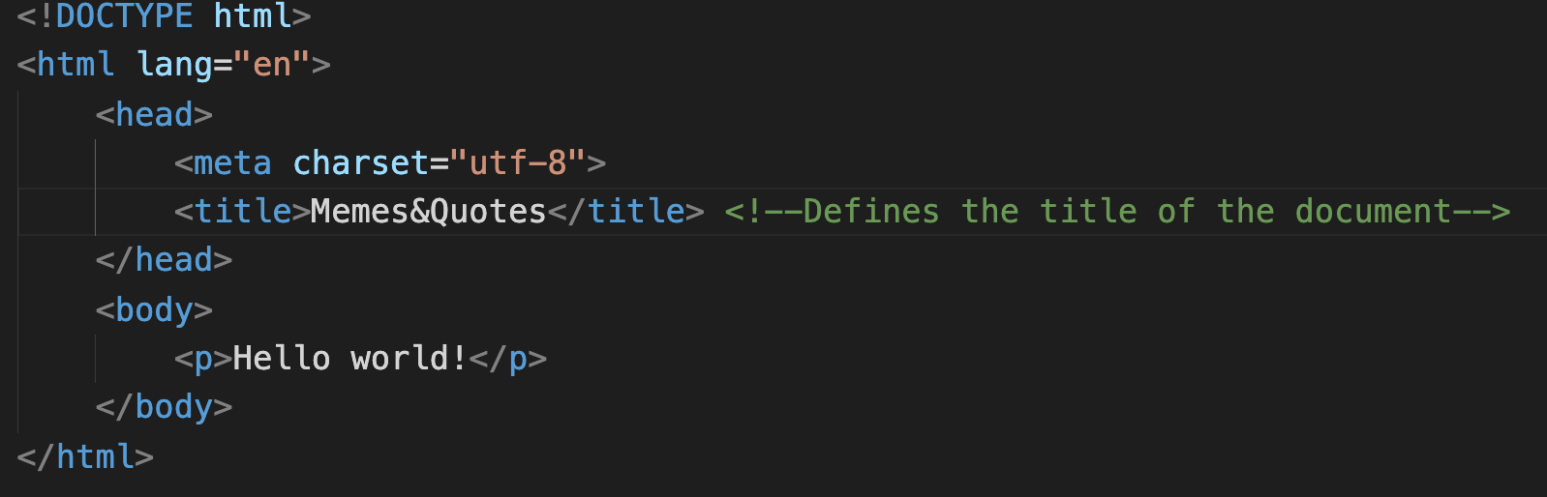
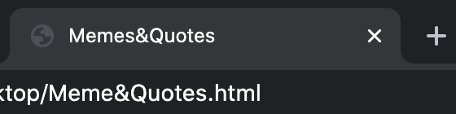
The structure of HTML
The content that you put as the title is also where the webpage gets its tab name from.

Slide 9
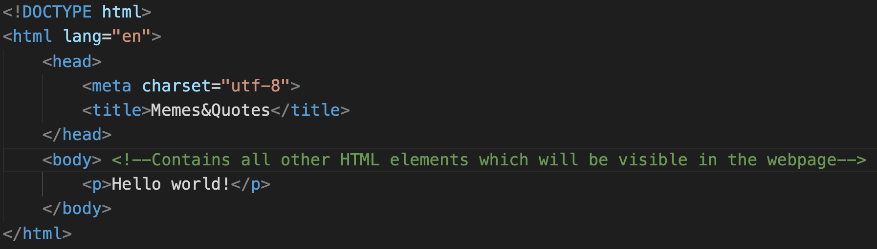
The structure of HTML
Notes:
This is section that we will be coding in most of the time.

Slide 10

The structure of an HTML element
An HTML element is comprised of an opening tag, the content and the closing tag.
Opening tag
Closing tag
Content
Notes:
So weve talked about tags a lot, now im going to explain the structure of various html elements.

Slide 11

The structure of an HTML element
Some tags do not wrap around any content. Therefore, it does not require an accompanying closing tag.

Slide 12

The structure of an HTML element
The class attribute specifies the class that the element belongs to and is mostly referred upon from a CSS.
Notes:
Multiple Different attributes can be placed into the header tag of an element

Slide 13

The structure of an HTML element
The ID attribute specifies a unique ID for an element and it is also referred upon from a CSS for styling purposes.

Slide 14
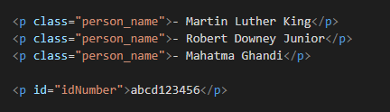
Difference between Class and ID
Multiple elements may belong to the same class, but every ID must be unique.

