Slide 1


asa
Introduction To Web Development
Notes:
Cheers for the introduction to HTML, Jayson. Hey guys, I’m Alex, currently studying Computer Science and Statistics in the University of Auckland. I went through MSA last year and I was fortunate enough to land a placement in SouthernCross at the end. I am excited to be back and hope you guys enjoy the video.

Slide 2


What is CSS
CSS (Cascading Style Sheet) allows to style our basic HTML page
Notes:
People always say learning by doing is the best way, although it is partially true, I argue there is a prerequisite before you start the “doing”, which is to understand the what and why ‘s that you are doing. I would not trust a someone who don’t know what they are doing to build my house. Thus, currently the slides help you get an idea of the essential concepts before we dive into the code. Without CSS, the webpage will look unorganized, dull or even boring.

Slide 3
Overview
Box model (inline and block)
Size (px, rem, em, vw, vh)
Layout (flexbox and grid)
Position (text-align, align-items …)
Notes:
There are still so much more to cover, such as animation, media query, pseudo selectors and more!

Slide 4
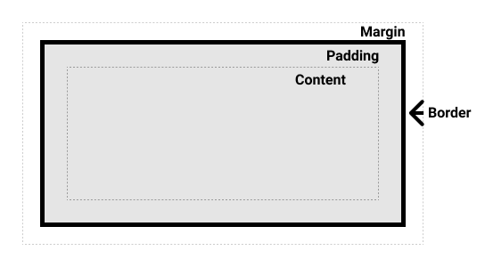
Box model
Every element is a BOX!
2 types, inline or block
Standard or Border-box?
Test time
Mozilla go-to reference
Notes:
The model helps us to understand how the width and the height of an element is set out. It goes a long way when you truly understand the box model because you will be in full control of the spacing of the elements. Inline box stays on the same line whereas a block box breaks into a new line There are also a few more differences, such as you cannot apply a fixed width or height to inline box. (show the example on the reference page) Padding is the space between the border and the content, and margin is the spacing between the border and the imaginary space surrounding the box. Standard and border-box model differs in the way which you calculate the width of the content. Let’s use the links (Standard or Border-box, then go to the test link) to test out understanding.

Slide 5
Size (width & height)
Units
px (base size unit)
em (size in proportion to the parent element)
rem (root size of the web page)
vw/vh (view width and view height)
{percentage} (i.e. 50%, 60% etc.)
Reference
Notes:
Often, we would love to control the size of our elements using style attributes width and height. The slide gives an overview of the unit for size that we can use. Generally, we use pixels for margin and padding as they are generally small concise values, and often don’t change much. For the size of the text however, we prefer to use em or rem we would like the text size scales with the width of the screen. Let’s give you some examples of what each of them means. (do some examples on sublime). Finally, we will touch base on the concept of controlling the layout of the elements.
(We need to use numeric values to specify the size with the above units which is more precise. However, you can also use keywords such as small and large to specify the size.)

Slide 6
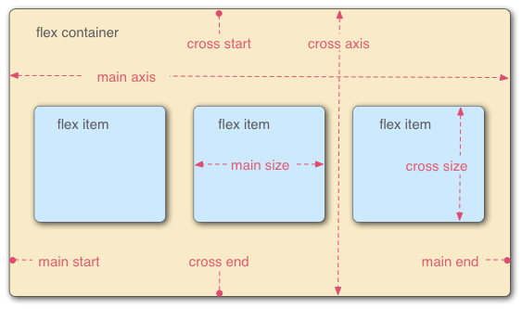
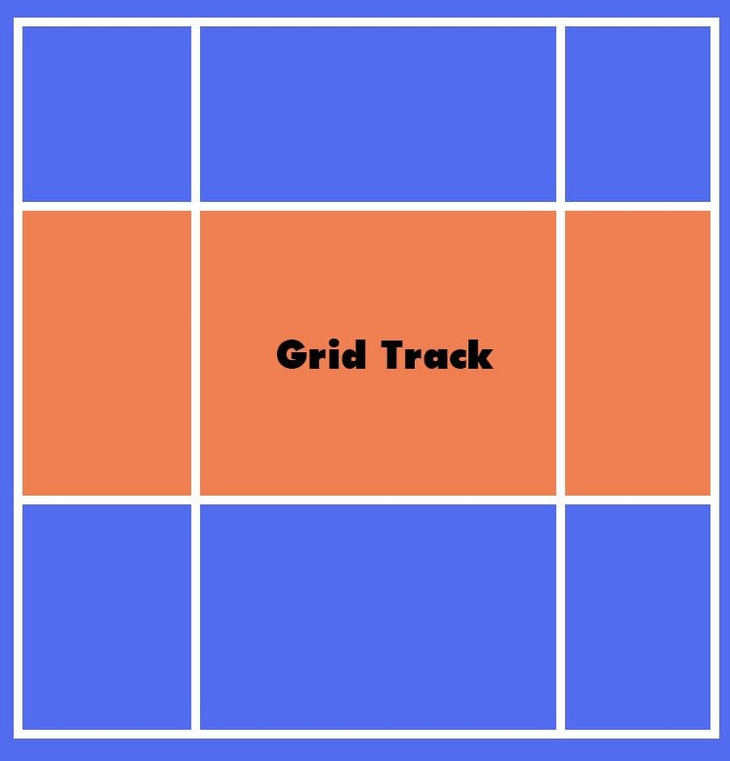
Layout & Positioning
Flexbox, align-items and justify-content (cookbook link)
Grid (minimal example)
Notes:
Flexbox and grid are the centrepiece that controls the layout of the webpage. Flex and grid are the inner display style that we can set on our element on the box. With flexbox, you can lay elements out horizontally or vertically which depends on the direction of our primary axis (do an example on Paint). With grid, it’s very much like a table, where you divides the box up into cells. You may ask, should I use grid or flexbox? I am sorry, there isn’t a clear-cut answer, because what can be done by grid can also be achieved through flexbox. A distinction should be made though, flexbox focuses on the control flow, that is the flex item can stretch or shrink. (Example on CSS tricks) Grid focuses on content placement, for example, a grid is broken into several cells horizontally and vertically. A big distinction pointed out Mozilla is flexbox controls the space distribution on either row or column. Whereas grid can control the space distribution both at the same time. (Show the example, https://developer.mozilla.org/en-US/docs/Web/CSS/CSS_Flexible_Box_Layout/Mastering_Wrapping_of_Flex_Items). (For more information, check out this link (https://webdesign.tutsplus.com/articles/flexbox-vs-css-grid-which-should-you-use--cms-30184). Sweet, here ends the presentation of the slides. Without further ado, let's jump in to the code.

