Slide 1


asa
Introduction To Web Development
JavaScript

Slide 2


What is JavaScript?
JavaScript is a high level programming and scripting language that allows you to implement complex features on web pages.

Slide 3
Overview
Variables
Operators
Loops
Arrays
Functions

Slide 4

Variables
Variables are names for storage locations
A variable stores only one value at a time
Assigned value using the assignment operator (=)

Slide 5
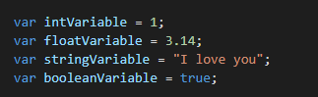
Data types
Integer (1, 2, 3, 4, 5)
Float (1.1, 3.14, 20.32)
String (“Hello”, “World”, “love”)
Boolean (True or False)

Slide 6
Operators
= (assignment)
+ (addition or concatenation)
- (subtraction)
* (multiplication)
/ (division)
% (modulo)

Slide 7

Arrays
Arrays are used to store multiple values in a single variable.
Each entry in the array is referred to using an index starting from 0.

Slide 8
Loops
Loops are used to implement repetition into a block of code.
While loops
For loops

Slide 9
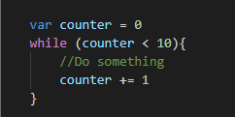
While loops
Initialisation
Condition
Block of code
Increment

Slide 10
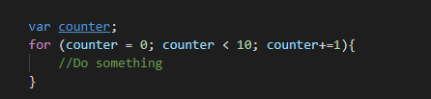
For loops
Initialisation
Condition
Block of code
Increment

Slide 11
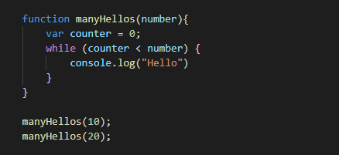
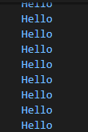
Functions
Definition
Code block
Function calling

