Slide 1
SGIPC KUET
Created by:
SOURAV CHAKRABORTY
ROLL:1607014
KU ET (Cse 16)

Slide 2
Story Behind Sgipc
Welcome, to the programming group of Khulna University of Engineering & Technology. It is a group which is specially created for programmer students who are interested in programming specially ACM solve, NCPC programming contest, University programming contest and etc. SGIPC means Special Group of Interest in Programming Contest. It is mainly a group of programmers who are developing their programming skills by learning, solving, practicing & teaching others different types of problems. If you have any interest on programming you are mostly invited to our programming group

Slide 3
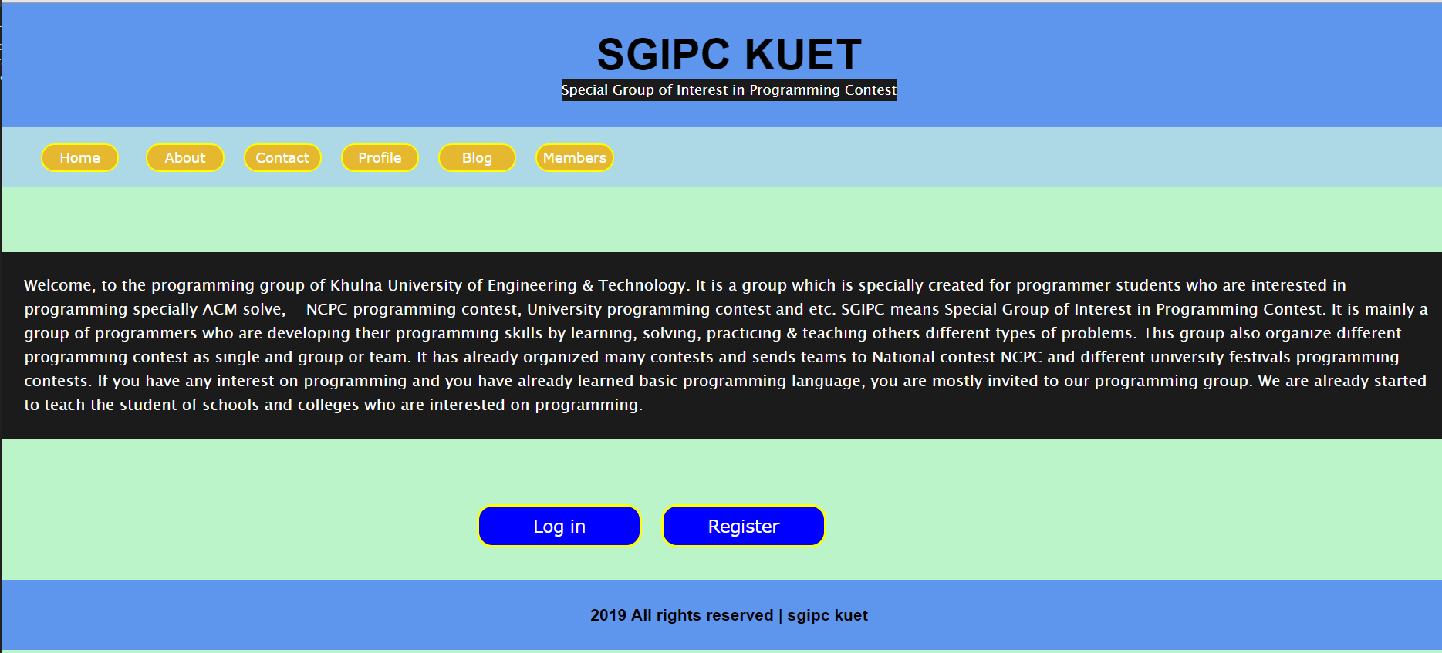
Homepage of sgipc

Slide 4
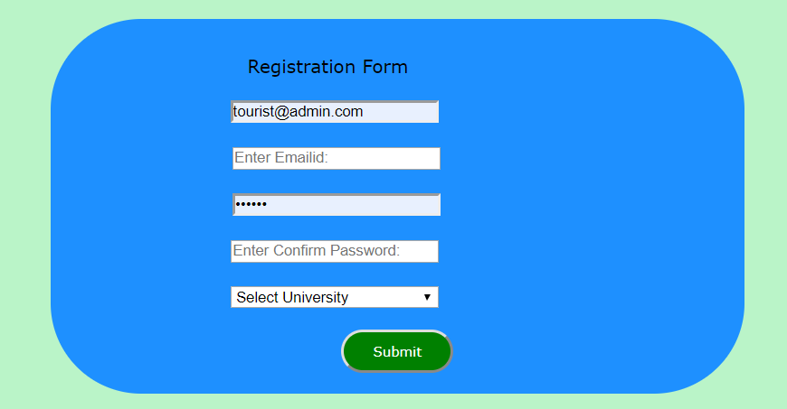
At first you have to register

Slide 5

You have to give a strong password

Slide 6
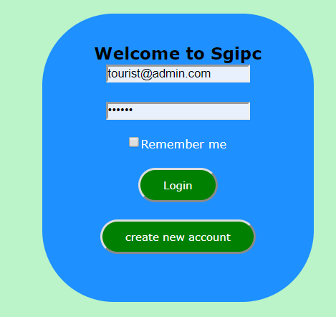
You have to login using your email and password
Check box for session & cookies

Slide 7
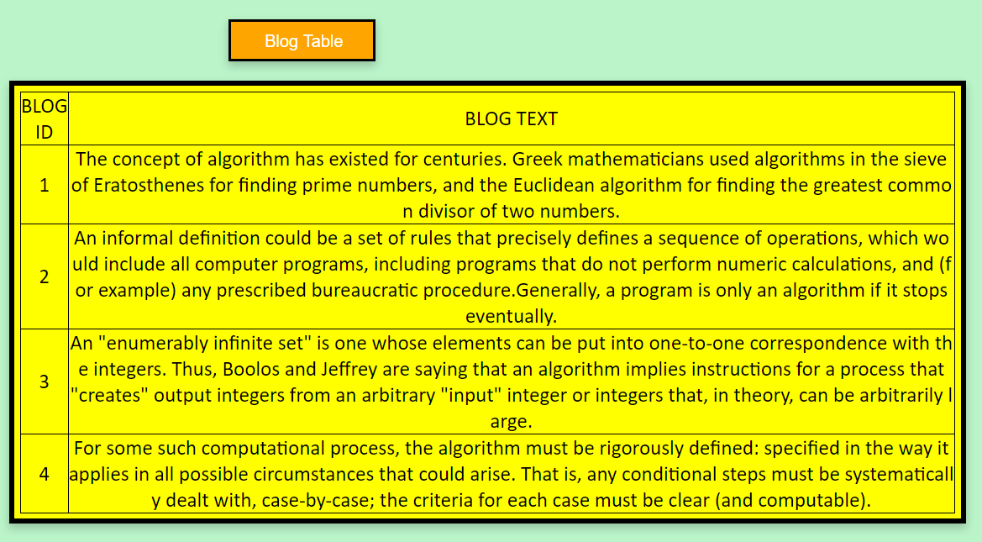
You have your own personal blog

Slide 8
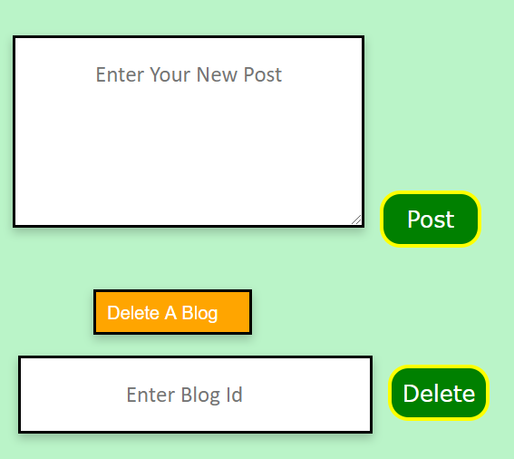
You can add or delete a post

Slide 9
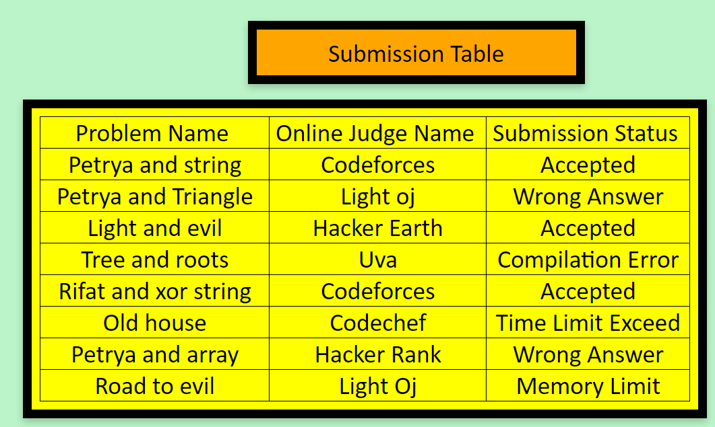
In submission table you can see status of your problem submission

Slide 10
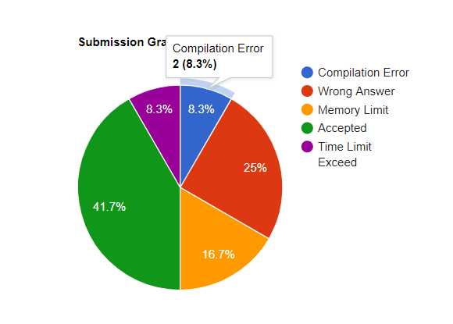
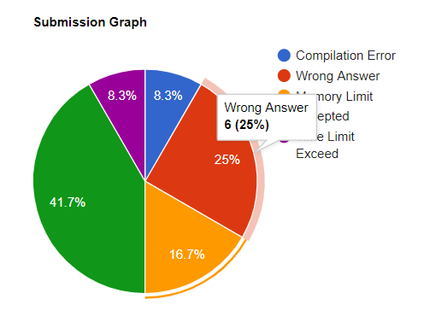
You can see graph of your submission

Slide 11


Sounds Interesting!!!

Slide 12
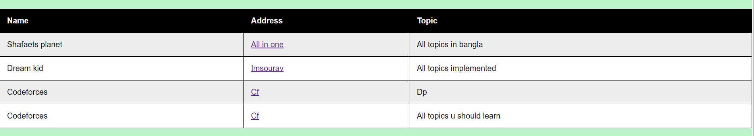
You can find all the programming resources at one place

Slide 13
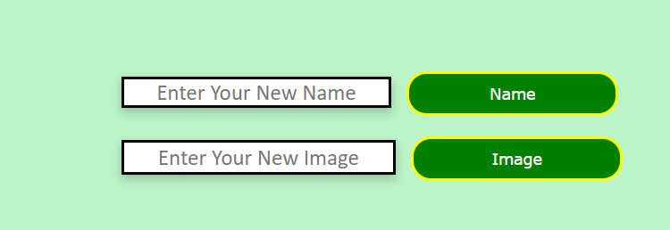
You can also change your name or image

Slide 14

SIMPLE,ISN’T IT?

Slide 15
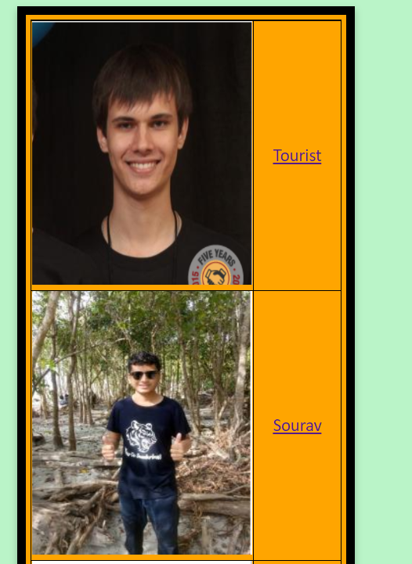
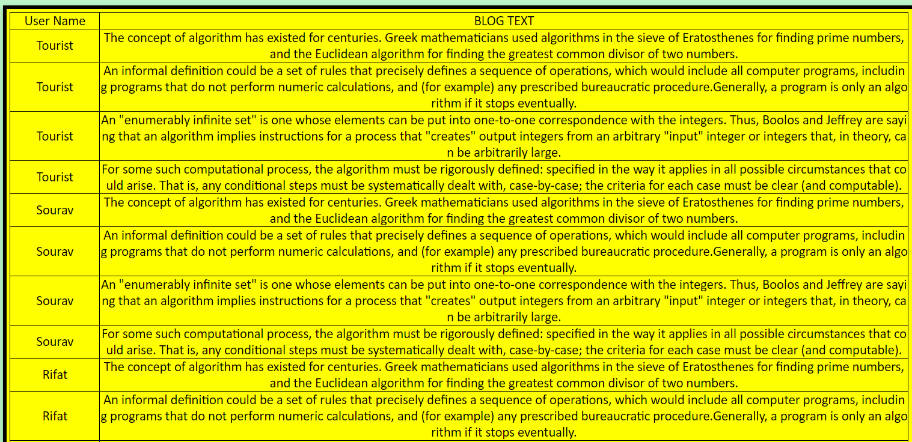
Guest can see the profile of programmers and they can also read the blogs

Slide 16
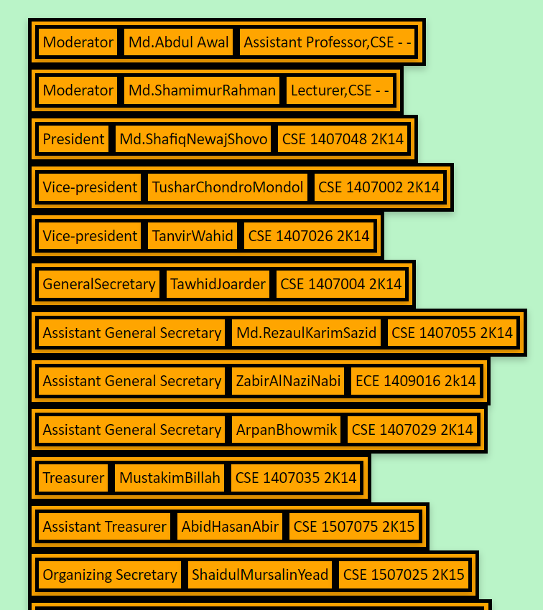
There is a list of past and present members of sgipc

Slide 17
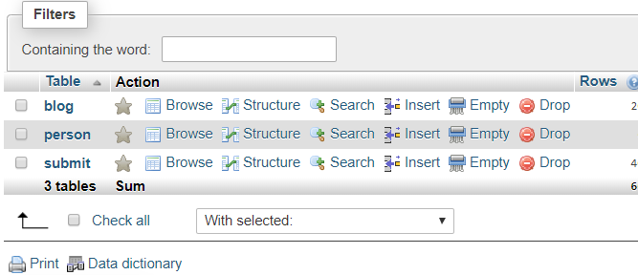
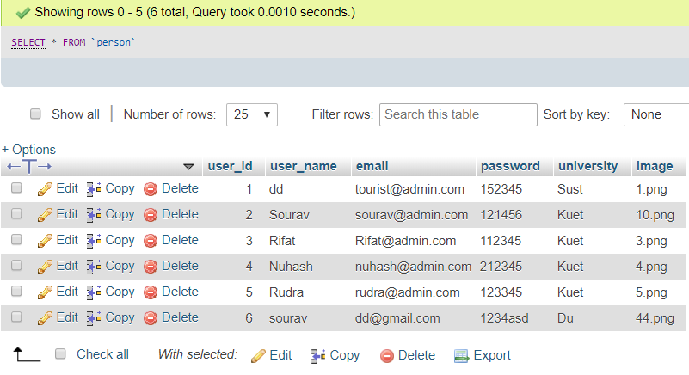
Use xampp as my Database

Slide 18
Summary of Sgipc
1. Streak notifier of your friends. 2. Feel like solving algorithmic problems — Why go to Codeforces and search for a problem? Solve problems from across all the platforms. 3. Want to solve problems that other coders are solving recently - We got a list of trending problems both globally and also amongst your friends. 4. A global leaderboard along with a unique rating which includes submissions from all the websites. 5.The goal is to keep people motivated in algorithmic programming and solve more and more problems. And yeah we do have a referral program.

Slide 19
Use below things in my project
Asp.net, Java script, Html, Css, Xml file, Xampp as Database, Basic use of Graphics and Many more.

Slide 20



Slide 21



