Slide 1

JDBC
Part- I
Prepared by
Rajesh Kumar Ojha
Asst. Prof., CSE, Silicon University

Slide 2
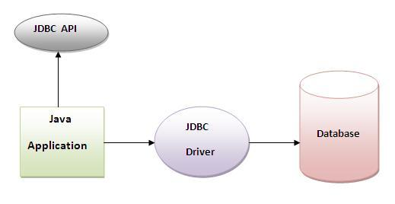
Java JDBC is a java API to connect and execute query with the database. JDBC API uses jdbc drivers to connect with the database.

Slide 3
Why use JDBC
Before JDBC, ODBC API was the database API to connect and execute query with the database. But, ODBC API uses ODBC driver which is written in C language (i.e. platform dependent and unsecured). That is why Java has defined its own API (JDBC API) that uses JDBC drivers (written in Java language).

Slide 4
What is API
API (Application programming interface) is a document that contains description of all the features of a product or software. It represents classes and interfaces that software programs can follow to communicate with each other. An API can be created for applications, libraries, operating systems, etc

Slide 5
JDBC Driver
There are 4 types of JDBC drivers:
JDBC-ODBC bridge driver
Native-API driver (partially java driver)
Network Protocol driver (fully java driver)
Thin driver (fully java driver)

Slide 6
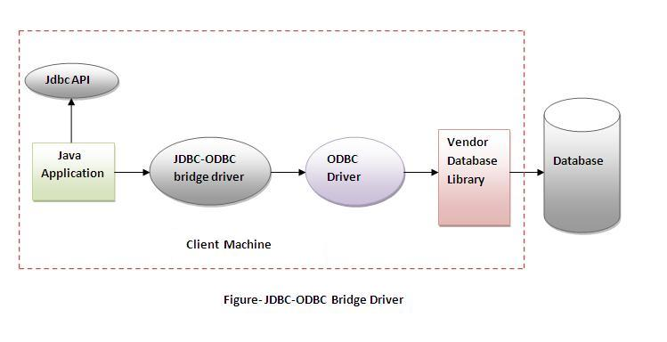
JDBC-ODBC bridge driver
The JDBC-ODBC bridge driver uses ODBC driver to connect to the database. The JDBC-ODBC bridge driver converts JDBC method calls into the ODBC function calls. This is now discouraged because of thin driver.

Slide 7
Advantages:
easy to use.
can be easily connected to any database.
Disadvantages:
Performance degraded because JDBC method call is converted into the ODBC function calls.
The ODBC driver needs to be installed on the client machine.

Slide 8
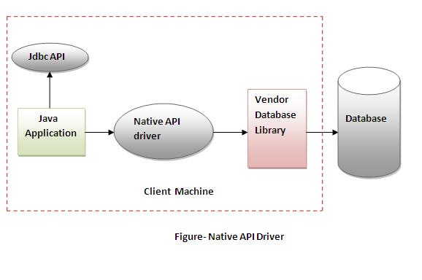
Native-API driver
The Native API driver uses the client-side libraries of the database. The driver converts JDBC method calls into native calls of the database API. It is not written entirely in java.

Slide 9
Advantage:
performance upgraded than JDBC-ODBC bridge driver.
Disadvantage:
The Native driver needs to be installed on the each client machine.
The Vendor client library needs to be installed on client machine.

Slide 10
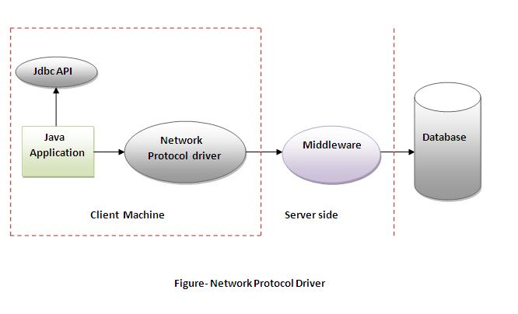
Network Protocol driver
The Network Protocol driver uses middleware (application server) that converts JDBC calls directly or indirectly into the vendor-specific database protocol. It is fully written in java.

Slide 11
Advantage:
No client side library is required because of application server that can perform many tasks like auditing, load balancing, logging etc.
Disadvantages:
Network support is required on client machine.
Requires database-specific coding to be done in the middle tier.
Maintenance of Network Protocol driver becomes costly because it requires database-specific coding to be done in the middle tier.

Slide 12
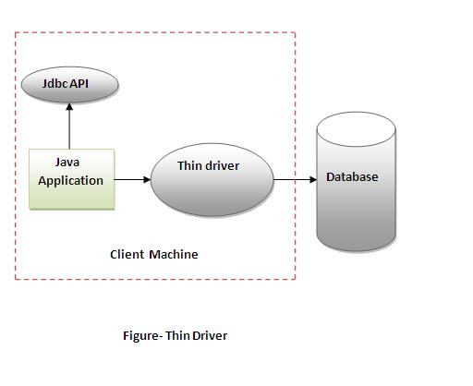
Thin driver
The thin driver converts JDBC calls directly into the vendor-specific database protocol. That is why it is known as thin driver. It is fully written in Java language.

Slide 13
Advantage:
Better performance than all other drivers.
No software is required at client side or server side.
Disadvantage:
Drivers depends on the Database.

Slide 14
Steps to connect to the database
There are 5 steps to connect any java application with the database in java using JDBC. They are as follows:
Register the driver class
Creating connection
Creating statement
Executing queries
Closing connection

Slide 15
Register the driver class
The forName() method of Class class is used to register the driver class. This method is used to dynamically load the driver class.
Syntax:
public static void forName(String className)throws ClassNotFoundException
Example to register the OracleDriver class
Class.forName("oracle.jdbc.driver.OracleDriver");

Slide 16
Create the connection object
The getConnection() method of DriverManager class is used to establish connection with the database.
Syntax:
public static Connection getConnection(String url)throws SQLException
public static Connection getConnection(String url,String name,String password) throws SQLException
Example to establish connection with the Oracle database
Connection con=DriverManager.getConnection( "jdbc:oracle:thin:@localhost:1521:xe","system","password");

Slide 17
Create the Statement object
The createStatement() method of Connection interface is used to create statement. The object of statement is responsible to execute queries with the database.
Syntax:
public Statement createStatement()throws SQLException
Example to register the OracleDriver class
Statement stmt=con.createStatement();

Slide 18
Execute the query
The executeQuery() method of Statement interface is used to execute queries to the database. This method returns the object of ResultSet that can be used to get all the records of a table.
Syntax:
public ResultSet executeQuery(String sql)throws SQLException
Example to register the OracleDriver class
ResultSet rs=stmt.executeQuery("select * from emp");
while(rs.next()){
System.out.println(rs.getInt(1)+" "+rs.getString(2));
}

Slide 19
Close the connection object
By closing connection object statement and ResultSet will be closed automatically. The close() method of Connection interface is used to close the connection.
Syntax:
public void close()throws SQLException
Example to register the OracleDriver class
con.close();

Slide 20
Example to connect to the Oracle database
In this example we are using Oracle10g as the database. So we need to know following information for the oracle database:
Driver class: The driver class for the oracle database is oracle.jdbc.driver.OracleDriver.
Connection URL: The connection URL for the oracle10G database is jdbc:oracle:thin:@localhost:1521:xe where jdbc is the API, oracle is the database, thin is the driver, localhost is the server name on which oracle is running, we may also use IP address, 1521 is the port number and XE is the Oracle service name. You may get all these informations from the tnsnames.ora file.
Username: The default username for the oracle database is system.
Password: Password is given by the user at the time of installing the oracle database.

Slide 21
Let's first create a table in oracle database.
create table emp(id number(10),name varchar2(40),age number(3));

Slide 22
import java.sql.*;
class OracleCon{
public static void main(String args[]){
try{
//step1 load the driver class
Class.forName("oracle.jdbc.driver.OracleDriver");
//step2 create the connection object
Connection con=DriverManager.getConnection( "jdbc:oracle:thin:@localhost:1521:xe","system","oracle");
//step3 create the statement object
Statement stmt=con.createStatement();

Slide 23
//step4 execute query
ResultSet rs=stmt.executeQuery("select * from emp");
while(rs.next())
System.out.println(rs.getInt(1)+" "+rs.getString(2)+" "+rs.getString(3));
//step5 close the connection object
con.close();
}catch(Exception e){
System.out.println(e);
}
}
}

Slide 24
To connect java application with the Oracle database ojdbc14.jar file is required to be loaded.
download the jar file ojdbc14.jar
Two ways to load the jar file:
paste the ojdbc14.jar file in jre/lib/ext folder
set classpath

Slide 25
Paste the ojdbc14.jar file in JRE/lib/ext folder:
Firstly, search the ojdbc14.jar file then go to JRE/lib/ext folder and paste the jar file here.
2) set classpath:
There are two ways to set the classpath:
temporary
permanent

Slide 26
How to set the temporary classpath:
Firstly, search the ojdbc14.jar file then open command prompt and write:
C:>set classpath=c:\folder\ojdbc14.jar;.;
How to set the permanent classpath:
Go to environment variable then click on new tab. In variable name write classpath and in variable value paste the path to ojdbc14.jar by appending ojdbc14.jar;.; as C:\oraclexe\app\oracle\product\10.2.0\server\jdbc\lib\ojdbc14.jar;.;

Slide 27
Example to connect to the mysql database
In this example we are using MySql as the database. So we need to know following informations for the mysql database:
Driver class: The driver class for the mysql database is com.mysql.jdbc.Driver.
Connection URL: The connection URL for the mysql database is jdbc:mysql://localhost:3306/sonoo where jdbc is the API, mysql is the database, localhost is the server name on which mysql is running, we may also use IP address, 3306 is the port number and sonoo is the database name. We may use any database, in such case, you need to replace the sonoo with your database name.
Username: The default username for the mysql database is root.
Password: Password is given by the user at the time of installing the mysql database. In this example, we are going to use root as the password.

Slide 28
Let's first create a table in the mysql database, but before creating table, we need to create database first.
create database sonoo;
use sonoo;
create table emp(id int(10),name varchar(40),age int(3));

Slide 29
import java.sql.*;
class MysqlCon{
public static void main(String args[]){
try{
Class.forName("com.mysql.jdbc.Driver");
Connection con=DriverManager.getConnection( "jdbc:mysql://localhost:3306/sonoo","root","root");
//here sonoo is database name, root is username and password
Statement stmt=con.createStatement();
ResultSet rs=stmt.executeQuery("select * from emp");
while(rs.next())
System.out.println(rs.getInt(1)+" "+rs.getString(2)+" "+rs.getString(3));
con.close();
}catch(Exception e){
System.out.println(e);
} } }

Slide 30
To connect java application with the mysql database mysqlconnector.jar file is required to be loaded.
download the jar file mysql-connector.jar
Two ways to load the jar file:
paste the mysqlconnector.jar file in jre/lib/ext folder
set classpath

Slide 31
1) paste the mysqlconnector.jar file in JRE/lib/ext folder:
Download the mysqlconnector.jar file. Go to jre/lib/ext folder and paste the jar file here.
2) set classpath:
There are two ways to set the classpath:
temporary
permament

Slide 32
How to set the temporary classpath
open comman prompt and write:
C:>set classpath=c:\folder\mysql-connector-java-5.0.8-bin.jar;.;
How to set the permanent classpath
Go to environment variable then click on new tab. In variable name write classpath and in variable value paste the path to the mysqlconnector.jar file by appending mysqlconnector.jar;.; as C:\folder\mysql-connector-java-5.0.8-bin.jar;.;

Slide 33
Thank you

