Slide 1

Layout Management in
JAVA
Prepared by:
Dr. Rajesh Kumar Ojha

Slide 2
Layout Managers
  Layouts are responsible for arranging the components within a Container.
  Since the size of an area we have to work with may vary, LayoutManagers tend to be more relative.
  The most important of the Container layout method is:
  - void setLayout(LayoutManager layout)
  allows you to change the LayoutManager of the corresponding Container.

Slide 3
Layout Managers
  There are five LayoutManagers in Java:
- FlowLayout
- BorderLayout
- CardLayout
- GridLayout
- GridBagLayout
  In simple applets or applications, only one layout manager would be needed. But for more complex designs, panels should be used to break up the drawing area, layout the panels according to layout manager, and finally give each panel a layout manager to arrange the components inside it.

Slide 4
1. FlowLayouts
  This Layout positions Components left to right until there is no more space available. Then it begins on the next row and continues from there going left to right.
  This is the default layout for applets and panels.
  It has three class constants:
- FlowLayout. LEFT
- FlowLayout. CENTER
- FlowLayout. RIGHT
  These correspond to the three possible alignments that a FlowLayout can have.

Slide 5
1. FlowLayouts (cont..)
  There are also two private variables that allow you to
specify the horizontal and vertical gaps between Components and rows of Components. These two variables can be changed when calling the FlowLayout constructor.
  There are three constructors for this layout:
- FlowLayout()
center aligned, with horizontal and vertical gaps of 5 pixels each
- FlowLayout( int alignment)
specified alignment, with horizontal and vertical gaps of 5 pixels each
- FlowLayout( int alignment, int hGap, int vGap)
specified alignments and gaps

Slide 6
1. FlowLayouts (cont..)
import java.awt.*;
import java.awt.event.*;
import javax.swing.*;
public class FlowLayoutExample {
private JFrame mainFrame;
private JLabel headerLabel;
private JLabel statusLabel;
private JPanel controlPanel;
private JLabel msglabel;
public FlowLayoutExample(){
prepareGUI(); }
public static void main(String[] args){
FlowLayoutExample flowLayoutExample = new FlowLayoutExample();
flowLayoutExample.showFlowLayoutDemo();
}
private void prepareGUI(){
mainFrame = new JFrame("Java SWING Examples");
mainFrame.setSize(400,400);
mainFrame.setLayout(new GridLayout(3, 1));
headerLabel = new JLabel("",JLabel.CENTER );
statusLabel = new JLabel("",JLabel.CENTER);
statusLabel.setSize(350,100);
mainFrame.addWindowListener(new WindowAdapter() {
public void windowClosing(WindowEvent windowEvent){
System.exit(0);
}
});

Slide 7
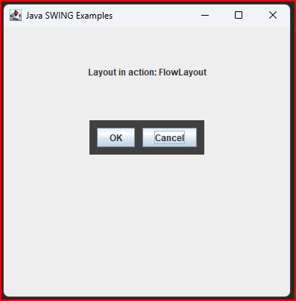
controlPanel = new JPanel();
controlPanel.setLayout(new FlowLayout());
mainFrame.add(headerLabel);
mainFrame.add(controlPanel);
mainFrame.add(statusLabel);
mainFrame.setVisible(true);
}
private void showFlowLayoutDemo(){
headerLabel.setText("Layout in action: FlowLayout");
JPanel panel = new JPanel();
panel.setBackground(Color.darkGray);
panel.setSize(200,200);
FlowLayout layout = new FlowLayout();
layout.setHgap(10);
layout.setVgap(10);
panel.setLayout(layout);
panel.add(new JButton("OK"));
panel.add(new JButton("Cancel"));
controlPanel.add(panel);
mainFrame.setVisible(true);
}
}
1. FlowLayouts (cont..)

Slide 8
2. BorderLayouts
This layout divides the Panel into five regions, North, East, South, West, and Center.
  The components along the edges or borders are given as much space as needed; the center component will then get any remaining space.
  There are two constructors:
- BorderLayout()
center aligned layout with no gaps
- BorderLayout( int hGap, int vGap)
allows you to specify the gaps

Slide 9
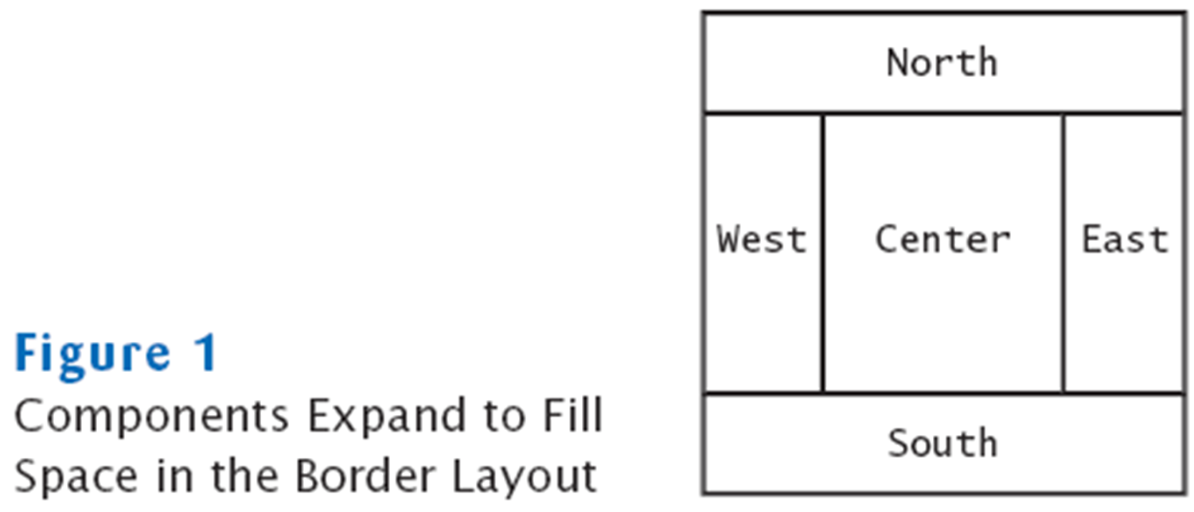
2. BorderLayouts
After creating an object, use
the add( String a, Component c) method
- The first argument is the String indicating the position of the
component given in the second argument.
  The North and South sections extend across the whole drawing area from left to right.
  The East and West sections extend vertically across the drawing area from the bottom of the North section to the top of the South section.

Slide 10
import java.awt.*;
import java.awt.event.*;
import javax.swing.*;
public class BorderLayoutExample {
private JFrame mainFrame;
private JLabel headerLabel;
private JLabel statusLabel;
private JPanel controlPanel;
private JLabel msglabel;
public BorderLayoutExample(){
prepareGUI(); }
public static void main(String[] args){
BorderLayoutExample borderLayoutExample = new BorderLayoutExample();
borderLayoutExample.showBorderLayoutDemo();
}
private void prepareGUI(){
mainFrame = new JFrame("Java SWING Examples");
mainFrame.setSize(400,400);
mainFrame.setLayout(new GridLayout(3, 1));
headerLabel = new JLabel("",JLabel.CENTER );
statusLabel = new JLabel("",JLabel.CENTER);
statusLabel.setSize(350,100);
mainFrame.addWindowListener(new WindowAdapter() {
public void windowClosing(WindowEvent windowEvent){
System.exit(0);
}
});

Slide 11
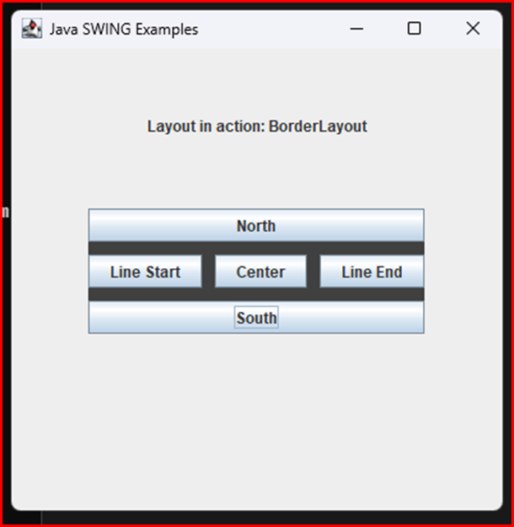
controlPanel = new JPanel();
controlPanel.setLayout(new FlowLayout());
mainFrame.add(headerLabel);
mainFrame.add(controlPanel);
mainFrame.add(statusLabel);
mainFrame.setVisible(true);
}
private void showBorderLayoutDemo(){
headerLabel.setText("Layout in action: BorderLayout");
JPanel panel = new JPanel();
panel.setBackground(Color.darkGray);
panel.setSize(300,300);
BorderLayout layout = new BorderLayout();
layout.setHgap(10);
layout.setVgap(10);
panel.setLayout(layout);
panel.add(new JButton("Center"),BorderLayout.CENTER);
panel.add(new JButton("Line Start"),BorderLayout.LINE_START);
panel.add(new JButton("Line End"),BorderLayout.LINE_END);
panel.add(new JButton("East"),BorderLayout.EAST);
panel.add(new JButton("West"),BorderLayout.WEST);
panel.add(new JButton("North"),BorderLayout.NORTH);
panel.add(new JButton("South"),BorderLayout.SOUTH);
controlPanel.add(panel);
mainFrame.setVisible(true);
}
}

Slide 12
3. CardLayouts
  CardLayouts behave differently from all the other layouts.
  It treats the layout as a deck of cards.
  Only one card appears on the screen at a time. By flipping through the “deck of cards” all the components can be displayed.
  Components are displayed in the order that they were added
to the Container.

Slide 13
3. CardLayouts
  There are two constructors:
- CardLayout()
no gaps
- CardLayout( int hGap, int vGap)
specified gaps
  There are many methods in this class. Some of them are:
- void first( Container c),
- void next( Container c),
- void last( Container c),
- void previous( Container c).

Slide 14
import java.awt.CardLayout;
import java.awt.event.ActionEvent;
import java.awt.event.ActionListener;
import javax.swing.JButton;
import javax.swing.JComboBox;
import javax.swing.JFrame;
import javax.swing.JLabel;
import javax.swing.JPanel;
public class CardLayoutExample {
private JFrame frame;
private JPanel panelOne;
private JPanel panelTwo;
private JButton buttonOne;
private JButton buttonTwo;
private CardLayout cardLayout;
public CardLayoutExample() {
makeComponents();
makeLayout();
}
private void makeLayout() {
frame.setLayout(cardLayout);
frame.add(panelOne,"one");
frame.add(panelTwo,"two");
frame.setDefaultCloseOperation(JFrame.EXIT_ON_CLOSE);
frame.setSize(300,300);
frame.setVisible(true);
}
3. CardLayouts (cont…)

Slide 15
private void makeComponents() {
frame = new JFrame("Example");
frame.setSize(300,300);
panelOne = new JPanel();
panelTwo = new JPanel();
panelOne.add(new JLabel("hello"));
panelOne.add(new JLabel("hello"));
buttonOne = new JButton("Press Me 1");
buttonOne.addActionListener(new CardListener());
buttonTwo = new JButton("Press Me 2");
buttonTwo.addActionListener(new OtherCardListener());
panelOne.add(buttonOne);
panelTwo.add(buttonTwo);
cardLayout = new CardLayout();
}
public class CardListener implements ActionListener {
public void actionPerformed(ActionEvent e) {
cardLayout.show(frame.getContentPane(),"two");
} }
public class OtherCardListener implements ActionListener {
public void actionPerformed(ActionEvent e) {
cardLayout.show(frame.getContentPane(),"one");
} }
public class BothListener implements ActionListener {
public void actionPerformed(ActionEvent e) {
if( e.getSource() == buttonOne)
{ cardLayout.show(frame.getContentPane(), "two"); }
else
{ cardLayout.show(frame.getContentPane(), "one"); }
} }
// create a listener that shows the first panel register with second button
public static void main(String[] args) {
CardLayoutExample ce = new CardLayoutExample(); }
}
3. CardLayouts (cont…)

Slide 16
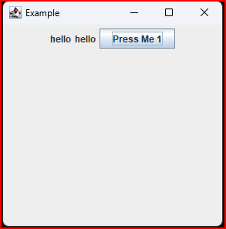
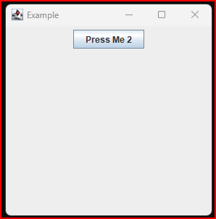
3. CardLayouts

Slide 17
4. GridLayouts
This layout will separate your Panel or Container into rows and columns.
  Each component added to the Panel will be placed in a cell of the grid from left to right, top to bottom.
  There are 3 constructors:
- GridLayout()
creates a layout with 1 row and an unlimited number of columns with no gaps
- GridLayout( int rows, int cols)
specified number of rows and columns with no gaps
- GridLayout( int rows, int cols, int hGap, int vGap)
allows you to set all parameters for the layout

Slide 18
4. GridLayouts
import java. awt.*;
public class GridLayoutExample extends java. applet. Applet {
public void init() {
setLayout( new GridLayout( 3,2));
add( new Button(“ One”));
add( new Button(“ Two”));
add( new Button(“ Three”));
add( new Button(“ Four”));
add( new Button(“ Five”));
add( new Button(“ Six”));
}//end of init
}//end of GridLayoutExample

Slide 19
Grid Layout example
Arranges components in a grid with a fixed number of rows and columns
Resizes each component so that they all have same size
Expands each component to fill the entire allotted area
Add the components, row by row, left to right:
JPanel numberPanel = new JPanel(); numberPanel.setLayout(new GridLayout(4, 3)); numberPanel.add(button7);
numberPanel.add(button8);
numberPanel.add(button9);
numberPanel.add(button4);
. . .
Continued

Slide 20
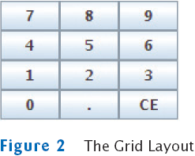

Slide 21
5. GridBagLayouts
  GridBagLayouts are the most powerful way of managing AWT layouts, they are also very complicated.
  Like GridLayouts, GridBagLayouts allow you to arrange yourcomponents in a grid like fashion
  However, GridBagLayouts give you control of the span of individual cells in the grid, the proportions between rows and columns, and arrangement of components inside cells in the grid.

Slide 22
5. GridBagLayouts
  There are two classes that are used:
- GridBagLayout: provides the overall layout manager
- GridBagConstraints: defines the properties of each component in
the grid such as placement, dimension, and alignment

Slide 23
5. GridBagLayouts
  Fields in GridBagConstraints:
  - gridx and gridy fields: specify the position of the component in the grid.
  - gridwidth and gridheight fields: specify the number of columns and rows, respectively, that the component occupies in the grid.
  - insets field: specify the margins that should be left around each individual component.
  - fill field:specify whether and how a component should grow when there is more space available for it than it needs for its default size.
  - anchor field: specify how a component should be positioned when there is more space available than it uses.
  - weightx and weighty fields: specify how extra horizontal and vertical space should be distributed among the components when the container is resized.

Slide 24
5. GridBagLayout
  import java.applet.*;
  import java.awt.*;
  public class GridBagLayoutExample extends Applet {
  public void init() {
  //Create and specify a layout manager
  this.setLayout(new GridBagLayout());
  //Create a constraint object, and specify some default values
  GridBagConstraints c = new GridBagConstraints();
  c.fill = GridBagConstraints.BOTH; //components grow in both dimensions
  c.insets = new Insets(5, 5, 5, 5); //5-pixel margins on all sides
  //Create and add a bunch of buttons, specifying different grid position, and
  //size for each.

Slide 25
5. GridBagLayout
  //Give the first button a resize weight of 1.0 and all others a weight of 0.0.
  //The first button will get all extra space.
  c.gridx = 0; c.gridy = 0; c.gridwidth = 4; c.gridheight = 4;
  c. weightx = c.weighty = 1.0;
  this.add(new Button(“Button #1”), c);
  c.gridx = 4; c.gridy = 0; c.gridwidth = 1; c.gridheight = 1;
  //c. weightx = c.weighty = 0.0;
  this.add(new Button(“Button #2”), c);
  c.gridx = 4; c.gridy = 1; c.gridwidth = 1; c.gridheight = 1;
  this.add(new Button(“Button #3”), c);

Slide 26
5. GridBagLayout
  c.gridx = 4; c.gridy = 2; c.gridwidth = 1; c.gridheight = 2;
  this.add(new Button(“Button #4”), c);
  c.gridx = 0; c.gridy = 4; c.gridwidth = 1; c.gridheight = 2;
  this.add(new Button(“Button #5”), c);
  c.gridx = 2; c.gridy = 4; c.gridwidth = 1; c.gridheight = 2;
  this.add(new Button(“Button #6”), c);
  c.gridx = 3; c.gridy = 4; c.gridwidth = 2; c.gridheight = 1;
  this.add(new Button(“Button #7”), c);

Slide 27
Nesting Panels Example
Keypad from the ATM GUI in previous slide:
JPanel keypadPanel = new JPanel(); keypadPanel.setLayout(new BorderLayout());
buttonPanel = new JPanel();
buttonPanel.setLayout(new GridLayout(4, 3)); buttonPanel.add(button7);
buttonPanel.add(button8);
// . . .
keypadPanel.add(buttonPanel, BorderLayout.CENTER);
JTextField display = new JTextField();
keypadPanel.add(display, BorderLayout.NORTH);
Continued

Slide 28
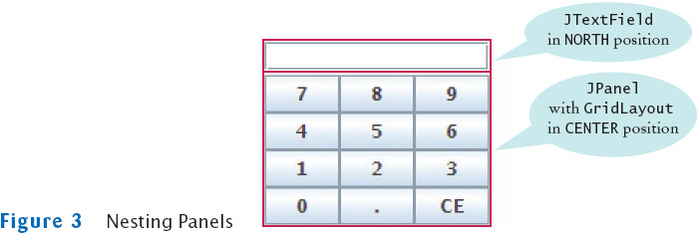
Nesting Panels Example (cont.)

Slide 29
No Layout
  To indicate that no LayoutManager is to be used in a
Container, use the null layout
- myContainer. setLayout( null);
  Without a LayoutManager, positioning components take a
lot of work.
  In general, always use a LayoutManager if possible!!

Slide 30
Manually Positioning Components
  You can move and resize each component in the paint( ) method by using
- public void setLocation(int x, int y);
- public void setSize(int width, int height);
  x and y are the coordinates of the upper left hand corner, width and height would be the width and height in pixels of you component.

Slide 31
Manually Positioning Components (cont…)
  Reasons not to use this approach:
- Layout Managers will adjust your components to fit the size of the display area. By manually positioning a component, you have no control when the user resizes the display area.
- Manually positioning components take a lot of work.
- Nesting panels or using GridBagLayouts can probably do everything you need to do with manual positioning.

Slide 32
Thank you

