Slide 1
Study on Electrochemical Corrosion
Behavior of Titanium Alloy
Liu Erju

Slide 2
1 METHODS
Titanium alloy
Erosion
Experiment of
soaking
Electrochemical
measurement
Microstructure
Corrosion rate
Open circuit
potential
Polarization
curve
EIS spectra

Slide 3
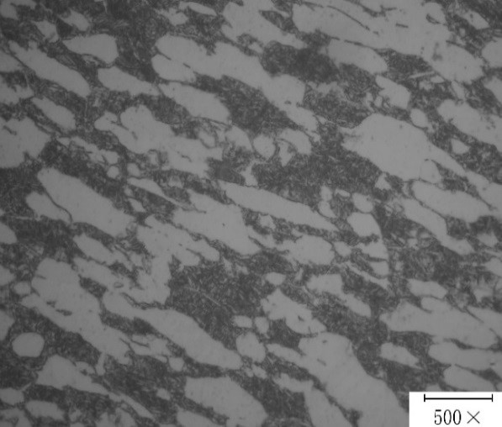
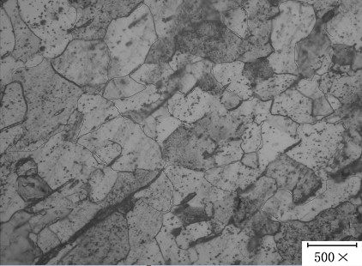
2 RESULTS AND DISCUSSION
2.1 Microstructure
Microstructure of TA4 Titanium Alloy
Microstructure of TA15 Titanium Alloy

Slide 4
2.2 SOAKING EXPERIMENT
Sample | The weight of the original material/(g) | Five days after the weight of the material/(g) | The rate of corrosion /(mm/a) | The average rate of corrosion /(mm/a)
15-1 | 8.4236 | 8.4238 | 0.000212 | 0.000424
15-2 | 8.4132 | 8.4138 | 0.000635
4-1 | 8.4784 | 8.4795 | 0.001165 | 0.001377
4-2 | 8.4851 | 8.4866 | 0.001588

Slide 5
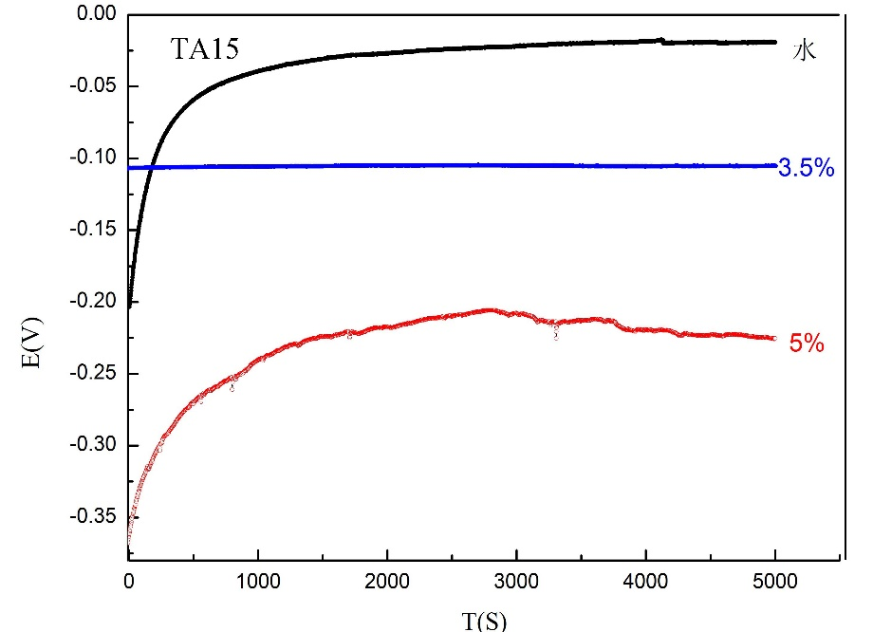
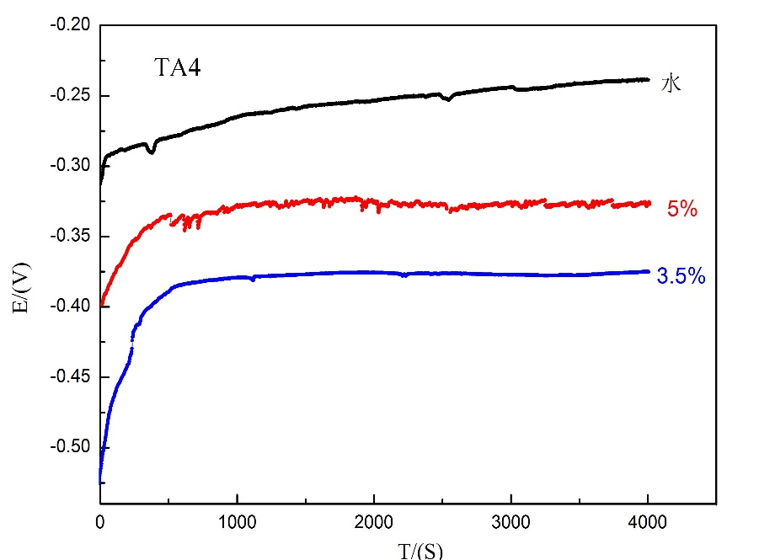
2.3 ELECTROCHEMICAL MEASUREMENT
2.3.1 Open circuit potential
 | tap water | 3.5%NaCl solution | 5% NaCl solution
TA4 | -240 mV | -376 mV | -327 mV
TA15 | -19mV | -105 mV | -224 mV

Slide 6
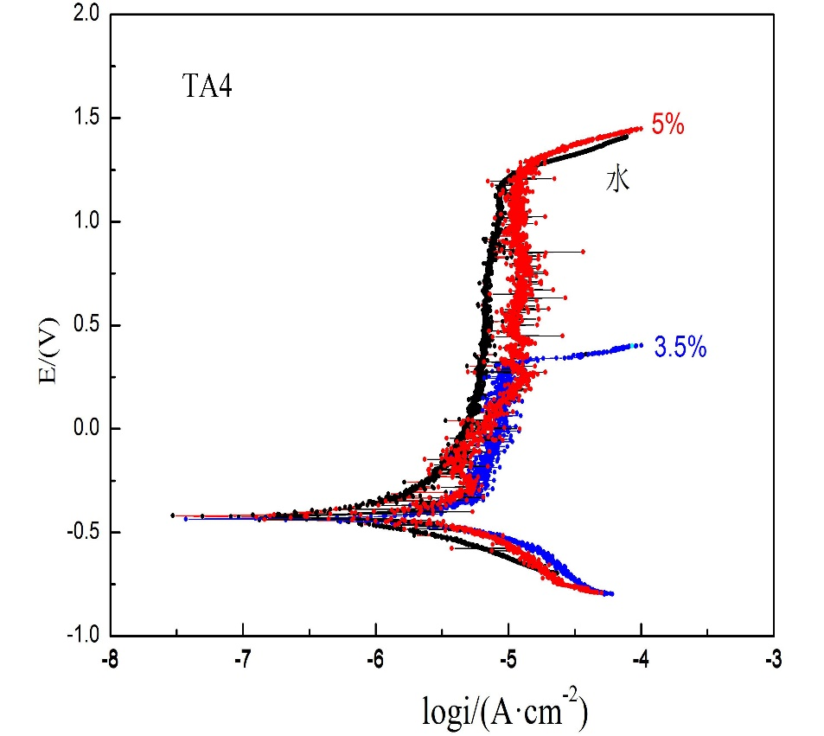
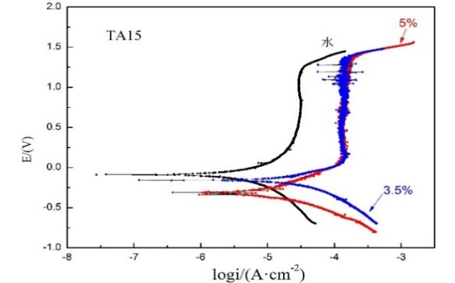
2.3.2 Polarization curve
 | Solution | E_{corr}/(V) | i_{corr}/(μA·cm⁻²)
TA4 | tap water | -0.417 | 0.390
 | 3.5% NaCl solution | -0.432 | 1.242
 | 5% NaCl solution | -0.435 | 1.875
TA15 | tap water | -0.087 | 1.592
 | 3.5% NaCl solution | -0.161 | 10.162
 | 5% NaCl solution | -0.31 | 10.592
The corrosion potential of TA15 is more positive than TA4, and the corrosion current density of TA15 is higher than TA4, which indicates that TA15 titanium alloy has better electrochemical stability than TA4 titanium alloy, but the corrosion rate is significantly increased.

Slide 7
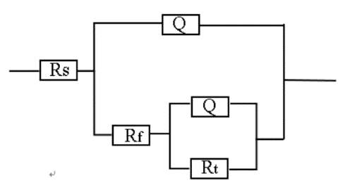
2.3.3 EIS spectra
 | Solution | Rs | R_{f} | R_{t}
TA4 | tap water | 0.6832 | 189.6 | 50840
 | 3.5% NaCl solution | 0.7135 | 137.4 | 24060
 | 5% NaCl solution | 0.7035 | 96.79 | 18970
TA15 | tap water | 0.7 | 150.6 | 22310
 | 3.5% NaCl solution | 0.8095 | 228.1 | 1781
 | 5% NaCl solution | 0.7049 | 117.8 | 16400
Equivalent Circuit
The electrochemical reaction resistance of TA4 in solution is greater than TA15,
indicating that TA4 is higher than TA15 has better corrosion resistance.

Slide 8
3 CONCLUSIONS
(1)The microstructure of TA4 titanium alloy is α + β phase, its morphology is a typical equiaxed structure, and equiaxed α phase is distributed on β matrix. The microstructure of TA15 titanium alloy can be observed in larger flakes of β grains .
(2) The corrosion resistance of TA4 titanium alloy in the same corrosion solution is better than TA15 titanium alloy.

Slide 9
Thank you !
PPT模板下载：www.1ppt.com/moban/ 行业PPT模板：www.1ppt.com/hangye/
节日PPT模板：www.1ppt.com/jieri/ PPT素材下载：www.1ppt.com/sucai/
PPT背景图片：www.1ppt.com/beijing/ PPT图表下载：www.1ppt.com/tubiao/
优秀PPT下载：www.1ppt.com/xiazai/ PPT教程： www.1ppt.com/powerpoint/
Word教程： www.1ppt.com/word/ Excel教程：www.1ppt.com/excel/
资料下载：www.1ppt.com/ziliao/ PPT课件下载：www.1ppt.com/kejian/
范文下载：www.1ppt.com/fanwen/ 试卷下载：www.1ppt.com/shiti/
教案下载：www.1ppt.com/jiaoan/ PPT论坛：www.1ppt.cn

