Slide 1
A brief talk on the Development History of Neural Network
Notes:
Today we mainly talk about the

Slide 2

Learning any knowledge should start from its history, grasp the history, then seize the present and the future.
———by Bryant LJ
Notes:
There is a quote(kwoʊt) by
[si:z]

Slide 3
CATALOGUE
01
Neural Network Classification
02
Development of Neural Networks
03
The next Development

Slide 4
Neural Network Classification
Neural Network
ANN(人工神经网络)
BNN(生物神经网络)
FFNN(前馈神经网络)
FBNN (反馈神经网络)
Perceptron(感知机)
MLP(两层神经网络)
DLP(多层神经网络)
BP神经网络
DNN(普通深度网络)
DBN(深度信念网络)
CNN(卷积神经网络)
HN(霍普菲尔网络)
RNN(循环神经网络)
SOM(自组织神经网络)
ART(自适应共振理论)
Notes:
Neural network is actually a very broad term. It consists of two types: one is to simulate the human brain in a computer way, which is what we often call Ann, and the other is to study biological neural networks. Also called BNN. For us computer people, it's definitely a study of the former.
Then artificial neural network consists feedforward neural network, Feedback neural network, self organizing neural network, Adaptive resonance([ˈrezənəns] ) theory.
In PowerPoint, we mainly talk about feedforward neural network, Feedback neural network. And feedforward neural network consists
卷积神经网络；Convolution neural network 循环神经网络：recurrent neural network
Through the above, we have a general understanding of the classification of neural networks.Next we talk about the development of Neural Networks,but before that , Let's take a quick look what exactly is feedforward neural network, and Feedback neural network.

Slide 5
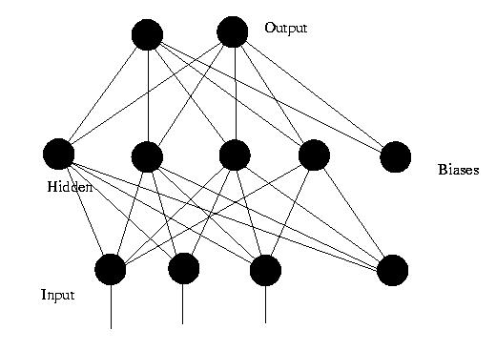
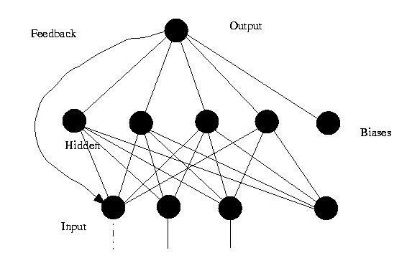
FFNN and FBNN
Feedforward networks(forward networks) : This kind of network only has feedback signals in the training process, but in the process of classification, the data can only be transmitted forward until it reaches the output layer, and there is no backward feedback signal between the layers.
Feedback neural network : a kind of neural network with feedback connection from output to input, and its structure is much more complicated than feedforward network.
Feedforward networks
Feedback neural network
Notes:
Feedforward networks are also called forward networks. This kind of network only has feedback signals in the training process, but in the process of classification, the data can only be transmitted forward until it reaches the output layer, and there is no backward feedback signal between the layers, so it is called feedforward network. The perceptron (perceptron) and BP neural network belong to the feedforward network. Feedback neural network is a kind of neural network with feedback connection from output to input, and its structure is much more complicated than feedforward network. Typical feedback neural networks include: hopfield network and so on.

Slide 6
Development map
Perceptron
Hopfield neural network
BP neural network
Boltzmann machine
Restricted Boltzmann machine(RBM)
Convolution neural network(CNN)
recurrent neural network(RNN)
Deep Belief network
(DBN+DNN)
Residual neural network
Long Short-Term Memory(LSTM)
Notes:
from the Development map We can see feedforward …developed like this

Slide 7
Development of Neural Networks
Can’t solve nonlinear problems
1969
A seven-layer CNN
1998
SOM
1972
1997
LSTM
Perceptron
1958
ART
1976
1990
RNN
Hebb rules
HN
1982
1989
1949
M-P model
1988
. DLP
. LeNet(CNN)
BM
1983
1943
1986
RBF
.MLP-BP
.RBM
Notes:
The time line represents the peak and low period of neural network development.
It is clear from the diagram that DL experienced two valleys before its rise([raɪz]) in 2006, which also divided the development of neural networks into three different stages,
First Generation Neural Network (1958-1969)
Second Generation Neural Network (1986 / 1998)
The third Generation Neural Network DL (2006-present)

Slide 8
Development of Neural Networks
BN,Faster R-CNN and Residual Net
2015
R-CNN
Alex Net
2012
DFNN
ReLU
2011
Deep Learning(DL)
2006
Notes:
Development beyond 2006 mainly focused on CNN and RNN,about this development stage I will write a blog or something introduce for you guys.

Slide 9
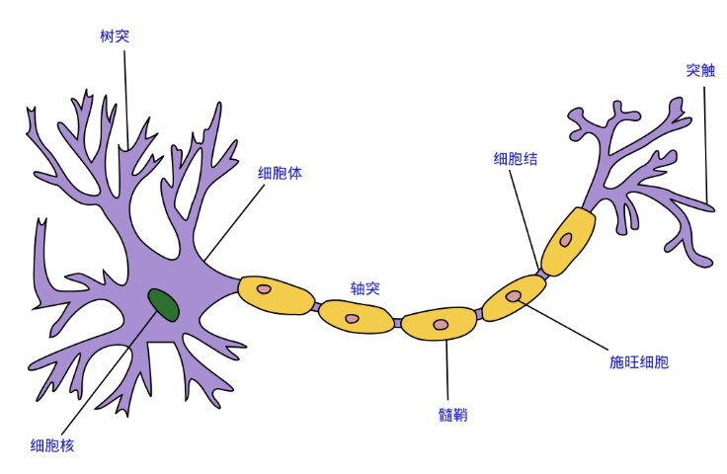
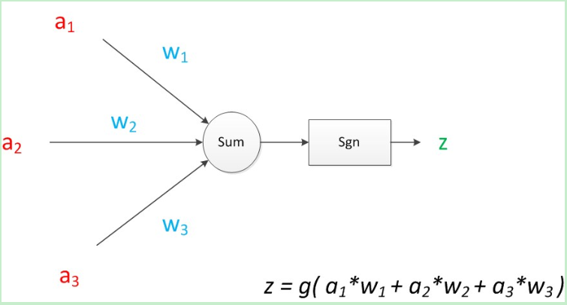
1943 ， McCulloch and Pittsn ， M-P model
Based on neural network
imitates the structure and working principle of neurons
It's just a model, not applied to the real calculate .
Notes:
First Generation Neural Network
麦卡洛克和匹兹堡 propose
MP model is a mathematical model based on neural network, which imitates the structure and working principle of neurons. This model is simple, but is great significance([sɪgˈnɪfɪkəns]).
A neuron model is a model that includes input, output, and computing functions. Inputs can be analogous([əˈnæləgəs] ) to dendrites([ˈdendraɪt] ) of neurons, outputs can be analogous to axons of neurons, calculations can be analogous to nuclei(['nju:klɪaɪ] ).
We use a for input and w for weight. A directed arrow（[ˈærəʊ]） representing the connection can be understood as follows: at the initial end, the signal size is still a, the middle of the end has a weighted parameter（[pəˈræmɪtə(r)] ） w, and the weighted signal will become a w. so at the end of the connection, the signal size becomes a w. As we all know more about this model, we will not introduce it
Z is the value of a function g superposed by the linear weighted sum of the input and weight values. In the MP model, the function g is a sgn function, that is, a symbolic function. This function outputs 1 when the input is greater than 0, otherwise it outputs 0.

Slide 10
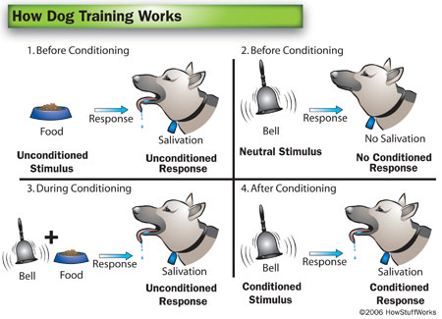
1949 ， Donald Herb， Hebb learning rate:
increase
positive
positive
Wij(t+1)=Wij(t)+a⋅yi⋅yj
smaller
positive
negateiv
Wij：the connection weight of neuron j to neuron i;
yi，yj： output of two neurons ;
a：the constant of the learning rate;
Notes:
In 1949, the psychologist Hebb proposed Hebb learning rate, which suggests that the intensity of synapses（触突） (that is, connections) of human brain cells can change. So computing scientists began to think about how to adjust weights to make machines learn. This lays the foundation for the following learning algorithm（[ˈælgərɪðəm]）.
Unsupervised learning rules obey Hebb learning rate. In order to understand the Hebb algorithm, it is necessary to briefly introduce the conditioned reflex experiment.
Pavlov‘s conditioned reflex experiment: every time a dog is fed, the bell rings, and over time the dog associates the bell with the food. In the future, if the bell rings but no food is given, the dog will drool.（[dru:l]
）
Hebb ‘ s theory thinks that the link between the neurons that is excited at the same time will be strengthened . For example , if a neuron is excited at the same time , the contact between the two neurons will intensify , keeping in mind that there is a link between the two things . On the contrary , if the two neurons are always incapable of being excited synchronously（['sɪŋkrənəslɪ]）, the links between them will become weaker and weaker
If Yi and YJ are positive at the same time, then the wij will increase.
If Yi is positive, YJ is negative, then wij will become smaller.

Slide 11
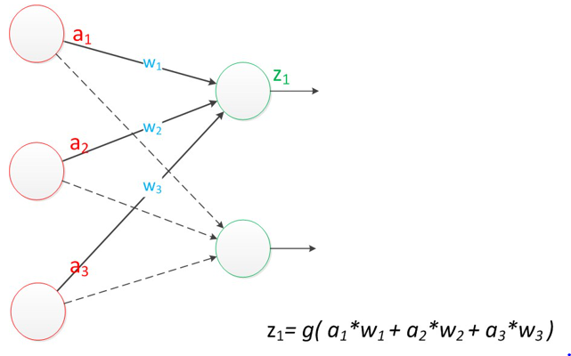
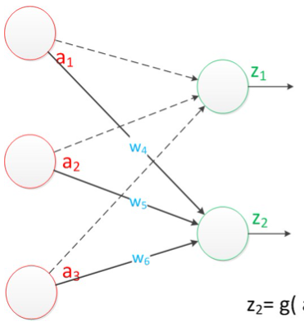
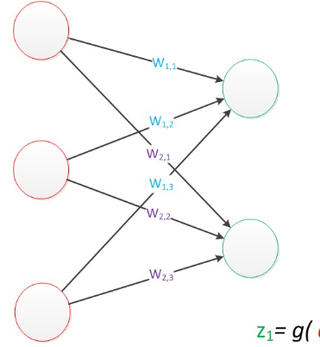



1958 ， Frank Rosenblatt ， Perceptron:
Basied on M-P mudel;
A neural network structure with one calculation layer characteristics.
a:[a_{1,}a_{2,}a₃]^{T}
z:[z_{1,}z₂]^{T}
g(W * a) = z;
Notes:
罗森布拉特
Perceptron basied on M-P model,which is…..
Actually add a neuron node to the input position of the original MP model, marking it as an input unit. The rest remains unchanged
In Perceptron, there are two levels. The input layer and the output layer are respectively. The input unit in the input layer is responsible for data transfer only, not calculation. The "output unit" in the output layer needs to calculate the input of the previous layer, which is called the "computational layer" and the network with a computational layer is called "single-layer neural network". Some papers are named after the number of layers owned by the network, for example, the perceptron is called a two-layer neural network.
we convert the values to vectors，after converting it to the concepts of matrices ([ˈmeɪtrɪsi:z] )and vectors, the formula is like this

Slide 12
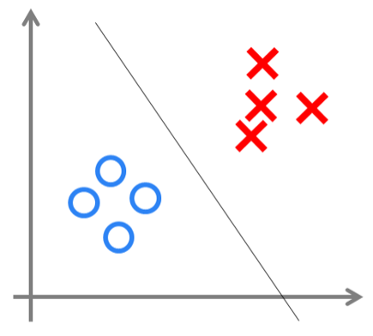
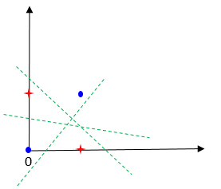
1958 ， Frank Rosenblatt ， Perceptron:
can be used to perform linear classification tasks.
1969 ， Minsky:
can only be used to solve linear problems,
can not solve XOR such simple classification.
XOR problem
Notes:
Unlike the neuron model, the weights in the perceptron are obtained by training. Therefore, based on previous knowledge, we know that the perceptron is similar to a logical regression model and can be used to perform linear classification tasks. The decision boundary is to draw a straight line in the two-dimensional([dɪ'menʃənəl] ) data plane([pleɪn]), and when the dimension of the data is three dimensions, it is to draw a plane, when the dimension of the data is n-dimensional. The left graph shows the effect of the decision demarcation in the two-dimensional plane, that is, the classification effect of the perceptron.
Although the single-layer perceptron is simple and elegant, it is clearly not smart enough it is only capable of classifying linear problems
We can see that a straight line can not be found in this case to separate the two types of results. That is, the perceptron can not find a linear model to divide the XOR problem.this proposed by Minsky in 1969

Slide 13
1972 ， KohonenT， Self-Organizing feature map (SOM) :
Based on a competitive Learning algorithm called "winner as King“;
Extract classification information without knowing which classification types exist.
1976 ， Grossberg， ART（ Adaptive resonance theory ）:
It’s learning process has the characteristics of self-organization and self-stability;
Maximizing the reception of new schema information and ensuring less impact on past sample patterns.
Notes:
SOM network is a kind of unsupervised learning network. It adopts a competitive learning algorithm of "winner as king", which is very different from the previous perceptron, and its learning training method is undirected training, which is a self-organizing network.
This training method is often used to extract classification information without knowing which classification types exist. It is mainly used in pattern recognition, speech recognition and classification.
格罗斯伯格;ART（ Adaptive resonance([ˈrezənəns]) theory ）Maximizing: ['mæksɪmaɪzɪŋ]

Slide 14
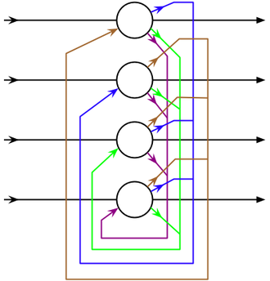
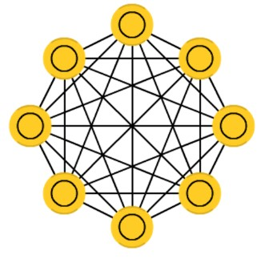
1982 ， Hopfield， Hopfield model (HN):
1982 : Discrete type
1984:Continuous type
each neuron acts as a whole role:
before the training is a neuron,
the training stage is a hidden neuron,
the output phase is the output neuron.
"associative memory " :When associative memory, only some information of input mode is given, and the complete output mode can be associated.
The feedback - type neural network hopfield neural network mainly adopts the Hebb rule and the convergence speed is very fast in general .
Notes:
Second Generation Neural Network (1986 / 1998)
Two neural network models were proposed in 1982 and 1984 respectively . In 1982 it was proposed that the discrete type was continuous , but they were all feedback networks .
It‘s like a completely mixed spaghetti([spəˈgeti])意大利面条, because each neuron acts as a whole role: every node before the training is a neuron, a training stage is a hidden neuron, and the output phase is the output neuron.
This type of network is called “associative memory ”because they converge to the state most similar to the input; there is no one-to-one mapping between the elements of the input-output schema. The dimension of input-output mode is not required to be the same. When associative memory, only some information of input mode is given, and the complete output mode can be associated. That is, fault-tolerant. For example, if humans see half a table, they can imagine the other half; similarly, if half the noise is entered, the network can converge to the entire table.
The feedforward neural network adopts the error correction method , the calculation is generally slow and the convergence speed is slow . The feedback - type neural network hopfield neural network mainly adopts the Hebb rule , and the convergence speed is very fast in general .

Slide 15
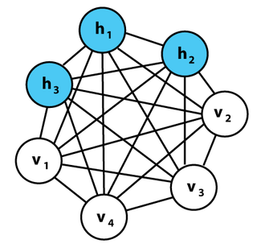
1983 ， Geoffrey Hinton and Terry Sejnowski ， Boltzmann machine model:
Boltzmann machines and Hopfield networks are similar except that some neurons are input neurons and others are hidden neurons.
Be seen as a random process, the corresponding Hopfield neural network that can be generated;
To solve complex combinatorial optimization problems;
Now only interesting in theory.
If the connection is constrained (i.e., the limited Boltzmann), the learning method is to solve the actual problem would be enough to be efficient.
Notes:
The Boltzmann machines is very close to the Hopfield network except that some neurons are input neurons and the rest are hidden neurons.
Boltzmann machine can be seen as a random process, the corresponding Hopfield neural network that can be generated. It is the earliest neural network to learn internal expression, and can express and (given sufficient time) to solve complex combinatorial（[ˌkɒmbɪnə‘tɔ:rɪəl]） optimization problems. However, the Boltzmann machine without a specific restriction on the connection side 。 so far has not been proved to be the machine What's useful for the practical problem of learning, so it is now only interesting in theory. However, because of the locality([ləʊˈkæləti]) and the Hebbian nature of the training algorithm, and the parallelism([ˈpærəlelɪzəm]) that they are similar to the simple physical processes, if the connection is constrained (i.e., the limited Boltzmann), the learning method is to solve the actual problem. It will be enough to be efficient.
. But what is can be generayted! complex combinatorial（[ˌkɒmbɪnə‘tɔ:rɪəl]） optimization problems
we talk about later .

Slide 16

1983 ， Geoffrey Hinton and Terry Sejnowski ， Boltzmann machine model:
Combinatorial optimization : a kind of task to find the optimal object in a finite object set.
For example, clothing factories make clothes, clothes are divided into many pieces, which need to be cut off from the cloth. How to cut, the waste cloth left the least?
Generating model : a model that can generate observation data randomly
In machine learning, can be used to model data directly or to establish conditional probability distribution between variables.
Notes:
finite : [ˈfaɪnaɪt]
This is the combinatorial optimization problem.
In the theory of probability and statistics, the generating model refers to the model that can generate observation data randomly, especially under the condition that some implicit parameters are given.
In machine learning, the generated model can be used to model data directly (such as sampling data according to a variable's probability density function) or to establish conditional probability distribution between variables.

Slide 17
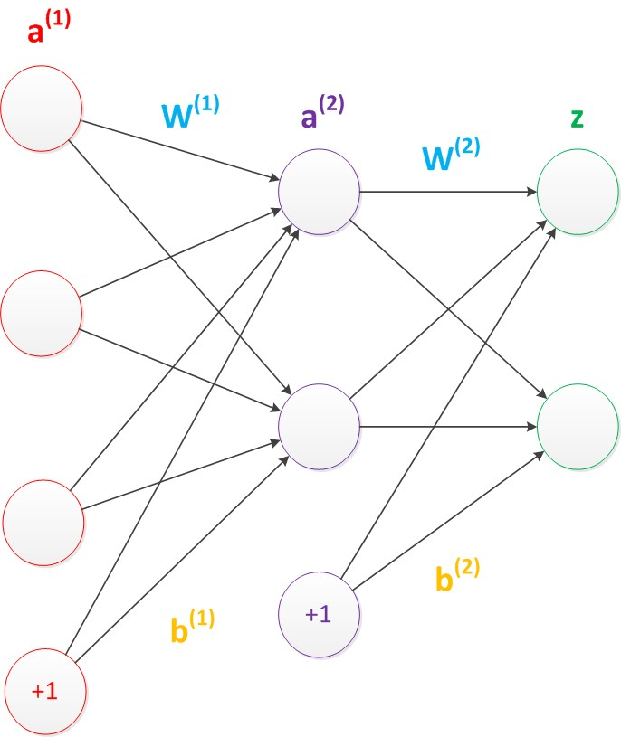
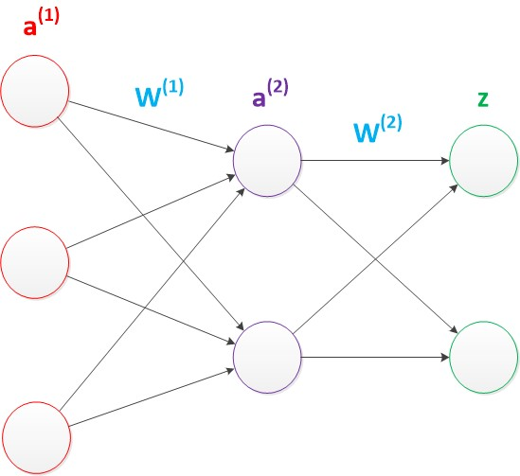
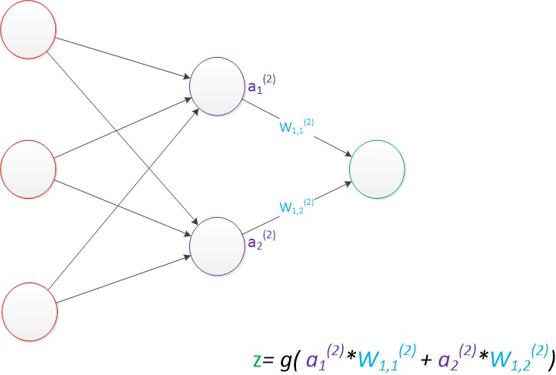
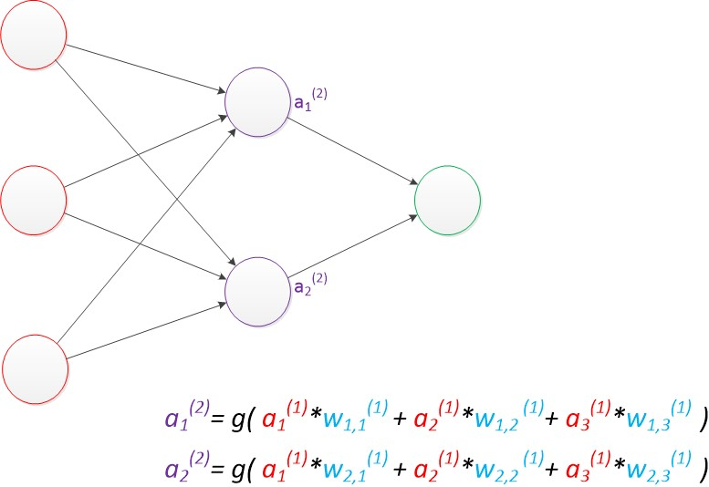
1986 ， Rumelhar and Hinton， Multi-Layer Perceptron(MLP):
Use matrix operations to express the entire formula :
g(W⁽¹⁾ * a⁽¹⁾) = a⁽²⁾;
g(W⁽²⁾ * a⁽²⁾) = z;
input layer
The matrix operations of a neural network after considering bias ：
g(W⁽¹⁾ * a⁽¹⁾ + b⁽¹⁾) = a⁽²⁾;
g(W⁽²⁾ * a⁽²⁾ + b⁽²⁾) = z;
computing layers
Notes:
It should be noted that, so far, we have not mentioned the biased node (bias unit). In our discussion of the structure diagram of neural networks In fact, these nodes exist by default. It is essentially a unit that contains only storage functions and always has a value of 1. In each layer of the neural network, except the output layer, there is such a bias unit. As in the linear regression model and the logical regression model, the bias unit is connected to all nodes in the next layer, and we set these parameter values as vector b, which is called bias. See below.
In addition to an input layer and an output layer, an intermediate layer has been added. At this point, both the middle and output layers are computing layers

Slide 18
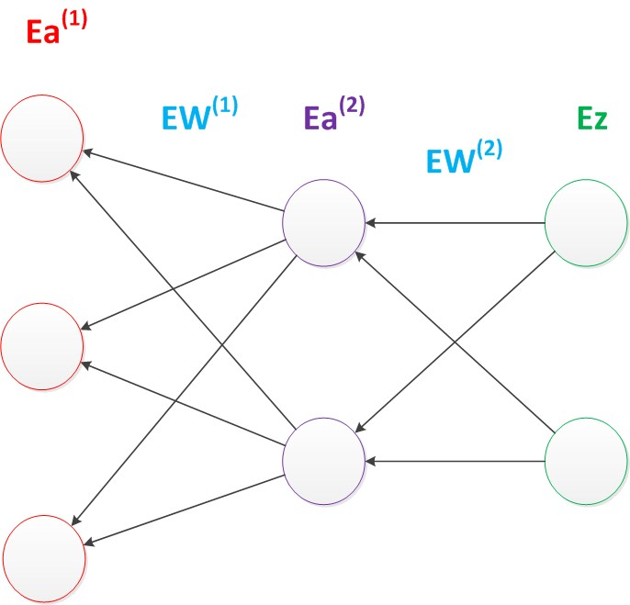
1986 ， Rumelhar and Hinton， Backpropagation (BP) algorithm:
Loss function:
the prediction target of the sample : y_{p}
the real target : y.
define a value that is lossy :
loss = (y_{p} - y)²
How to optimize parameters to minimize the value of loss function
Gradient descent algorithm
BP algorithm:
The calculation of the gradient propagates backwards from back to front layer by layer. The prefix E stands for the relative derivative. The revelation of back Propagation algorithm is the chain Rule in partial differential
Notes:
Optimization of parameters generally by gradient descent algorithm.
In the neural network model, because of the complexity of the structure, the cost of calculating the gradient every time is very high. Therefore, it is necessary to use the back propagation algorithm.
The calculation of the gradient propagates backwards from back to front layer by layer. The prefix E stands for the relative derivative. The revelation of back Propagation algorithm is the chain Rule in partial differential.

Slide 19
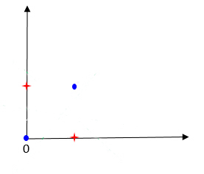
1986 ， Rumelhar and Hinton， MLP-BP:
MLP-BP : two-layer feedforward neural networks using back-propagation BP algorithm and is applied to the nonlinear mapping by Sigmoid , which effectively solves the problem of nonlinear classification and learning .
limitations :
It requires tagged training data, but almost all data are unmarked.
Learning time is not easy to measure, in the multi-layer network, the speed is very slow.
It falls into local minima and does not converge.
Notes:
In fact, It is also the most common two-layer neural network.
The BP algorithm for multi - layer perceptron ( mlp ) are two-layer feedforward neural networks using back-propagation BP algorithm and is applied to the nonlinear mapping by Sigmoid , which effectively solves the problem of nonlinear classification and learning .
It can constantly modify the connection weights between the artificial neurons that make up the forward multilayer network, so that the forward multilayer network can transform the input information into the desired output information. It is called a reverse learning algorithm because, in modifying the connection weights of each artificial neuron, it is based on the difference between the actual output of the network and its desired output, and the difference is reversed one layer back. To determine the modification of the connection weight value.
It requires tagged training data, but almost all data are unmarked.
Learning time is not easy to measure, in the multi-layer network, the speed is very slow.
It falls into local minima and does not converge.

Slide 20
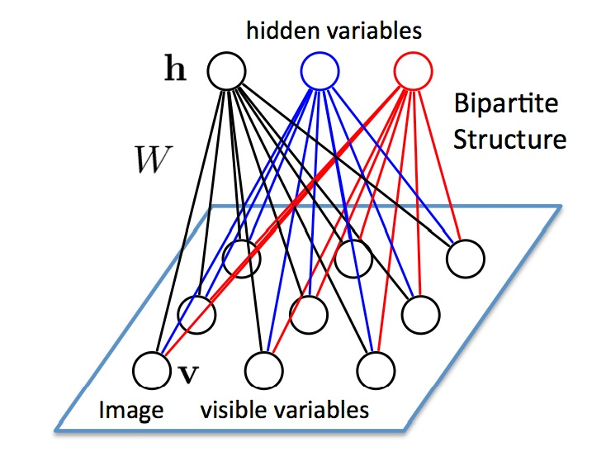
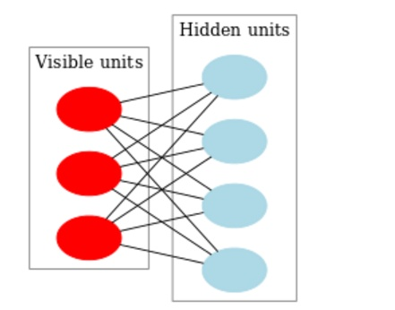
1986 ， Paul Smolensky，Rrestricted Boltzmann Machine,(RBM) :
RBM :
a simplified BM model;
an Unsumervised Machine Learning Model, which is used to reconstruct the input data(to extract the features of the data effectively and construct a new data structure for prediction and analysis).
Therefore, RBM can stack up to realize deep neural network mining data characteristics.
characteristics of the connections between :
no connection in the layer
whole connection between the layers
this is different with BM
bipartite graph
Notes:
It is a randomly generated neural network that can learn the probability distribution by input data set.
The essence of input is an undesired Machine Learning Model, which is used to reconstruct the input data, that is, to extract the features of the data effectively and construct a new data structure for prediction and analysis.
Deep neural networks can be continuously stacked to mine the features of data.
RBM consists of two layers, the visible layer (visible layer) and the hidden layer (hidden layer). The connections between neurons have the following characteristics: there is no connection in the layer and the whole connection between the layers. It is obvious that the graph corresponding to RBM is a bipartite graph. Generally speaking, the visible layer unit is used to describe an aspect or feature of the observed data, while the meaning of the hidden layer unit is generally not clear. The difference between RBM and BM can be seen as the fact that BM allows connections between neurons in the layer, whereas RBM requires that there is no connection between neurons in the layer, so the nature of RBM is that when the state of neurons in the visible layer is given, The activation conditions of each hidden layer neuron are independent, whereas when the state of the hidden layer neuron is given, the activation of the visible layer neuron is also conditional independent. Boltzmann machine allows neurons in the same layer to connect. RBM is a simplified BM model.

Slide 21
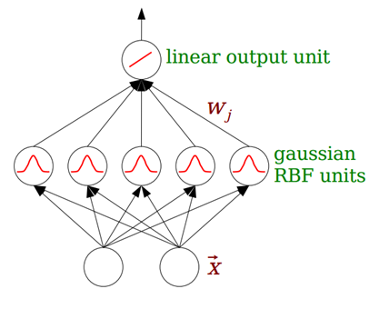
1988 ， J.Moody and C.Darken， Radical Basis Function (RBF) :
responds to the action of the input mode
RBF neural network:
forward neural network;
can approach any continuous function with arbitrary precision;
especially suitable for classification problems.
RBF radial basis function
The basic idea of RBF neural network :
the input vector can be directly mapped to the hidden space .
the data of low dimensional space is more likely to become separable when it reaches high dimensional space.
then the curve is fitted in this high-dimensional space. This is different from the ordinary multilayer perception machine MLP.
the signal source node
Notes:
RBF neural network, which belongs to the type of forward neural network, can approach any continuous function with arbitrary([ˈɑ:bɪtrəri]) precision, and is especially suitable for classification problems.
The structure of RBF network is similar to that of multilayer forward network, and it is a three-layer forward network. The input layer is composed of the signal source node, the second layer is the hidden layer, the number of hidden units depends on the need of the described problem, the transformation function of the hidden unit is RBF radial basis function. The third layer is the output layer, which responds to the action of the input mode. The transformation from the input space to the hidden layer space is nonlinear, and the transformation from the hidden layer space to the output layer space is linear.
The basic idea of RBF neural network is that RBF is used as the "basis" of the hidden unit to form the hidden layer space, so that the input vector can be directly mapped to the hidden space (that is, the input vector does not need to be connected by weight). According to cover theorem, the data of low dimensional space is more likely to become separable when it reaches high dimensional space. In other words, the function of hidden layer of RBF network is to map the input of low-dimensional space to a high-dimensional space by nonlinear function. Then the curve is fitted in this high-dimensional space. It is equivalent to finding a surface in an implicit high-dimensional space that can best fit the training data. This is different from the ordinary multilayer perception machine MLP.

Slide 22
1988 ， J.Moody and C.Darken， Radical Basis Function (RBF) :
global approximation network :
When one or more tunable parameters (weights or thresholds) of the network have influence on any output.
BP network-the global approximation network :
At each input, every weight value on the network should be adjusted, which leads to the slow learning speed of.
RBF network- the local approximation network :
If only a few connection weights affect the output in a certain local area of the input space, the network is called.
Notes:
RBF network can approximate any nonlinear function. It can handle the regularity that is difficult to resolve in the system, has a good generalization ability, and has a faster learning speed. When one or more tunable parameters (weights or thresholds) of the network have influence on any output, this network is called global approximation network. At each input, every weight value on the network should be adjusted, which leads to the slow learning speed of the global approximation network, such as the BP network. If only a few connection weights affect the output in a certain local area of the input space, the network is called a local approximation network, such as the RBF network.

Slide 23
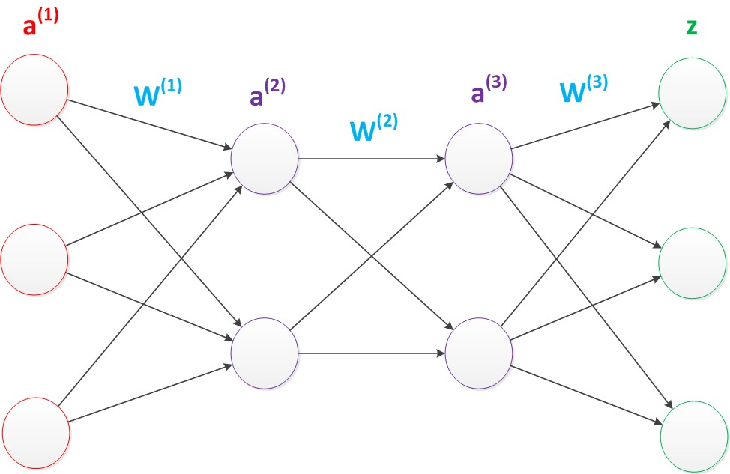
1989 ， Robert Hecht-Nielsen， Deep-Layer Perceptron(DLP) :
After the output layer of the two-layer neural network, continue to add the layer.
the original output layer the middle layer; the new level the new output layer.
activation function : ReLU function
g(W⁽¹⁾ * a⁽¹⁾) = a⁽²⁾;
g(W⁽²⁾ * a⁽²⁾) = a⁽³⁾;
g(W⁽³⁾ * a⁽³⁾) = z;
Notes:
After the output layer of the two-layer neural network, continue to add the layer. The original output layer becomes the middle layer, and the new level becomes the new output layer.
In this way, we can get more layers of multilayer neural networks. Formula derivation ([ˌderɪˈveɪʃn])is actually similar to a two-layer neural network.
In training multilayer neural networks, ReLU functions are easier to converge and have better prediction performance. Therefore, in depth learning, the most popular nonlinear function is ReLU function. ReLU function is not a traditional nonlinear function, but a piecewise linear function.
Actually,In 2011, the ReLU activation function was proposed, which can effectively suppress the problem of gradient([ˈgreɪdiənt]) disappearance.

Slide 24
1989 ， Robert Hecht-Nielsen， Deep-Layer Perceptron(DLP) :
The universal approximation theorem of DLP :
for a continuous function f in any closed interval, it can be approximated by BP network with an implicit layer.
The more powerful function simulation ability is that as the number of layers increases , more parameters mean that the function of the simulation can be more complex , and can have more capacity to fit the real relation .
Notes:
The more powerful function simulation ability is that as the number of layers increases , the more parameters of the whole network are . The essence of the neural network is the method of simulating the real relation function between the characteristic and the target , and more parameters mean that the function of the simulation can be more complex , and can have more capacity to fit the real relation .like this picture!

Slide 25
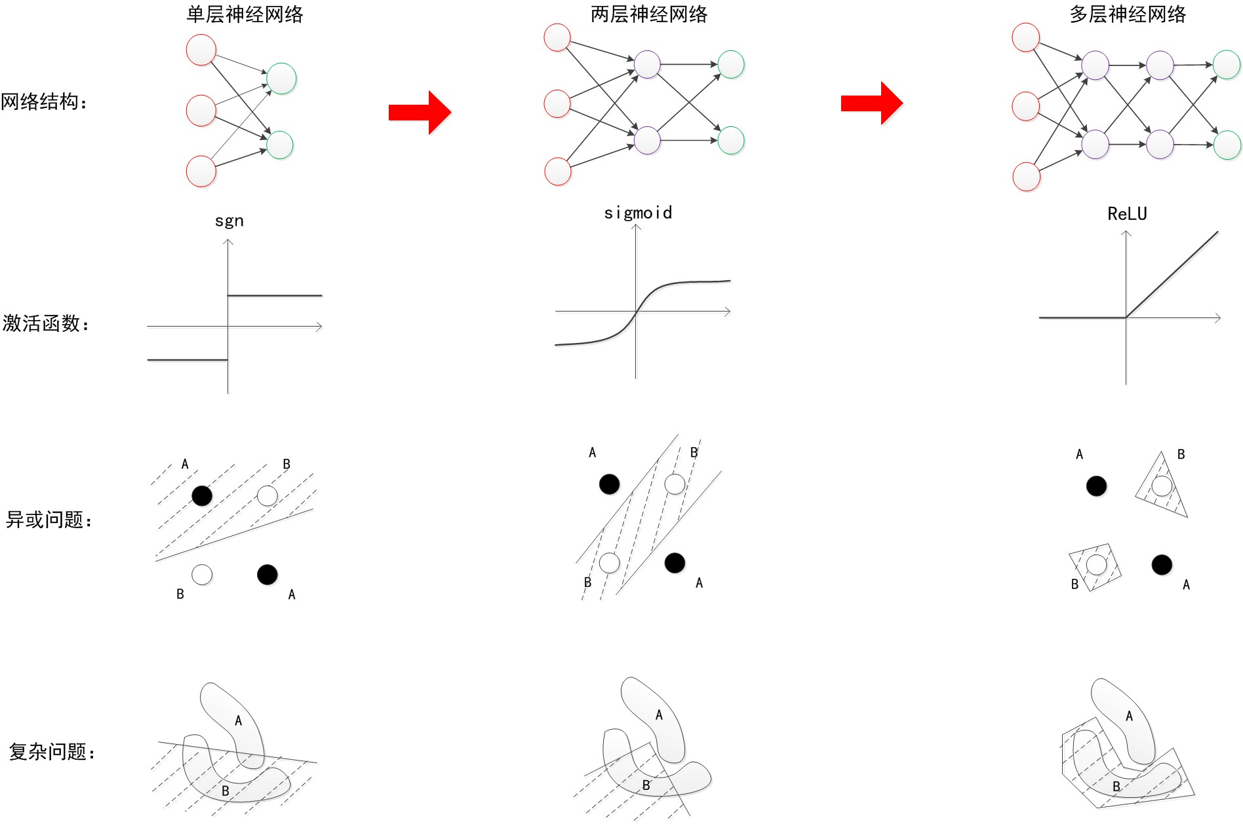
Contrast:
latticework
activation function
XOR problem
challenge
Notes:
This diagram is a perfect illustration of single-layer, two-layer, multi-layer neural networks’s development in latticewrke……..and how to solve XOR and复杂问题problem。

Slide 26
1989 ， Yann LeCun， LeNet(CNN):
It was used in digital recognition and achieved good results, but it did not attract enough attention at that time.
Notes:
In 1989, LeCun invented convolutional neural network -LeNet. and applied it to digital recognition, and achieved good results. About CNN’s development I will introduce alone. Next we will introduce RNN’s development.

Slide 27
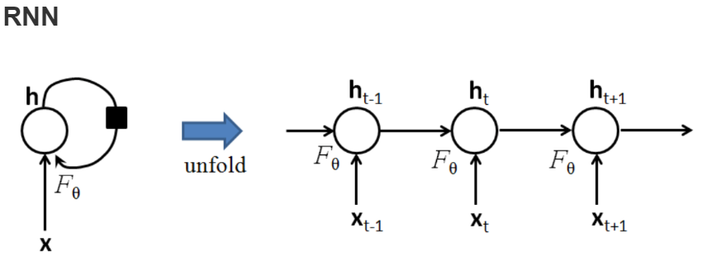


1989 ， Jeffrey L. Elmani ， Recurrent Neural Network (RNN):
RNN
recurrent neural network
recursive neural network
RNN：mainly solves the processing of sequence data
A sequence such as :
$X\{x_{1},x_{2},…,x_{N}$}
hidden variable : h
$$h_{t}=F_{θ}(\begin{matrix}h_{t−1}{,x}_{t}\end{matrix})$$
Notes:
Recurrent neural network (RNN) is the general name of two kinds of artificial neural networks. One is time recurrent neural network (recurrent neural network),) and the other is structured recursive neural network (recursive neural network). RNN generally refers to the time recurrent neural network.
RNN mainly solves the processing of sequence data, such as text, voice, video and so on. There is a sequential relationship between the samples of such data, and each sample is associated with the previous sample. For example, in the text, a word is associated with the word before it; in weather data, the temperature of the day is related to the temperature of the previous day.
A sequence such as:
Considering a sequence as a time series, the self-joining edge of the hidden layer th is actually connected to the h of the previous moment.
At each time t, the value of $h_{t}$ is the input $x_{t}$ at the current time, and a function of the implied layer value of the previous moment,the formula like this$h_{t}=F_{θ}(\begin{matrix}h_{t−1}{,x}_{t}\end{matrix})$

Slide 28
1989 ， Jeffrey L. Elmani ， Recurrent Neural Network (RNN):
Main problems of RNN :
Gradient vanishing : if the gradient is small (< 1), multiply by multiple exponential declines, with little effect on output
Gradient explosion : In turn , if the gradient is large , multiply exponentially and lead to a gradient explosion
Notes:
The main reason for the difficulty of RNN training is the propagation of hidden layer parameter([pəˈræmɪtə(r)]) w: because the error propagates on the expanded RNN, WW multiplies many times in the forward propagation process and in the back propagation process. This leads to: the gradient disappears: if the gradient is small (< 1), multiplying multiple exponential drops, the output has almost no effect on the gradient explosion: conversely, if the gradient is large, multiply by multiple exponential increases. And, of course, this problem exists in any depth neural network, only because of the recursive structure of the RNN. The simple recursive neural network can not deal with the problem that the weight exponent explodes or disappears with recursion.

Slide 29
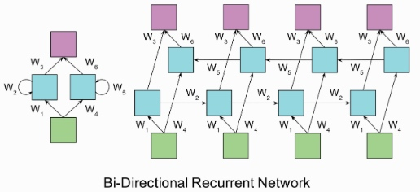
1997 ， Schuster， bi-directional RNN :
The problem of unidirectional RNN :
the information before t moment can only be used when t time is classified, but the information of future time may also be used when classifying at t moment.
the bi-directional (bi-directional) model :
one layer :used to propagate information from left to right;
the other layer is used to record the propagation of information from right to left.
Notes:
The problem of unidirectional RNN is that the information before t moment can only be used when t time is classified, but the information of future time may also be used when classifying at t moment. In order to solve this problem, the bi-directional (bi-directional) model maintains two hidden layers at any time t, one layer is used to propagate information from left to right and the other layer is used to record the propagation of information from right to left.

Slide 30
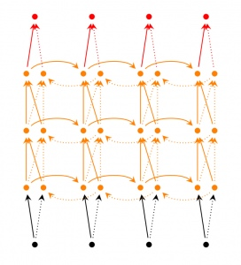
Deep RNN :
Deep RNNs are similar to Bidirectional RNNs, except that there are multilayer networks for each step of input.
the network has more powerful expression and learning ability;
the complexity is also increased;
more training data is needed.

Slide 31
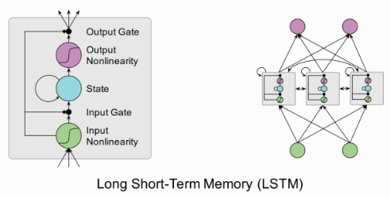
1997 ， Hochreiter and Schmidhuber ， Long Short Term Memory (LSTM):
The characteristic of this model in sequential modeling is very prominent .
difference from traditional RNN :
different from the structure of neurons.
Each LSTM cell contains ：
Input gate : a Sigmoid layer；
Forgotten Gate : a Sigmoid layer determines which information we want to update and creates a new candidate value by a tanh layer
Notes:
The characteristic of this model in sequential([sɪˈkwenʃl]) modeling is very prominent .The only difference from traditional RNN is that it is different from the structure of neurons. The traditional RNN is no different from the perceptron of a general neural network, but in LSTM, each neuron is a “cell state”, which connects the previous information to the current task. Each LSTM cell contains :
Input gate : a Sigmoid layer,outputting a number of 1 between 0 and 1 to indicate "completely retain this information" or "completely discard the information."
Forgotten Gate :a Sigmoid layer determines which information we want to update and creates a new candidate value by a tanh layer

Slide 32
1997 ， Hochreiter and Schmidhuber ， Long Short Term Memory (LSTM):
The typical workflow is as follows:
In the "input gate“: the influence of the cell memory is controlled according to the current data flow;
In the "forgotten door", the memory and data flow of the cell is updated;
Then the output updated memory and data stream.
The key of the “forgotten gate” :
control the convergence of the gradient in training time (thus avoiding the Gradient vanishing/exploding problem);
maintain long-term memory.
Notes:
霍克赖特;
The typical workflow is as follows: in the "input gate", the influence of the cell memory is controlled according to the current data flow, then, in the "forgotten door", the memory and data flow of the cell is updated. Then the output updated memory and data stream.
one of the keys to generating LSTM model in the output gate is this "forgotten gate", which can control the convergence([kən'vɜ:dʒəns]) of the gradient in training time (thus avoiding the Gradient vanishing/exploding problem), but also can maintain long-term memory.

Slide 33
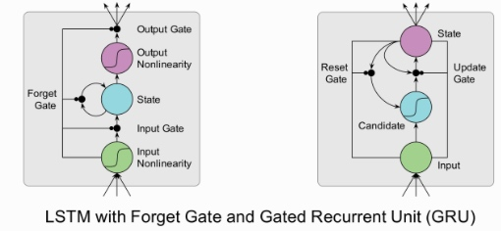
2014 ， K.Cho， Gated Recurrent Unit (GRU):
Comparison between LSTM and GRU :
GRU is a variant of LSTM.
the forgotten gate + input gate ="Update Gate",
combines Cell State and Hidden State.
The method of calculating new information at present time is different from LSTM.
GRU is chosen because its experimental effect is similar to that of LSTM, but easier to calculate.
Notes:
GRU (gated Recurrent Unit) is a variant([ˈveəriənt] ) of LSTM. It merges the forgotten gate and input gate in LSTM into a single "Update Gate", and combines Cell State and Hidden State. The method of calculating new information at present time is different from LSTM.
Compared with GRU, LSTM has less "gate control" and fewer parameters([pə'ræmɪtəz] ) than LSTM, but it can achieve the same function as LSTM. Given the computing power and time cost of hardware, we often choose a more "practical" GRU.

Slide 34
Development priorities for the next step：
Transfer learning；
intensive learning；
unsupervised learning；
confrontation Network (GAN)；
Notes:
[praiˈɔritiz]
Transfer learning, intensive（[ɪnˈtensɪv] ） learning, unsupervised learning, confrontation Network (GAN) will also radiate（[ˈreɪdieɪt] ） a new luster.
下一步的发展重点在 迁移学习、强化学习、非监督学习 层面，对抗网络（GAN） 也将会焕发新的光彩。

Slide 35

THANKS FOR WATCHING
Notes:
In the process of the introduction, there must be some shortcomings. I hope you can correct and supplement([ˈsʌplɪmənt] ) them.
Ok ,thinks for watching

