Slide 2
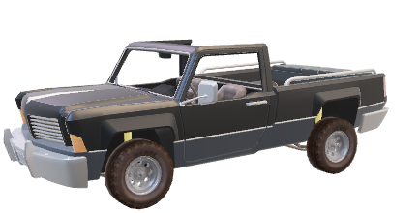
Schemas
ISA Schemas
CAR
PRIM
API Schemas
Automatic
1000Kg
RigidBody
Collisions

