Slide 1
JMS & ActiveMQ
KimmKing (禹皇)
kimmking@163.com
2011-05-18

Slide 2

Contents
Overview
JMS
ActiveMQ
Demo
Discussion

Slide 3
Overview
Message/Messaging
Approach
File
Socket
Database
RPC(dcom/corba/rmi/.net remoting/werbservice /soap/hessian/potocol buffer/thrift…)
file
DB
Client
Server
RPC

Slide 4
Overview
A
B
C
RPC
D
E
F

Slide 5
Overview
Target
Standard format
Cross platform
Syn & Asyn
Loose coupling
High Available
Reliable
…

Slide 6
Overview
B
A
C
MOM
MOM
D
F
E

Slide 7
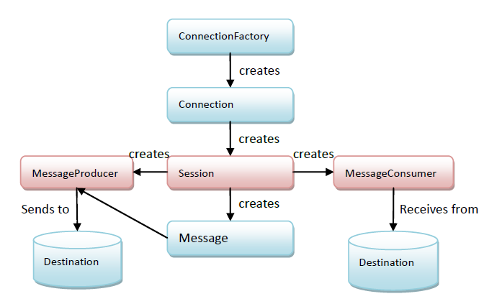
JMS
Interface

Slide 8
JMS
Message
Header
Properties
Body
Headers
JMSDestination
JMSDeliveryMode
JMSExpiration
JMSPriority
JMSMessageID
JMSTimestamp
JMSCorrelationID
JMSReplyTo
JMSType
JMSRedelivered

Slide 9
JMS
Message Types
TextMessage
MapMessage
StreamMessage
BytesMessage
ObjectMessage

Slide 10
JMS
Message Selector
A subset of SQL92
Literals
Identifiers
Expressions
Operators
NULL

Slide 11
JMS
Messaging Patterns
Point-To-Point
Queue/TemporaryQueue
QueueBrower
Pub/Sub
Topic/TemporaryTopic
DurableSubscriber

Slide 12
JMS
Acknowledgement
Transaction
Non-Transaction
AUTO_ACKNOWLEDGEMENT
CLIENT_ACKNOWLEDGEMENT
DUPS_OK_ACKNOWLEDGEMENT

Slide 13
JMS
Others
QueueRequestor/TopicRequestor
Combine Request and Response
MessageListener
On Session
On Consumer
XA Transaction
Optional interface
Strong encouraged to use transactional support by jms client

Slide 14
ActiveMQ
Jboss MQ
Open MQ
RabbitMQ
zeroMQ
……
JMS Server
JMS Client
Producer
Consumer
Producer
JMS specification

Slide 15
ActiveMQ
Apache ActiveMQ
ActiveMQ is the most popular and powerful open source messaging and Integration Patterns provider.
Tools
Web Admin Console
http://localhost:8161
JMX Console
service:jmx:rmi:///jndi/rmi://localhost:1099/jmxrmi

Slide 16
ActiveMQ
Features
Broker
Transport
Openwire
Persistence
Others

Slide 17
ActiveMQ
Broker
Failover
Network
Master-slave
Pure master-slave
JDBC master-slave
Shared file system master-slave

Slide 18
ActiveMQ
Transport
TCP
VM
SSL
HTTP/HTTPS
UDP
NIO
Peer
Multicast
Discovery/Zoreconf

Slide 19
ActiveMQ
Openwire
Command
Wire Protocol
command
command
command

Slide 20
ActiveMQ
Persistence
MemoryPersistenceAdapter
AmqPersistenceAdapter
KahaPersistenceAdapter
KahaDBPersistenceAdapter
JDBCPersistenceAdapter
Locker!

Slide 21
ActiveMQ
Message Cursor
Store-based
File
VM
Enough memory？
cursor
Yes
No
Store-based
Enough memory？
cursor
Yes
No
File

Slide 22
ActiveMQ
Tips
Auto-create queue
Composite Destinations
Flow-control
Fast/slow comsumer
Xpath selector
Wildcard
……

Slide 23
ActiveMQ
Performance Test
Direct
ActiveMQ perf-plugin √
HermesJMS and SoapUI
LoadRunner-java
Indirect
JSP/Servlet—(LR/ab…) √
Webservice—(SoapUI)
Configs
http://fusesource.com/docs/broker/5.4/tuning/index.html

Slide 24
Others
Integration with Spring
Xbean-spring
Spring-JMS
Integration with Camel
Transports
Routers

Slide 25
Others
Other support
Rest(camel)
Ajax(camel)
Axis/CXF(camel)
JMS UnitTest(memory broker)
Osgi(Activator)
Plugin(Interceptor)

Slide 26
Refers
JMS Specification(JSR914)
http://jcp.org/en/jsr/detail?id=914
http://www.oracle.com/technetwork/java/jms/index.html
ActiveMQ
http://activemq.apache.org/
Books
ActiveMQ in Action
Apache ActiveMQ Reference Guide
Enterprise Integration Pattern

Slide 27
for more…
Discussion
Config server
NoSQL persistence
ActiveMQ-Store-MongoDB
http://code.google.com/p/activemq-store-mongodb/
Governor/Management
Master-Slave

Slide 28

Thanks!

