Slide 1
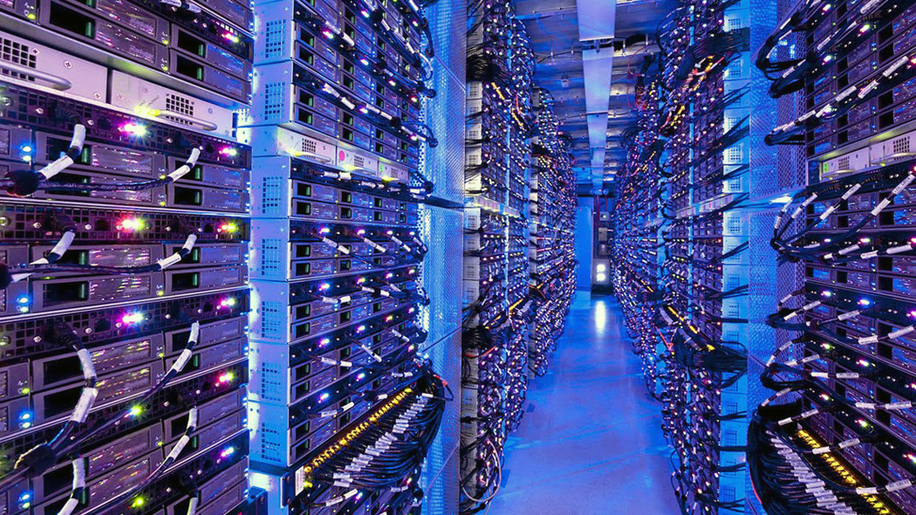
Big Data
Zwe Nyan Zaw
CS1104 Presentation
This Photo by Unknown author is licensed under CC BY-NC-ND.

Slide 2
What is Big Data?
Big data refers to extremely large and complex data
It is brought about by the invention of the digital computer, the internet and the world wide web
Big data is usually characterized by its
Volume
Velocity and
Variety

Slide 3
Volume and Velocity
1990 – Total digital data in the world is 1.5 Exabytes
1991 – The world wide web was publicly launched
1999 – 1.5 Exabytes of data produced in one year
Nowadays – 2.5 Exabytes of data produced every day
Note
1 Exabyte = 1,000,000 Terabytes

Slide 4
Serving Big Data and its replication
Data can be encoded or decoded in different schemes for different purposes but it is just binary (1s and 0s) in the end
Binary data has to be stored in memory (like SSD) somewhere
Exabytes of data are produced every day and they are stored in large data centers around the world
Data also has to be served. Content-Delivery-Networks (CDNs) are a global network of big data centers dedicated to serving data on the internet. They often use caching (replication) for a better UX.

Slide 5


Inside a Microsoft data center
This Photo by Unknown author is licensed under CC BY-NC-ND.

Slide 6
Sources of big data
Structured Data
Unstructured Data
refers to data stored in relational databases (with rows, columns, and relationships) as well as spreadsheets and CSV files
refers to the rest of data like emails, blog posts, audio recordings, images, videos, social media posts, fitness data, sensor data, car and vehicle data, video games, etc.

Slide 7
Why does variety matter?
The fact that there are different sources of data and each data can in turn be considered structured or unstructured is called its variety.
Variety matters because structured data is far more easier for data analysis.
Unstructured data requires much more advanced tools like natural language processing (NLP), machine learning, and audio analysis in order to analyze meaningful relationships between unstructured data.
It is also considered to take up more memory than structured data.

Slide 8
Veracity and Value
Veracity refers to the trustworthiness of data.
Since the volume of data is so large, a sizable percentage of it contain human errors as well as machine errors. Applications and systems taking advantage of big data need to take this into consideration.
ChatGPT is one of the most advanced uses of big data. It is trained on 45 terabytes of text, and has a vocabulary of 3.4 billion unique words. A technological marvel like ChatGPT is possible only because of the enormous value that big data provides.

Slide 9
Challenges and concerns
Building data centers for serving data, data processing and storage costs a lot of money, even for big companies.
Each server or hardware is an electrical component that must be manufactured, shipped, and installed in-house.
Shortage of semi- conductors, micro-chips, memory, etc. and the global economy has a direct impact on big data infrastructure.
Big data is expected to grow even more exponentially in the coming years. Scalability of big data infrastructure is thus a real challenge.

Slide 10
Some solutions
Storing, processing, and retrieving big data is not easy, especially for unstructured data
There are much more unstructured data than structured data. Also, much of the unstructured data tend to be unimportant like routine system reports, crash logs, non-critical sensor data, etc.
To solve this, non-relational databases have been created. They are good at storing and querying large quantities of unstructured data
They are also equipped with both horizontal and vertical scaling

Slide 11


Thanks for listening

