Slide 1
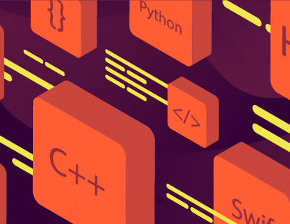
Classification of Programming Languages
Zwe Nyan Zaw
CS1104 Presentation

Slide 2
Procedural vs Non-procedural
Procedural programming
The emphasis is on giving explicit instructions (how)
You use control structures like sequence, selection, and iteration to write the program logic
Code is usually organized in procedures or functions
Non-procedural programming
Declarative programming (specifying what not how)
Functional programming (immutable data, pure functions that have no side effects, uses recursion)
Logic and Object-Oriented programming

Slide 3
Scripting (interpreted)
Used to script an existing application or system rather than to create new compiled programs.
They are usually interpreted languages. (do not compile to machine code directly, need a runtime)
Examples
JavaScript is interpreted and executed (JIT) by the browser's engine to modify web pages and use browser APIs. It is also used in the NodeJS runtime as a server-side language but it is still interpreted.
Python is used in data visualization, natural language processing, machine learning, writing scripts such as Discord and Telegram bots, etc.
Lua is used to configure games (e.g. Roblox) and customize IDEs and text editors (e.g. NeoVim).

Slide 4
Domain-specific (or problem-oriented)
Limited to usage only in their domains or problems.
They are designed to be the best at what they do.
Examples
Hyper-Text Markup Language (HTML) is used to define the structure, markup, and semantics of a web page
Cascading Style Sheets (CSS) is used to define the styling and appearance of a web page
HTML and CSS are defined according to the web standards set by the W3 Consortium for a common world wide web experience.
Structured Query Language (SQL) is used in relational databases to query data

Slide 5
Low level vs High level
Low level languages
Interact directly with hardware
Used when you want to control and debug the exact behaviors of a CPU
Assembly languages (if similar architecture then similar instruction set, for example x86, ARM, etc.)
Machine code, and Systems programming languages with manual memory management like C
High Level languages
Are closer to human language
Easier to create new functionality as they provide layers of abstraction
Most popular languages are high level languages

Slide 6
Dynamic vs Static
Dynamically typed languages
You can reassign variables to any type
Variable types can change at runtime
Examples — Python, Ruby, JavaScript
Statically typed languages
You cannot reassign variables to a different type
Variable types are checked at runtime
Examples — C, C++, Java, Go, Rust

Slide 7
Key points for exam
QUESTIONS
What are the differences between dynamic and static programming languages? Give 2 examples for each.
What are higher-order functions?
OBJECTIVES
Data is ______ in declarative programming languages. (a) mutable (b) immutable (c) finite (d) infinite (immutable)
One example of a systems programming language is ____ .
All CPUs have the same Assembly language. (false)

Slide 8

Thanks for listening

