Slide 1
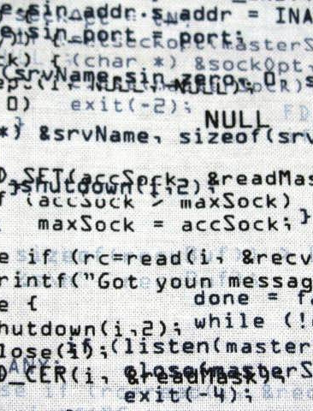
Control Structures
Zwe Nyan Zaw
CS1104 Presentation

Slide 2
Overview
Sequence
Controls the order in which instructions are processed
Selection
Defines which paths a program could take while executing
If-else statement
switch statements
Iteration
Repeats the execution of a specific code
While statement
Do … while statement (repeat … until)
For statement

Slide 3
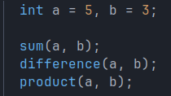
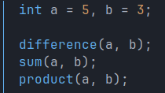
Sequence
Controls the order in which instructions are processed

Slide 4
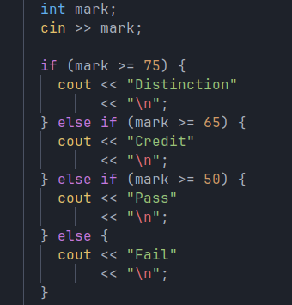
Selection if-else statement
Defines which paths a program could take while executing

Slide 5
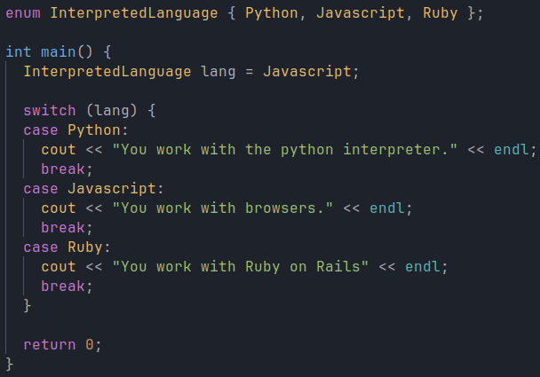
Selection switch statement
Defines which paths a program could take while executing

Slide 6
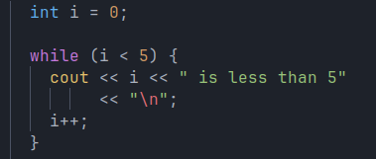
Iteration while loop
Repeats the execution of a specific code

Slide 7
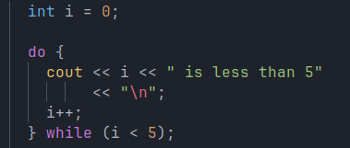
Iteration do … while loop
Repeats the execution of a specific code

Slide 8
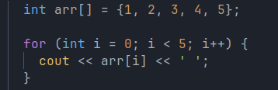
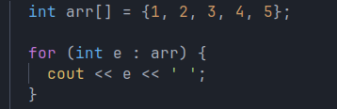
Iteration for loop
Repeats the execution of a specific code

Slide 9
Key points for exam
QUESTIONS
List the three control structures.
When are selection and iteration control structures used?
OBJECTIVES
You can use ____ to control the program logic. (a) switch (b) do … while (c) for loop (switch)
Selection control structures are ____ and ____ .
The for loop is a selection control structure. (false)

Slide 10

Thanks for listening

