Slide 1

Data Types in C++
Zwe Nyan Zaw
CS1104 Presentation

Slide 2
Overview
Primitive data types
char
int, float, double
bool, void
Derived data types
Arrays
Pointers
References
User-defined data types
Structs
Classes
Enums

Slide 3
Integers
The memory allocation of int depends on the specific compiler used (Clang, GCC, etc.) and the architecture of the operating system (32-bit, 64-bit, etc.)
In a 32-bit environment, an int is usually 16 to 32 bits.
In a 64-bit environment, an int is usually be allocated 32 to 64 bits.

Slide 4
Type modifiers
Type modifiers are used to modify the behavior and properties of data types
Type modifiers
long
short
signed
unsigned
For example
long int, unsigned int

Slide 5
Floats and Doubles
float
Uses 32 bits
Also called "single precision"
1 bit for the sign part, 8 bits for counting decimal places, and 23 bits for significant digits.
double
Uses 64 bits
Also called "double precision"
1 bit for the sign part, 11 bits for counting decimal places, and 52 bits for significant digits.
Reason behind the naming
The notion of the name double comes from it having significantly more bits than a float, though not literally double the bits.

Slide 6
Characters
Memory allocation of a C++ char depends on the specific compiler used and the operating system
The <cctype> (C Character Type) header from the C++ standard library supports useful functions such as:
toupper() tolower() isupper() islower()
C-style character array strings are supported by the <cstring> header. It supports useful functions such as:
strcmp() strcpy() strcat() strlen()
Input-output of C strings is support by <iostream>
cin getline() get() ignore()

Slide 7
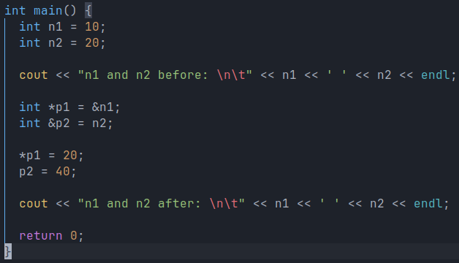
Pointers vs References
A pointer (*) is a memory address of a variable.
A reference (&) is an alias for an existing variable.
A pointer allows you to do memory management. You can also change the actual value of the variable using pointer dereferencing (with *).

Slide 8
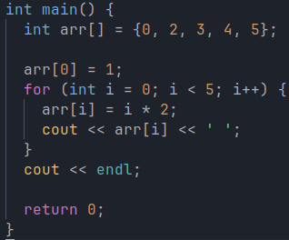
Arrays
Arrays are fixed in both length and data type.
You can access array elements by using their index or by looping over the array using a "for" loop.
A "for" loop consists of Initialization, Condition, and Increasement/ De-creasement.

Slide 9
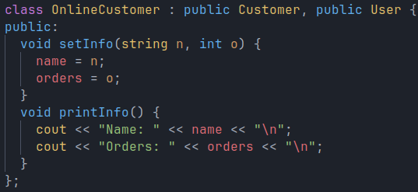
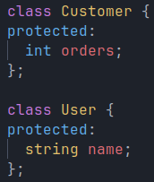
Classes
C++ classes have 3 access keywords: public, private, and protected.
C++ also allows classes multiple inheritance.

Slide 10
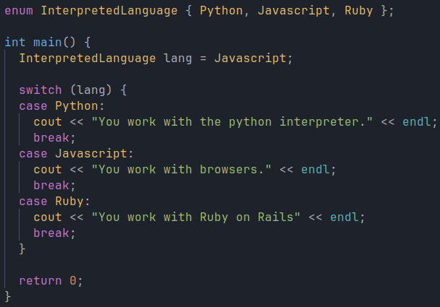
Enums
Enums are a way to enumerate every possible value for a variable.

Slide 11
Key points for exam
QUESTIONS
What is an enum used for?
What are the differences between pointers and references?
What are the characteristics of a "for" loop?
OBJECTIVES
You can use ____ if you want to use OOP in C++. (a) structs (b) classes (c) enums (classes)
Memory allocation of a C++ integer usually depends on ____ used as well as ____ .
All CPUs have the same Assembly language. (false)

Slide 12

Thanks for listening

