Slide 1
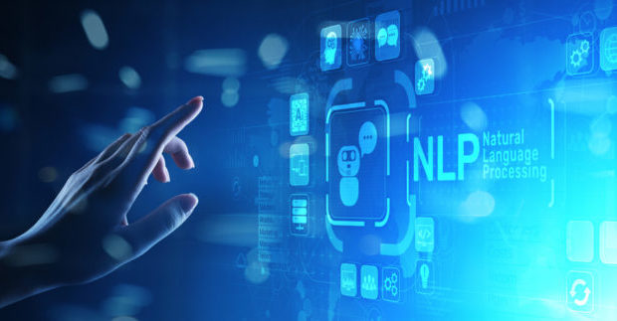
Natural Language Processing
Zwe Nyan Zaw
CS1104 Presentation

Slide 2
Overview
Natural Language Processing is essentially taking in training datasets, transforming them into an acceptable format, and using different models to train them.
Once trained, the model can make predictions on future datasets that it hasn't seen before.
For example
Label 20,000 sentences with polite or rude. This is our training dataset.
However, we first need to transform (tokenize) them into a format our NLP model will understand.
Once trained, the model can predict entirely new sentences it has never seen before whether it's polite or rude. This is called sentiment analysis.

Slide 3
Measuring model accuracy
We can also measure a model's accuracy if we have the correct labels for our testing dataset.
We will feed the model the testing dataset but we won't show it the correct labels.
Once the model has done the prediction, we can compare the results with the correct labels.
We now have the model's accuracy score!
The accuracy of the model depends on
The quality of the dataset
How big the dataset is
The quality of the model itself
Whether there is sampling bias or not, etc..

Slide 4
Types of processing in NLP
Morphological processing
Unsuccessful – un + success + ful (morphemes)
Syntactic processing
London is the capital of the United Kingdom
Is the United Kingdom the of London capital.
Semantic processing
Using knowledge bases and dictionaries to learn what each word in the sentence means (semantic structure)
Context processing
Interpreting relationships between sentences and pronouns such as "it" and "that"
Intention processing
Taking into consideration the intention of a sentence
The bark of a tree (not equal to dog barks)

Slide 5
Loading datasets
First, you must create data frames with the Pandas library
Training datasets are usually prepared in .CSV format, sometimes in JSON format
Pandas provide several functions like
read_csv()
read_json() and
DataFrame() constructor

Slide 6
Tokenization
Training datasets can have millions of words, this is called its Corpus. The collection of unique words that appear in the corpus is called the Vocabulary.
Tokenization is creating a numerical representation of each unique word in the dataset, stripping punctuation marks (like ! , etc.) in the process.
For example
Programming is fun.
I love programming!
Our corpus has 6 words. But our vocabulary will contain only 4 unique words (no repeating).
Programming = 1, is = 2, fun = 3, I = 4, love = 5
Tokenization should recognize 'programming' even though it has a "!" the second time we see it.

Slide 7
Transformation (creating feature matrix or vector)
We can now create feature matrices or vectors by mapping the sentences with the vocabulary we just created.
Vocabulary
Programming = 1, is = 2, fun = 3, I = 4, love = 5
Feature Vectors
[ 1 1 1 0 0 ]
[ 1 0 0 1 1 ]
In many NLP libraries, creating the vocabulary is called fit or fitting and creating feature vectors is called transform or transformation.
Why create feature vectors? Short answer is:
Because NLP models do not usually process raw words or strings. They may also need a vocabulary.

Slide 8
Conclusion
Feature vectors are then input into a classification model like Multinomial NB (Naive Bayes), which is based on the Bayes' theorem in mathematics (probability and statistics).
Once trained, you can save the model for future use.
All of this can be done in a Jupyter notebook using python libraries like Pandas and Scikit-Learn.
There are also other libraries like SpaCy and NTLK.
Deep learning (neural networks)
If you want to use deep learning models instead, you can use frameworks like TensorFlow, PyTorch, and Keras.

Slide 9
Conclusion
Today there is on-going exciting research in NLP about new models, techniques and applications.
Our example uses a classification model. However, NLP is not limited to binary classification.
For example, ChatGPT uses a transformer model. It is trained using 2-step process: pre-training and fine-tuning.
Language capabilities (of latest transformer models)
Morphological understanding
Syntactic understanding
Semantic understanding
Contextual understanding
Intention understanding

Slide 10
Key points for exam
QUESTIONS
Define the following terms in NLP: corpus, vocabulary, tokenization, and feature vectors.
What factors does the accuracy of an NLP model depend on?
OBJECTIVES
You can use the ____ library to load the datasets. (a) Scikit-Learn (b) Pandas (c) Jupyter (Pandas)
One example of a programming language used for scientific computing and statistics is ____ .
NLP models are able to process raw words or strings. (false)

Slide 11

Thanks for listening

