Slide 1

Programming Paradigms
Zwe Nyan Zaw
CS1104 Presentation

Slide 2
Procedural
You have to specify how to solve a problem
The emphasis is on giving explicit instructions
So procedural languages are imperative in nature
You use control structures like sequence, selection, and iteration to write the program logic
This is also known as "control flow"
Code is organized in procedures or functions
Data is mutable
Data is stored in local and global variables

Slide 3
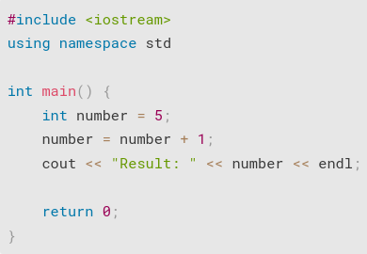
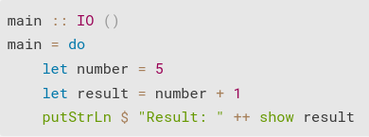
Functional
Data is immutable (in purely functional languages)
Only constants are available, variables don't exist
You do not reassign data, you create new bindings
language: C++
language: Haskell

Slide 4
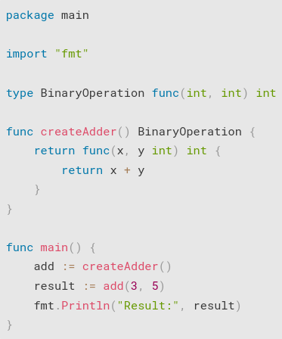
Functional
Functions are first-class citizens
Higher-order functions also exist
language:
Go

Slide 5
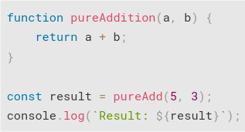
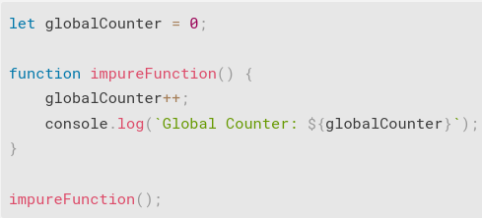
Functional
Functions should have no side effects (pure functions)
JavaScript pure function
JavaScript impure function

Slide 6
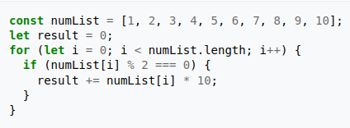
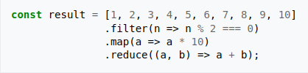
Functional
The emphasis is usually on expressing what you want to do without explicitly describing how to do it.
This is called known as declarative paradigm.
functional (declarative) JavaScript
Non-functional (imperative) JavaScript

Slide 7
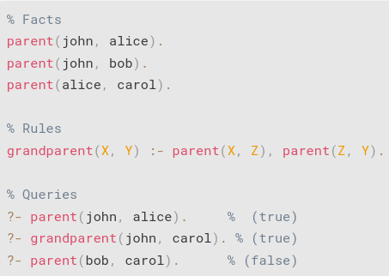
Logical
Logical paradigm uses facts, rules (relationships), and queries for logical reasoning
language:
Prolog

Slide 8
Object-Oriented
Code is organized around classes and objects
An object is an instance of a class
Objects can have attributes (properties) as well as methods (behaviors)
OOP emphasizes the qualities of encapsulation, inheritance and polymorphism
Encapsulation is implemented with keywords like public, private, and protected. Messages should be used to ensure the object is treated as a black box.
Some languages support multiple inheritance and some do not. The parent class is called the Super-class and the child class is called the Sub-class
Polymorphism can be achieved with parent class inheritance (function overriding, overloading)

Slide 9
Multi-paradigm
It is worth mentioning that most languages these days are multi-paradigm, meaning they try to support more than one style of programming.
For example
Python, JavaScript, and C++ can be written in both procedural and object-oriented paradigms
They have limited support for functional paradigm (because unpure functions (functions with side effects) are allowed, and data is mutable in these languages)
Thus not all languages can be considered to be purely functional, object-oriented or procedural.

Slide 10
Single-paradigm
However, there are also languages considered to be purely single-paradigm languages
For example
C is procedural (imperative)
Haskell, Lisp and Erlang are considered to be purely functional languages (data is immutable, functions should not have side effects, logic is declarative)
Prolog is a purely logical programming language

Slide 11
Key points for exam
QUESTIONS
What are the differences between dynamic and static programming languages? Give 2 examples for each.
What are higher-order functions?
OBJECTIVES
Data is ______ in declarative programming languages. (a) mutable (b) immutable (c) finite (d) infinite (immutable)
One example of a systems programming language is ____ .
All CPUs have the same Assembly language. (false)

Slide 12

Thanks for listening

