Slide 1

Situational Self Leadership

Slide 2
Why I needed it?
Conflict at work, where I had two options of resolving it or running away from it.
Choose to give a try at resolving it.
Started looking for resources and identified this 8-hour in person training called “Situation Self Leadership”.

Slide 3
Purpose
“… build your competence as a SELF LEADER to get the direction and support you need to achieve your goals and to increase your work passion.”
Checklist:
Speak the language of leadership -- Situational Leadership II
Partner for Performance with your manager
Accelerate your learning cycle
Gain autonomy and control

Slide 4
What Motivates you at work?
 | What Motivates Me? | What Motivates This Group?
Interesting work
Full appreciation of my work and efforts
Feeling of being in on things
Job security
Good wages
Promotion and growth within the organization
Good working conditions
Personal loyalty to employees
Sympathetic help with personal problems
Tactful disciplining

Slide 5
What Motivates you at work? (Research Results)
Research Results
 | (Employees) | (Supervisor)
Interesting work | 1 | 5
Full appreciation of my work and efforts | 2 | 8
Feeling of being in on things | 3 | 10
Job security | 4 | 2
Good wages | 5 | 1
Promotion and growth within the organization | 6 | 3
Good working conditions | 7 | 4
Personal loyalty to employees | 8 | 7
Sympathetic help with personal problems | 9 | 9
Tactful disciplining | 10 | 6

Slide 6
True or False?
It is unrealistic to expect others to always know your goals, motivations, and needs—people can’t read minds
It is in your own best interest to determine what you need in order to create your own success.

Slide 7
Diagnosing development level
What is the goal or task?
What is my level of competence at this goal or task?
DEFINITION: Competence is a measure of your knowledge and skills related to the task at hand.
What is my level of commitment to this goal or task?
DEFINITION: Commitment is a measure of your motivation to want to do the task and your confidence in your ability to do the task.

Slide 8
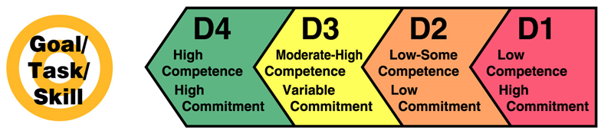
Development Level Continuum

Slide 9
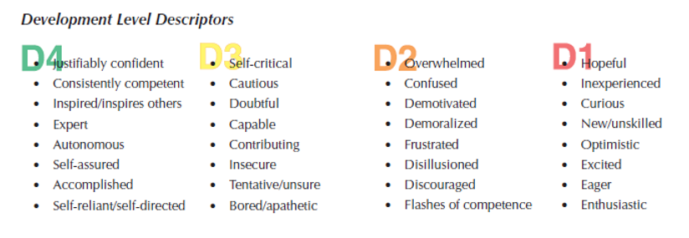

Slide 10
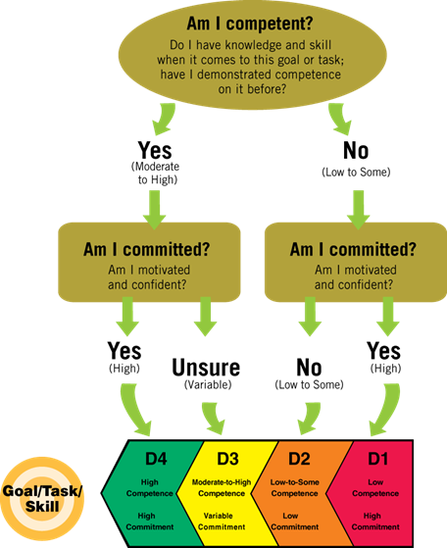

Slide 11
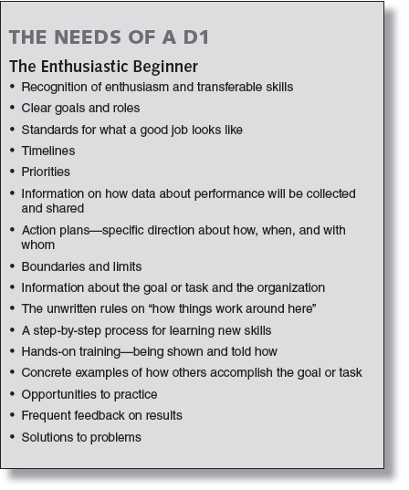
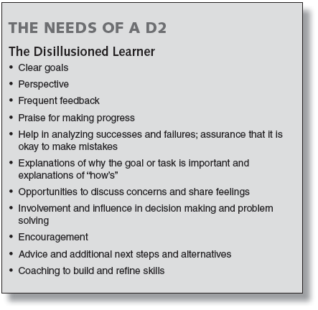
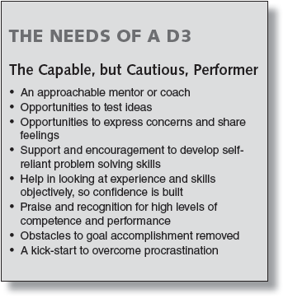
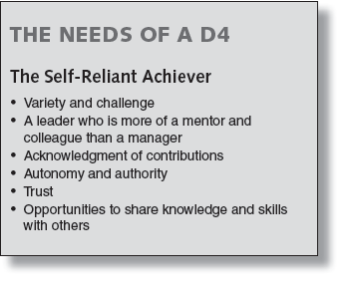

Slide 12
Leadership styles
Directive Behaviors…
Help you build your competence -- your task-relevant knowledge and skills
Supportive Behaviors…
Help you build your commitment -- your motivation and confidence

Slide 13

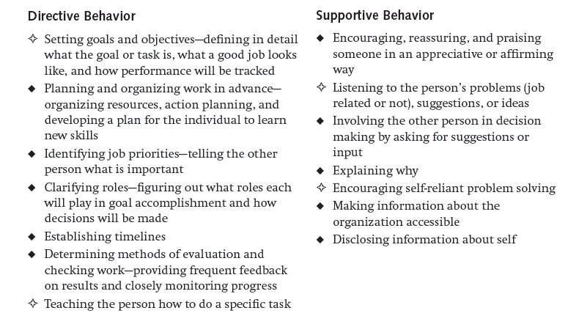
Directive & Supportive Behaviors

Slide 14
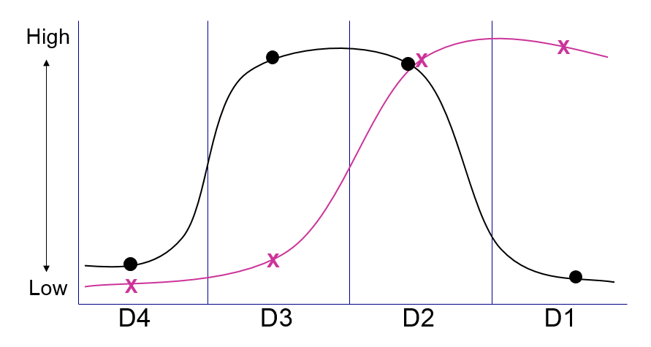
How Much Support & Direction do you need?
Legend: x = Direction
• = Support

Slide 15
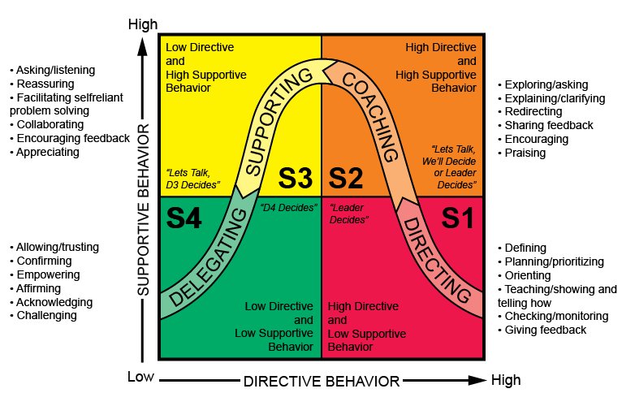
The Four leadership Syles

Slide 16
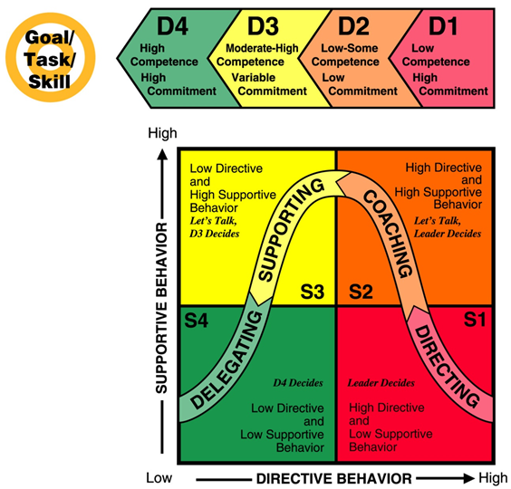
When it all comes together…

Slide 17
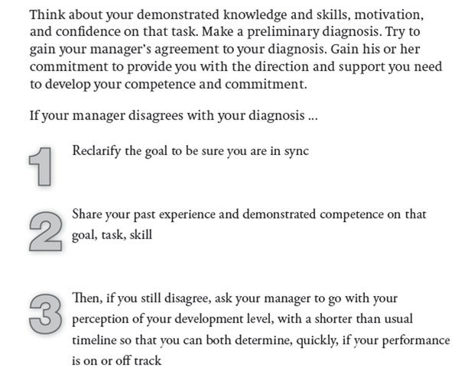
What if, it doesn’t.. ☺

Slide 18
Other personal learnings over last 5 years..
Common sense is not so common! ☹
This framework fits for both work & life.
Almost every problem that I see, there must be someone else who already faced it before.
Learn from others’ experiences.
Be proactive
Set…. follow-up…. course correct…. SUCCEED!!
SUCCEED LEARN!!

Slide 19
Additional Resources
Link to the book based off which this workshop was designed: https://microsoft.sharepoint.com/sites/mslibrary/Pages/BibDetailsEx.aspx?bibid=296055

