Slide 1

Keyboards &
Presented by Shijie Zhang

Slide 2
Keyboards &
Covert Channels
Guarav Shah, Andres Molina, Matt Blaze
The Best Student Paper in 15th USEINX, 2006

Slide 3
Outlines
Introduction
Previous work
Presented scheme
Implementation details
Evaluation
Conclusion

Slide 4
Outlines
Introduction
Previous work
Presented scheme
Implementation details
Evaluation
Conclusion

Slide 5
Introduction
How to hide information?

Slide 6
Introduction
How to hide information?
Cryptography
Steganography

Slide 7

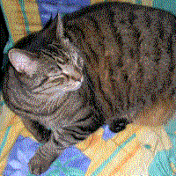

Introduction
How to hide information?
e.g. an image
Cryptography --
Does no hide the
existence of the message
Steganography --
hide the
existence of the message

Slide 8


Introduction
Applications of steganography:
Protection against removal
(Watermarking)
Steganography
Protection against detection
(Data hiding)
Covert channel is the network steganography

Slide 9
Introduction
Applications of steganography:
Protection against removal
(Watermarking)
Steganography
Protection against detection
(Data hiding)
Covert channel is a subset of steganography

Slide 10
Introduction
Steganography VS Covert channel
Both aim to establish secret communication channels
neutral bad -- violates security policies
(data hiding or (data hiding)
watermarking)
usually focus on volatility data such
as memory, network traffic

Slide 11
Introduction
Side Channel VS Covert channel
Both aim to establish secret communication channels
Sender leaks data Sender leaks data
unintentionally intentionally

Slide 12
Introduction – Applications
Applications of covert channel:
MAC systems (Mandatory Access Control)
2. General purpose systems

Slide 13

Introduction – Applications
Applications of covert channel:
MAC systems (mandatory access control systems):
Light Pink Book:
Specially on
Covert channel analysis
in MAC systems
Notes:
The notion of covert channel was popularized by the Rainbow Series. The Rainbow Series are a series of computer security guidelines and processes to certificate that a computer system is secure. They were developed by US government in 1980s and 1990s. Basically different colors deal with different aspects of security.
Among them, the Light Pink Book focuses on analysis of covert channels.
Light Pink Book - specifically focus on covert channel analysis
Orange Book
- Centerpiece of the Rainbow Series
- Has requirements on covert channel analysis for specific systems

Slide 14


Introduction – Applications
Applications of covert channel:
MAC systems (mandatory access control systems):
Depends on the system administrator to decide which user can access which information
higher
Top Secret
Secret
Confidential
Unclassified
Top Secret
Secret
Confidential
Unclassified
user
information

Slide 15
Introduction – Applications
Applications of covert channel:
To keep confidentiality in MAC system:
Top Secret
Secret
Confidential
Unclassified
information
Cannot read/can write
Can read/write
user
information
Can read/cannot write
information

Slide 16
Introduction – Applications
Applications of covert channel:
To keep confidentiality in MAC system:
Top Secret
Secret
Confidential
Unclassified
information
Cannot read/can write
Can read/write
user
information
Can read/cannot write
information
Covert channels will establish secret channels!!!

Slide 17
Introduction – Applications
Applications of covert channel:
General purpose systems:
To leak out sensitive information (credentials) by malwares

Slide 18
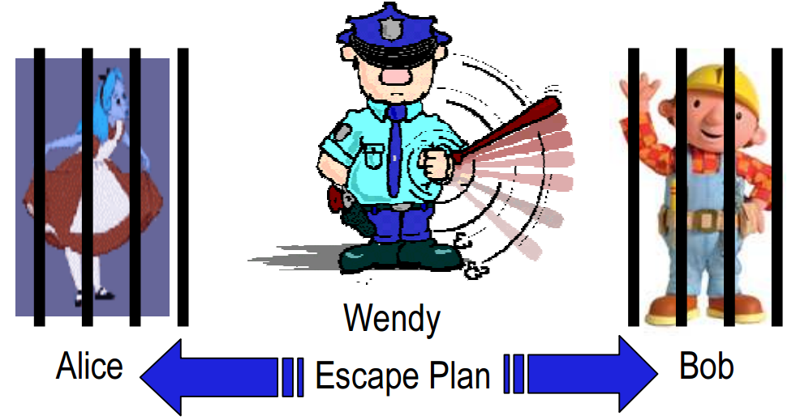
Introduction – Threat Model
Prisoner model:
Alice
Walter
Bob
prisoner
Warden
(passive)
prisoner

Slide 19
Introduction – Threat Model
Prisoner model:
Alice and Bob are prisoners locked up in different cells and wish to escape.
They are allowed to communicate using computers as long as the message is innocuous.
They have already shared a secret.
Walter is a warden who monitors the network.
Alice and Bob win when they escape without rousing suspicion of Walter.
Alice
Walter
Bob
prisoner
Warden
(passive)
prisoner

Slide 20
Introduction – Threat Model
In practical applications, Alice and Bob could be the same person
Alice
Walter
Bob
prisoner
warden
prisoner
Notes:
In a practical instantiation of this problem, Alice and Bob may well be the same person. Consider a machine to which an attacker has unrestricted access for only a short amount of time, and which lies within a closely monitored network. The attacker installs a keylogger on the machine, and wishes to leak passwords to himself in such a way that the owner of the network does not observe that anything untoward is happening.

Slide 21
Introduction – Possible Covert Channels
Criteria to select communication channel:
Generality
Technical difficulty
Capacity
Detectability
More like final steps in covert channel design
Notes:
In a practical instantiation of this problem, Alice and Bob may well be the same person. Consider a machine to which an attacker has unrestricted access for only a short amount of time, and which lies within a closely monitored network. The attacker installs a keylogger on the machine, and wishes to leak passwords to himself in such a way that the owner of the network does not observe that anything untoward is happening.

Slide 22
Introduction – Possible Covert Channels
Disk
Memory
Network protocol headers
Network payload
… …
Storage channel
Manipulate content
of a location
covert
channels
Disk accesses
Memory accesses
Network Packet arrivals
… …
Timing channel
Manipulate timing or ordering of events

Slide 23
Introduction – Possible Covert Channels
Disk
Memory
Network protocol headers
Network payload
… …
Storage channel
Higher capacity,
Less noises,
Easier to be detected
covert
channels
Disk accesses
Memory accesses
Network Packet arrivals
… …
Timing channel
Lower capacity,
More noises,
Harder to be detected

Slide 24
Introduction – Possible Covert Channels
Disk
Memory
Network protocol headers
Network payload
… …
Storage channel
Require
Shared
resources
covert
channels
Disk accesses
Memory accesses
Network Packet arrivals
… …
Not quite general
Timing channel

Slide 25
Introduction – Possible Covert Channels
Disk
Memory
Network protocol headers
Network payload
… …
Storage channel
What about
network
???
covert
channels
Disk accesses
Memory accesses
Network Packet arrivals
… …
Many options
Timing channel

Slide 26
Introduction – Which Layers & Protocols?
Which network layers and protocols should be exploited
for cover channels?

Slide 27
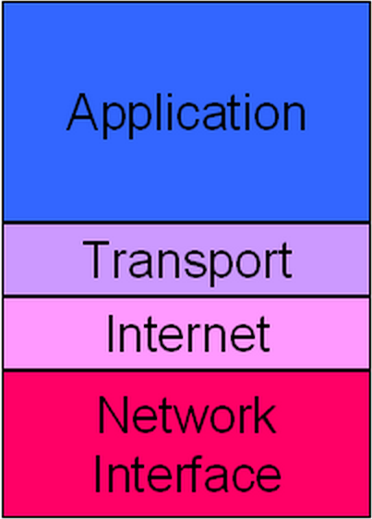
Introduction – Which Layers & Protocols?
Technical
difficulty
TCP/IP model

Slide 28
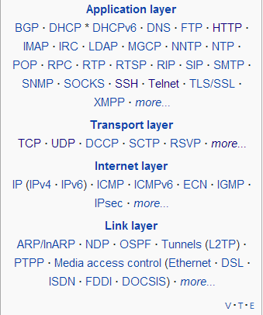
Introduction – Which Layers & Protocols?
TCP/IP model
Diversity of protocol
Generality

Slide 29
Introduction – Which Layers & Protocols?
realizing covert channels in network interface layer ???
Relies on hardware and
network topologies. Requires to
be on the same LAN
E.g. information hided may be
stripped out at network devices
such as router
2. More technical difficulties
TCP/IP model

Slide 30
Introduction – Which Layers & Protocols?
Two Observations:
1. More popular the protocol is,
more general the covert channel is.
2. More higher the layer is,
the less technical difficulty they will encounter.
TCP/IP model

Slide 31
Outlines
Introduction
Previous work
Presented scheme
Implementation details
Evaluation
Conclusion

Slide 32
Introduction – Which Layers & Protocols?
Disk
Memory
Network protocol headers
Network payload
… …
Most previous work focus on
the protocols:
Storage channel
TCP, IP, ICMP, HTTP/FTP, DNS, etc.
covert
channels
Disk accesses
Memory accesses
Network Packet arrivals
… …
Timing channel

Slide 33
Introduction – Which Layers & Protocols?
Disk
Memory
Network protocol headers
Network payload
… …
Storage channel
covert
channels
Disk accesses
Memory accesses
Network Packet arrivals
… …
Timing channel
Three options here

Slide 34
Previous Work – Network Payload
Disk
Memory
Network protocol headers
Network payload
… …
Storage channel
TCP, IP, ICMP, HTTP/FTP, DNS, etc.
e.g. email subject, attachment
covert
channels
Disk accesses
Memory accesses
Network Packet arrivals
… …
Timing channel

Slide 35
Previous Work – Protocol Headers
Header fields unused, or reserved for future use
Disk
Memory
Network protocol headers
Network payload
… …
Storage channel
TCP, IP, ICMP, HTTP/FTP, DNS, etc.
covert
channels
Disk accesses
Memory accesses
Network Packet arrivals
… …
Timing channel

Slide 36
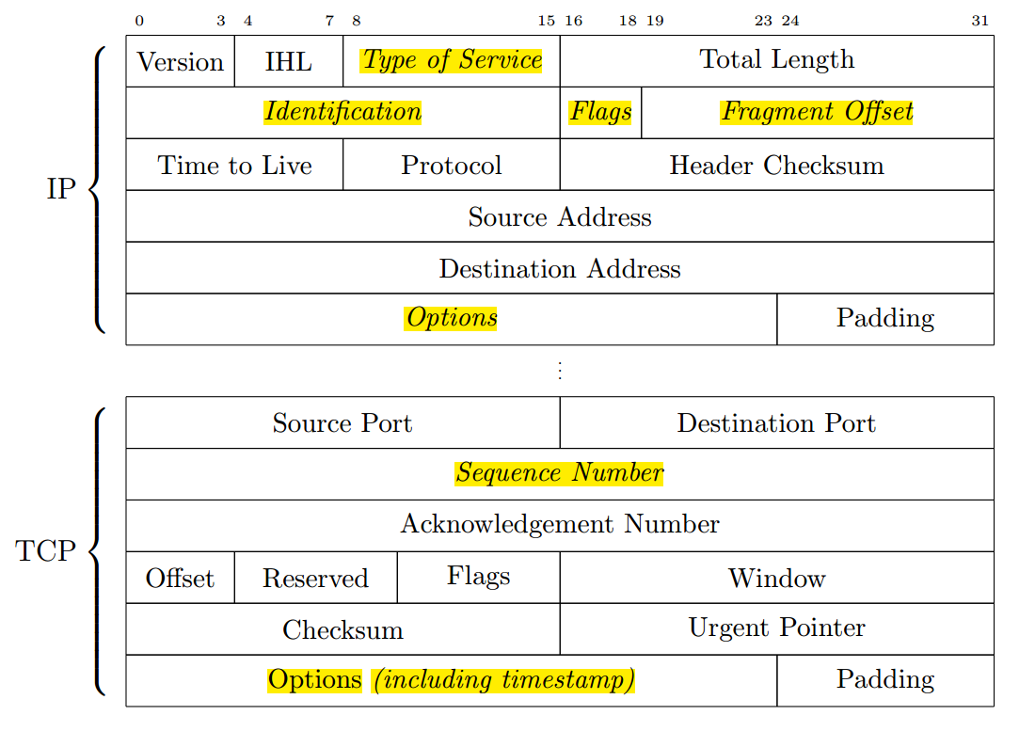
Previous Work – Protocol Headers
e.g. Basic TCP/IP header structure:
Highlighted: could be used for covert channels

Slide 37
Previous Work – Network Timing
Disk
Memory
Network protocol headers
Network payload
… …
Storage channel
TCP, IP, ICMP, HTTP/FTP, DNS, etc.
covert
channels
Disk accesses
Memory accesses
Network Packet arrivals
… …
Timing channel

Slide 38
Previous Work – Network Timing
Disk
Memory
Network protocol headers
Network payload
… …
Storage channel
covert
channels
Disk accesses
Memory accesses
Network Packet arrivals
… …
Packet rate
Timing channel
Inter-packet times

Slide 39
Previous Work – Network Timing
Categories of network timing channel:
Packet rates:
the number of arriving packets in time interval τ
Packet intervals:
the time interval between two consecutive packets

Slide 40
Previous Work – Packet Rates
Cabuk, S., Broldley, C., and Shields, C. “IP covert timing channels”. (CCS, 04)
Alice and Bob agreed a prior on a constant time interval τ
Alice:
To send a “0”, Alice maintains silence through out interval τ
To send a “1”, Alice send a packet in the middle of τ
Bob:
By observing each interval τ consecutively,
Bob records a “0” if no packet is received during interval τ
Bob records a “1” if one packet is received during interval τ

Slide 41
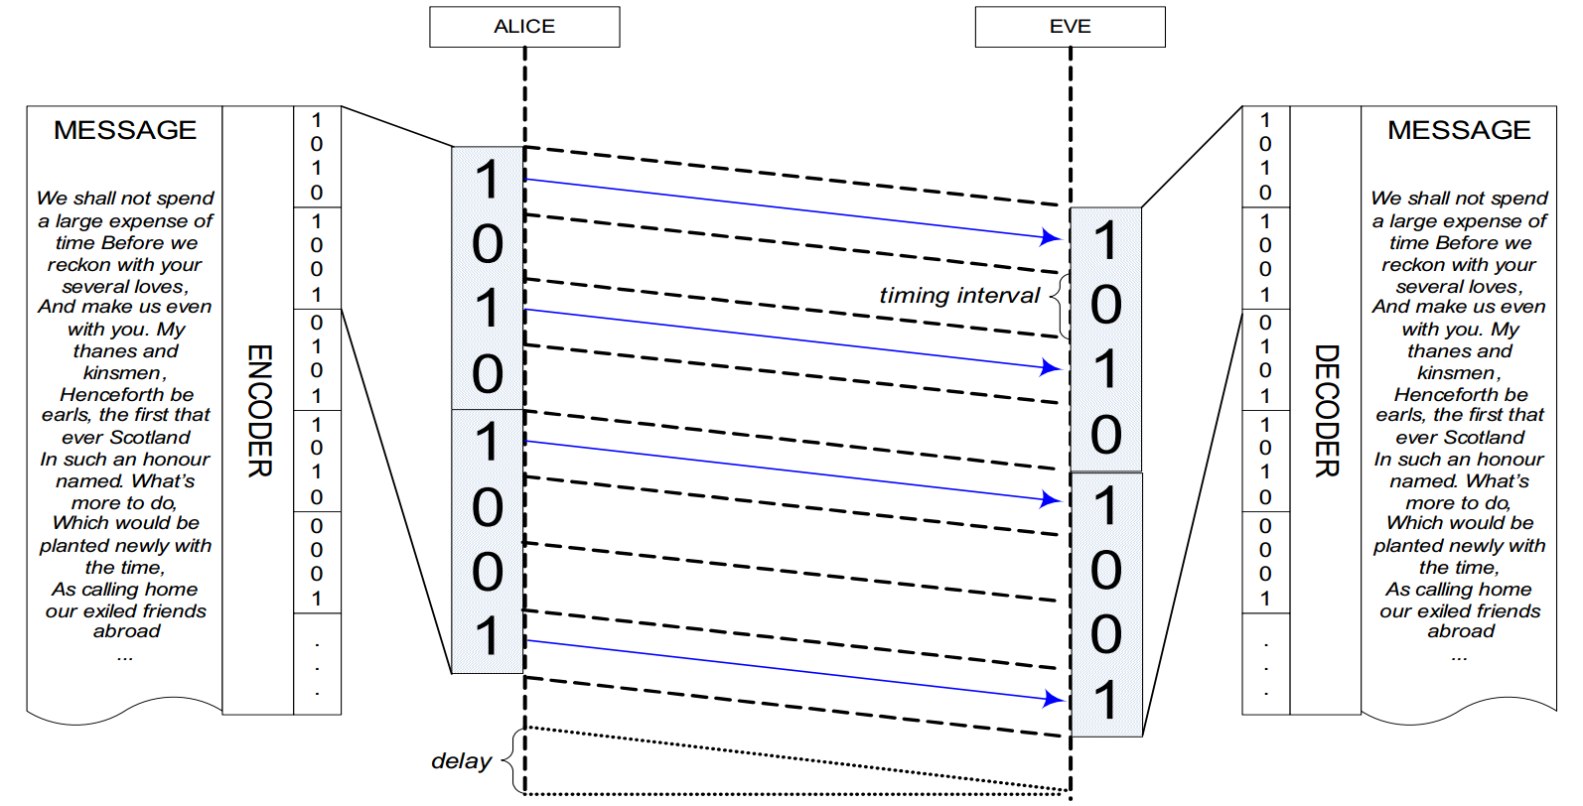
Bob

Slide 42
Previous Work – Network Timing
Categories of network timing channel:
Packet rates:
the number of arriving packets in time interval τ
Packet intervals:
the time interval between two consecutive packets

Slide 43
Previous Work – Packet Intervals
Cabuk, S. “Network Covert Channels: Design, Analysis, Detection and Elimination”. (PhD Thesis, Purdue University, 2006)
Alice and Bob agree a prior on two timing intervals τ1, τ2
Alice:
To send a “0”, Alice sleeps for τ1 and sends a packet at the end of interval τ1
To send a “1”, Alice sleeps for τ2 and sends a packet at the end of interval τ2
Bob:
By consecutively recording the inter-arrival time,
Bob record a “0” if inter-arrival time is τ1.
Bob record a “1” if inter-arrival time is τ2.

Slide 44
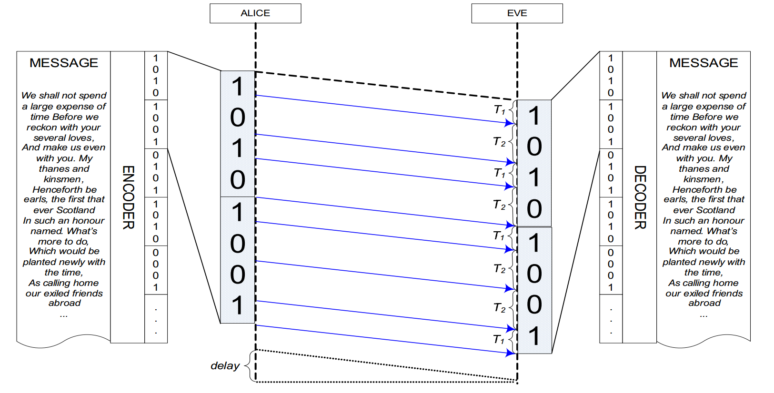
Bob

Slide 45
Previous Work – packet intervals
Cabuk, S. “Network Covert Channels: Design, Analysis, Detection and Elimination”. (PhD Thesis, Purdue University, 2006)
Alice and Bob agree a prior on two timing interval bins (0,τc) ,(τc, τmax).
τc is a threshold.
Alice:
To send a “0”, Alice randomly selects a value τtemp from (0,τc), sleeps for τtemp and sends a packet at the end of interval τtemp
To send a “1”, Alice randomly selects a value τtemp from (τc, τmax), sleeps for τtemp and sends a packet at the end of interval τtemp
Bob:
By consecutively recording the inter-arrival time, (0,τc)
Bob record a “0” if inter-arrival time falls in (0,τc).
Bob record a “1” if inter-arrival time falls in (τc, τmax).
0
1

Slide 46
Previous Work – Passive Sender
Wang, X., Chen, S., and Jajodia, S. “Tracking anonymous peer-to-peer VoIP calls on the internet. (CCS, 05)”
Key idea: To de-anonymize peer-to-peer VoIP calls,
embed a unique watermark into VoIP flows
by slightly adjusting the timing of selected packets.
Introduce the notion of passive sender,
just modify timing of existing network traffic,
do not create new traffic

Slide 47
Outlines
Introduction
Previous work
Presented scheme
Implementation details
Evaluation
Conclusion

Slide 48
Presented Scheme – Highlights
Shan, G., Molina, A. and Blaze, M. ”Keyboards and Covert Channels”. (USEINX, 2006,
The Best Student Paper)
What makes it stands out? – quite particular perspectives
Focus on input system rather than output systems
Focus on loosely-coupled network (many intermediate layers involved)
Focus on interactive applications such as SSH instead of specific network protocols such as TCP

Slide 49
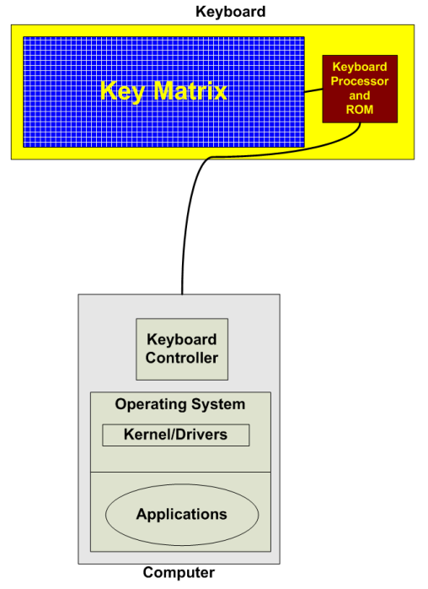
Presented Scheme – Highlights
Focus on input system rather than output systems
JitterBug sender

Slide 50
Presented Scheme – Highlights
Focus on loosely-coupled network (many intermediate layers involved)
Inside the host system
Covert Channel Sender
Keyboard buffering
& network buffering
OS
Scheduling
Nagle’s algorithm
Network jitter
Outside the host system
Covert Channel
Receiver

Slide 51
Presented Scheme – Highlights
focus on interactive applications such as SSH
Basic background we need to know:
After initial login, SSH automatically goes into interactive mode
In interactive mode, every keystroke a user types is sent in a separate
IP packet immediately after the key is pressed.
For improving interactive
experience for users

Slide 52
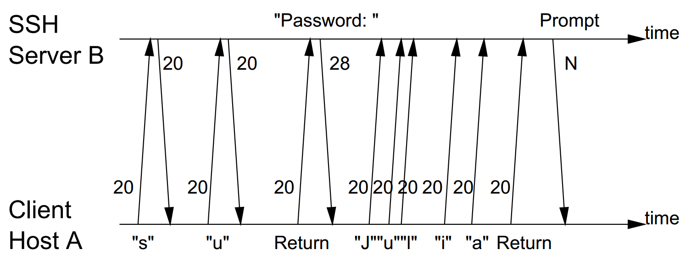
Presented Scheme - Highlights
focus on interactive applications such as SSH
The user types in ”su Return JuIia”

Slide 53
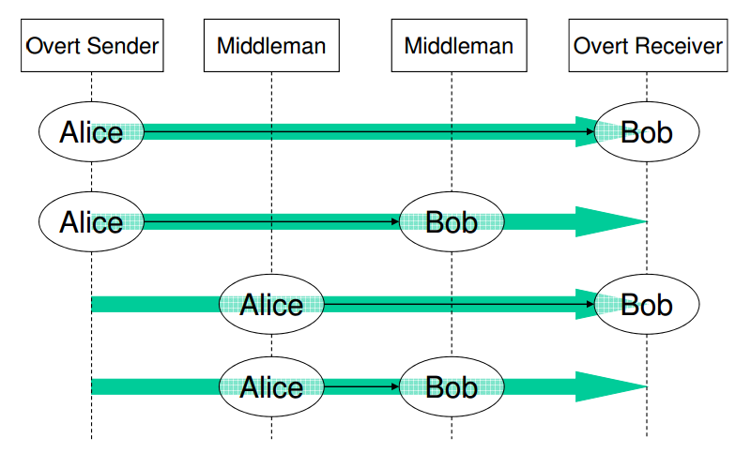
Presented Scheme – Threat Model
Alice (JitterBug) is not the packet sender. Alice could just modify the
packet timings indirectly by timing of keystrokes.
Bob is not the packet receiver. Bob is just on the path.
JitterBug

Slide 54
Presented Scheme – Steps
Alice (JitterBug) steals credentials
Alice (JitterBug) sends out credentials
Bob extracts the credentials
Then I will give a simple example on how the scheme works

Slide 55
Presented Scheme – An Simple Example
JitterBug steals credentials - detects keystroke pattern
e.g.:
SSH
JitterBug detects user is typing “ssh username@host”
JitterBug stores the credentials

Slide 56
Presented Scheme – An Simple Example
JitterBug sends credentials out
Inside the host system
Covert Channel Sender
Keyboard buffering
& network buffering
OS
Scheduling
Nagle’s algorithm
Network jitter
Outside the host system
Covert Channel
Receiver

Slide 57
Presented Scheme – An Simple Example
JitterBug sends credentials out
Suppose the stolen credential is “ Hi mom”
JitterBug transmit credential to frames
character H i
Ascii code (decimal) 72 151
Ascii code (binary) 1001000 10010111
Framing the binaries – add header and tailor to frames(in the paper, bit stuffing)
Error correcting codes – add redundant bits
To put it simple, let us suppose no framing and error correcting is used
username
password

Slide 58
Presented Scheme – An Simple Example
JitterBug sends credentials out
Suppose the stolen credential is “ Hi mom”
JitterBug transmit credential to frames
character H i
Ascii code (decimal) 72 151
Ascii code (binary) 1001000 10010111
The final string 100100010010111…….
username
password
How to encode the binary string in keystroke timings?

Slide 59


Presented Scheme – An Simple Example
JitterBug sends credentials out
Suppose the stolen credential is “ Hi mom”
a. JitterBug transmit credential to frames
The final string 10010…….…….
Suppose the window size is w=20ms
The modified inter-key stroke timings (modulo 20) should be
10, 0, 0, 10, 0, ……
username
password
Inter-key stroke timings

Slide 60
Presented Scheme – An Simple Example
JitterBug sends credentials out
Suppose the stolen credential is “ Hi mom”
First step. JitterBug transmit credential to frames
The final string 10010…….…….
Suppose the window size is w=20ms
The modified inter-key stroke timings (modulo 20) should be
10, 0, 0, 10, 0, ……
username
password

Slide 61
Presented Scheme – An Simple Example
JitterBug sends credentials out
Second Step. Decide when to delay key stroke timings
By detecting certain keystroke patterns
find a user is working in an interactive ssh session.

Slide 62
Presented Scheme – An Simple Example
JitterBug sends credentials out
Third Step. JitterBug adds delays to the inter-keystroke timings.
The original observed inter-keystroke timings are
123, 145, 333, 813, 140, …. (ms)
The modified inter-key stroke timings (modulo 20) should be
10, 0, 0, 10, 0, ……
Adding delay: 7, 15, 7, 17, 0, ….. (ms)
The final modified inter-key stroke timings:
130, 160, 340, 830, 140, …… (ms)

Slide 63
Presented Scheme – An Simple Example
Receiver extracts the credentials
Inside the host system
Covert Channel Sender
Keyboard buffering
& network buffering
OS
Scheduling
Nagle’s algorithm
Network jitter
Outside the host system
Covert Channel
Receiver

Slide 64
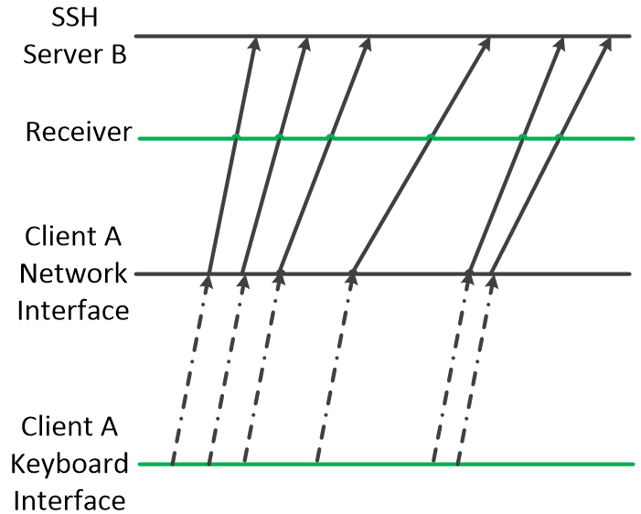
Presented Scheme – An Simple Example
Receiver extracts the credentials
137
162
343
833
142
130
162
340
830
140

Slide 65


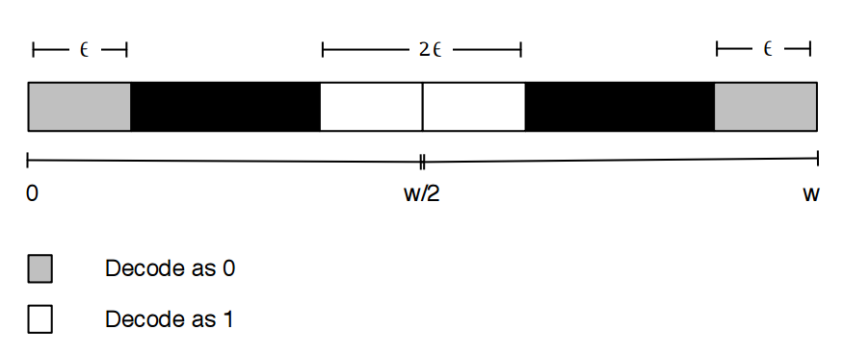
Presented Scheme – An Simple Example
Receiver extracts the credentials
Inter-key stroke timings

Slide 66
Presented Scheme – An Simple Example
Receiver extracts the credentials
The final modified inter-key stroke timings:
130, 160, 340, 830, 140, …… (ms)
The final received inter-packet stroke timings:
137, 162, 343, 833, 142, ……. (ms)
Window size = 20ms, suppose ɛ = 3ms:
The decoded binaries:
1, 0, 0, 1, 0, …… (ms)
Bingo

Slide 67
Outlines
Introduction
Previous work
Presented scheme
Implementation details
Evaluation
Conclusion

Slide 68
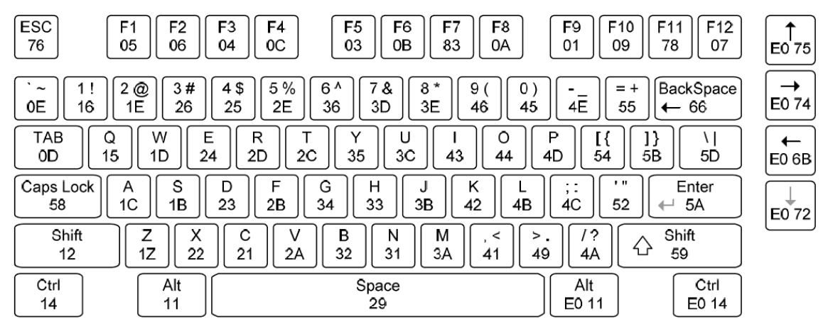
Implementation Details

Slide 69
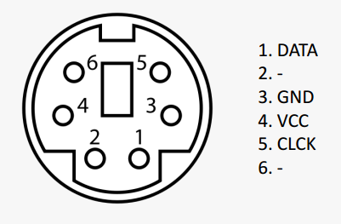
Implementation Details
SP/2 Protocol:
Connector Interface
JitterBug sender

Slide 70
Implementation Details
Data line: transmit 8-bit scan code to indicate which key was pressed.
Clock line: used to synchronization to indicate when data is valid
VCC & GND lines: power lines
SP/2 Protocol:
Connector Interface

Slide 71
Implementation Details
Possible Events:
Key pressed: 11-bit code is sent
-- start bit, 8-bit scan code, odd parity bit, stop bit
Key released: two 11-bit codes are sent
-- first scan code is FO
-- second scan code is the released key code
Key held down: 11-bit code is sent every 100 ms
-- scan code is pressed key code

Slide 72
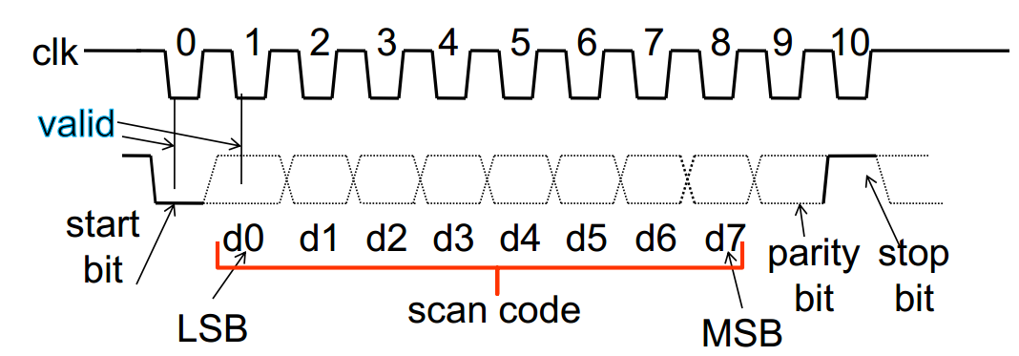
Implementation Details
Notes:
Data is valid on negative edge of the clock.

Slide 73
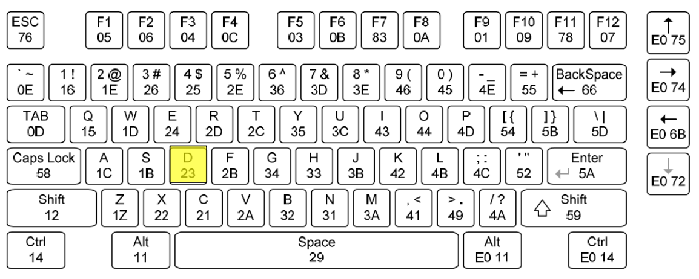
Implementation Details

Slide 74
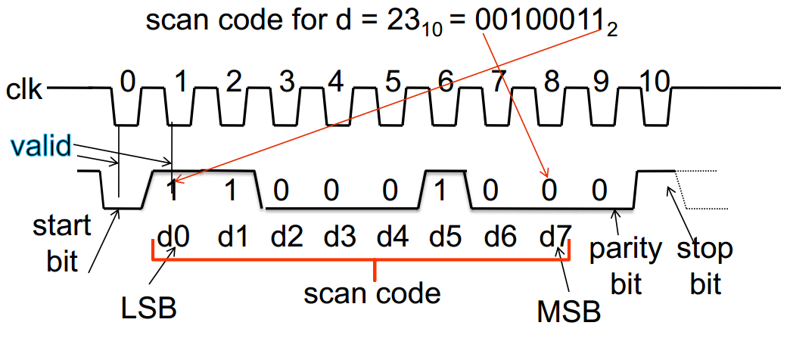
Implementation Details

Slide 75
Implementation Details
Use PIC microcontroller
Hardware functionalities:
Identify certain keystroke patterns
– whether to store keystrokes and when to add delay to keystrokes
e.g. Detect “ssh username@host”
1. the following keystrokes should be password. --- should be stored
2. the user will be in interactive ssh session. --- is appropriate for adding delays
Delay keyboard signal
External interrupt + timer interrupt
Store
EEPROM
Input signal
Triggers
External interrupt
Timer interrupt
Output signal
Add delays

Slide 76
Outlines
Introduction
Previous work
Presented scheme
Implement details
Evaluation
Conclusion

Slide 77
Evaluation
Accuracy
Bandwidth
Detectability

Slide 78
Evaluation
Accuracy
Bandwidth
Detectability

Slide 79
Evaluation - Accuracy
Data flow:
Inside the host system
Covert Channel Sender
Keyboard buffering
& network buffering
OS
Scheduling
Nagle’s algorithm
Network jitter
Outside the host system
Covert Channel
Receiver

Slide 80
Evaluation - Accuracy
Data flow:
Inside the host system
Covert Channel Sender
Keyboard buffering
& network buffering
OS
Scheduling
Nagle’s algorithm
High priority in OS scheduling
Network jitter
Outside the host system
Covert Channel
Receiver

Slide 81
Evaluation - Accuracy
Data flow:
Handle small packets: Decide when to buffer
data before sending it out in a network packet
By default, disabled !!!
Inside the host system
Covert Channel Sender
Keyboard buffering
& network buffering
OS
Scheduling
Nagle’s algorithm
Network jitter
Outside the host system
Covert Channel
Receiver

Slide 82
Evaluation - Accuracy
Data flow:
Inside the host system
Covert Channel Sender
Keyboard buffering
& network buffering
OS
Scheduling
Nagle’s algorithm
Biggest factor:
Add most randomized noises
Network jitter
Outside the host system
Covert Channel
Receiver

Slide 83
Evaluation - Accuracy
Experiment settings:
Source machine is located in University of Pennsylvania
Interactive SSH Sessions
Timing information comes from the destination host using tcpdump

Slide 84
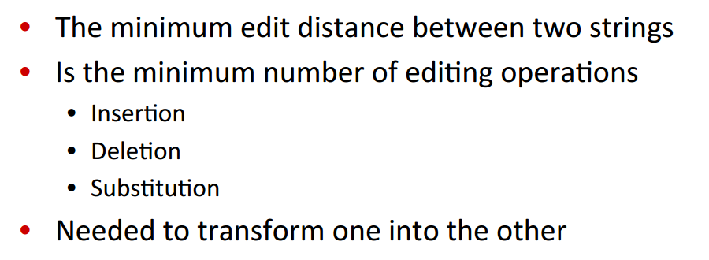
Evaluation - Accuracy
How to compare difference between sent and received binaries?
Raw Bit Error
calculated by:
Levenshtein Distance: used when sent and received binaries are of different length
Definition of Levenshtein distance:

Slide 85
Evaluation - Accuracy
Factor of geographic locations:
How to set up the experiment platform?

Slide 86
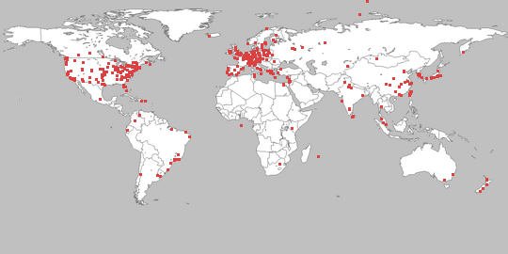
Evaluation - Accuracy
PlanetLab
Global research network – setup worldwide network services
Since 2003, more than 1000 researchers have used PlanetLab to develop new technologies

Slide 87
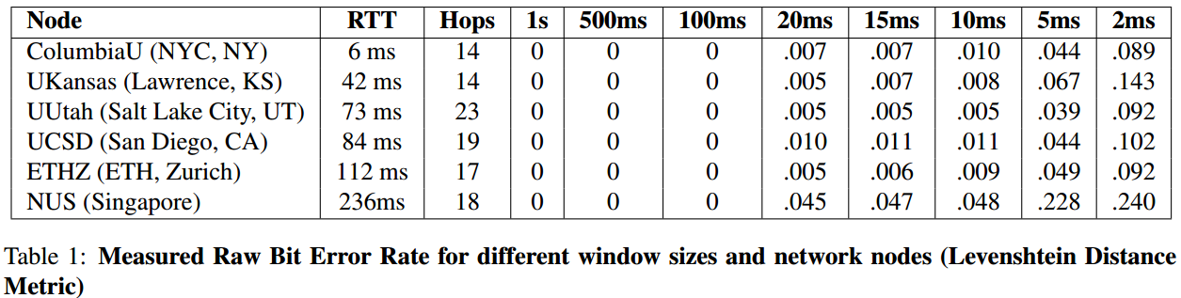
Evaluation - Accuracy
Factor of geographic locations:
Observations:
For a fixed window size, the channel performance does not exhibit any clear trend. In other words, geographic locations do not matter much to channel performance.

Slide 88
Evaluation - Accuracy
Factor of geographic locations:
Observations:
The smaller the window size is, the higher error rates will be. But the window size should not be too big as to perceived by the user.

Slide 89
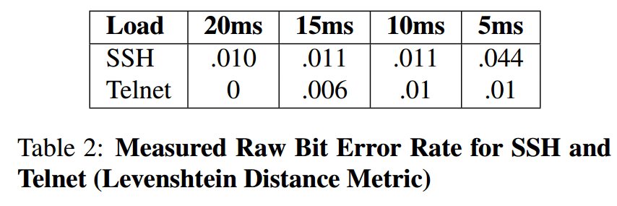
Evaluation - Accuracy
Factor of different applications:
Observations:
The channel performance is not affected much by the choice of interactive terminal applications.

Slide 90
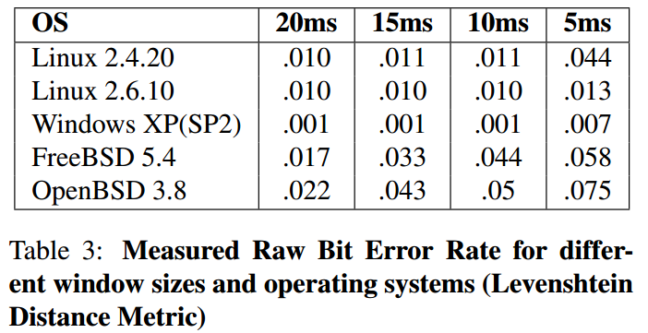
Evaluation - Accuracy
Factor of different systems:
Observations:
The channel performance is not affected much by the choice of operating systems.

Slide 91
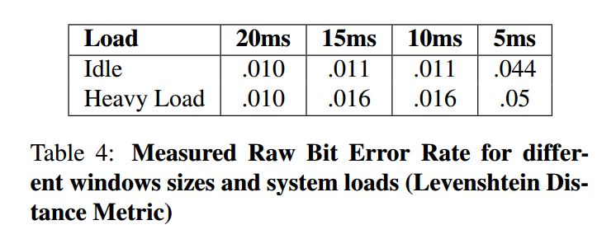
Evaluation - Accuracy
Factor of different system loads:
Observations:
The channel performance is not affected much by system load.

Slide 92
Evaluation - Accuracy
Factor of network jitters:
???

Slide 93
Evaluation
Accuracy
Bandwidth
Detectability

Slide 94
Evaluation - Bandwidth
Each keystroke could encode one bit information
How to improve?
Subdivide the window further to improve encoding (but may also lead to lower accuracy)

Slide 95
Evaluation
Accuracy
Bandwidth
Detectability

Slide 96
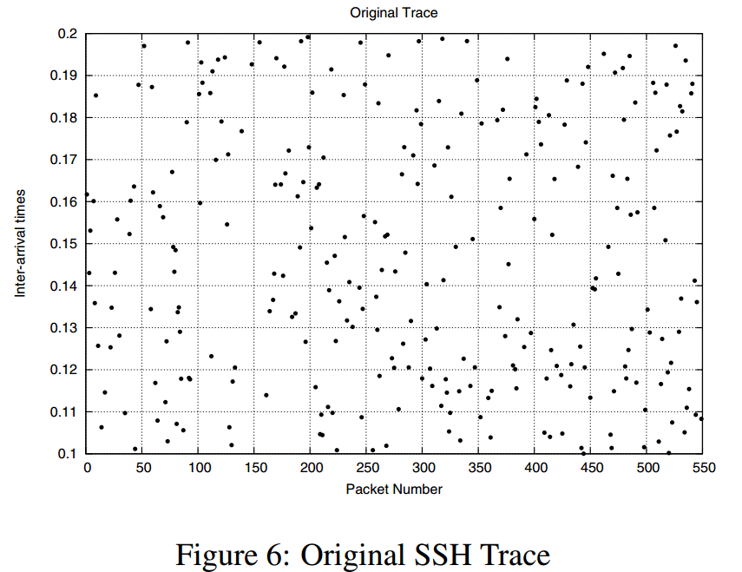
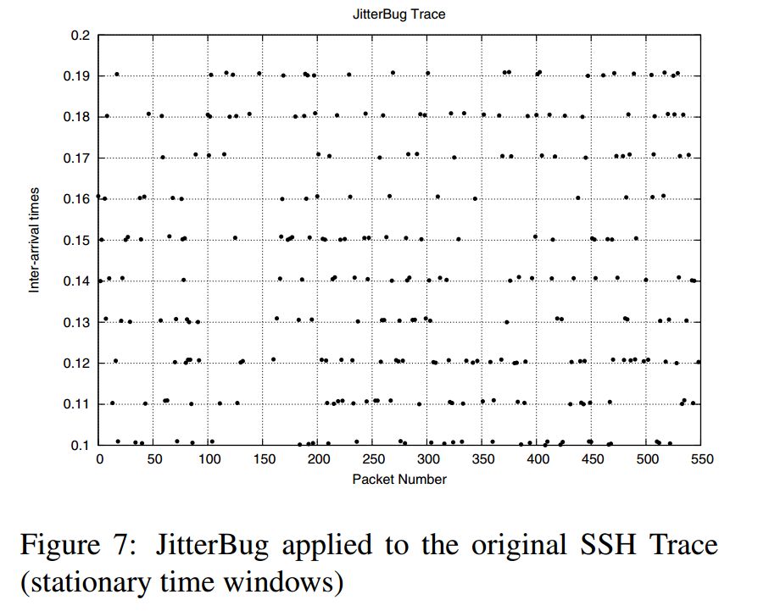
Evaluation - Detectability
Without JitterBug
With JitterBug
Observations:
Simple plot of inter-arrival times will detect the proposed covert channel

Slide 97

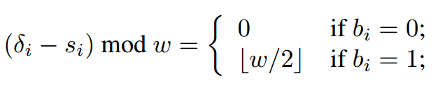
Evaluation - Detectability
Rotating time windows:
Assumes:
Alice and Bob shares a sequence of integers
Basically, after Alice sending one bit and Bob receiving one bit,
They will move to the next shared integer.
Inter-key stroke timings

Slide 98
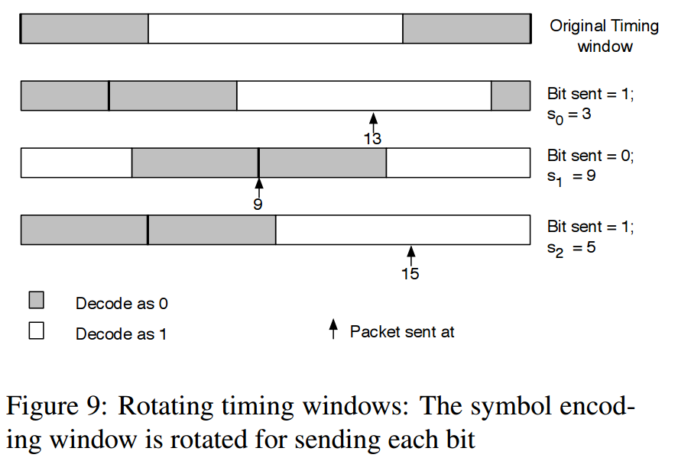
Evaluation - Detectability
Example:
Sent binaries {1,0,1}
shared sequence {s0, s1, s2}={3,9,5}

Slide 99
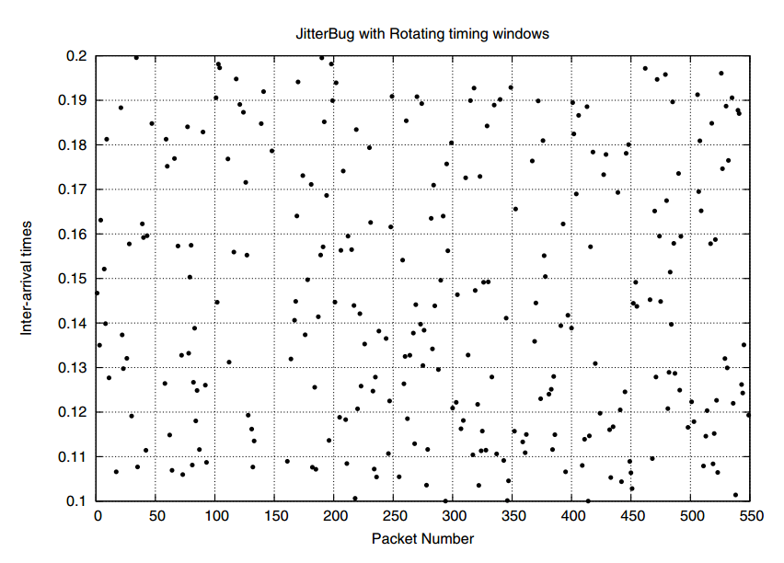
Evaluation - Detectability

Slide 100
Outlines
Introduction
Previous work
Presented scheme
Implement details
Evaluation
Conclusion

Slide 101
Conclusion
Compromising an input channel is useful not only for learning secrets, but also for leaking information over network.
Loosely coupled network timing channels are practical.
Possible future works:
Better framing and error correcting schemes
Better ways to evade detection

Slide 102
References
1. Cabuk, S., Broldley, C., and Shields, C. “IP covert timing channels”. (CCS, 04)
2. Cabuk, S. “Network Covert Channels: Design, Analysis, Detection and Elimination”. (PhD Thesis, Purdue University, 2006)
3. Shah, Gaurav, Andres Molina, and Matt Blaze. "Keyboards and Covert Channels." USENIX Security. 2006.

