Slide 1
An Extremely Simple ORAM Protocol – Path ORAM
Published by Stefanov, Emil, et al.
Presented by Shijie Zhang

Slide 2
Cloud storage
Dropbox
Amazon S3, EBS
Windows Azure Storage
SkyDrive
EMC Atmos
Mozy
iCloud
Google Storage

Slide 3

Cloud storage
Can we TRUST the cloud?
Not completely
Dropbox
Amazon S3, EBS
Windows Azure Storage
SkyDrive
EMC Atmos
Mozy
iCloud
Google Storage

Slide 4



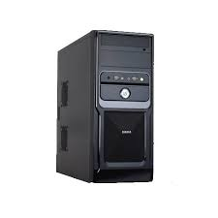
Cloud storage
Sensitive documents
should be encrypted
Files
Encrypted Files
User
Server

Slide 5
Search on Cloud storage
What if users need to search on encrypted documents?
e.g. documents containing keyword “urgent”

Slide 6
Searchable Encryption
Searchable encryption schemes are proposed
Files
Encrypted Files + Index
(contains trapdoors
only known by user)
User
Server

Slide 7
Searchable Encryption
Searchable encryption schemes proposed
Search for documents containing keyword
e.g. “urgent”
User
Server

Slide 8
Searchable Encryption
Searchable encryption schemes proposed
Search for documents containing keyword
e.g. “urgent”
Trapdoor function (“urgent”)
User
Server

Slide 9
Searchable Encryption
Searchable encryption schemes proposed
Search for documents containing keyword
e.g. “urgent”
Trapdoor function (“urgent”) + Index
Trapdoor function (“urgent”)
User
Server

Slide 10
Searchable Encryption
Searchable encryption schemes proposed
Search for documents containing keyword
e.g. “urgent”
Trapdoor function (“urgent”) + Index
Trapdoor function (“urgent”)
Requested encrypted documents
User
Server

Slide 11
Information leaked ???
Most previous research works
Do not leaked Encrypted documents
Do not leaked Searched keywords
However, most previous research works
leaked access pattern

Slide 12
Access Pattern Leaked
Access Pattern leaked:
Which data is being accessed
When the data was last accessed
Whether the same data is being accessed
Access randomly or sequentially
Whether the access is a read or write
What could be done
with access pattern ?

Slide 13
Example Attack
Access patterns leak: 80% of search queries to encrypted database (Islam et. al)
Buy IBM
Buy EMC
?
Buy IBM
?
Buy IBM
Client
Server
?
Buy PC
Search queries

Slide 14
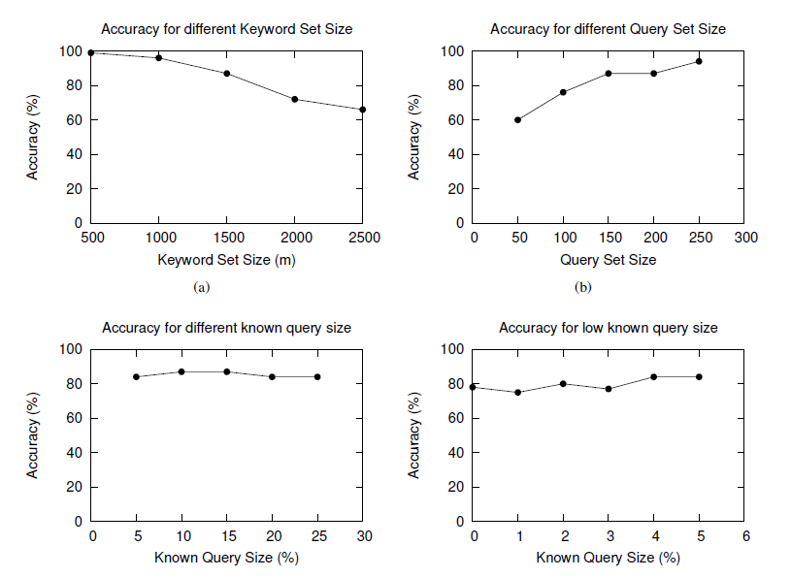
Example Attack

Slide 15
Oblivious RAM
Search over encrypted data
without revealing access pattern
Impractical O(N) bandwidth overhead

Slide 16
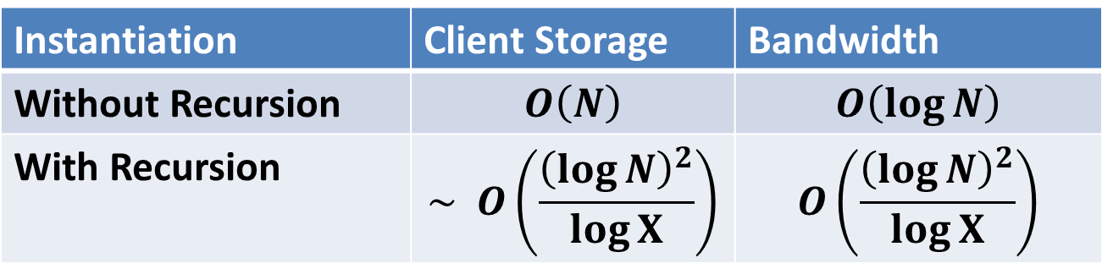
Path ORAM
Most practical ORAM construction to date
High efficiency and low overhead
Asymptotic breakthrough for large blocks
Instantiation | Client Storage | Bandwidth
Without Recursion | $$O\left(N\right)$$ | $$O\left(\log{N}\right)$$
With Recursion | $$\sim O\left(\frac{{\left(\log{N}\right)}^{2}}{\log{X}}\right)$$ | $$O\left(\frac{{\left(\log{N}\right)}^{2}}{\log{X}}\right)$$

Slide 17
Path ORAM
Server storage
binary map
Client storage
position map, stash

Slide 18
Path ORAM
Server: data blocks stored in nodes of the tree
some nodes are empty
bucket
nodes can contain multiple blocks
block
Block #
data

Slide 19
Path ORAM
1 2 3 4 5 6 7 8
“Position” comes from the leaf sequence number.

Slide 20
Path ORAM
1 2 3 4 5 6 7 8
A block must be placed on the path to its “position”
If a BLOCK’s position is 5, it can only be in the this path

Slide 21
Path ORAM
1 2 3 4 5 6 7 8
A block must be placed on the path to its “position”
If a BLOCK’s position is 1, it can only be in the this path

Slide 22
Path ORAM
1 2 3 4 5 6 7 8
Blocks’ position are chosen randomly from 1 to 2^L(number of leaves).
Some nodes(buckets) have multiple blocks while some are empty.

Slide 23
Path ORAM
Client storage: position map & stash
position map: to store each block’s “position”
(assume there are N blocks in the tree)
Block #
1 | 2 | … … …. …. | N-1 | N
5 | 4 | … … …. …. | 1 | 7
Block’s “position”

Slide 24
Path ORAM
Client storage: position map & stash
position map: to store each block’s “position”
(assume there are N blocks in the tree)
Block #
1 | 2 | … … …. …. | 13 | 14
2 | 4 |  | 1 | 1
Block’s “position”
1 2 3 4
14
9
1
7
3
12
4
11
8
13
2
5
10
6

Slide 25
Path ORAM
Client storage: position map & stash
Stash: 1. block cash
2. to store blocks overflowed from the server
one block

Slide 26
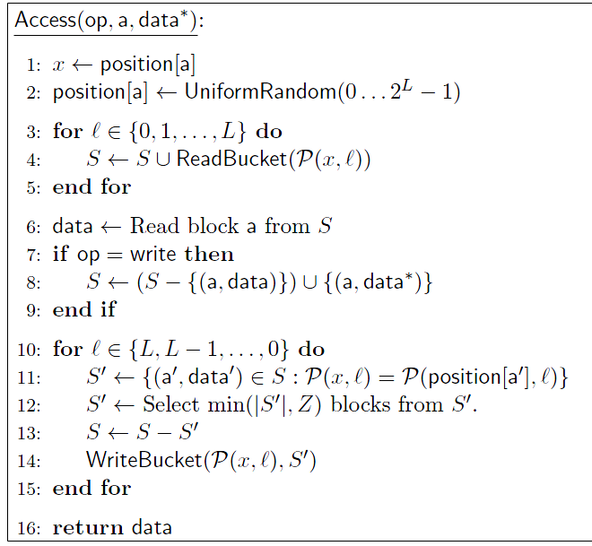
Path ORAM
16 lines
of
pseudocode

Slide 27
Path ORAM
An example for access (op, a, data)
Example:
A user wants to modify block “7”

Slide 28
Path ORAM
Example: A user wants to modify block “7”
1 2 3 4
14
1
7
3
12
4
11
13
2
5
Server
10
6
Client
1 | 2 | 3 | 4 | 5 | 6 | 7 | 8 | 9 | 10 | 11 | 12 | 13 | 14
2 | 4 | 3 | 4 | 3 | 1 | 2 | 2 | 1 | 1 | 4 | 3 | 2 | 1
position map
stash
8
9

Slide 29
Path ORAM
Example: A user wants to modify block “7”
1 2 3 4
14
9
1
7
3
12
4
11
13
2
5
Server
10
6
Client
1 | 2 | 3 | 4 | 5 | 6 | 7 | 8 | 9 | 10 | 11 | 12 | 13 | 14
2 | 4 | 3 | 4 | 3 | 1 | 2 | 2 | 1 | 1 | 4 | 3 | 2 | 1
position map
1. Lookup block’s position
stash
8
9

Slide 30
Path ORAM
Example: A user wants to modify block “7”
1 2 3 4
14
1
7
3
12
4
11
13
2
5
2. Read the entire path
Server
10
6
Client
1 | 2 | 3 | 4 | 5 | 6 | 7 | 8 | 9 | 10 | 11 | 12 | 13 | 14
2 | 4 | 3 | 4 | 3 | 1 | 2 | 2 | 1 | 1 | 4 | 3 | 2 | 1
position map
1
7
13
10
6
decrypt
stash
8
9
1
7
13
10
6

Slide 31
Path ORAM
Example: A user wants to modify block “7”
1 2 3 4
14
1
7
3
12
4
11
13
2
5
Server
10
6
Client
1 | 2 | 3 | 4 | 5 | 6 | 7 | 8 | 9 | 10 | 11 | 12 | 13 | 14
2 | 4 | 3 | 4 | 3 | 1 | 2 | 2 | 1 | 1 | 4 | 3 | 2 | 1
position map
3. Client can now read/modify data in block
1
7
13
10
6
decrypt
stash
8
9
1
7
13
10
6

Slide 32
Path ORAM
Example: A user wants to modify block “7”
1 2 3 4
14
9
1
7
3
12
4
11
8
13
2
5
Note:
the blocks on the tree are encrypted
Server
10
6
Client
1 | 2 | 3 | 4 | 5 | 6 | 7 | 8 | 9 | 10 | 11 | 12 | 13 | 14
2 | 4 | 3 | 4 | 3 | 1 | 2 | 2 | 1 | 1 | 4 | 3 | 2 | 1
position map
4. Assign a new random position.
Position[block 7] = UniformRandom(1, 2, 3, 4)
here = 1
1 | 2 | 3 | 4 | 5 | 6 | 7 | 8 | 9 | 10 | 11 | 12 | 13 | 14
2 | 4 | 3 | 4 | 3 | 1 | 1 | 2 | 1 | 1 | 4 | 3 | 2 | 1

Slide 33
Path ORAM
1 2 3 4
14
1
7
3
12
4
11
13
2
5
Note:
the blocks on the tree are encrypted
Server
10
6
Client
Principles:
A. Blocks should be pushed down as deep as possible
B. Blocks should always be on the path to its position
5. Write path back

Slide 34
Path ORAM
Principle A:
Push blocks as deep as possible
1 2 3 4
14
1
3
12
4
11
Try the deepest possible node first
13
2
5
Note:
the blocks on the tree are encrypted
Server
10
6
Client
1 | 2 | 3 | 4 | 5 | 6 | 7 | 8 | 9 | 10 | 11 | 12 | 13 | 14
2 | 4 | 3 | 4 | 3 | 1 | 1 | 2 | 1 | 1 | 4 | 3 | 2 | 1
position map
5. Write path back.
stash
8
9
1
7
13
10
6

Slide 35
Path ORAM
Principle A:
Push blocks as deep as possible
1 2 3 4
14
1
3
12
4
11
If full, try the upper level
13
2
5
Note:
the blocks on the tree are encrypted
Server
10
6
Client
1 | 2 | 3 | 4 | 5 | 6 | 7 | 8 | 9 | 10 | 11 | 12 | 13 | 14
2 | 4 | 3 | 4 | 3 | 1 | 1 | 2 | 1 | 1 | 4 | 3 | 2 | 1
position map
5. Write path back.
stash
8
9
1
7
13
10
6

Slide 36
Path ORAM
Principle A:
Push blocks as deep as possible
1 2 3 4
14
1
3
12
4
11
13
2
5
If full, try the upper level
Note:
the blocks on the tree are encrypted
Server
10
6
Client
1 | 2 | 3 | 4 | 5 | 6 | 7 | 8 | 9 | 10 | 11 | 12 | 13 | 14
2 | 4 | 3 | 4 | 3 | 1 | 1 | 2 | 1 | 1 | 4 | 3 | 2 | 1
position map
5. Write path back.
stash
8
9
1
7
13
10
6

Slide 37
Path ORAM
Principle A:
Push blocks as deep as possible
1 2 3 4
14
1
3
12
4
11
13
2
5
If root is full, store in the stash
Note:
the blocks on the tree are encrypted
Server
10
6
Client
1 | 2 | 3 | 4 | 5 | 6 | 7 | 8 | 9 | 10 | 11 | 12 | 13 | 14
2 | 4 | 3 | 4 | 3 | 1 | 1 | 2 | 1 | 1 | 4 | 3 | 2 | 1
position map
5. Write path back.
stash
8
9
1
7
13
10
6

Slide 38
Path ORAM
Principle B:
The block should always be on its path to “position”
1 2 3 4
14
1
7
3
12
4
11
13
2
5
Note:
the blocks on the tree are encrypted
Server
10
6
Client
1 | 2 | 3 | 4 | 5 | 6 | 7 | 8 | 9 | 10 | 11 | 12 | 13 | 14
2 | 4 | 3 | 4 | 3 | 1 | 1 | 2 | 1 | 1 | 4 | 3 | 2 | 1
position map
5. Write path back
“positions”
2 1 2 1 2 1 1
stash
8
9
1
7
13
10
6

Slide 39
Path ORAM
Principle B:
The block should always be on its path to “position”
1 2 3 4
14
1
7
3
12
4
11
13
2
5
Block 8, 1, 13 can
end up at any buckets on the entire path
Note:
the blocks on the tree are encrypted
Server
10
6
Client
1 | 2 | 3 | 4 | 5 | 6 | 7 | 8 | 9 | 10 | 11 | 12 | 13 | 14
2 | 4 | 3 | 4 | 3 | 1 | 1 | 2 | 1 | 1 | 4 | 3 | 2 | 1
position map
5. Write path back
2 1 2 1 2 1 1
stash
8
9
1
7
13
10
6

Slide 40
Path ORAM
Principle B:
The block should always be on its path to “position”
1 2 3 4
14
1
7
3
12
4
11
13
2
5
Block 9, 7, 10, 6 can only
end up at these buckets
Note:
the blocks on the tree are encrypted
Server
10
6
Client
1 | 2 | 3 | 4 | 5 | 6 | 7 | 8 | 9 | 10 | 11 | 12 | 13 | 14
2 | 4 | 3 | 4 | 3 | 1 | 1 | 2 | 1 | 1 | 4 | 3 | 2 | 1
position map
5. Write path back
2 1 2 1 2 1 1
stash
8
9
1
7
13
10
6

Slide 41
Path ORAM
Get back to our example:
1 2 3 4
3
2
1
14
3
12
4
11
2
5
Note:
the blocks on the tree are encrypted
Server
Client
1 | 2 | 3 | 4 | 5 | 6 | 7 | 8 | 9 | 10 | 11 | 12 | 13 | 14
2 | 4 | 3 | 4 | 3 | 1 | 1 | 2 | 1 | 1 | 4 | 3 | 2 | 1
position map
5. Write path back
2 1 2 1 2 1 1
stash
8
9
1
7
13
10
6

Slide 42
Path ORAM
1 2 3 4
3
2
1
14
8
13
3
12
4
11
2
5
Note:
the blocks on the tree are encrypted
Server
Client
1 | 2 | 3 | 4 | 5 | 6 | 7 | 8 | 9 | 10 | 11 | 12 | 13 | 14
2 | 4 | 3 | 4 | 3 | 1 | 1 | 2 | 1 | 1 | 4 | 3 | 2 | 1
position map
5. Write path back
2 1 2 1 2 1 1
stash
8
9
1
7
13
10
6

Slide 43
Path ORAM
1 2 3 4
3
2
1
14
8
13
3
12
4
11
1
7
2
5
Note:
the blocks on the tree are encrypted
Server
Client
1 | 2 | 3 | 4 | 5 | 6 | 7 | 8 | 9 | 10 | 11 | 12 | 13 | 14
2 | 4 | 3 | 4 | 3 | 1 | 1 | 2 | 1 | 1 | 4 | 3 | 2 | 1
position map
5. Write path back
2 1 2 1 2 1 1
stash
8
9
1
7
13
10
6

Slide 44
Path ORAM
1 2 3 4
3
2
1
14
8
13
3
12
4
11
1
7
2
5
Note:
the blocks on the tree are encrypted
Server
9
6
Client
1 | 2 | 3 | 4 | 5 | 6 | 7 | 8 | 9 | 10 | 11 | 12 | 13 | 14
2 | 4 | 3 | 4 | 3 | 1 | 1 | 2 | 1 | 1 | 4 | 3 | 2 | 1
position map
5. Write path back
2 1 2 1 2 1 1
stash
8
9
1
7
13
10
6

Slide 45
Path ORAM
1 2 3 4
3
2
1
14
8
13
3
12
4
11
1
7
2
5
Note:
the blocks on the tree are encrypted
Server
9
6
Client
1 | 2 | 3 | 4 | 5 | 6 | 7 | 8 | 9 | 10 | 11 | 12 | 13 | 14
2 | 4 | 3 | 4 | 3 | 1 | 1 | 2 | 1 | 1 | 4 | 3 | 2 | 1
position map
5. Write path back
stash
10

Slide 46
Client storage
Position map:
Log N bits per block
Totally N log N bits
Too much !!!

Slide 47
Recursion
Store the position map in another ORAM.
Do this recursively.
O-RAM #1
O-RAM #2: Position Map for O-RAM #1
O-RAM #3: Position Map for O-RAM #2
…
Server
Client
…

Slide 48
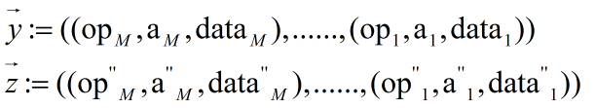

Security
Security Definition:
Given two access sequences,
Computational indistinguishable by anyone but the user
Server only observes a single random number on access to each block
Each access number is random
not computational distinguishable by anyone but the user

Slide 49
Security - example
positions:
0
1
2
3
4
5
6
7
If client instead accesses: 46, 49, 53, 60
Server observes:
5, 1, 6, 4
Server
Client
Suppose client accesses blocks 1, 2, 3, 4.
position map
stash
5
1
6
4
5
1
6
4
the two access patterns are indistinguishable
Client looks up in position map.
equally likely

Slide 50

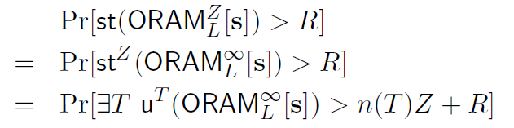
Proof for Bounds on Stash Usage
Target: the probability for stash overflow is low
Equivalent to:
Find a subtree in ORAM binary tree
that after a sequences of access “s”, the number of
Remaining blocks are bigger than n(T)Z+R

Slide 51
References
Path ORAM, Emil, S., et al. slides and papers, 2012
Access Pattern Disclosure on Searchable Encryption. Mohammad, S. et al. , 2006

