Slide 1
Authorization service migration
Shijie Zhang

Slide 2
Agenda
Experiences
Goals
Project context
Highlights in service migration
Highlights in service governance
Summary

Slide 3
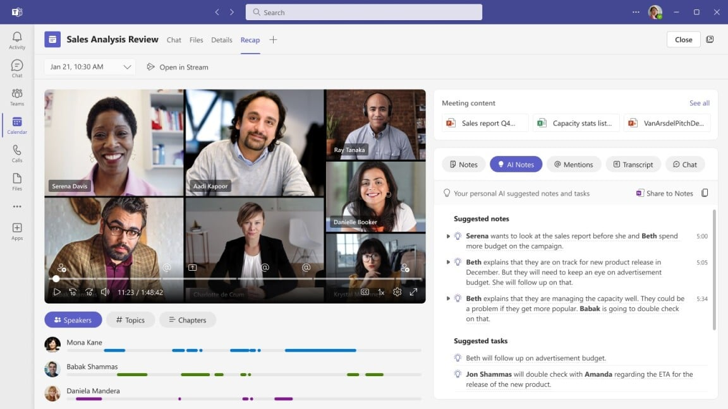
Experiences
Middle-layer service in Microsoft Teams product
2017 GA
300 million DAU as of 2023
Hands-on experience on microservice governance & auth topics
Tech stack:
Web framework: C#, .Net Core, REST
Azure KV store, redis, queue
CI/CD: Azure pipelines
Container: Azure service fabric

Slide 4
Goals
Problems:
High risks: Mission critical service shares resources with others
Slow cycles
Goals (within 9 months):
Migration: Build a brand new AuthZ service from scratch
Governance: Improve AuthZ service availability above 99.9%

Slide 5
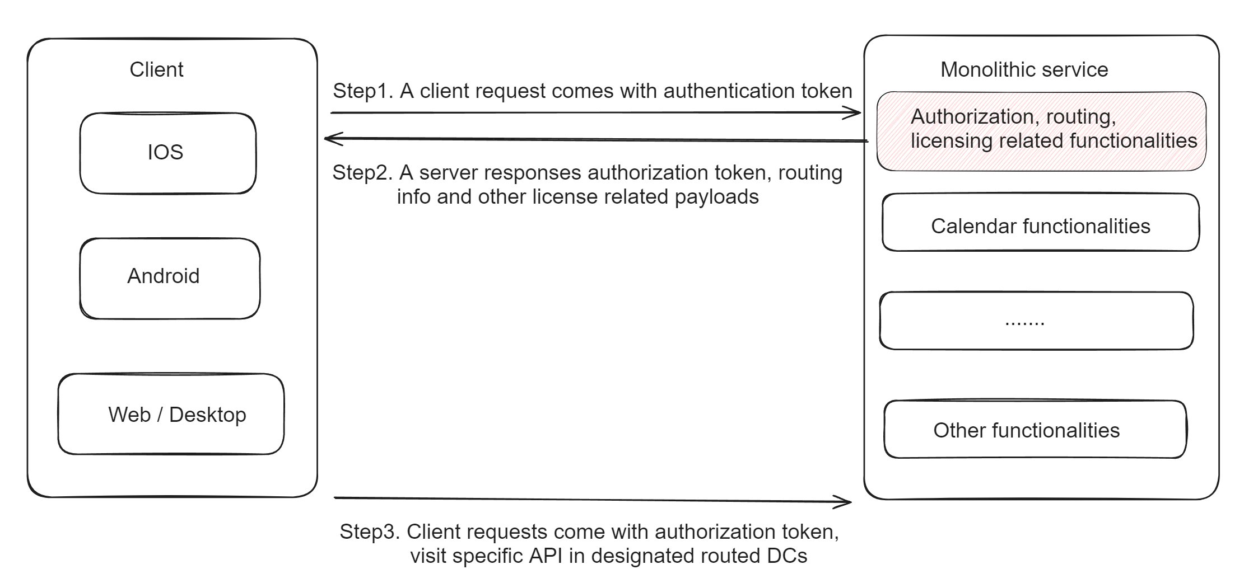
AuthZ project context

Slide 6
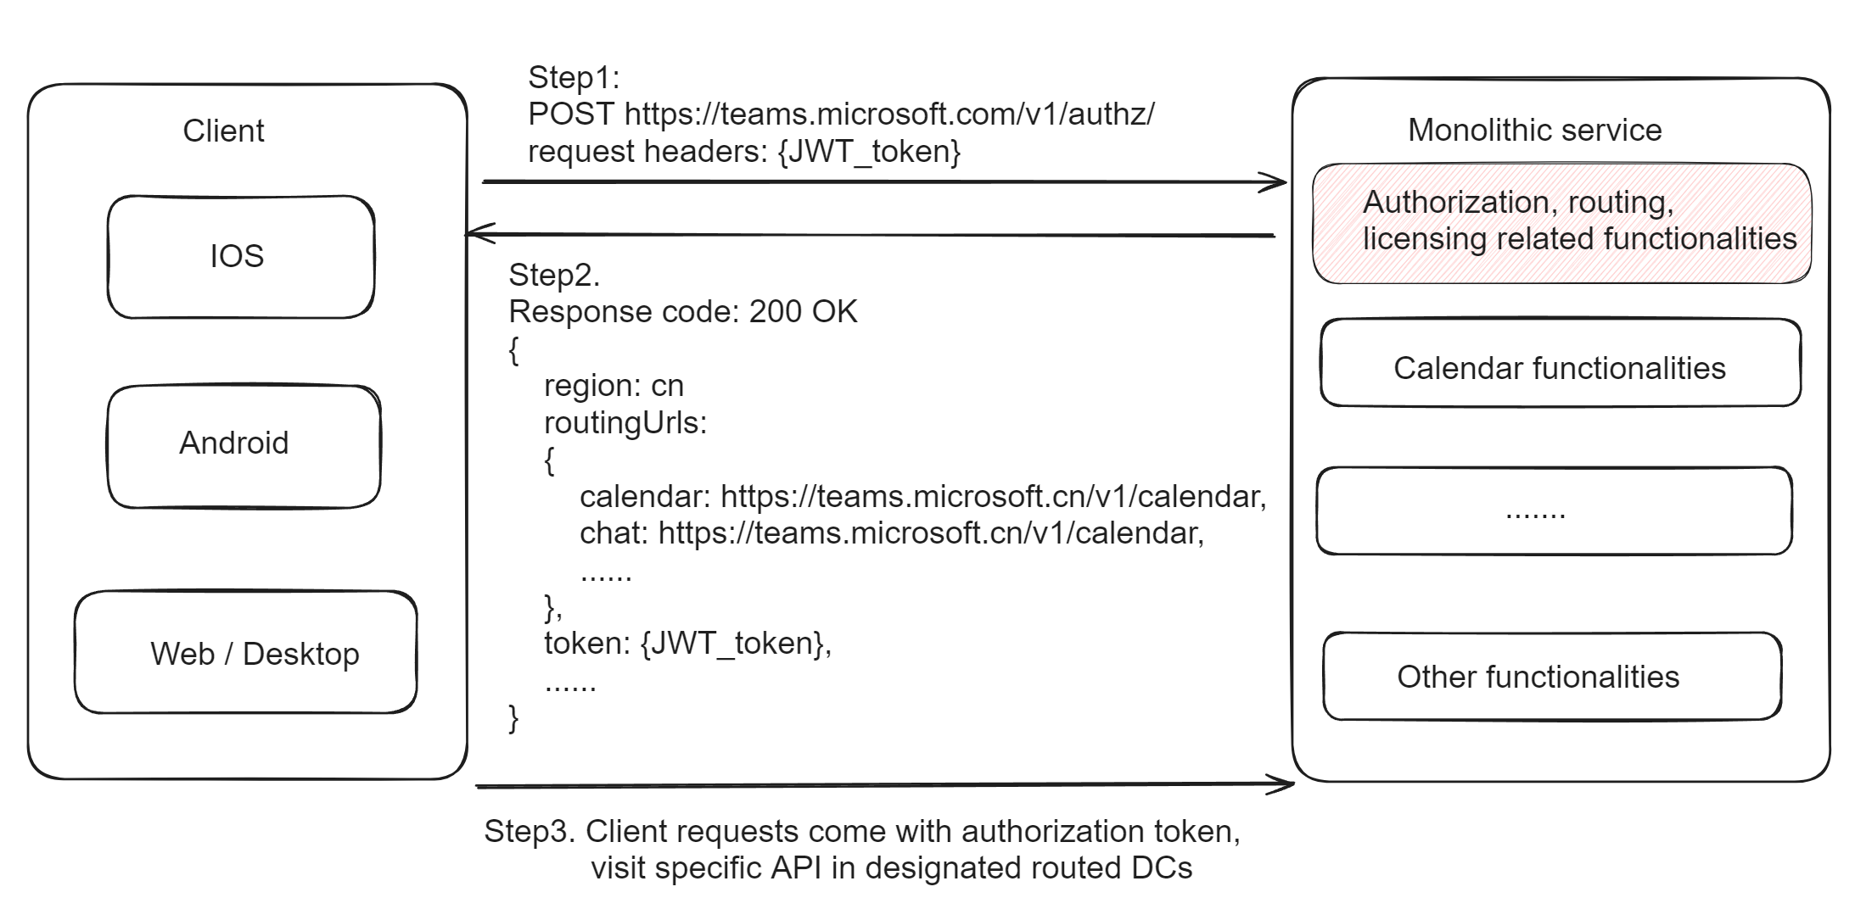
AuthZ project context

Slide 7

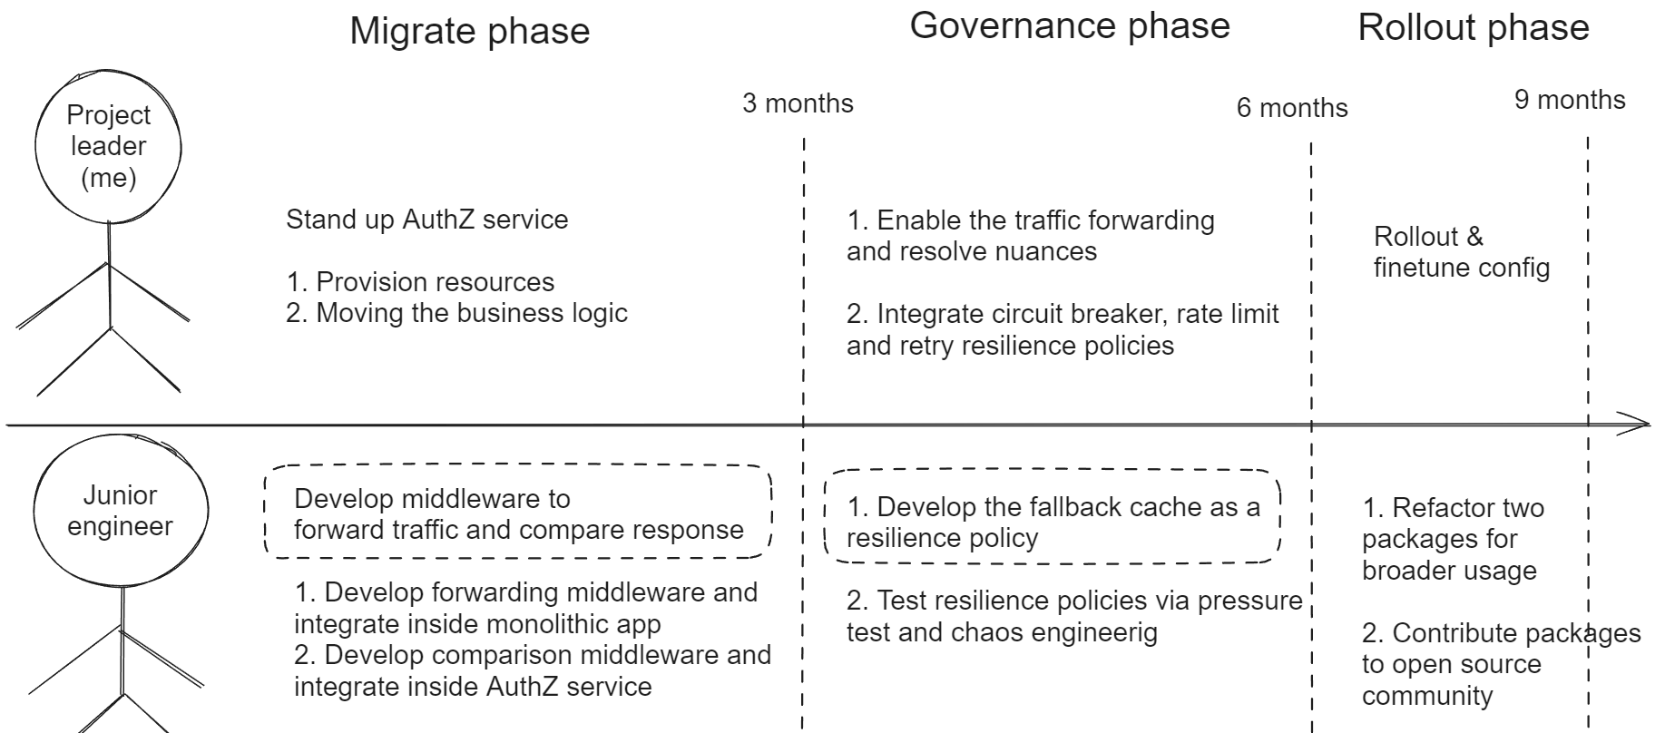
Project outline

Slide 8
Agenda
Experiences
Goals
Highlights in service migration
Highlights in service governance
Summary

Slide 9
Service migration
Challenges:
Mission critical service with complex business logic (~3K RPS globally)
Limited test coverage inside monolithic app
Verification methods:
Unit test, component test
Canary release
Real traffic verification

Slide 10
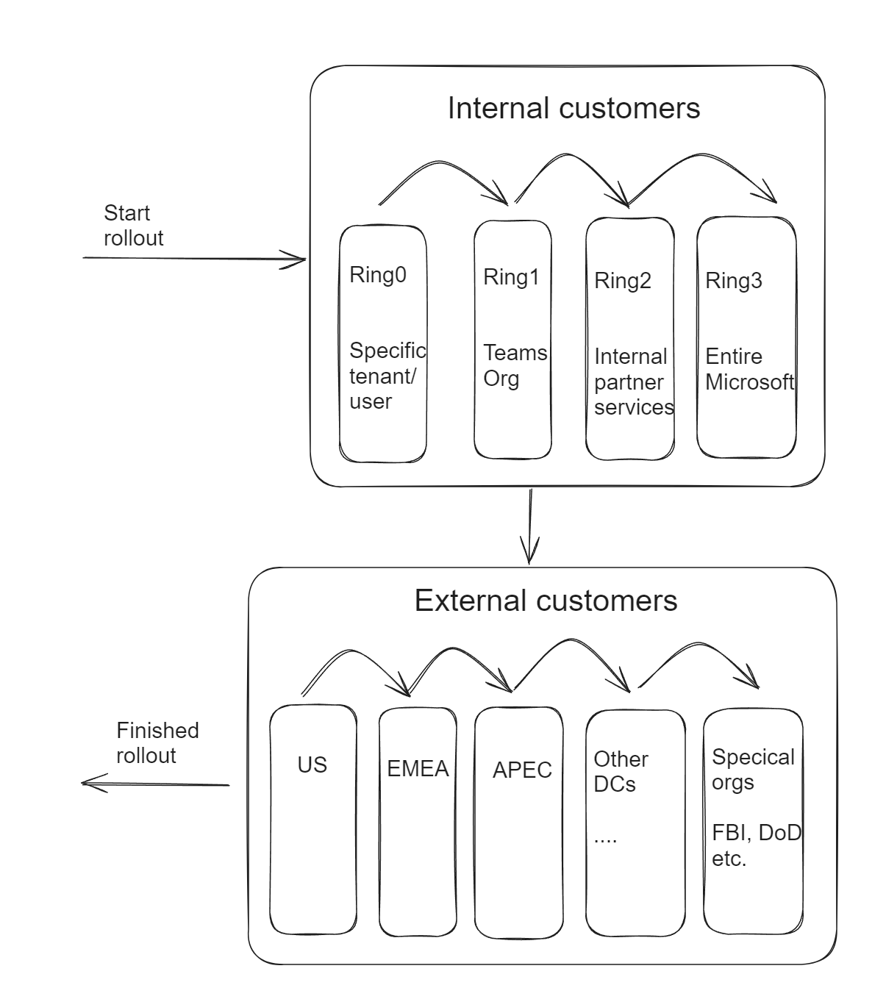
Real traffic validation
Existing rollout process:
Canary release
Flags for turning on/off specific features
Motivations for real traffic validation:
Poor edge case coverage in existing
monolithic app
Service scope rollout, not feature scope
Minimize “test in prod” risks

Slide 11
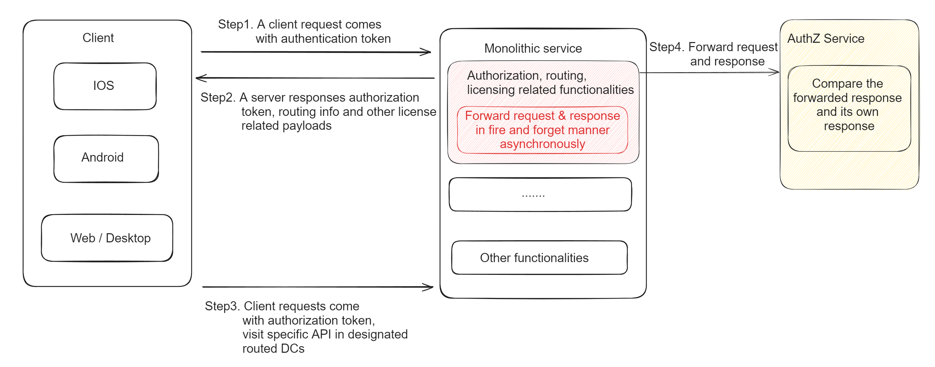
Service migration – Real traffic verification

Slide 12
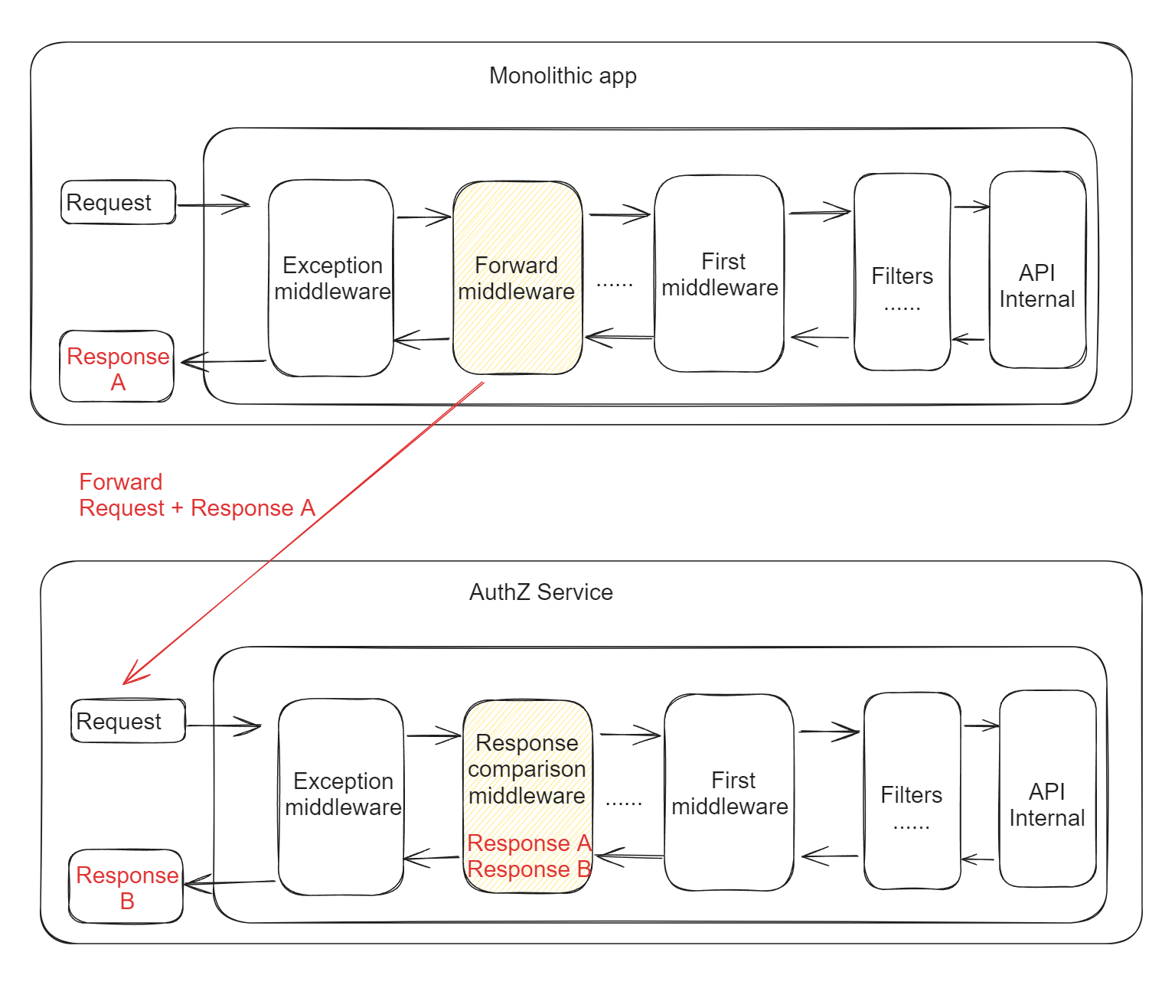
Service migration – Real traffic verification
Assumption:
APIs are idempotent

Slide 13
Service migration
Results:
No high impact incidents during migration
The majority of traffic shifted from monolithic app to AuthZ service.
Service availability improves from 98% to above 99.9%
Key api 99% latency improves above 5ms around 10%

Slide 14
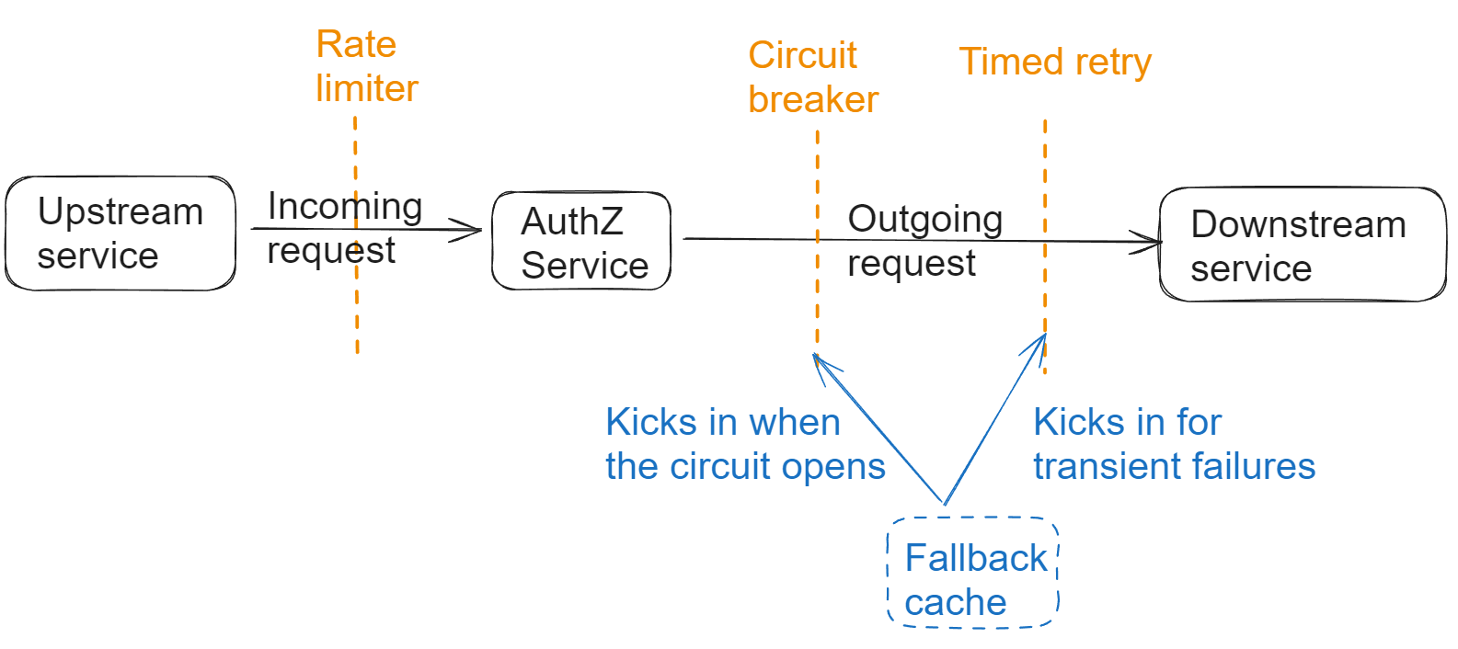
Service governance
Challenges:
Improve the availability beyond 99.9%
Service governance:
Incoming: Rate limiting
Outgoing:
Circuit breaker
Timed retry

Slide 15
Fallback cache
Motivations for falling back to cache:
Improve availability from 99.9% to 99.99%
There are five+ unstable downstream services beyond control
Observation:
Size of cache items is small
The cache items rarely change
Idea:
Store cache value with much longer retention period
Key | Value | Retention Period
{userId} region | us | 1 days
StaleCache: {userId} region | us | 7 days

Slide 16
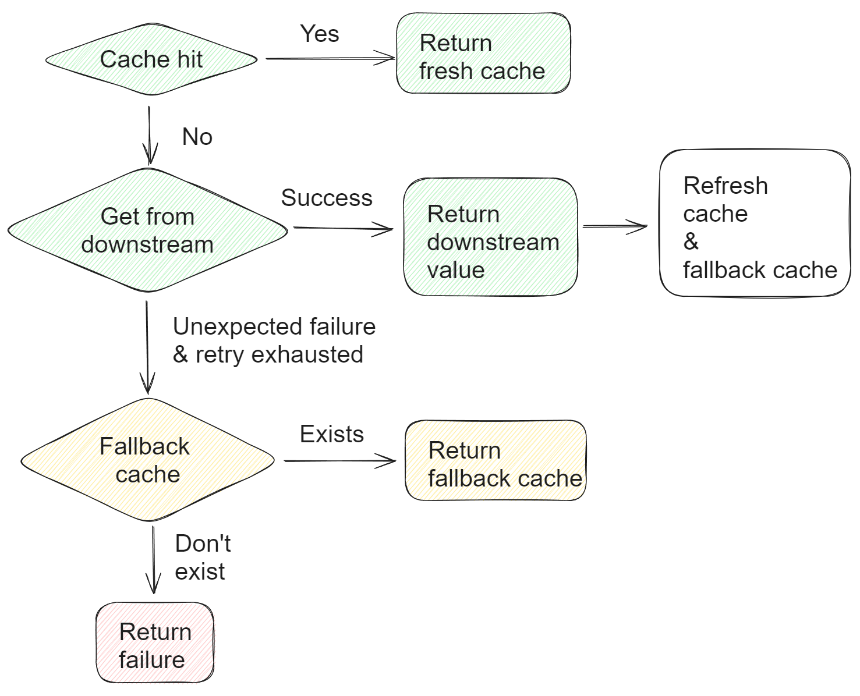
Fallback cache
Green: Best case path
Orange: Fallback cache path
Red: Failure path

Slide 17
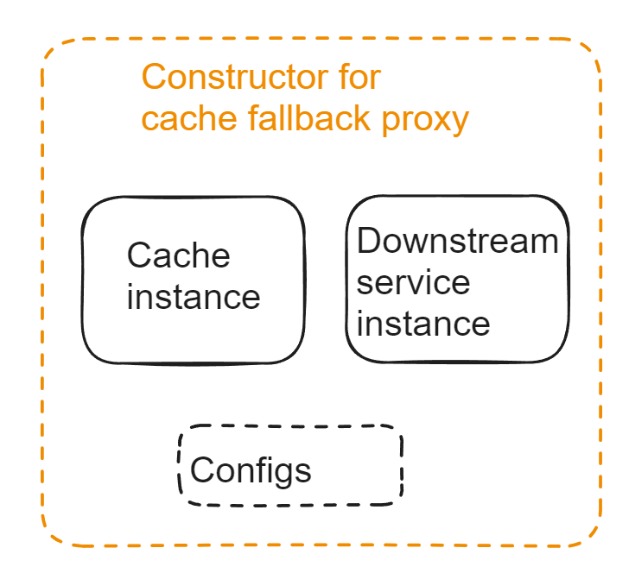
Fallback cache
Structure:
Proxy pattern
Cache and downstream service as input
Config:
Serialization: Protobuf + compression
Expiration time: 7 days
Algorithm: LRU

Slide 18
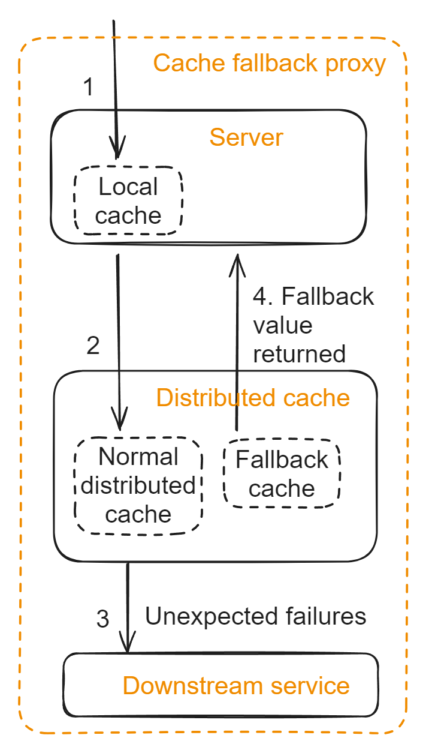
Fallback cache
Design considerations:
Fallback cache only exist in distributed cache, not local
Use case (failure scenarios) not fit well with local
cache purposes (hot key, etc)
To avoid introducing cache inconsistency problem

Slide 19
Service governance
Results:
Downstream service availability improves beyond 99.99%.
Service availability improves above 99.9%, almost reaching 99.99%.
Key api 99.9% latency improves above 5ms around 10%

Slide 20
Summary
AuthZ service availability improves beyond 99.9% to 99.99%
Publish two reusable packages:
Traffic forwarding and comparison middleware
Fallback cache resilience policy

