Slide 1
Authorization service migration
Shijie Zhang

Slide 2
Agenda
AuthZ project context
Service migration
Service governance
Summary

Slide 3
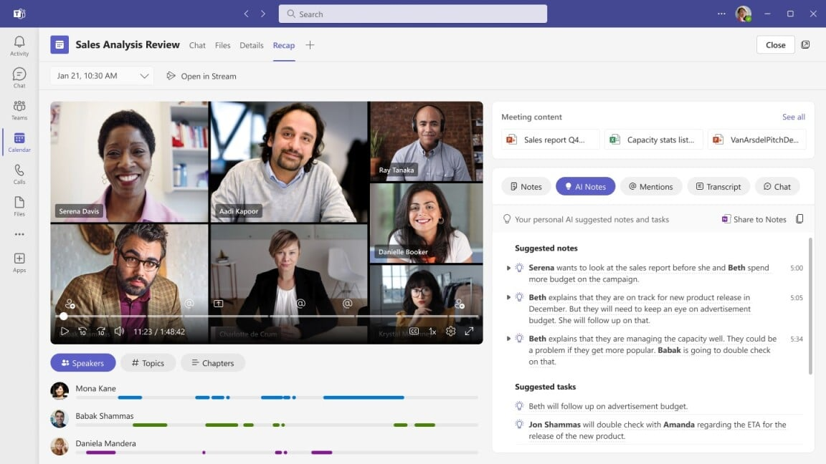
AuthZ project context
Backend service in Microsoft Teams product
SaaS app built on C#, .Net Core and Azure cloud

Slide 4
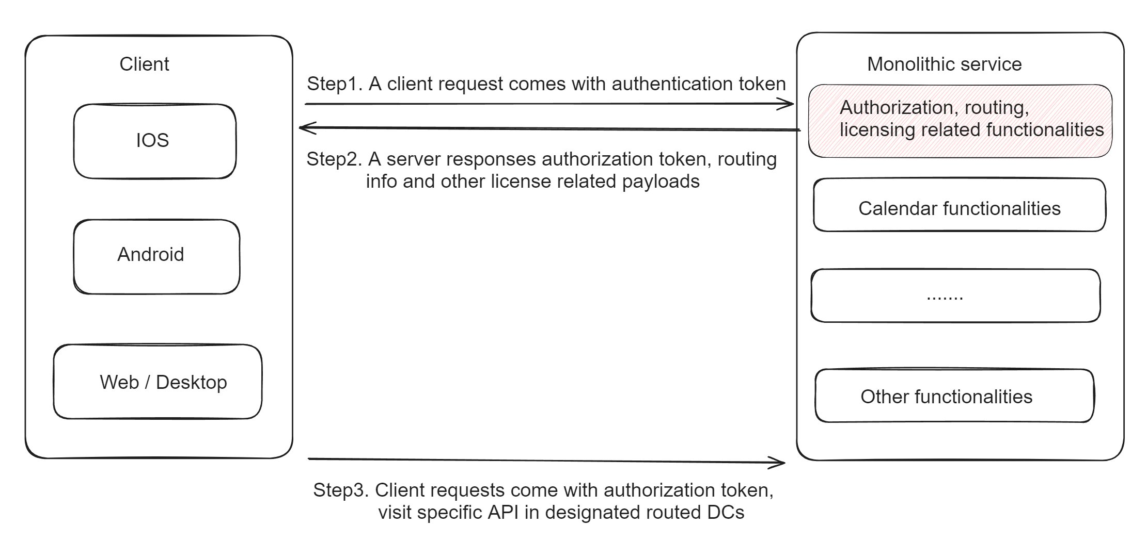
AuthZ project context

Slide 5
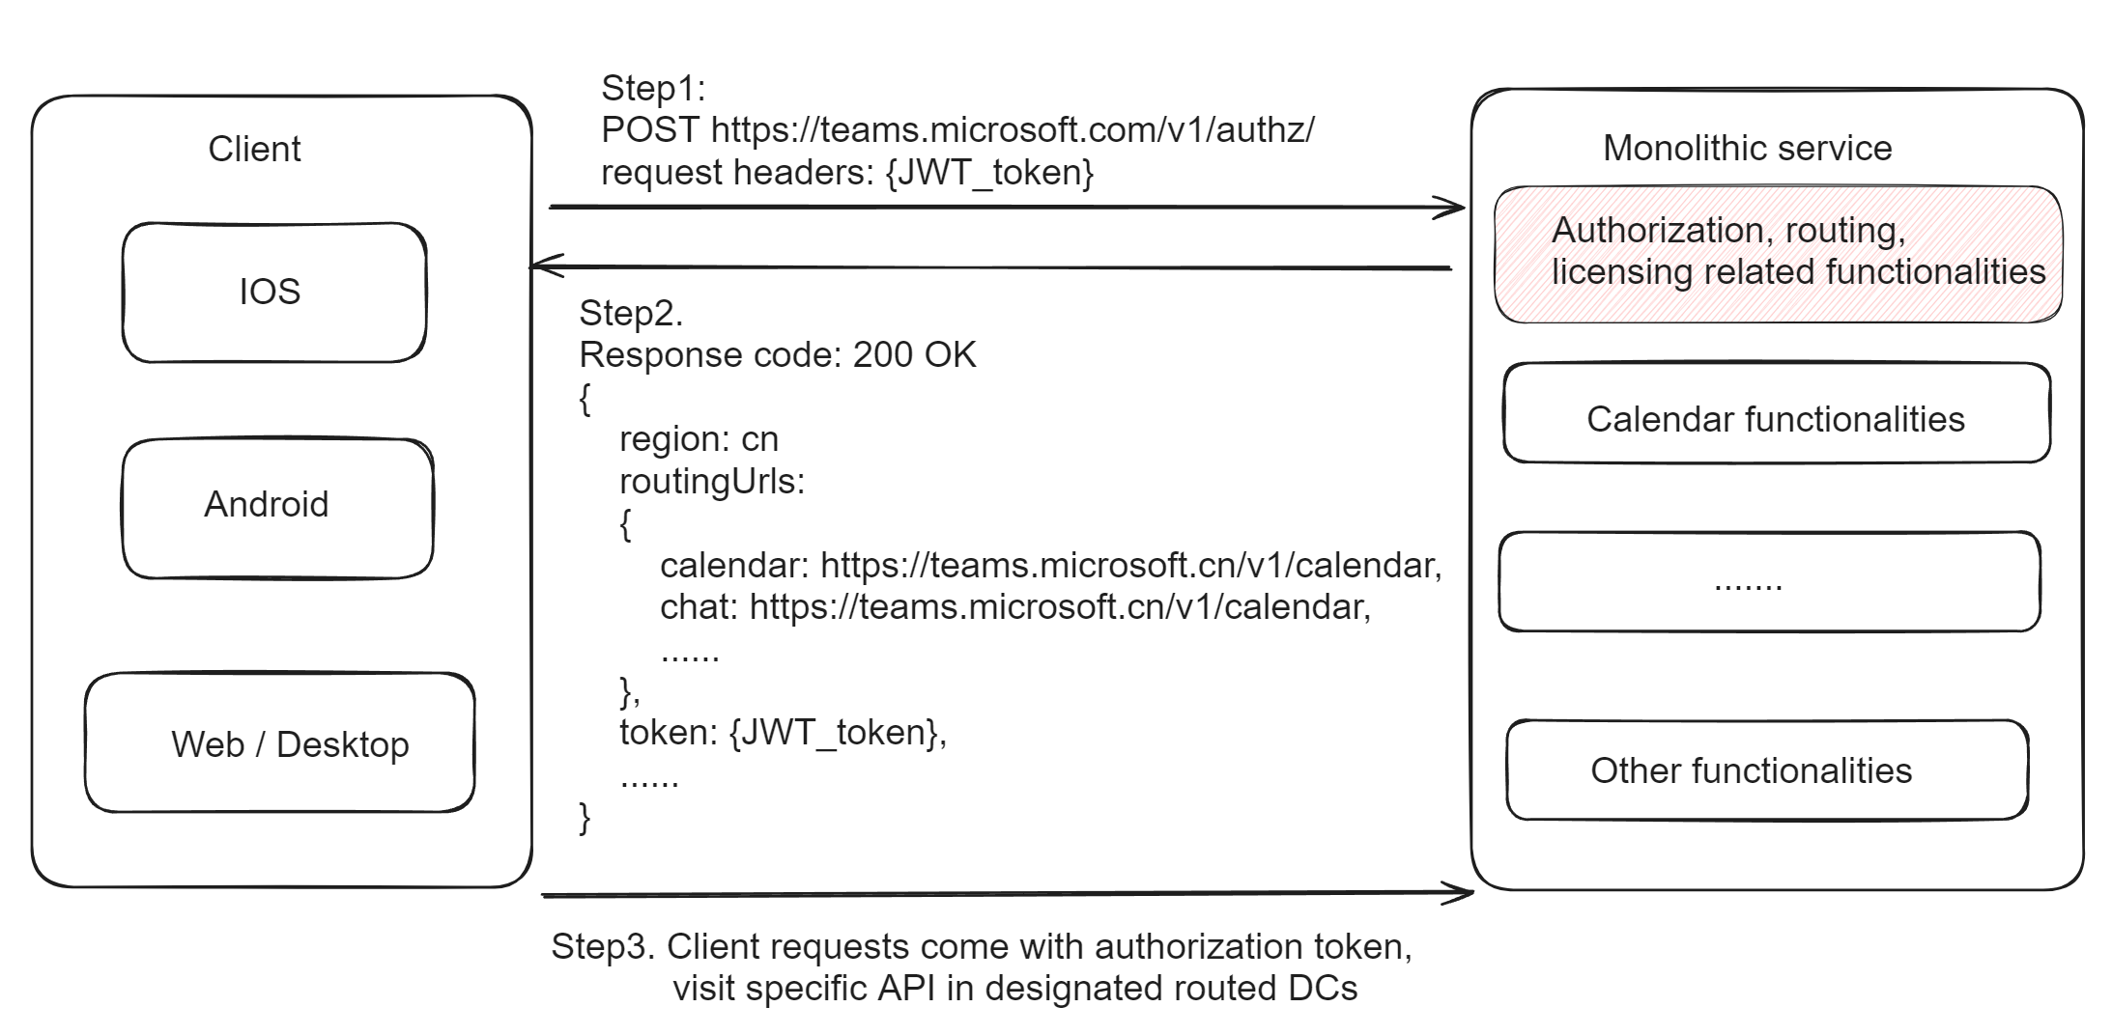
AuthZ project context

Slide 6
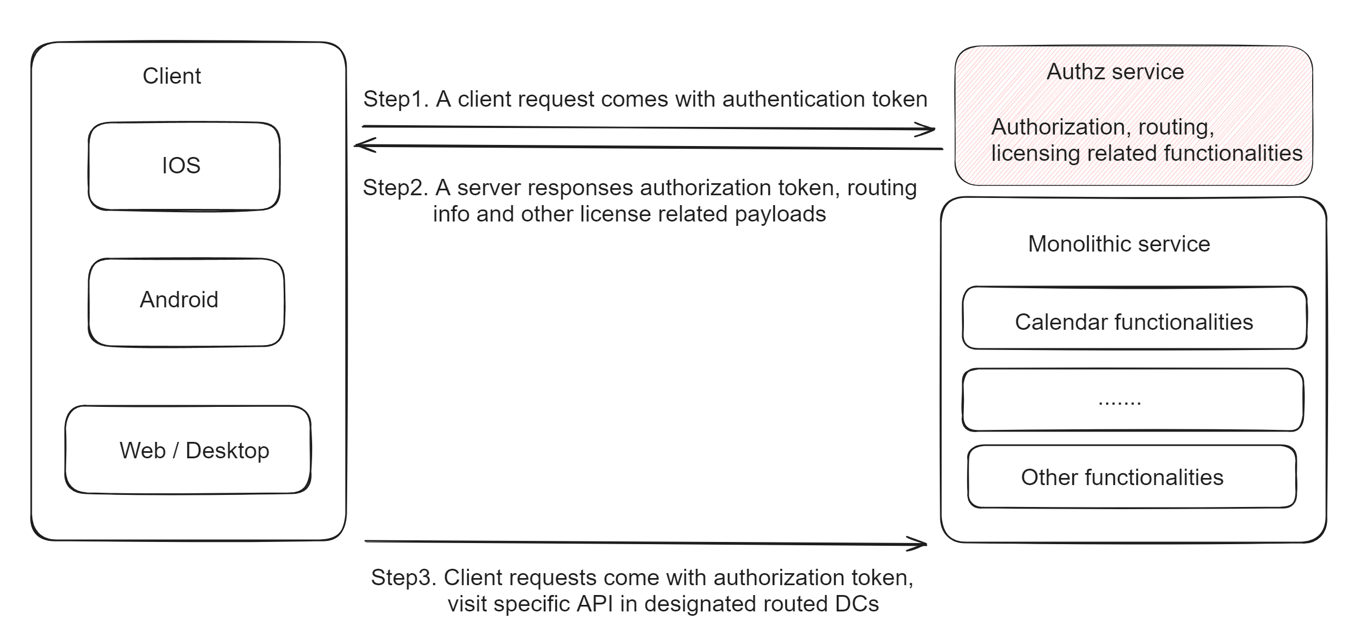
AuthZ project context

Slide 7
Goals
Problems:
Mission critical service shares resources (CPU, cache…) with others
Slow development and deployment cycle
Goals:
Migration: Build a brand new AuthZ service from scratch
Governance: Improve AuthZ service availability above 99.9%
Optimization: Improve AuthZ cache consistency

Slide 8
Service migration
Challenges:
Mission critical service
Stateless by itself but persist license data to database
Verification methods:
Unit test, component test
Real traffic verification
Canary release

Slide 9
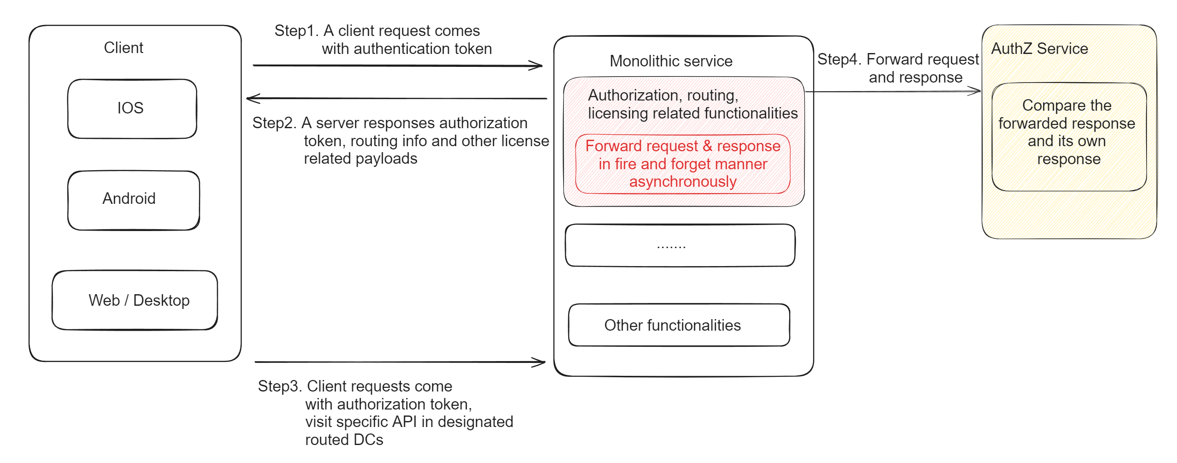
Service migration – Real traffic verification

Slide 10
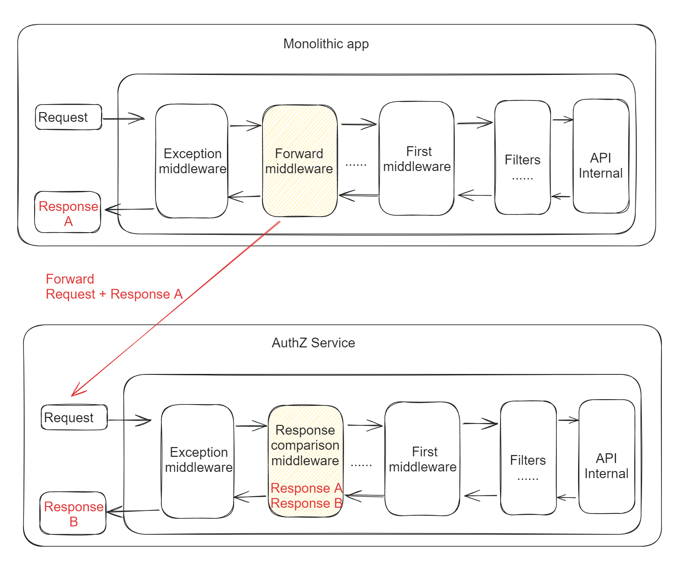
Service migration – Real traffic verification
Assumption:
APIs are idempotent
Existing test coverage is limited
Benefits:
Real traffic has more complete coverage on edge cases

Slide 11
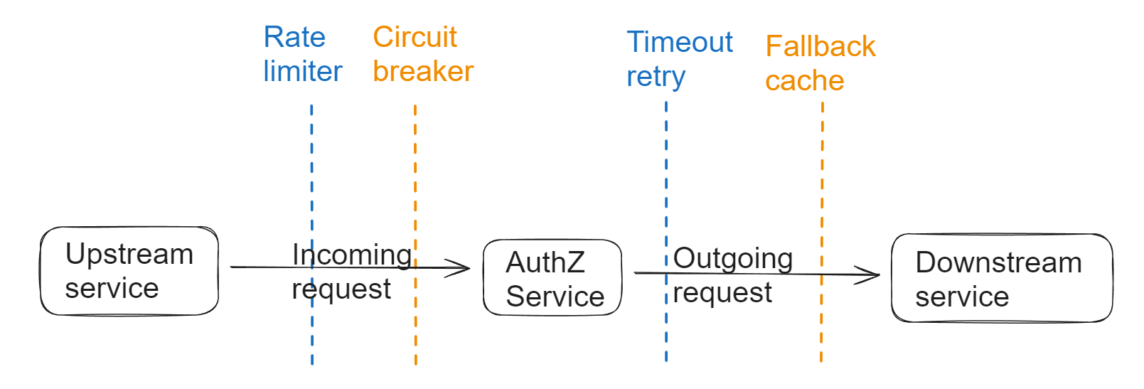
Service governance
Challenges:
Improve the availability beyond 99.9%
Service governance:
Rate limiting
Circuit breaker
Fallback cache
Timeout retry

Slide 12
Fallback cache
Open sourced: https://github.com/Polly-Contrib/Polly.Contrib.CachePolicy
Assumption:
Cache items (number*size) is small
The cache items rarely change
Example:
{userId} region: us, 1 days
Cache: {userId} region: us, 7 days

Slide 13
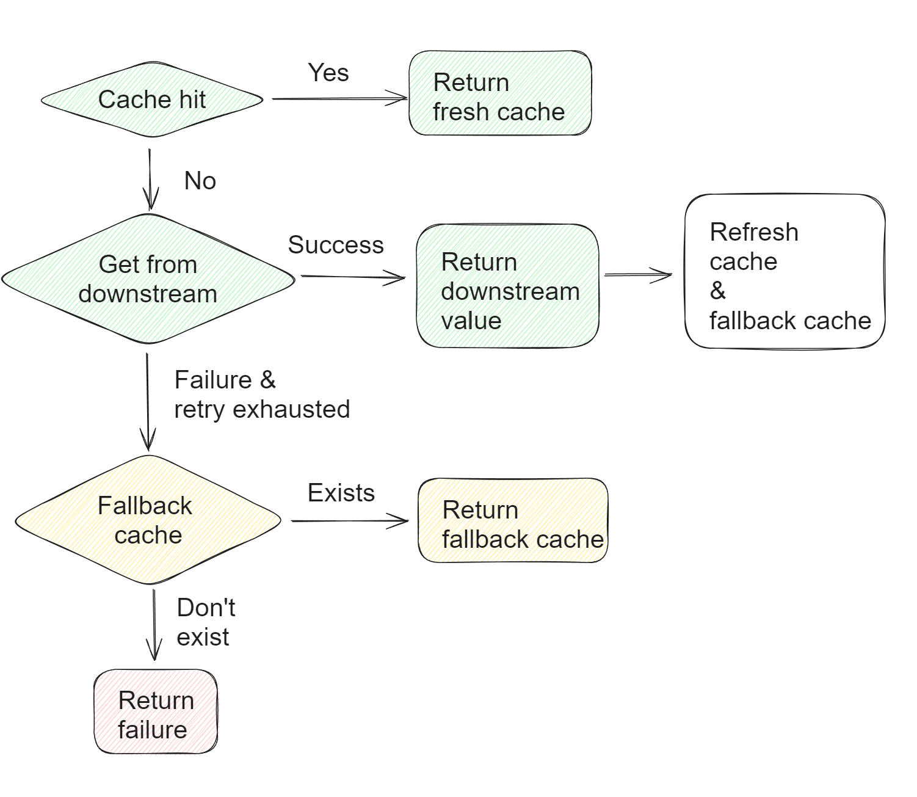
Fallback cache

Slide 15
Summary
AuthZ project context

