Slide 1
Convolution1D
Input dim = 1
Input dim = None
feature
filters
feature
…
Kernel
Size
….
…
…
Steps
New
Steps
Equal to
Nb_filter
Con2d with no stride in feature

Slide 2
CNN 1D
Flatten
Convolution
Dense
Convolution
Max pooling
Input
Output

Slide 3
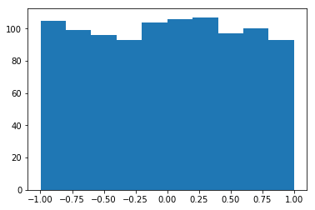
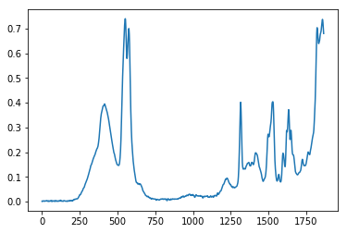
Generator
GAN|Design
Structure
Uniform Distribution
False
Discriminator
Loss
True
Layer（type） | Output Shape | Activation | Parameter
Dense | (None,1024) | Tanh | Normal initial
Dense | (None,14944) | BN+Tanh | Normal initial
Reshape | (None,467,32) | - | -
UpSampling1D | (None,934,32) | - | Stepsize = 2
Conv1D | (None,934,64) | Tanh | (64,3) ,same
UpSampling1D | (None,1868,64) | - | Stepsize = 2
Conv1D | (None,1868,1) | Tanh | (1,3),same
Layer（type） | Output Shape | Activation | Parameter
Conv1D | (None,1868,64) | Tanh | (64,3), same
MaxPooling1D | (None,934,64) | - | Stepsize = 2
Conv1D | (None,934,32) | Tanh | (32,3), same
MaxPooling1D | (None,467,32) | - | Stepsize =2
Flatten | (None,14944) | - | -
Dense | (None,1024) | Tanh | Normal initial
Dense | (None,1) | Sigmoid | Normal initial

Slide 4
epoch
………………………………………………………………….
Compile
Optimizer
epoch
LOSS
Gen
Dcm
D on G
Batch Size
……………………………..
Batch Size
DISCRIMINATOR
Transform
Preprocessing
Noise
Gen
True Specturm
[0]
[1]
Import data
DCM
TRAINING
LOSS
PREFERENCE
GENERATOR
Noise
[1]
GAN|Algorithm
SHUT D
DGEN
TRAINING
LOSS
OPEN D
SAVE WEIGHT

Slide 5
GAN| Design Regressor
WEIGHT SHARE
DISCRIMINATOR
REGRESSOR
Noise
Gen
True Specturm
True Specturm
[0]
[1]
Label
DCM
TRAINING
DCM
TRAINING
LOSS
LOSS

Slide 6
Generator
GAN|Design
Structure
Uniform Distribution
False
Discriminator
Loss
True
Layer（type） | Output Shape | Activation | Parameter
Dense | (None,1024) | Tanh | Normal initial
Dense | (None,5600) | BN+Tanh | Normal initial
Reshape | (None,175,32) | - | -
UpSampling1D | (None,350,32) | - | Stepsize = 2
Conv1D | (None,350,64) | Tanh | (64,3) ,same
UpSampling1D | (None,700,64) | - | Stepsize = 2
Conv1D | (None,700,1) | Tanh | (1,3),same
Layer（type） | Output Shape | Activation | Parameter
Conv1D | (None,700,64) | Tanh | (64,3), same
MaxPooling1D | (None,350,64) | - | Stepsize = 2
Conv1D | (None,350,32) | Tanh | (32,3), same
MaxPooling1D | (None,175,32) | - | Stepsize =2
Flatten | (None,5600) | - | -
Dense | (None,1024) | Tanh | Normal initial
Dense | (None,1) | Sigmoid | Normal initial

Slide 7
GENERATOR
DISCRIMINATOR
FLSE
LOSS
TRUE

Slide 8
INPUT
ONE HOT
LOGIT
SOFTMAX
X
L
Y
S(Y)
LINEAR NODEL
CROSS
ENTROPY
WX+b
S(Y)
D(S,L)

