Slide 1
Convolution1D
Input dim = 1
Input dim = None
feature
filters
feature
…
Kernel
Size
….
…
…
Steps
New
Steps
Equal to
Nb_filter
Con2d with no stride in feature

Slide 2
CNN 1D
Flatten
Convolution
Dense
Convolution
Max pooling
Input
Output

Slide 3
3
128
256
512
64
1024
16
32
8
4
100z
4
4
8
16
Project and reshape
32
CONV1
CONV2
CONV3
64
CONV4
G(z)

Slide 4
1
64
28
128
14
100z
7
7
14
Project and reshape
STRIDE 2
CONV1
CONV2
28
G(z)

Slide 5
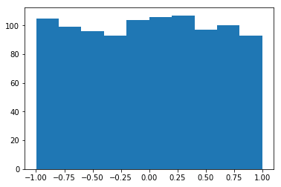
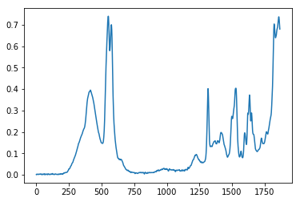
Generator
GAN|Design
Structure
Uniform Distribution
False
Discriminator
Loss
True
Layer（type） | Output Shape | Activation | Parameter
Dense | (None,1024) | Tanh | Normal initial
Dense | (None,14944) | BN+Tanh | Normal initial
Reshape | (None,467,32) | - | -
UpSampling1D | (None,934,32) | - | Stepsize = 2
Conv1D | (None,934,64) | Tanh | (64,3) ,same
UpSampling1D | (None,1868,64) | - | Stepsize = 2
Conv1D | (None,1868,1) | Tanh | (1,3),same
Layer（type） | Output Shape | Activation | Parameter
Conv1D | (None,1868,64) | Tanh | (64,3), same
MaxPooling1D | (None,934,64) | - | Stepsize = 2
Conv1D | (None,934,32) | Tanh | (32,3), same
MaxPooling1D | (None,467,32) | - | Stepsize =2
Flatten | (None,14944) | - | -
Dense | (None,1024) | Tanh | Normal initial
Dense | (None,1) | Sigmoid | Normal initial

Slide 6
epoch
………………………………………………………………….
Compile
Optimizer
epoch
LOSS
Gen
Dcm
D on G
Batch Size
……………………………..
Batch Size
DISCRIMINATOR
Transform
Preprocessing
Noise
Gen
True Specturm
[0]
[1]
Import data
DCM
TRAINING
LOSS
PREFERENCE
GENERATOR
Noise
[1]
GAN|Algorithm
SHUT D
DGEN
TRAINING
LOSS
OPEN D
SAVE WEIGHT

Slide 7
GAN| Design Regressor
WEIGHT SHARE
DISCRIMINATOR
REGRESSOR
Noise
Gen
True Data
True Data
[0]
[1]
Label
DCM
TRAINING
DCM
TRAINING
LOSS
LOSS

Slide 8
Generator
N
Generator
F
Discriminator
True/False
Loss
T
Layer（type） | Output Shape | Activation | Parameter
Dense | (None,1024) | Tanh | Normal initial
Dense | (None,5600) | BN+Tanh | Normal initial
Reshape | (None,175,32) | - | -
UpSampling1D | (None,350,32) | - | Stepsize = 2
Conv1D | (None,350,64) | Tanh | (64,3) ,same
UpSampling1D | (None,700,64) | - | Stepsize = 2
Conv1D | (None,700,1) | Tanh | (1,3),same
Layer（type） | Output Shape | Activation | Parameter
Conv1D | (None,700,64) | Tanh | (64,3), same
MaxPooling1D | (None,350,64) | - | Stepsize = 2
Conv1D | (None,350,32) | Tanh | (32,3), same
MaxPooling1D | (None,175,32) | - | Stepsize =2
Flatten | (None,5600) | - | -
Dense | (None,1024) | Tanh | Normal initial
Dense | (None,1) | Sigmoid | Normal initial

Slide 9
GENERATOR
DATA
DISCRIMINATOR
FLSE
LABEL
LOSS
TRUE

Slide 10
AC-WGAN|STRUCTURE
REGRESSOR
GENERATOR
MSE LOSS
Z
F
L
DISCRIMINATOR
TRUE/FALSE LOSS
T

Slide 11
Regression Segment
Classffier
REGRESSOR
GENERATOR
Z
F
REGRESSOR
CATEGORICAL LOSS
L
DISCRIMINATOR
T
TRUE/FALSE LOSS

Slide 12
真实数据x
判别器
（Discriminator）
判别结果
随机噪声z
生成器
（Generator）
生成数据G(z)
图像（二维数据集）
核磁共振氢谱（一维数据集）
运行指标（时间序列数据集）
GAN
GAN
CGAN
WGAN
InfoGAN

