Slide 1
t1
p1
t2
p2
X
E
=
+
+…+
X1
t1
p1
X2
t2
p2
E
+
+…+

Slide 2
Convolution1D
Input dim = 1
Input dim = None
feature
filters
feature
…
Kernel
Size
….
…
…
Steps
New
Steps
Equal to
Nb_filter
Con2d with no stride in feature

Slide 3
CNN 1D
Flatten
Convolution
Dense
Convolution
Max pooling
Input
Output

Slide 4
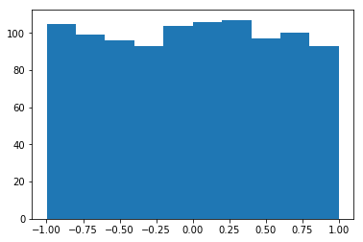
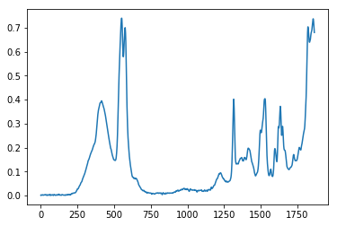
Generator
GAN|Design
Structure
Uniform Distribution
False
Discriminator
Loss
True
Layer（type） | Output Shape | Activation | Parameter
Dense | (None,1024) | Tanh | Normal initial
Dense | (None,14944) | BN+Tanh | Normal initial
Reshape | (None,467,32) | - | -
UpSampling1D | (None,934,32) | - | Stepsize = 2
Conv1D | (None,934,64) | Tanh | (64,3) ,same
UpSampling1D | (None,1868,64) | - | Stepsize = 2
Conv1D | (None,1868,1) | Tanh | (1,3),same
Layer（type） | Output Shape | Activation | Parameter
Conv1D | (None,1868,64) | Tanh | (64,3), same
MaxPooling1D | (None,934,64) | - | Stepsize = 2
Conv1D | (None,934,32) | Tanh | (32,3), same
MaxPooling1D | (None,467,32) | - | Stepsize =2
Flatten | (None,14944) | - | -
Dense | (None,1024) | Tanh | Normal initial
Dense | (None,1) | Sigmoid | Normal initial

Slide 5
epoch
………………………………………………………………….
Compile
Optimizer
epoch
LOSS
Gen
Dcm
D on G
Batch Size
……………………………..
Batch Size
DISCRIMINATOR
Transform
Preprocessing
Noise
Gen
True Specturm
[0]
[1]
Import data
DCM
TRAINING
LOSS
PREFERENCE
GENERATOR
Noise
[1]
GAN|Algorithm
SHUT D
DGEN
TRAINING
LOSS
OPEN D
SAVE WEIGHT

Slide 6
GAN| Design Regressor
WEIGHT SHARE
DISCRIMINATOR
REGRESSOR
Noise
Gen
True Specturm
True Specturm
[0]
[1]
Label
DCM
TRAINING
DCM
TRAINING
LOSS
LOSS

Slide 7
Generator
GAN|Design
Structure
Uniform Distribution
False
Discriminator
Loss
True
Layer（type） | Output Shape | Activation | Parameter
Dense | (None,1024) | Tanh | Normal initial
Dense | (None,5600) | BN+Tanh | Normal initial
Reshape | (None,175,32) | - | -
UpSampling1D | (None,350,32) | - | Stepsize = 2
Conv1D | (None,350,64) | Tanh | (64,3) ,same
UpSampling1D | (None,700,64) | - | Stepsize = 2
Conv1D | (None,700,1) | Tanh | (1,3),same
Layer（type） | Output Shape | Activation | Parameter
Conv1D | (None,700,64) | Tanh | (64,3), same
MaxPooling1D | (None,350,64) | - | Stepsize = 2
Conv1D | (None,350,32) | Tanh | (32,3), same
MaxPooling1D | (None,175,32) | - | Stepsize =2
Flatten | (None,5600) | - | -
Dense | (None,1024) | Tanh | Normal initial
Dense | (None,1) | Sigmoid | Normal initial

