Slide 1

Data Warehouse Data Description
M108660006 簡君維

Slide 2
Data Source
Description

Slide 3
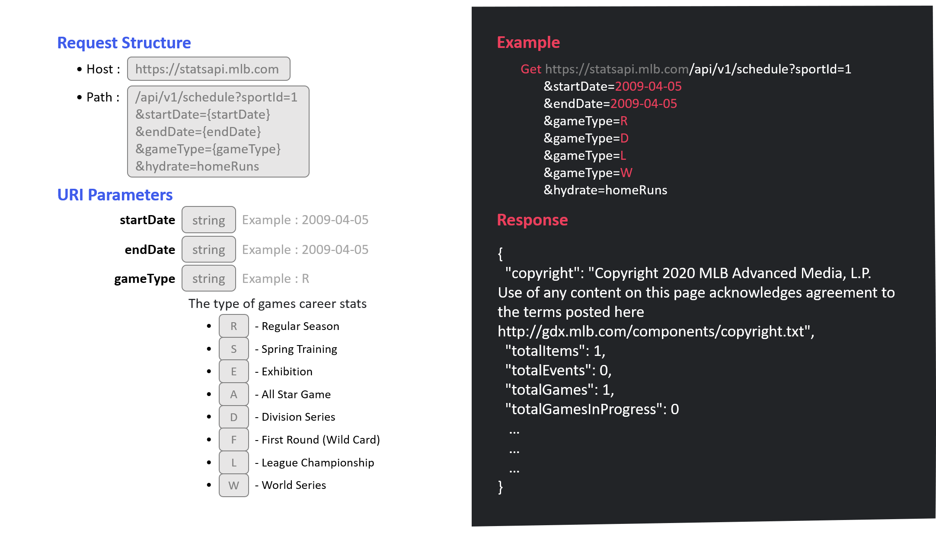
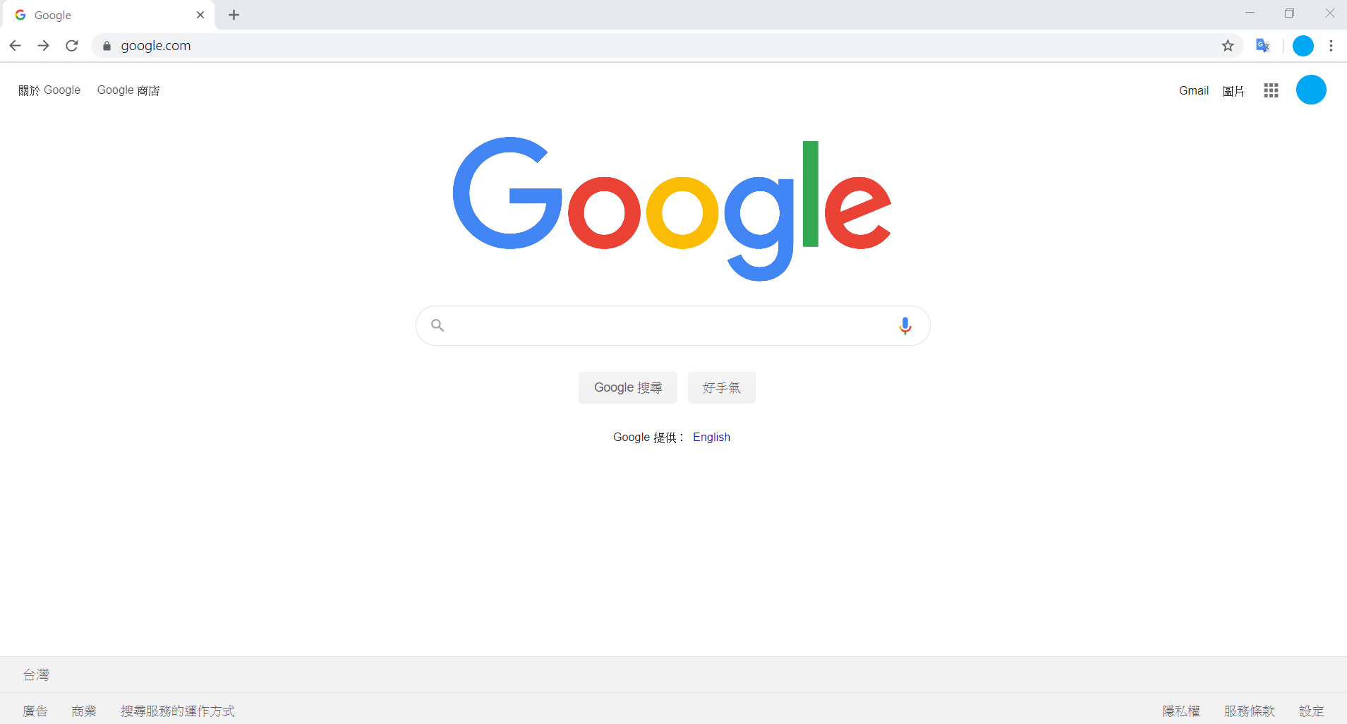
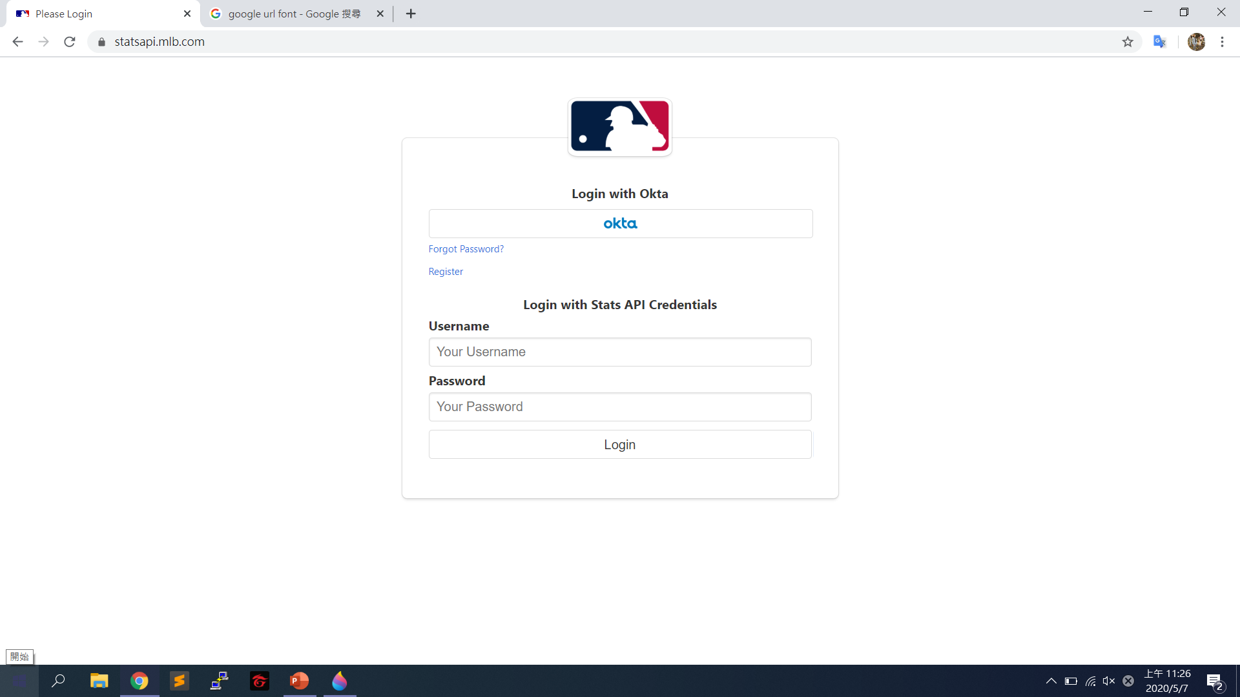
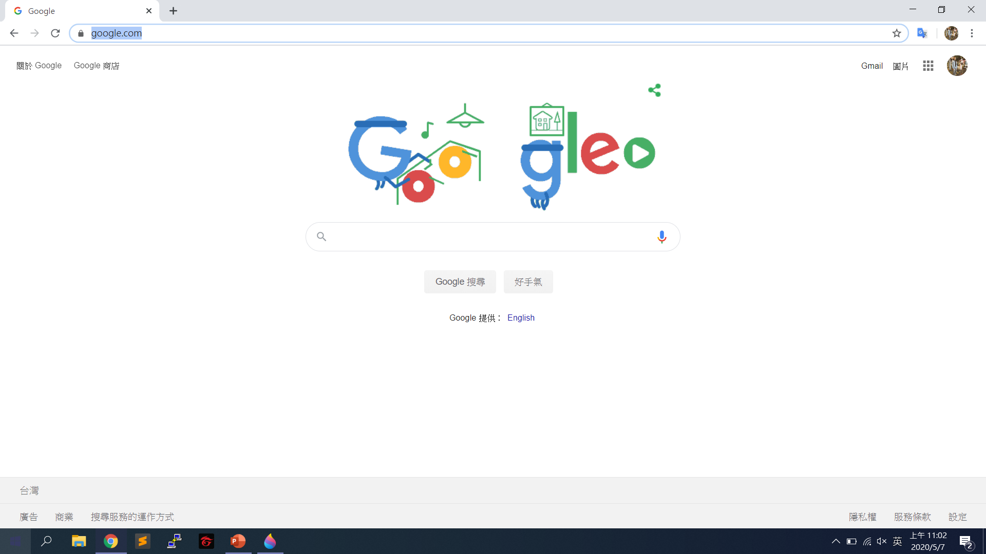
statsapi.mlb.com
Data Source
Description

Slide 4
Description

Slide 5
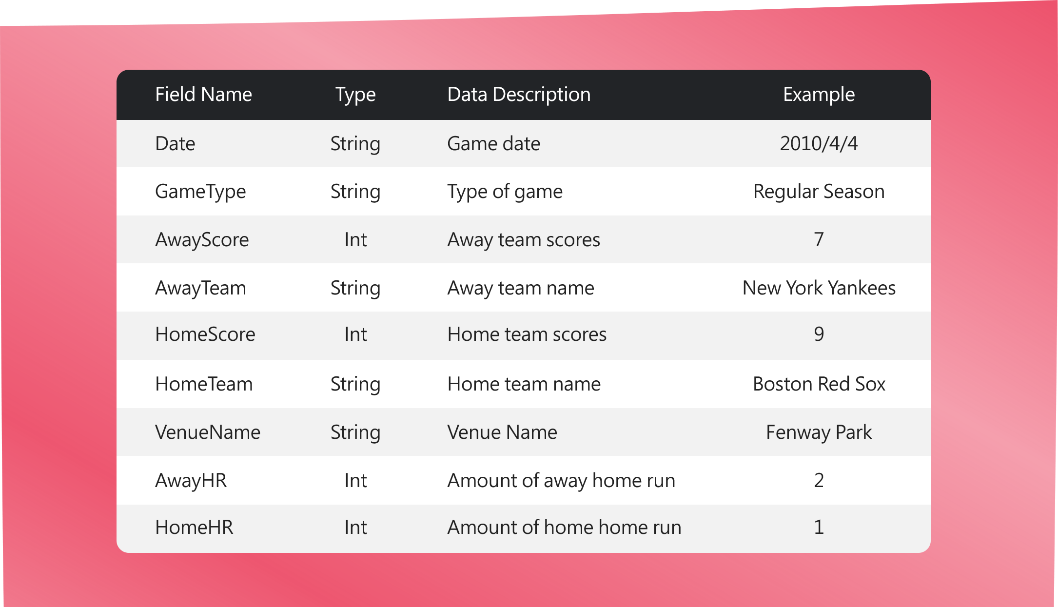
Description

Slide 6
Thanks !
Any question?

Slide 7
Request Structure
Example
• Host :
https://statsapi.mlb.com
Get https://statsapi.mlb.com/api/v1/schedule?sportId=1
&startDate=2009-04-05
&endDate=2009-04-05
&gameType=R
&gameType=D
&gameType=L
&gameType=W
&hydrate=homeRuns
• Path :
/api/v1/schedule?sportId=1
&startDate={startDate}
&endDate={endDate}
&gameType={gameType}
&hydrate=homeRuns
URI Parameters
startDate
string
Example : 2009-04-05
Response
endDate
string
Example : 2009-04-05
{
"copyright": "Copyright 2020 MLB Advanced Media, L.P. Use of any content on this page acknowledges agreement to the terms posted here http://gdx.mlb.com/components/copyright.txt",
"totalItems": 1,
"totalEvents": 0,
"totalGames": 1,
"totalGamesInProgress": 0
…
…
…
}
gameType
string
Example : R
The type of games career stats
•
R
- Regular Season
•
S
- Spring Training
•
E
- Exhibition
•
A
- All Star Game
•
D
- Division Series
•
F
- First Round (Wild Card)
•
L
- League Championship
•
W
- World Series

Slide 8
Field Name
Type
Data Description
Example
Date
String
Game date
2010/4/4
GameType
String
Type of game
Regular Season
AwayScore
Int
Away team scores
7
AwayTeam
String
Away team name
New York Yankees
HomeScore
Int
Home team scores
9
HomeTeam
String
Home team name
Boston Red Sox
VenueName
String
Venue Name
Fenway Park
AwayHR
Int
Amount of away home run
2
HomeHR
Int
Amount of home home run
1

