Slide 1
A Simplified Image Analysis Pipeline
for Detecting sidekick Mutant Phenotypes
in Drosophila Gastrulation
2026-8-12

Slide 2
Sidekick (Sdk):
Sdk is a membrane protein with a small intercellular domain and a massive extracellular domain, which also localizes to tricellular junctions at the level of the adheren junction.
The purpose of Sdk protein is presumed to be facilitating T1 transitions and promoting convergent elongation during GBE.
sdk mutants demonstrate a very subtle phenotype; these mutants are viable, and their mutant phenotype is time-dependent.

Slide 3
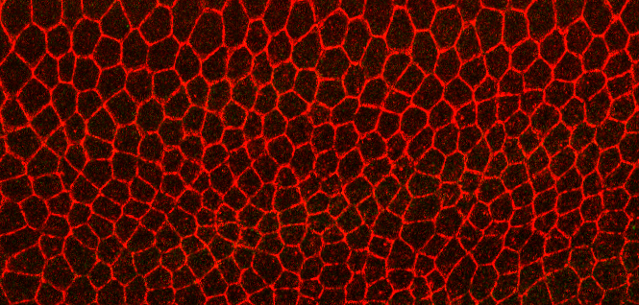
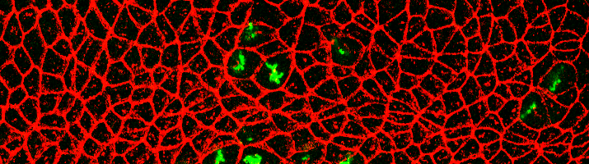
Stage 7
Stage 8

Slide 4
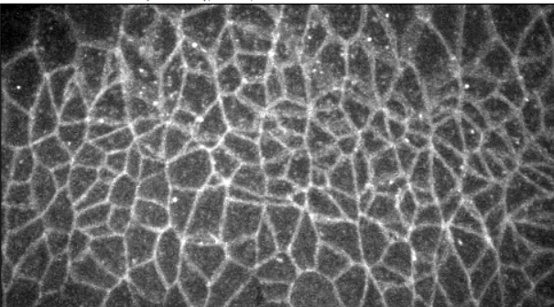
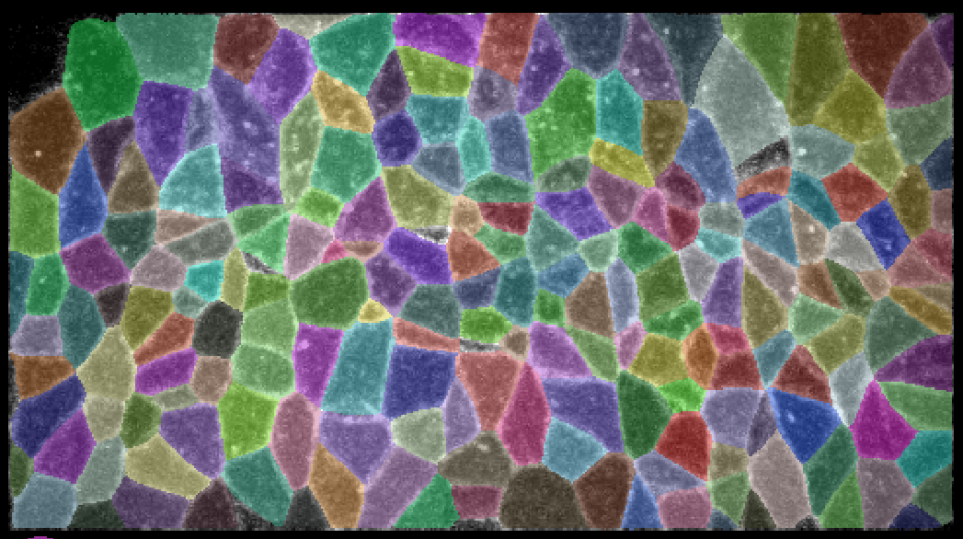
Data pre-processing:
midline
A
P
Synchronisation: (i) timepoint (time of first cell division)
(ii) EM orientation
(iii) ROI
2. Croping and segmentation (using cellpose)
ROI

Slide 5


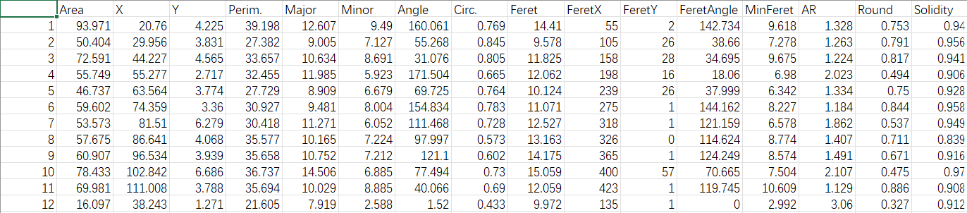
Create masks (for ShapeEmbedLite),
  and take geometric measurements
  of each cell (for other models)

Slide 6
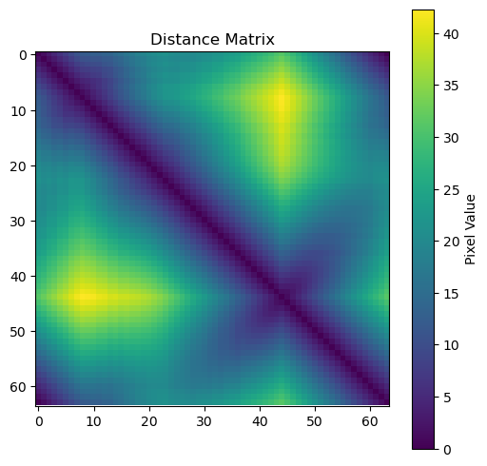
Training models:
ShapeEmbedLite
Working principal:
every cell shape is input as a distance matrix.
The model calculates the feature vectors for each matrix, and learns a normal distribution around each feature vector.
A distance matrix is reconstructed from the mean feature vectors, which is compared with the test distance matrix
Motivation:
see if there is a general difference in cell shape between control and mutant embryos
Notes:
Only captures mean and variance of features, not finer details of the distribution

Slide 7
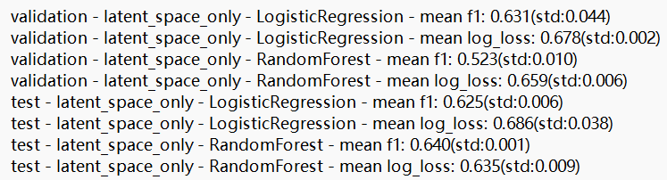
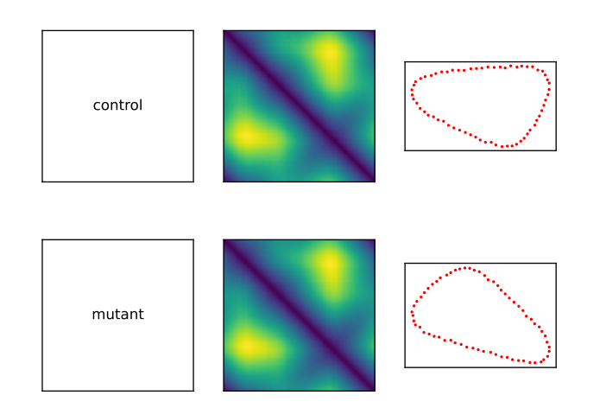
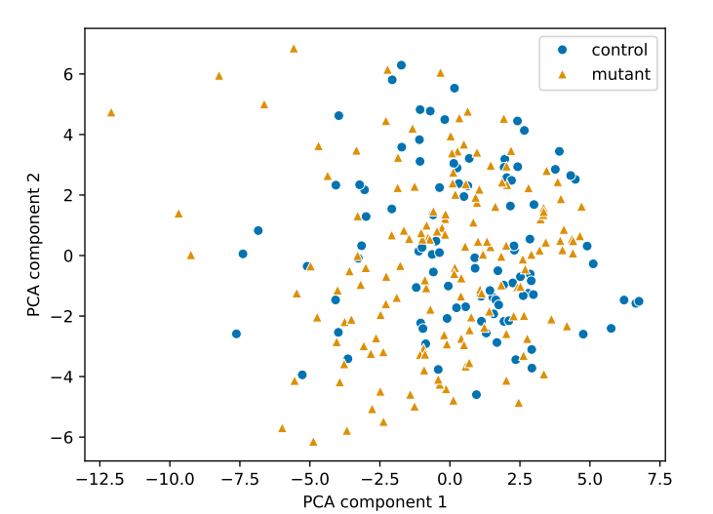
Result:

Slide 8
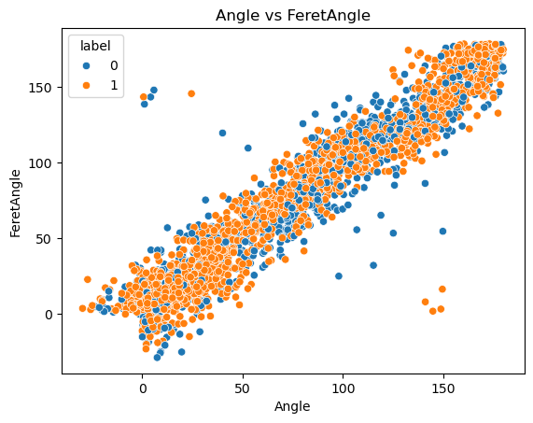

Data Cleaning for RF and SVM
(i) Discard irrelevant and redundant features
 | Area | Angle | Circ. | Solidity
Area | 1.000000 | 0.021386 | 0.148395 | 0.019079
Angle | 0.021386 | 1.000000 | 0.082805 | 0.062577
Circ. | 0.148395 | 0.082805 | 1.000000 | 0.558872
Solidity | 0.019079 | 0.062577 | 0.558872 | 1.000000
(ii) Focus on severely deformed cells only

Slide 9
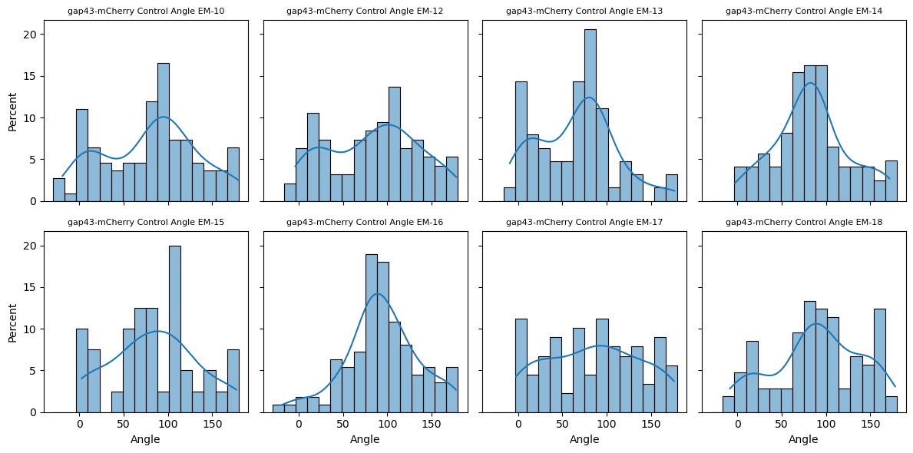
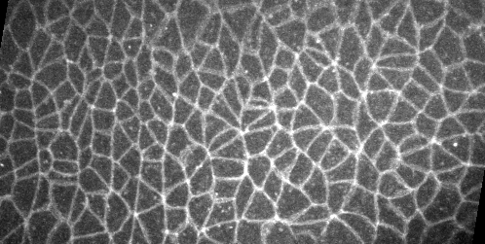
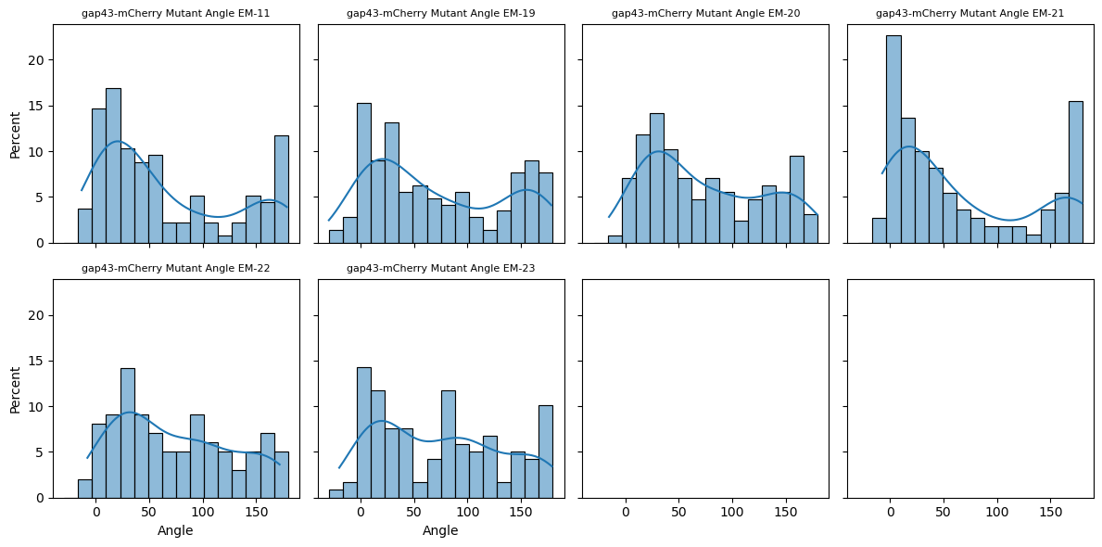
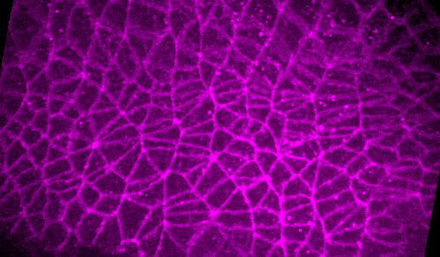
Plot Feature Distribution

Slide 10
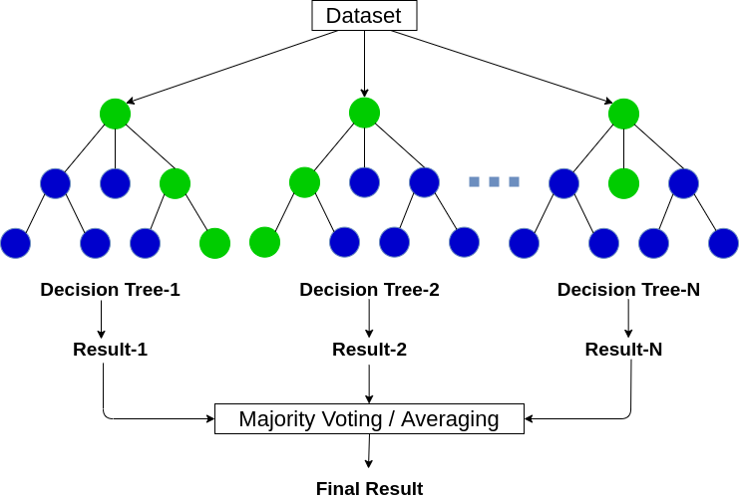
Random Forest
Motivation：see if a RandomForest can capture this difference in feature distribution
  working principal:
  1. the forest is composed of decision trees
  2. every node on the tree asks ‘yes-or-no’ questions about the dataset, splitting it into 2 branches. This is done recursively until a certain depth is reached.
  3. all the trees take a majority vote to make the prediction

Slide 11
Motivation：see if a RandomForest can capture this difference in feature distribution
For every embryo, every one of its feature distributions is binned and concatenated.
 |  | Area_bin_0 | Area_bin_1 | Area_bin_2 | Area_bin_3 | Area_bin_4 | Area_bin_5 | Area_bin_6 | Area_bin_7 | Area_bin_8 | Area_bin_9 | ... | Solidity_bin_6 | Solidity_bin_7 | Solidity_bin_8 | Solidity_bin_9 | Solidity_bin_10 | Solidity_bin_11 | Solidity_bin_12 | Solidity_bin_13 | Solidity_bin_14 | Solidity_bin_15
EM | label
0 | 0 | 10.000000 | 13.529412 | 24.117647 | 21.176471 | 8.823529 | 8.823529 | 6.470588 | 4.705882 | 1.176471 | 0.588235 | ... | 1.764706 | 3.529412 | 4.705882 | 10.00000 | 15.882353 | 24.117647 | 21.764706 | 13.529412 | 2.941176 | 0.588235
1 | 1 | 3.524229 | 18.502203 | 28.193833 | 26.872247 | 12.775330 | 3.524229 | 2.202643 | 2.202643 | 0.440529 | 0.881057 | ... | 1.762115 | 4.405286 | 9.251101 | 12.77533 | 11.894273 | 25.550661 | 16.740088 | 8.810573 | 3.524229 | 0.440529

Slide 12
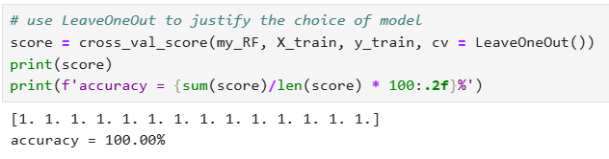
LeaveOneOut Evaluation
Result:
Most Important Bins
 | Area_bin_1 | Area_bin_2 | Angle_bin_3 | Angle_bin_4 | Angle_bin_7 | Angle_bin_9 | Angle_bin_10 | Solidity_bin_10
0 | 5.60568 | 14.0 | 10.502969 | 20.122807 | 8.877193 | 6.0 | 6.754386 | 4.974583

Slide 13
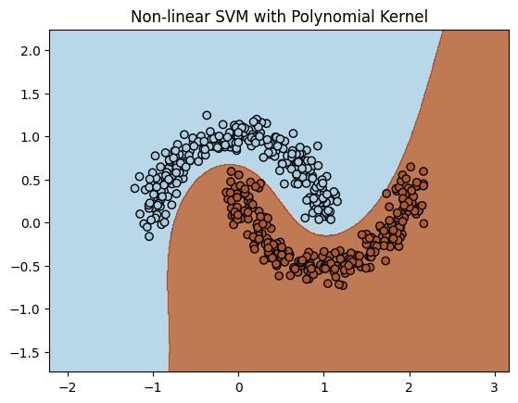
SVM
Motivation：SVM may give a better decision boundary than RandomForest
Working Principal:
1. Binning allows us to convert each embryo into a high-dimensional vector
2. draws a line that best separates controls from mutants

Slide 14
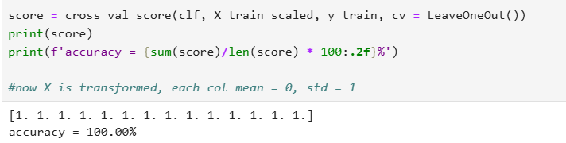
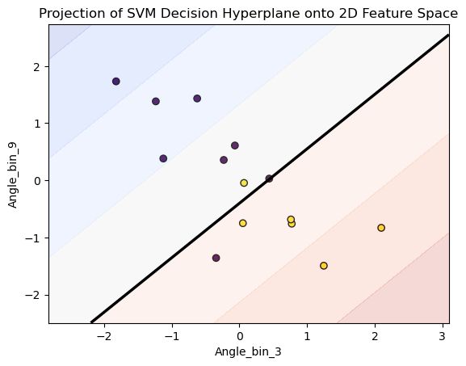
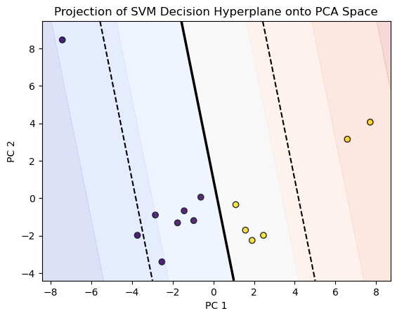
Result:
LeaveOneOut Evaluation

Slide 15
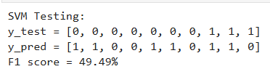
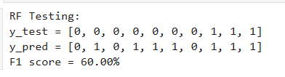
Testing on E-CadGFP strains

Slide 16
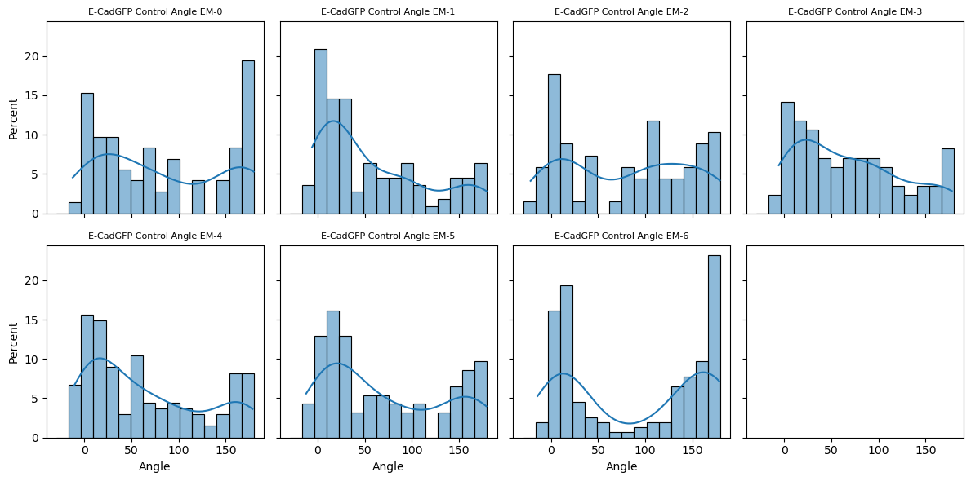
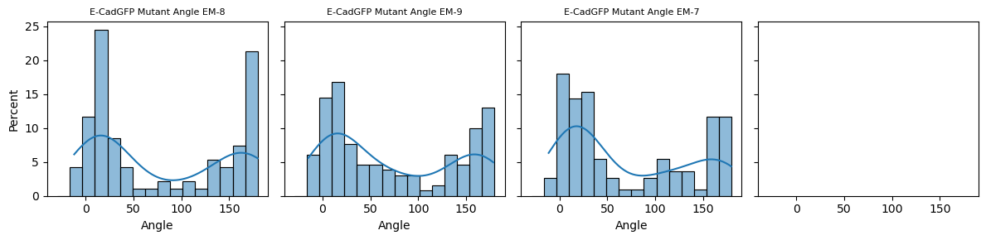
Angle Distribution for E-CadGFP strains

Slide 17
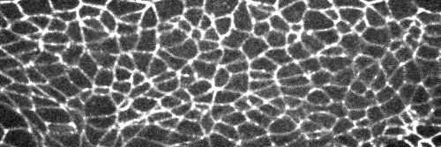
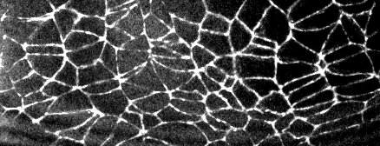
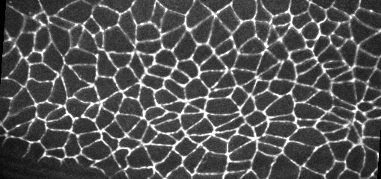
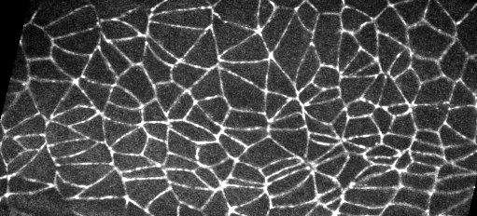
E-Cad GFP controls
E-Cad GFP mutants

Slide 18
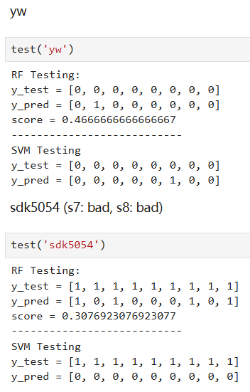
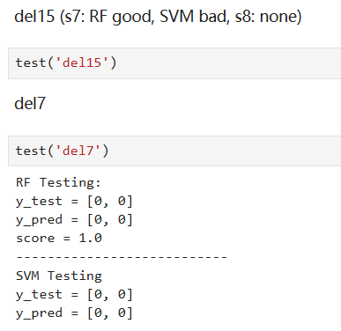
Testing on Fixed Images
Most embryos appear to be WT-like, which is agreed by both models.
Certain sdk5054 embryos show a visible mutant pattern.
A reasonable conclusion:
s7 is too early and s8 too late for the mutant phenotype

Slide 19
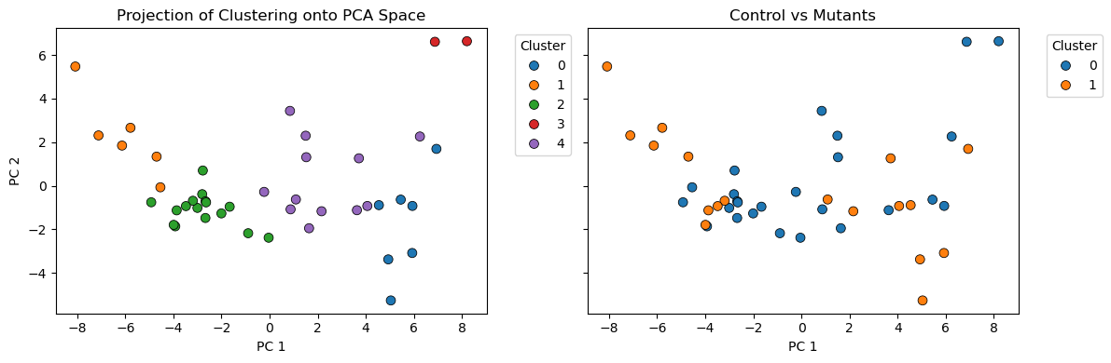
Clustering Test:

Slide 20
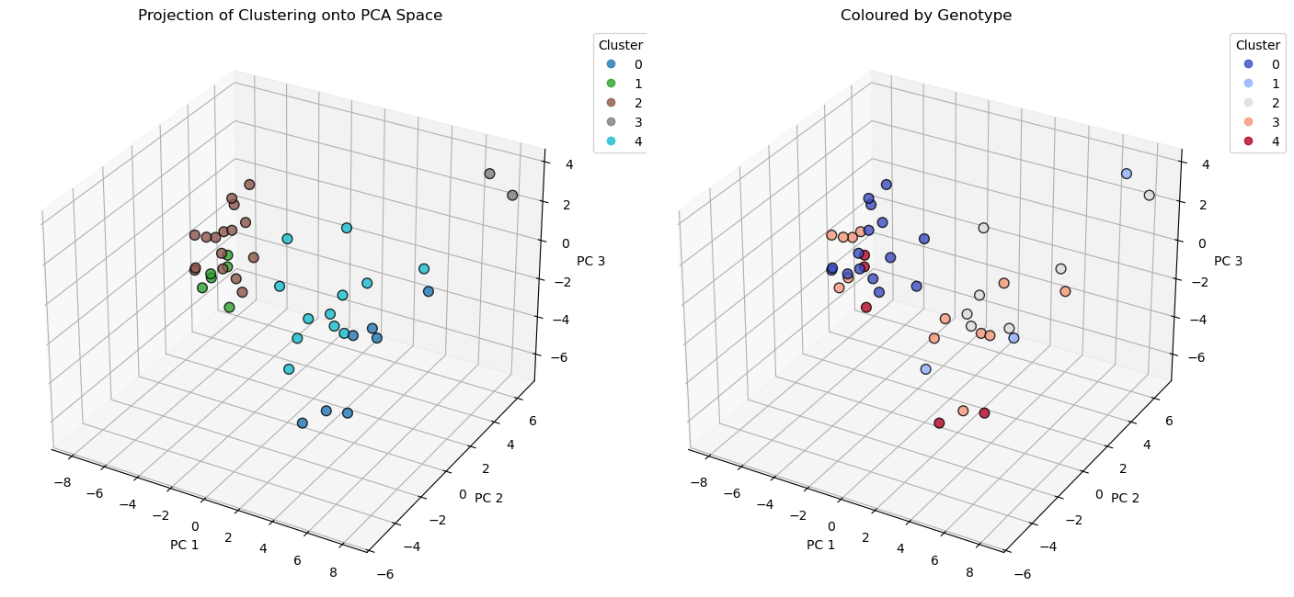

Slide 21
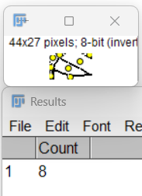
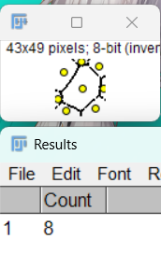
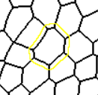
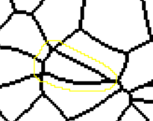
Neighbour Counting
Method 1: enlarge the cell boundary, and see how many (white) cell areas it encircles
Benefit: fast Drawback: overestimation

Slide 22

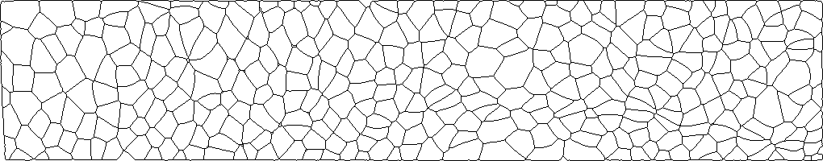
Method 2:
Plot a centroid graph and a boundary graph

Slide 23
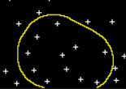
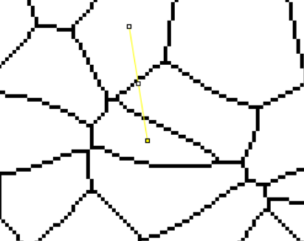
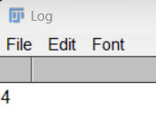
Enlarge cell boundary on the centroid graph. Cells that have their centroid enclosed are potential neighbours
Draw a line between the central centroid and every close centroid, and check how many times it passes through cell boundary
Benefit: accurate Drawback: slow

Slide 24
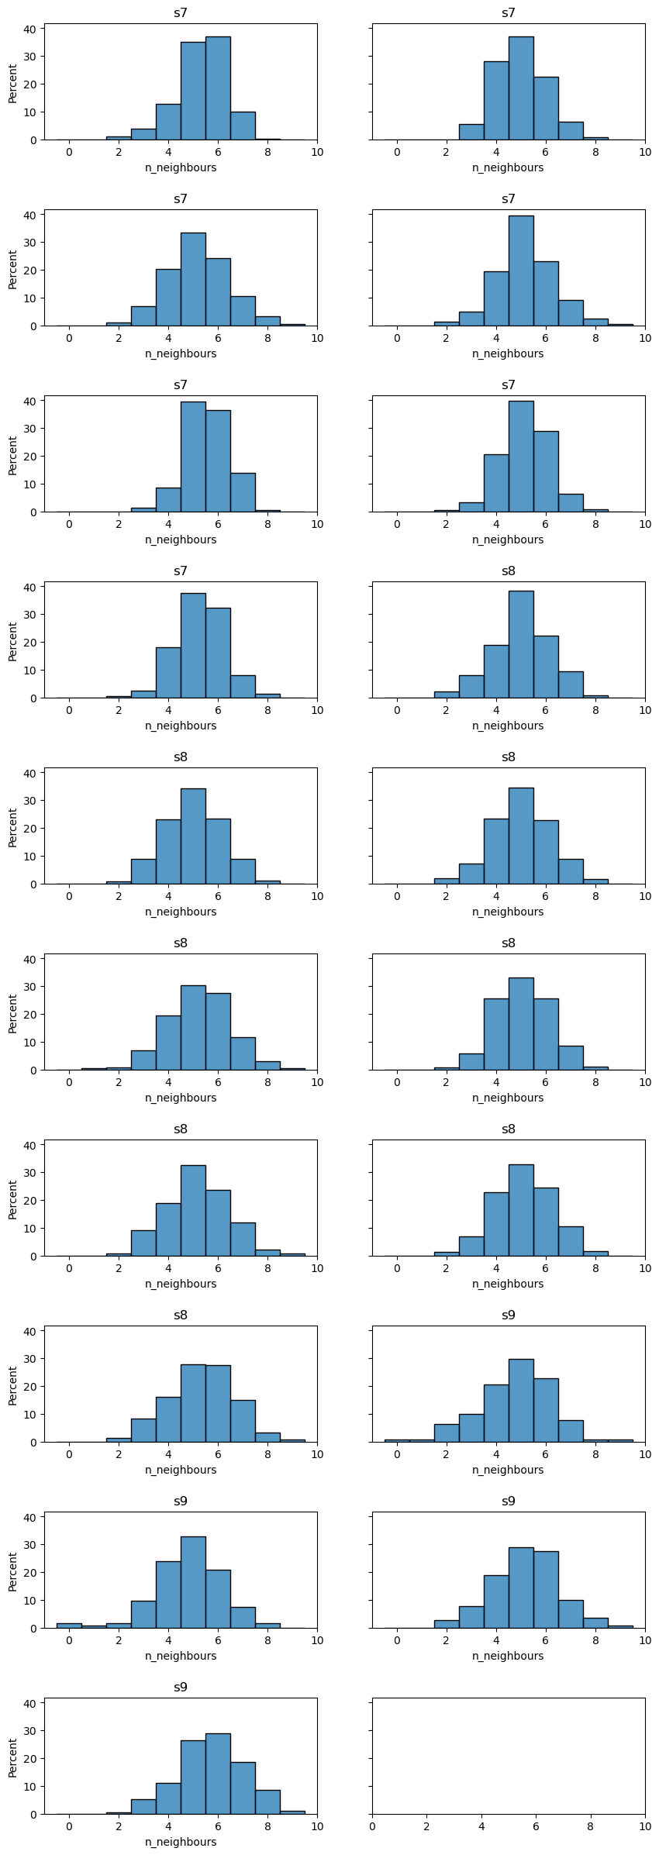
yw
neighbour distribution

Slide 25
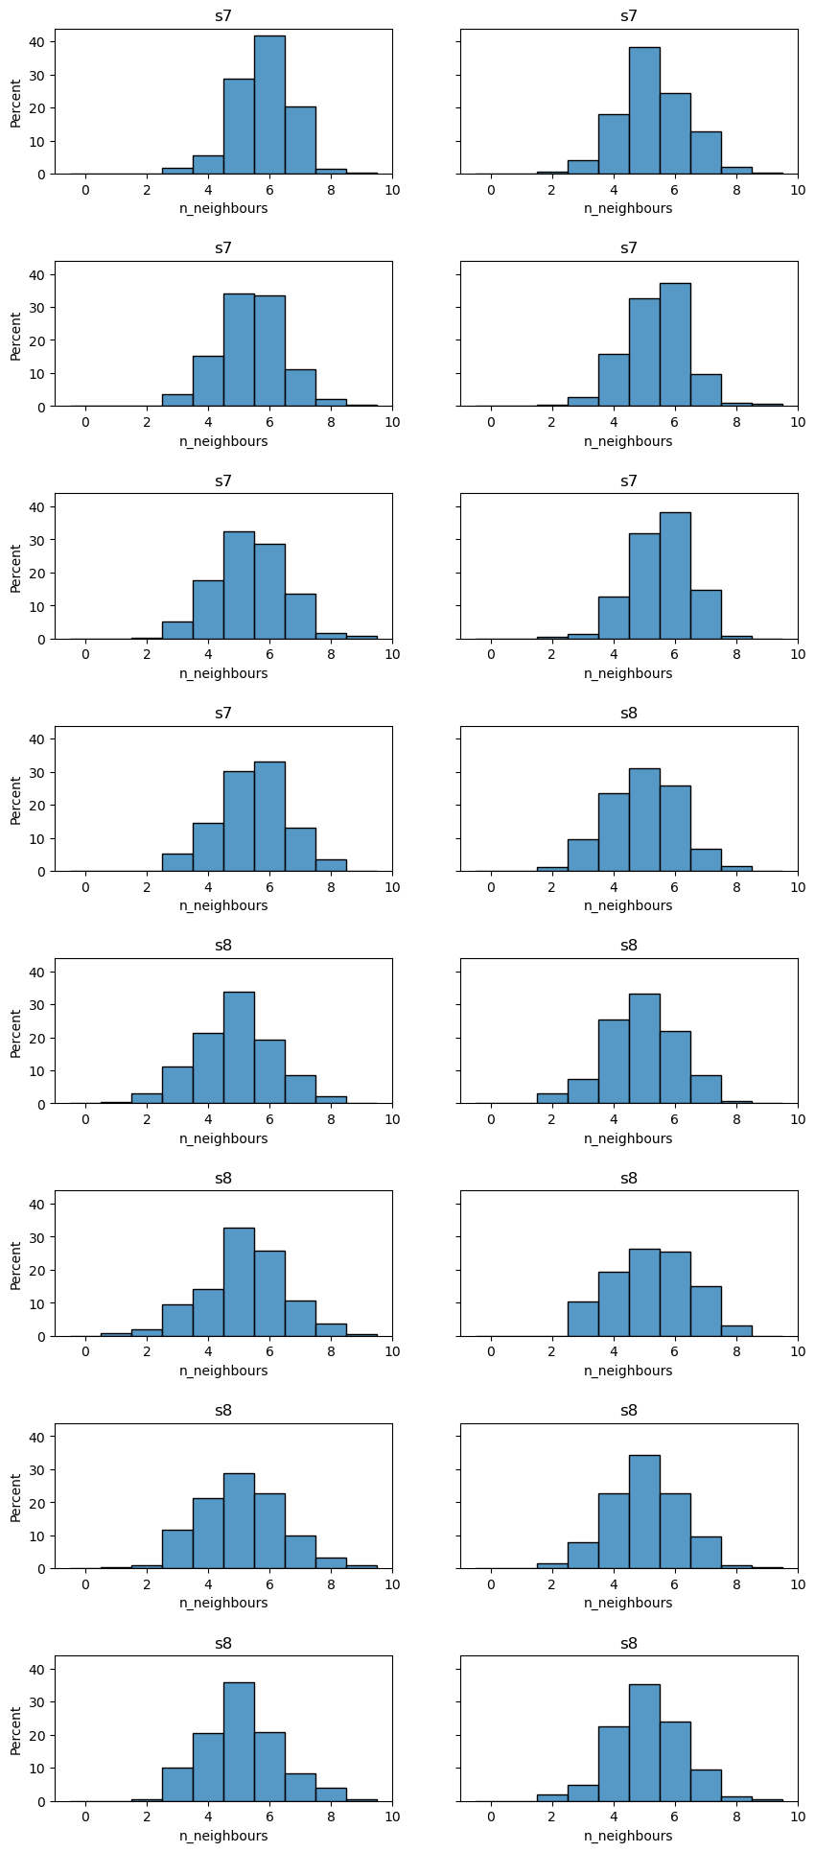
sdk5054
neighbour distribution

Slide 26
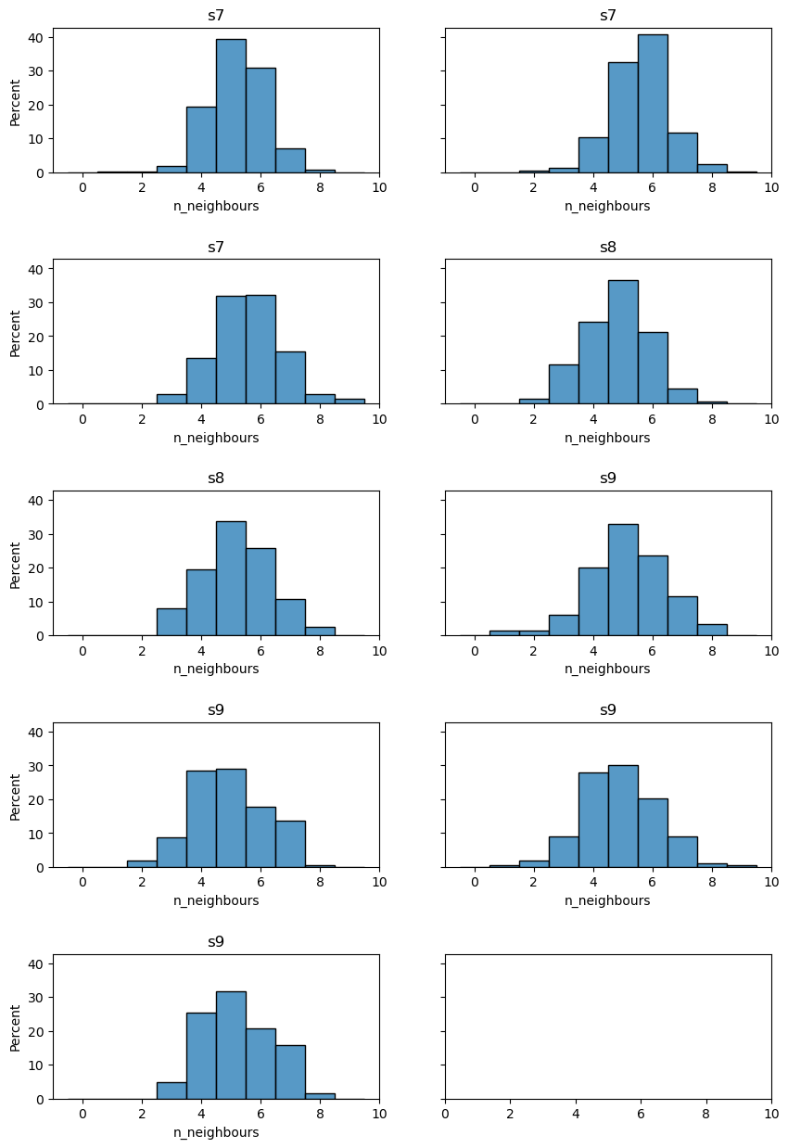
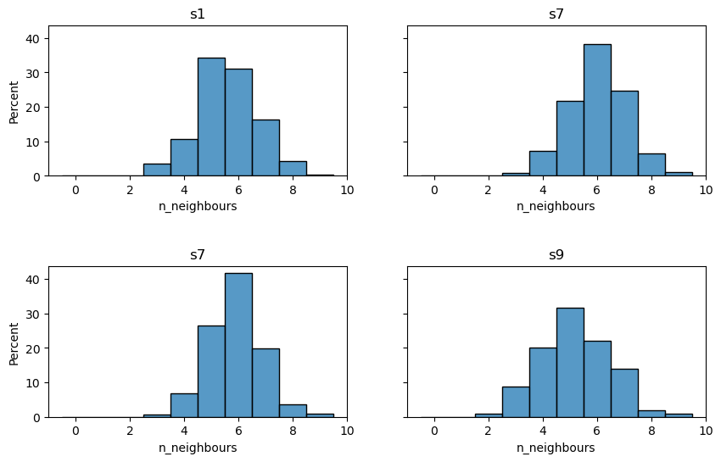
del7
neighbour distribution
del15
neighbour distribution

