Slide 1
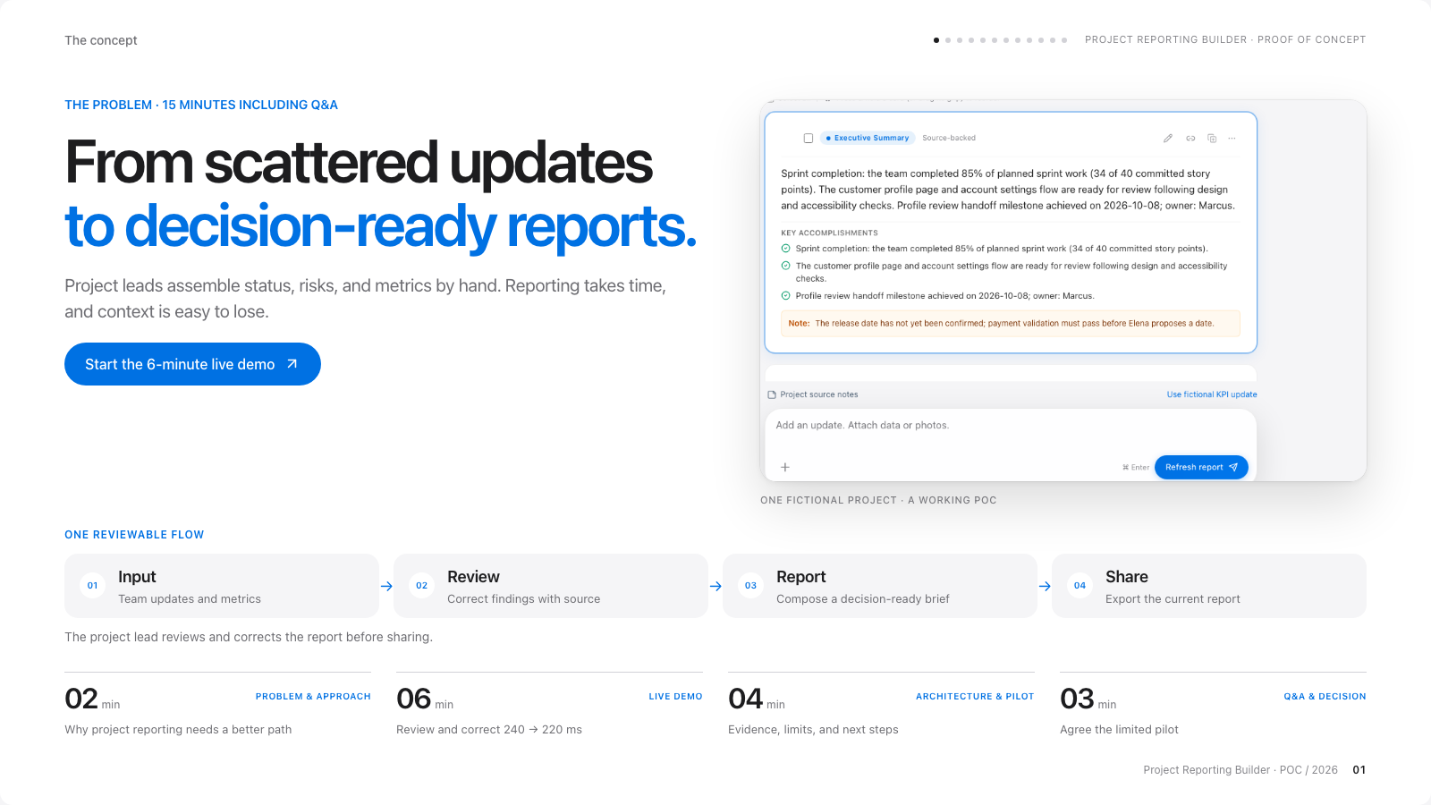
Notes:
Image-based slide: artwork preserves the website deck layout and is not individually editable.
Vision & user story
The concept
PROJECT REPORTING BUILDER · PROOF OF CONCEPT
Vision & user story
THE PROBLEM · 15 MINUTES INCLUDING Q&A
From scattered updates
to decision-ready reports.
Project leads assemble status, risks, and metrics by hand. Reporting takes time, and context is easy to lose.
Start the 6-minute live demo
ONE FICTIONAL PROJECT · A WORKING POC
ONE REVIEWABLE FLOW
01
Input
Team updates and metrics
02
Review
Correct findings with source
03
Report
Compose a decision-ready brief
04
Share
Export the current report
The project lead reviews and corrects the report before sharing.
02min
PROBLEM & APPROACH
Why project reporting needs a better path
06min
LIVE DEMO
Review and correct 240 → 220 ms
04min
ARCHITECTURE & PILOT
Evidence, limits, and next steps
03min
Q&A & DECISION
Agree the limited pilot
Project Reporting Builder · POC / 2026
01

Slide 2
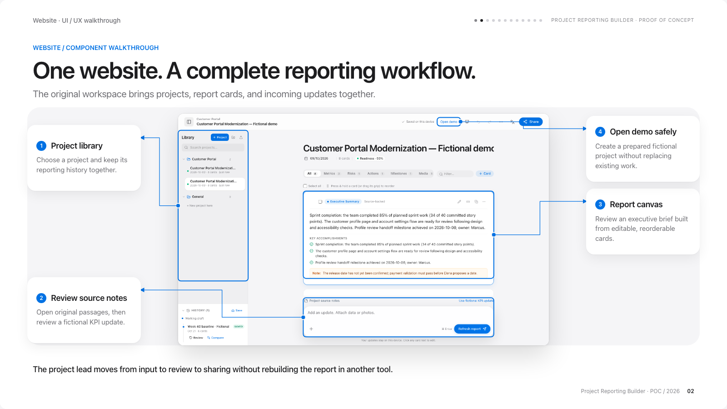
Notes:
Image-based slide: artwork preserves the website deck layout and is not individually editable.
Website overview
Website · UI / UX walkthrough
PROJECT REPORTING BUILDER · PROOF OF CONCEPT
Website overview
WEBSITE / COMPONENT WALKTHROUGH
One website. A complete reporting workflow.
The original workspace brings projects, report cards, and incoming updates together.
1
Project library
Choose a project and keep its reporting history together.
2
Review source notes
Open original passages, then review a fictional KPI update.
3
Report canvas
Review an executive brief built from editable, reorderable cards.
4
Open demo safely
Create a prepared fictional project without replacing existing work.
The project lead moves from input to review to sharing without rebuilding the report in another tool.
Project Reporting Builder · POC / 2026
02
COMPONENT CONTEXT
Project library: Folders, search, and project actions belong to ProjectSidebar. Data is saved in this browser.
Review source notes: Review update classifies new text. Refresh report retains reviewed narrative and corrections.
Report canvas: The canvas also provides type filters, search, selection, and manual card creation.
Open demo safely: Each demo gets its own baseline and Undo history. Header Share exports the whole report by default.

Slide 3
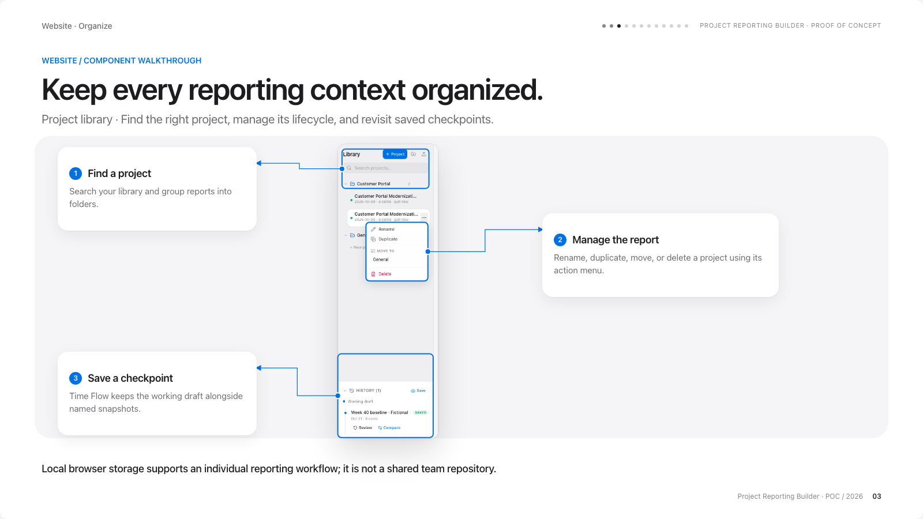
Notes:
Image-based slide: artwork preserves the website deck layout and is not individually editable.
Project library
Website · Organize
PROJECT REPORTING BUILDER · PROOF OF CONCEPT
Project library
WEBSITE / COMPONENT WALKTHROUGH
Keep every reporting context organized.
Project library · Find the right project, manage its lifecycle, and revisit saved checkpoints.
1
Find a project
Search your library and group reports into folders.
2
Manage the report
Rename, duplicate, move, or delete a project using its action menu.
3
Save a checkpoint
Time Flow keeps the working draft alongside named snapshots.
Local browser storage supports an individual reporting workflow; it is not a shared team repository.
Project Reporting Builder · POC / 2026
03
COMPONENT CONTEXT
Find a project: The project count and active report help you identify the current reporting context.
Manage the report: The expanded menu shown here is part of the actual application, captured before any destructive action.
Save a checkpoint: Use Save to create a checkpoint, Review to inspect it, and Compare to see changes against the current draft.

Slide 4
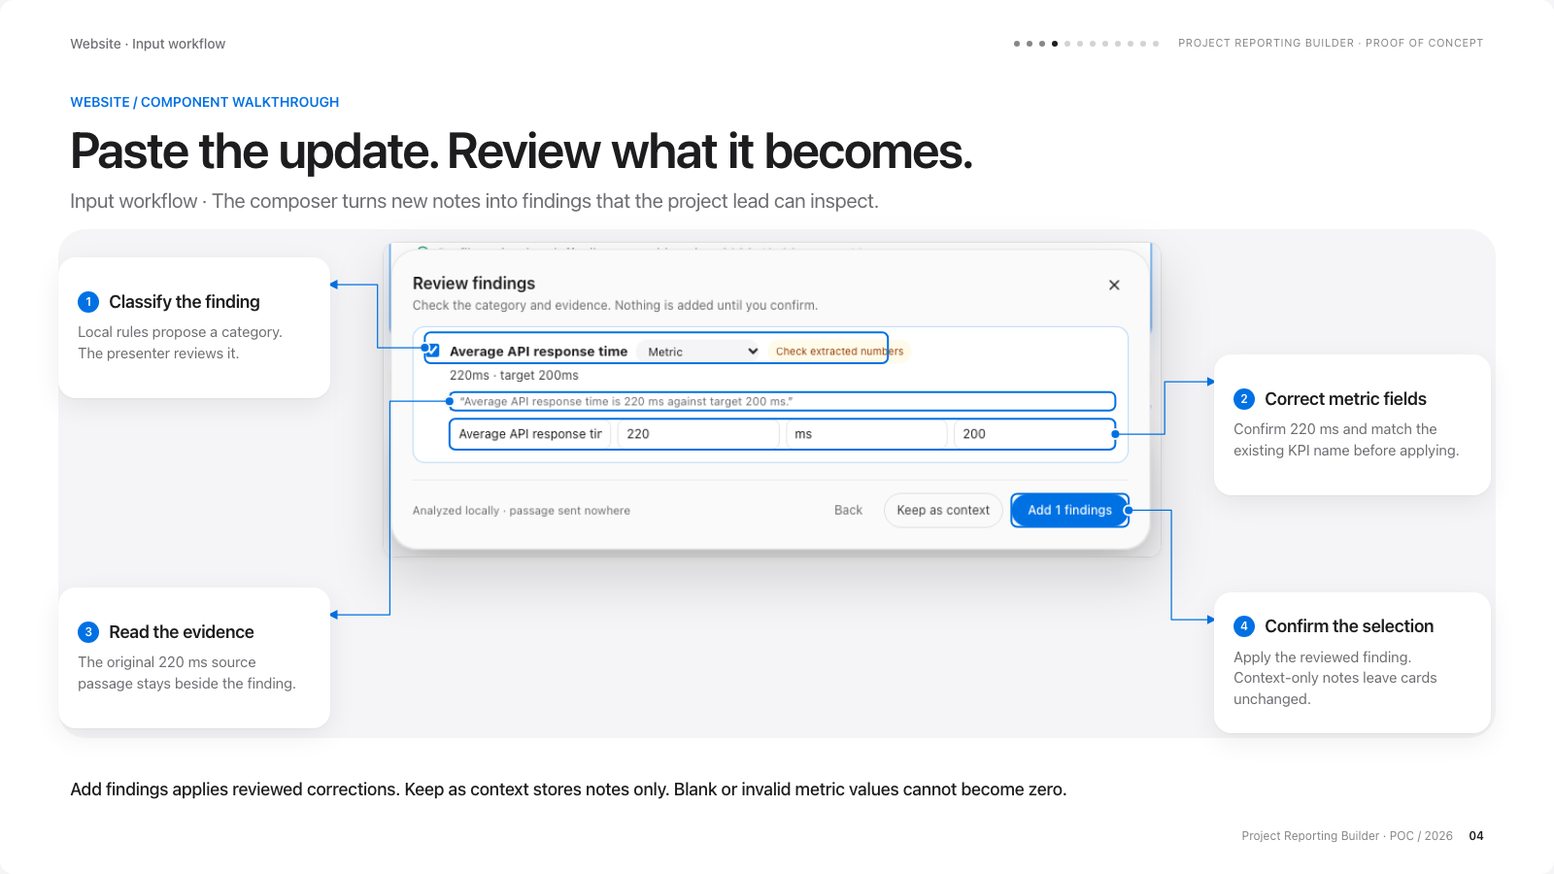
Notes:
Image-based slide: artwork preserves the website deck layout and is not individually editable.
Capture & review
Website · Input workflow
PROJECT REPORTING BUILDER · PROOF OF CONCEPT
Capture & review
WEBSITE / COMPONENT WALKTHROUGH
Paste the update. Review what it becomes.
Input workflow · The composer turns new notes into findings that the project lead can inspect.
1
Classify the finding
Local rules propose a category. The presenter reviews it.
2
Correct metric fields
Confirm 220 ms and match the existing KPI name before applying.
3
Read the evidence
The original 220 ms source passage stays beside the finding.
4
Confirm the selection
Apply the reviewed finding. Context-only notes leave cards unchanged.
Add findings applies reviewed corrections. Keep as context stores notes only. Blank or invalid metric values cannot become zero.
Project Reporting Builder · POC / 2026
04
COMPONENT CONTEXT
Classify the finding: This is rule-based processing, not an AI API. Review candidates are not independently verified facts.
Correct metric fields: Stable metric identity preserves the target, previous value, chart settings, and existing card instead of creating a duplicate.
Read the evidence: A manual correction can differ from the passage; the passage remains original and the report identifies edits.
Confirm the selection: The new value replaces the same KPI card. Refresh and reload preserve the accepted correction.

Slide 5
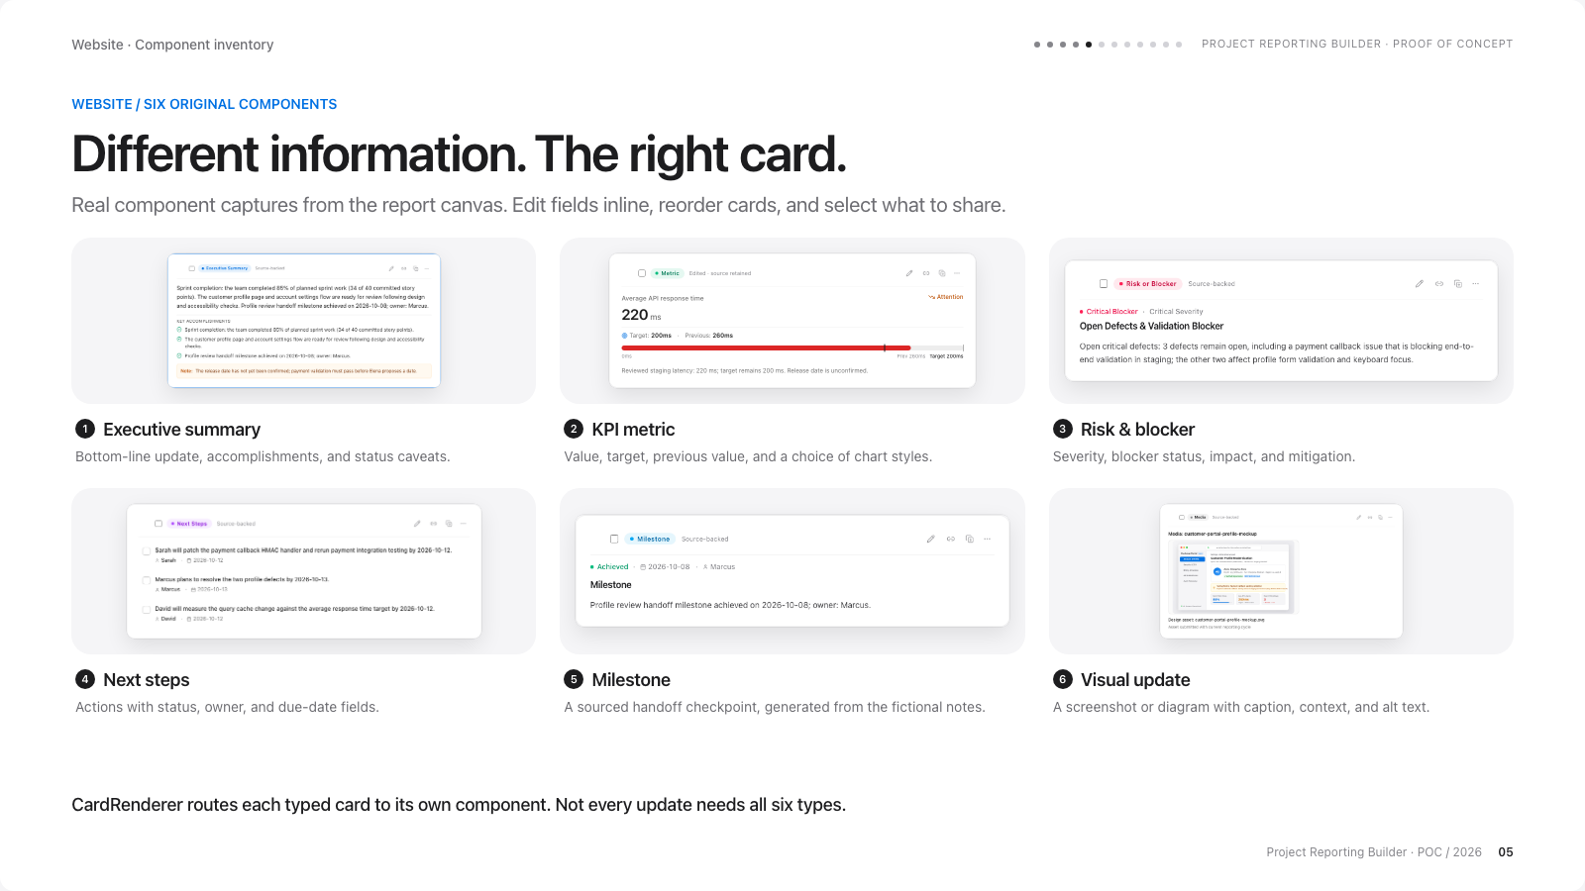
Notes:
Image-based slide: artwork preserves the website deck layout and is not individually editable.
Report components
Website · Component inventory
PROJECT REPORTING BUILDER · PROOF OF CONCEPT
Report components
WEBSITE / SIX ORIGINAL COMPONENTS
Different information. The right card.
Real component captures from the report canvas. Edit fields inline, reorder cards, and select what to share.
1Executive summary
Bottom-line update, accomplishments, and status caveats.
2KPI metric
Value, target, previous value, and a choice of chart styles.
3Risk & blocker
Severity, blocker status, impact, and mitigation.
4Next steps
Actions with status, owner, and due-date fields.
5Milestone
A sourced handoff checkpoint, generated from the fictional notes.
6Visual update
A screenshot or diagram with caption, context, and alt text.
CardRenderer routes each typed card to its own component. Not every update needs all six types.
Project Reporting Builder · POC / 2026
05

Slide 6
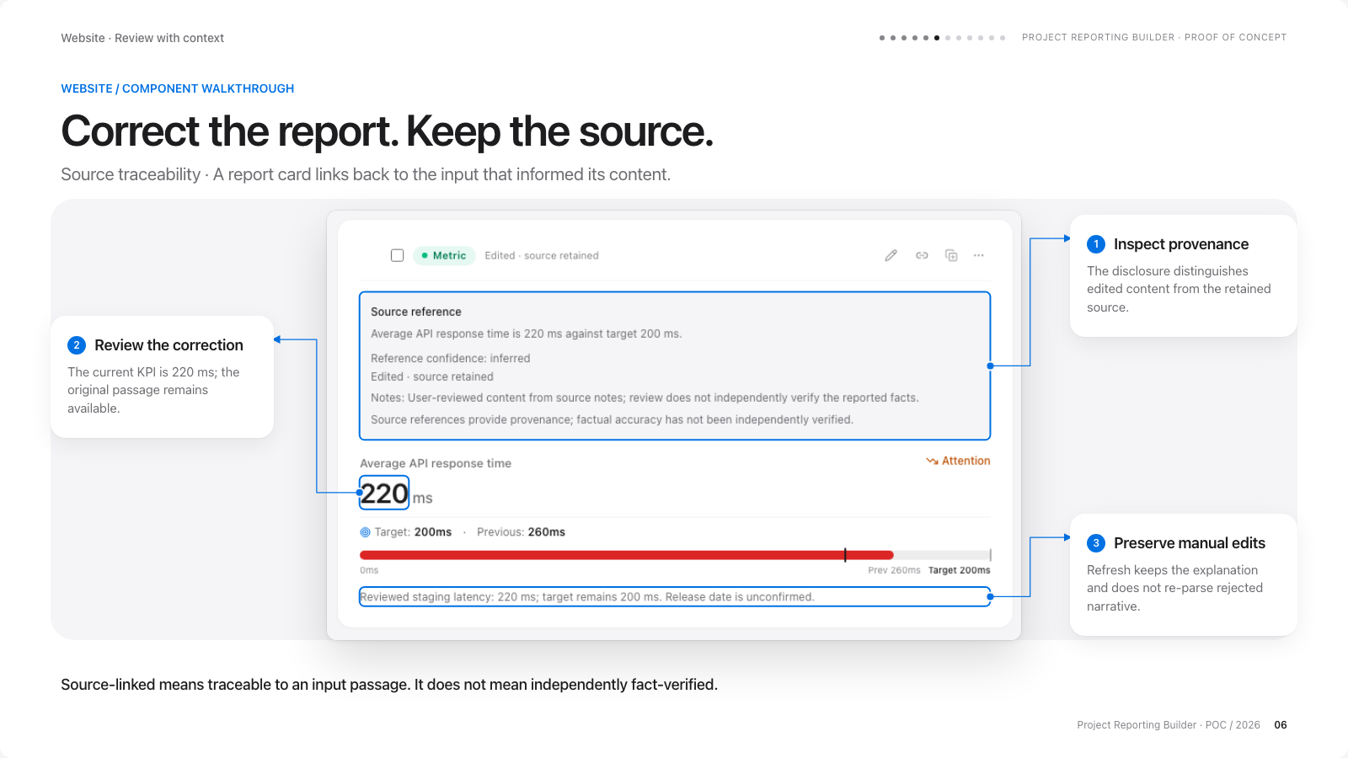
Notes:
Image-based slide: artwork preserves the website deck layout and is not individually editable.
Source traceability
Website · Review with context
PROJECT REPORTING BUILDER · PROOF OF CONCEPT
Source traceability
WEBSITE / COMPONENT WALKTHROUGH
Correct the report. Keep the source.
Source traceability · A report card links back to the input that informed its content.
1
Inspect provenance
The disclosure distinguishes edited content from the retained source.
2
Review the correction
The current KPI is 220 ms; the original passage remains available.
3
Preserve manual edits
Refresh keeps the explanation and does not re-parse rejected narrative.
Source-linked means traceable to an input passage. It does not mean independently fact-verified.
Project Reporting Builder · POC / 2026
06
COMPONENT CONTEXT
Inspect provenance: Source-backed, inferred, manual, and edited content are labelled separately. No label certifies factual accuracy.
Review the correction: Inline card edits synchronize the structured KPI. Later structured-input edits synchronize back to the card.
Preserve manual edits: Refresh preserves accepted narrative and corrections. Introduce new text through Review update.

Slide 7
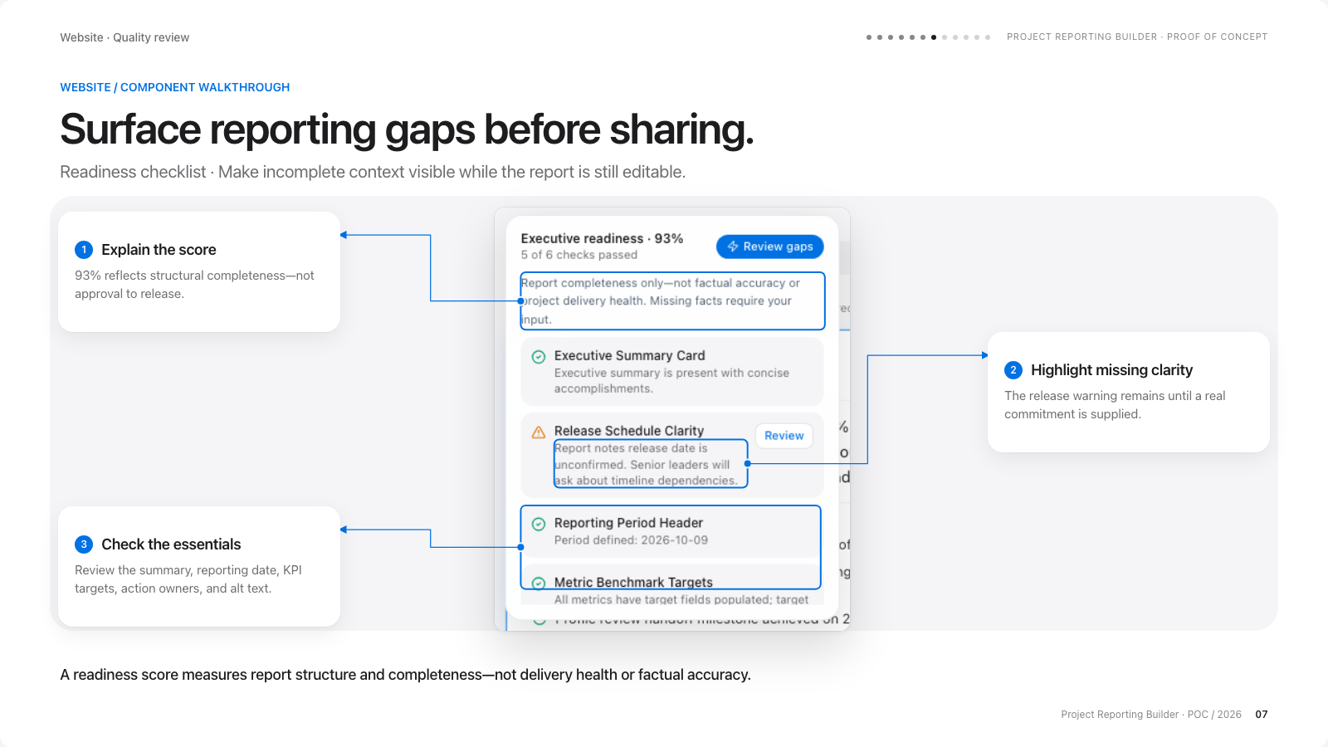
Notes:
Image-based slide: artwork preserves the website deck layout and is not individually editable.
Readiness checks
Website · Quality review
PROJECT REPORTING BUILDER · PROOF OF CONCEPT
Readiness checks
WEBSITE / COMPONENT WALKTHROUGH
Surface reporting gaps before sharing.
Readiness checklist · Make incomplete context visible while the report is still editable.
1
Explain the score
93% reflects structural completeness—not approval to release.
2
Highlight missing clarity
The release warning remains until a real commitment is supplied.
3
Check the essentials
Review the summary, reporting date, KPI targets, action owners, and alt text.
A readiness score measures report structure and completeness—not delivery health or factual accuracy.
Project Reporting Builder · POC / 2026
07
COMPONENT CONTEXT
Explain the score: Five of six structural checks pass in the fictional sample. The release-date warning remains unresolved.
Highlight missing clarity: Review actions point out missing context. They do not invent release dates, owners, KPI targets, or accomplishments.
Check the essentials: Missing facts need human input. A complete-looking report can still describe a blocked project.

Slide 8
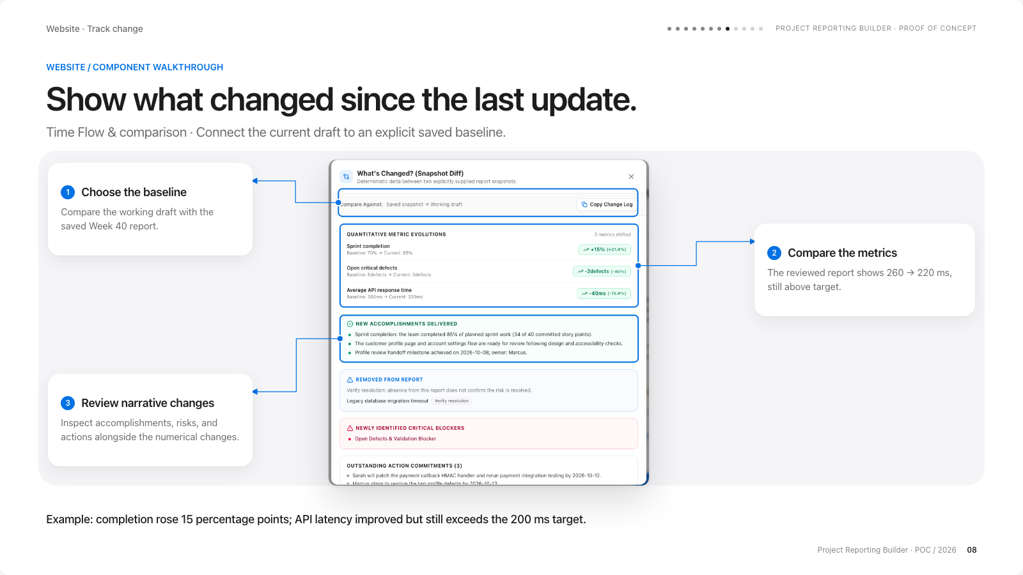
Notes:
Image-based slide: artwork preserves the website deck layout and is not individually editable.
Snapshots & comparison
Website · Track change
PROJECT REPORTING BUILDER · PROOF OF CONCEPT
Snapshots & comparison
WEBSITE / COMPONENT WALKTHROUGH
Show what changed since the last update.
Time Flow & comparison · Connect the current draft to an explicit saved baseline.
1
Choose the baseline
Compare the working draft with the saved Week 40 report.
2
Compare the metrics
The reviewed report shows 260 → 220 ms, still above target.
3
Review narrative changes
Inspect accomplishments, risks, and actions alongside the numerical changes.
Example: completion rose 15 percentage points; API latency improved but still exceeds the 200 ms target.
Project Reporting Builder · POC / 2026
08
COMPONENT CONTEXT
Choose the baseline: Snapshots are saved reporting checkpoints. The project timeline also offers review and restore actions.
Compare the metrics: The fictional example is 70% → 85% completion, 5 → 3 defects, and 260 → 220 ms average latency. Missing risks are removed from the report, not automatically resolved.
Review narrative changes: Matching and inferred resolutions are comparison hints. Validate whether a missing risk was actually resolved.

Slide 9
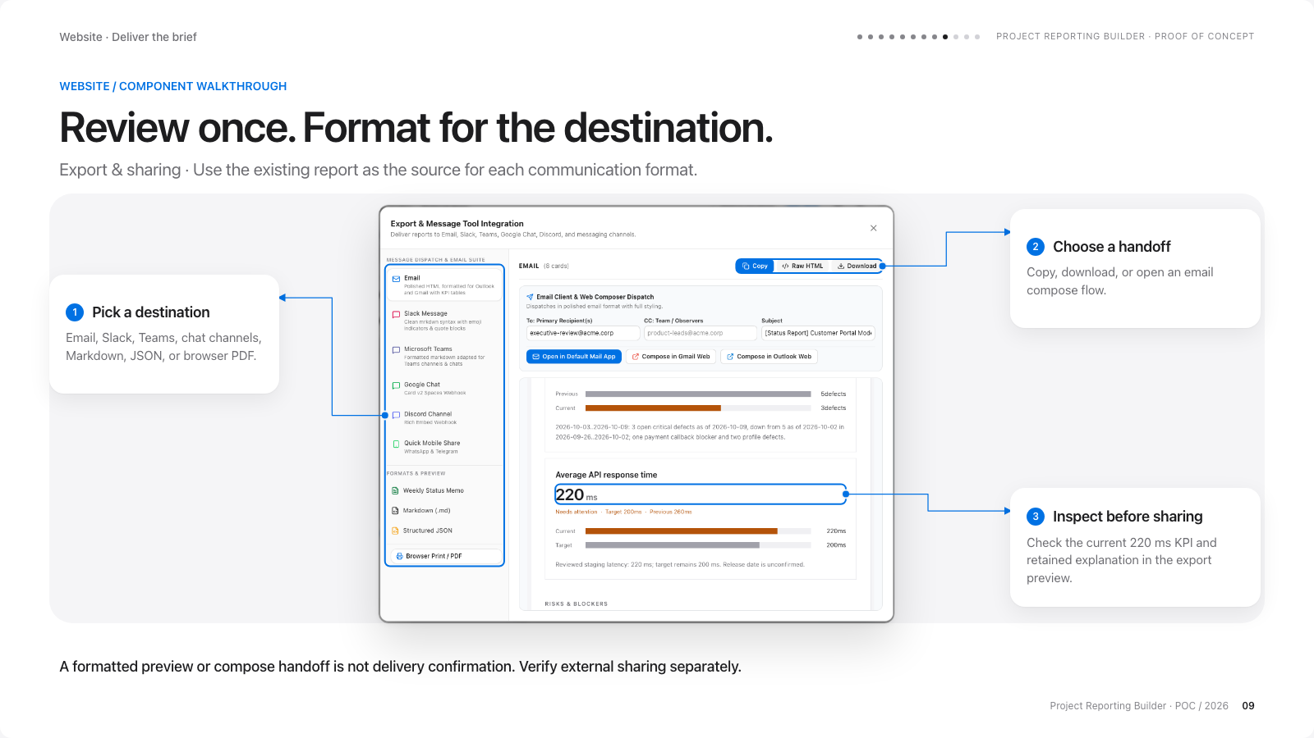
Notes:
Image-based slide: artwork preserves the website deck layout and is not individually editable.
Export & sharing
Website · Deliver the brief
PROJECT REPORTING BUILDER · PROOF OF CONCEPT
Export & sharing
WEBSITE / COMPONENT WALKTHROUGH
Review once. Format for the destination.
Export & sharing · Use the existing report as the source for each communication format.
1
Pick a destination
Email, Slack, Teams, chat channels, Markdown, JSON, or browser PDF.
2
Choose a handoff
Copy, download, or open an email compose flow.
3
Inspect before sharing
Check the current 220 ms KPI and retained explanation in the export preview.
A formatted preview or compose handoff is not delivery confirmation. Verify external sharing separately.
Project Reporting Builder · POC / 2026
09
COMPONENT CONTEXT
Pick a destination: The dialog formats the current report or a selected subset of cards. The screenshot shows the entire fictional report.
Choose a handoff: Configured webhooks attempt outbound delivery; browser restrictions mean destination acceptance is not always observable.
Inspect before sharing: Header Share defaults to all eight cards. JSON summaries and Markdown use current report values, not stale inputs.

Slide 10
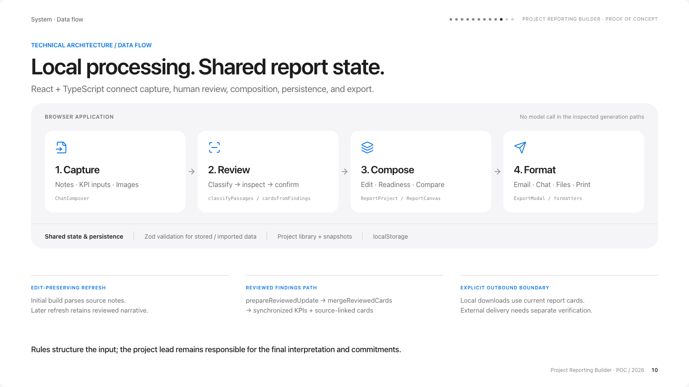
Notes:
Image-based slide: artwork preserves the website deck layout and is not individually editable.
Technical architecture
System · Data flow
PROJECT REPORTING BUILDER · PROOF OF CONCEPT
Technical architecture
TECHNICAL ARCHITECTURE / DATA FLOW
Local processing. Shared report state.
React + TypeScript connect capture, human review, composition, persistence, and export.
BROWSER APPLICATION
No model call in the inspected generation paths
1. Capture
Notes · KPI inputs · Images
ChatComposer
2. Review
Classify → inspect → confirm
classifyPassages / cardsFromFindings
3. Compose
Edit · Readiness · Compare
ReportProject / ReportCanvas
4. Format
Email · Chat · Files · Print
ExportModal / formatters
Shared state & persistence
Zod validation for stored / imported data
Project library + snapshots
localStorage
EDIT-PRESERVING REFRESH
Initial build parses source notes.
Later refresh retains reviewed narrative.
REVIEWED FINDINGS PATH
prepareReviewedUpdate → mergeReviewedCards
→ synchronized KPIs + source-linked cards
EXPLICIT OUTBOUND BOUNDARY
Local downloads use current report cards.
External delivery needs separate verification.
Rules structure the input; the project lead remains responsible for the final interpretation and commitments.
Project Reporting Builder · POC / 2026
10

Slide 11
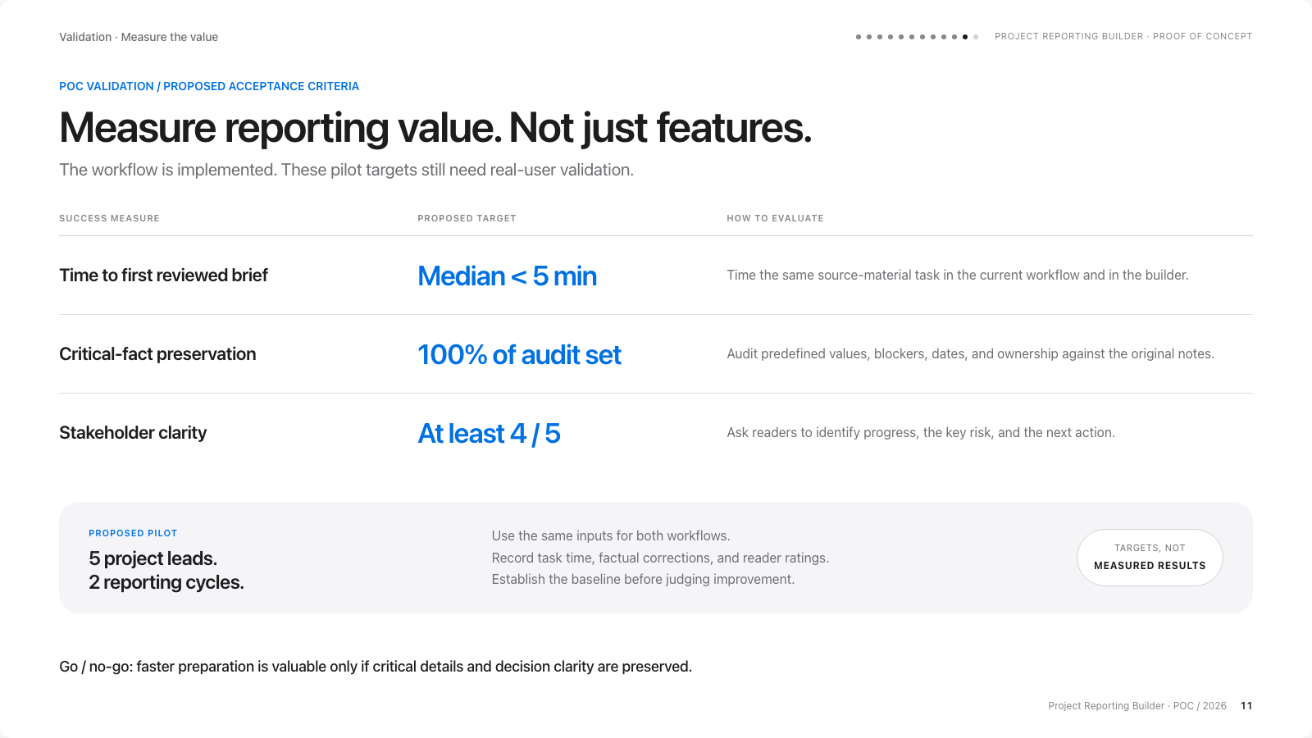
Notes:
Image-based slide: artwork preserves the website deck layout and is not individually editable.
POC success criteria
Validation · Measure the value
PROJECT REPORTING BUILDER · PROOF OF CONCEPT
POC success criteria
POC VALIDATION / PROPOSED ACCEPTANCE CRITERIA
Measure reporting value. Not just features.
The workflow is implemented. These pilot targets still need real-user validation.
SUCCESS MEASURE
PROPOSED TARGET
HOW TO EVALUATE
Time to first reviewed brief
Median < 5 min
Time the same source-material task in the current workflow and in the builder.
Critical-fact preservation
100% of audit set
Audit predefined values, blockers, dates, and ownership against the original notes.
Stakeholder clarity
At least 4 / 5
Ask readers to identify progress, the key risk, and the next action.
PROPOSED PILOT
5 project leads.
2 reporting cycles.
Use the same inputs for both workflows.
Record task time, factual corrections, and reader ratings.
Establish the baseline before judging improvement.
TARGETS, NOT
MEASURED RESULTS
Go / no-go: faster preparation is valuable only if critical details and decision clarity are preserved.
Project Reporting Builder · POC / 2026
11

Slide 12
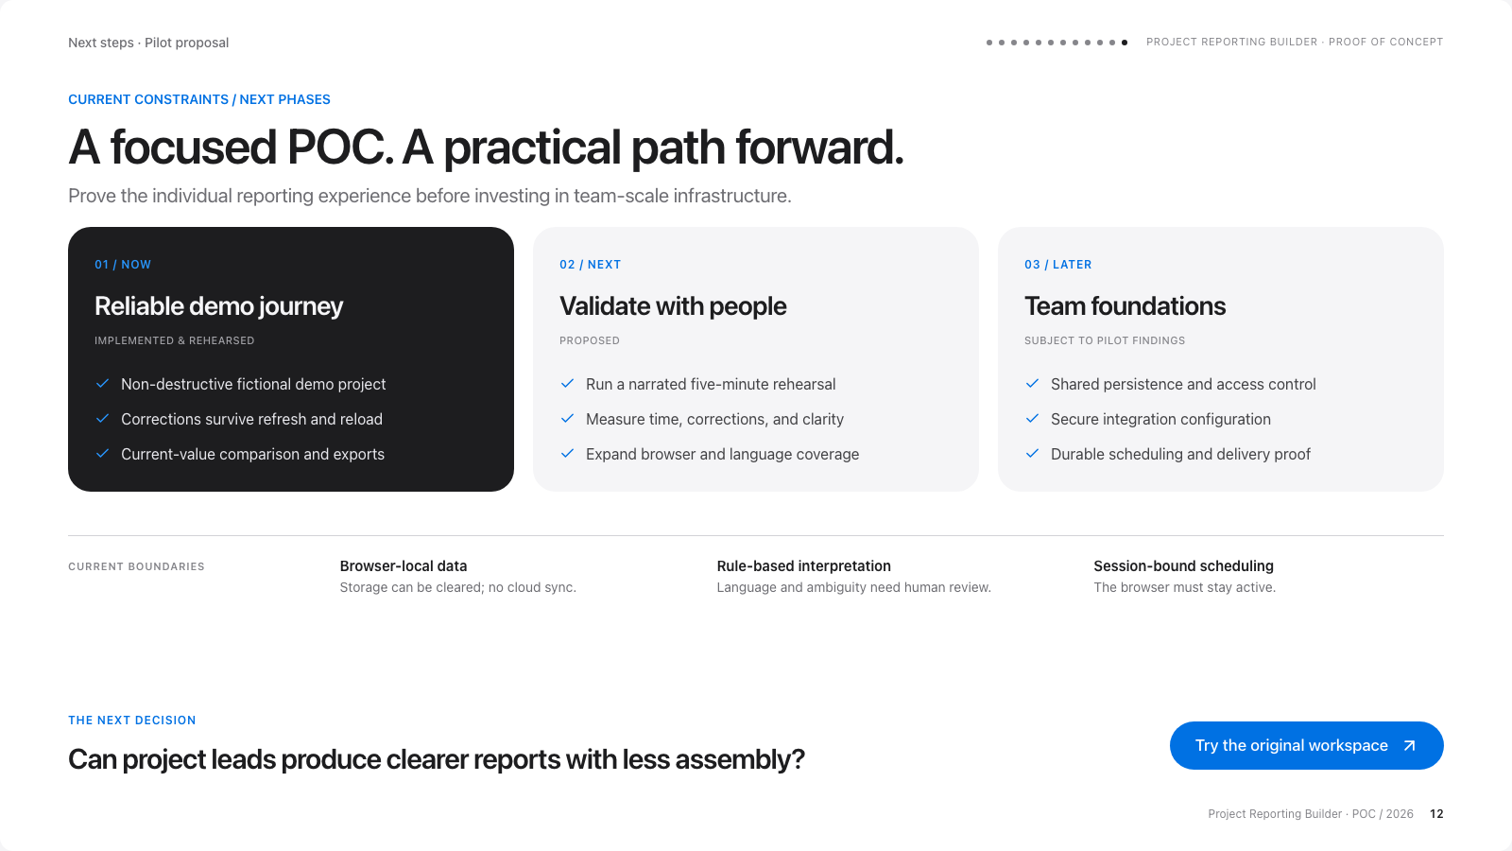
Notes:
Image-based slide: artwork preserves the website deck layout and is not individually editable.
Constraints & roadmap
Next steps · Pilot proposal
PROJECT REPORTING BUILDER · PROOF OF CONCEPT
Constraints & roadmap
CURRENT CONSTRAINTS / NEXT PHASES
A focused POC. A practical path forward.
Prove the individual reporting experience before investing in team-scale infrastructure.
01 / NOW
Reliable demo journey
IMPLEMENTED & REHEARSED
Non-destructive fictional demo project
Corrections survive refresh and reload
Current-value comparison and exports
02 / NEXT
Validate with people
PROPOSED
Run a narrated five-minute rehearsal
Measure time, corrections, and clarity
Expand browser and language coverage
03 / LATER
Team foundations
SUBJECT TO PILOT FINDINGS
Shared persistence and access control
Secure integration configuration
Durable scheduling and delivery proof
CURRENT BOUNDARIES
Browser-local data
Storage can be cleared; no cloud sync.
Rule-based interpretation
Language and ambiguity need human review.
Session-bound scheduling
The browser must stay active.
THE NEXT DECISION
Can project leads produce clearer reports with less assembly?
Try the original workspace
Project Reporting Builder · POC / 2026
12

