Slide 1
FedInt
A Mutually Trusted Integration Platform on Blockchain
TEAM SUPER-JUNIOR
Notes:
Hi everyone, our project is FedInt, short for federation integration. It’s a mutually trusted integration platform on blockchain.

Slide 2
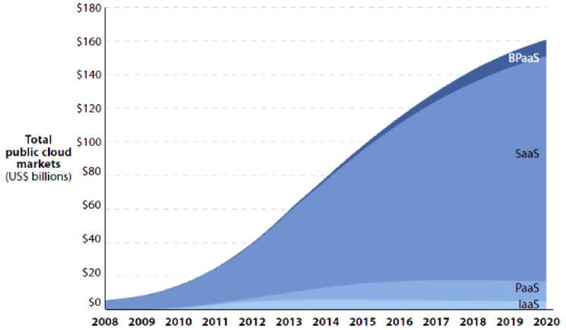
Trends
Booming Enterprise Integration
Protocol Compliance
Notes:
In recent years, infrastructures, platforms and software are built as a service for easier integration. Enterprise integrations keep growing. Meanwhile, security is essential for enterprise data. Enterprises don’t want their services integrated by unauthorized entities.

Slide 3
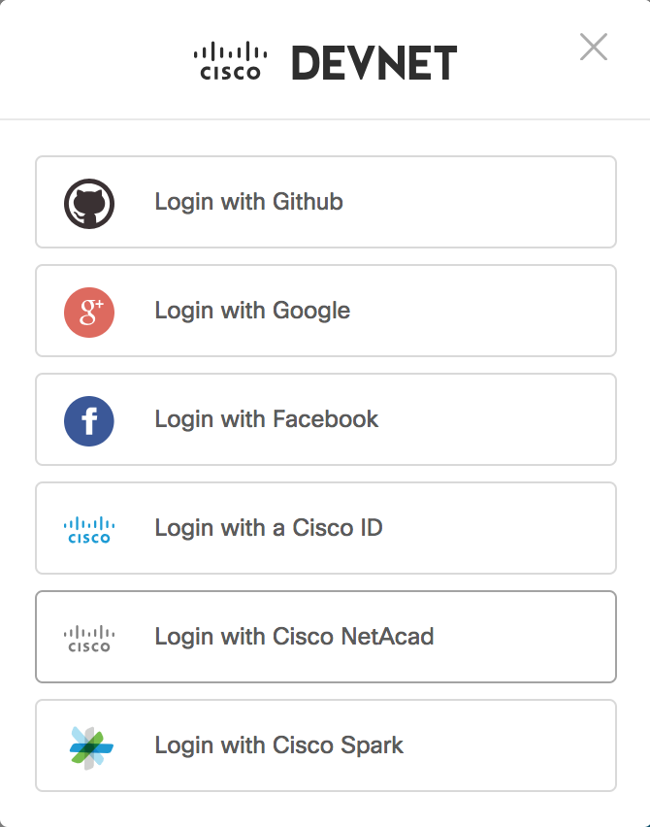
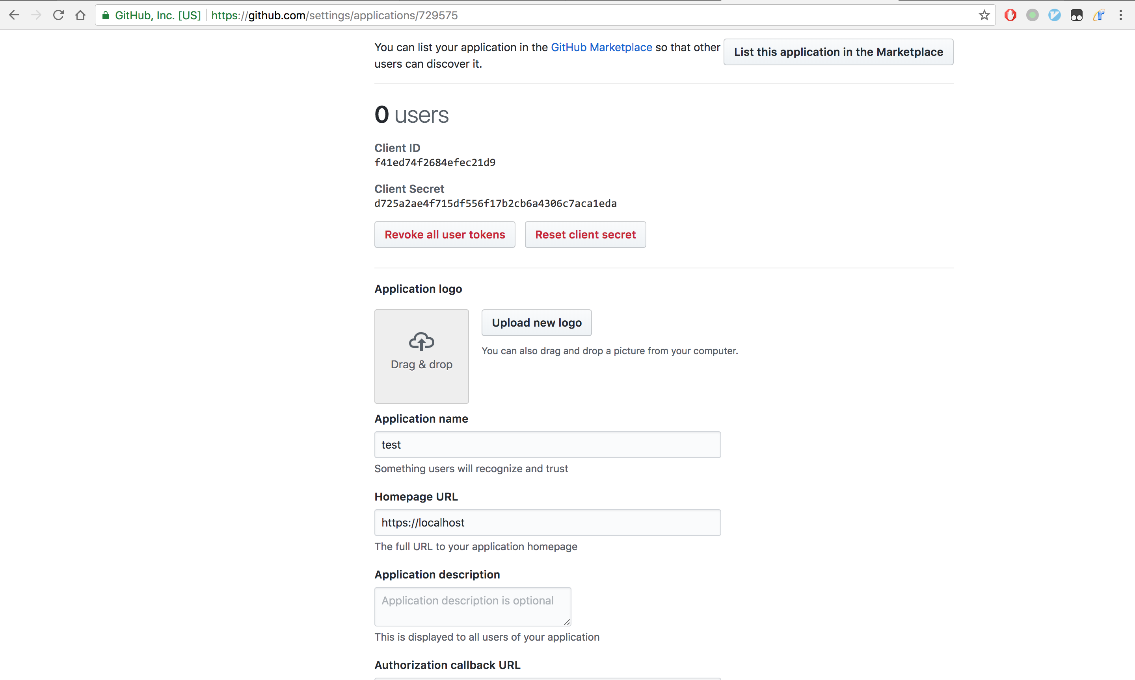
Flow of Social Integration
How to integrate?
c
Step1: Go to https://github.com/settings/developers
Step3: DONE
Step2: Fill in some blanks

Slide 4


Chaos of Enterprise Integration
Let’s have a meeting!
How to integrate?
Notes:
For now, if enterprises want to integrate their services with each other, they need to setup a huge amount of meetings. It’s inconvenient for adopters in different time zone to contact. Pairwise meeting will waste a lot of resources.

Slide 5
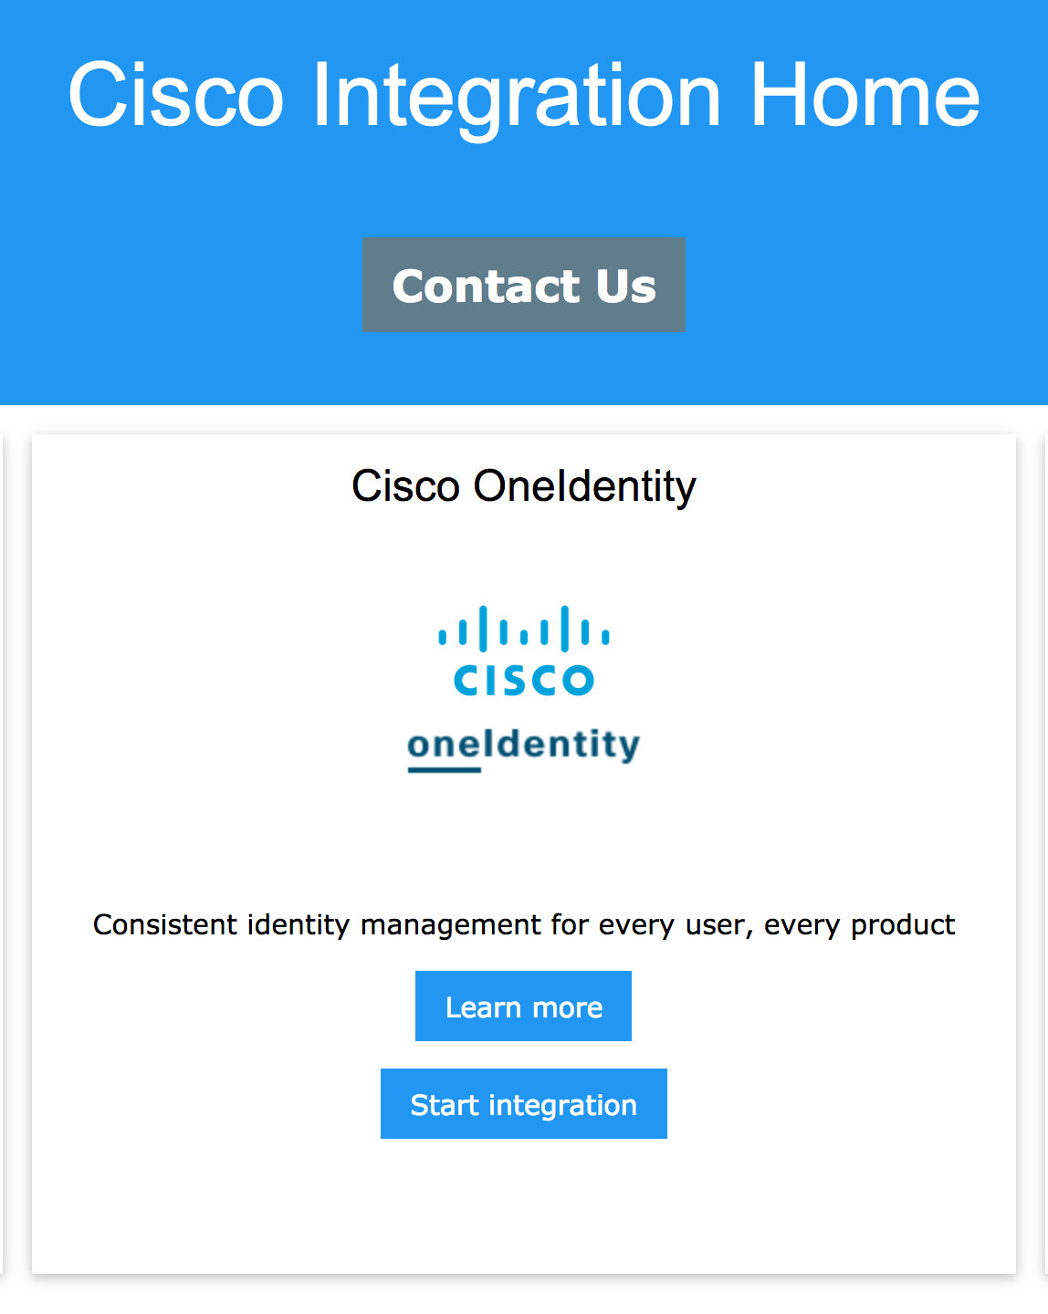
Chaos of Enterprise Integration
I have published.
Who are you?
Let’s have a meeting.
I want to integrate.
Notes:
For now, if enterprises want to integrate their services with each other, they need to setup a huge amount of meetings. It’s inconvenient for adopters in different time zone to contact. Pairwise meeting will waste a lot of resources.

Slide 6




Chaos of Enterprise Integration
MEETINGS!
Notes:
For now, if enterprises want to integrate their services with each other, they need to setup a huge amount of meetings. It’s inconvenient for adopters in different time zone to contact. Pairwise meeting will waste a lot of resources.

Slide 7
Chaos of Enterprise Integration
Third-party
Notes:
Our solution, FedInt, makes integration far more easier. Every company just need to interact with it.

Slide 8
Solution
FedInt
Notes:
Our solution, FedInt, makes integration far more easier. Every company just need to interact with it.

Slide 9
Overview of FedInt
Company A
Company C
Integration Secret
Company B
Cert
Integration
Guide
Federation
Blockchain
Notes:
Ultimately, companies need to exchange two kind of information when integrating. One is the steps to integrate, another is the secret to identify the client. Blockchain stores the integration homepage of each company and the list of companies inside the federation. Those information are distributed. Every company has a copy and no one has the ability to modify information of other companies. If company B inside the federation wants to get a secret from company A. Company A find company B is a trusted member, so company A will response with the secret. But a company C outside the federation will be rejected.

Slide 10
Overview of FedInt
Company A
Company B
Admin Agent
Admin Agent
Blockchain
Company D
Company C

Slide 11
Overview of FedInt
Company A
Company B
Integration
Guide
API
Admin Agent
Blockchain

Slide 12
Overview of FedInt
Company A
Company B
Integration
Secret
Integration Secret
Gateway
Cert
CA
CERT
Cert
Admin Agent
CA
Blockchain

Slide 13
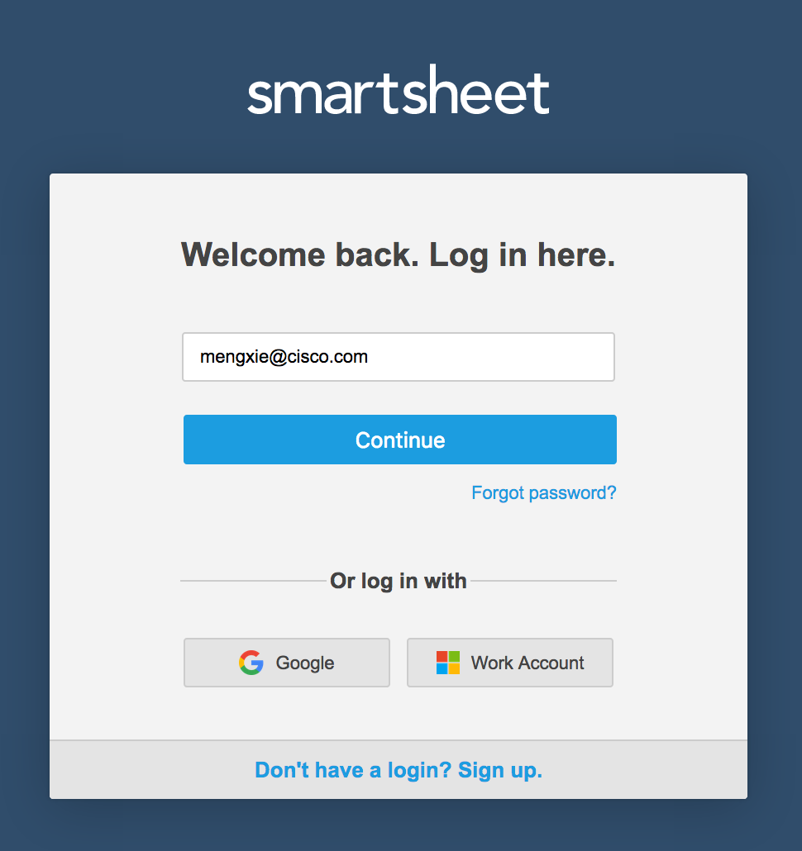
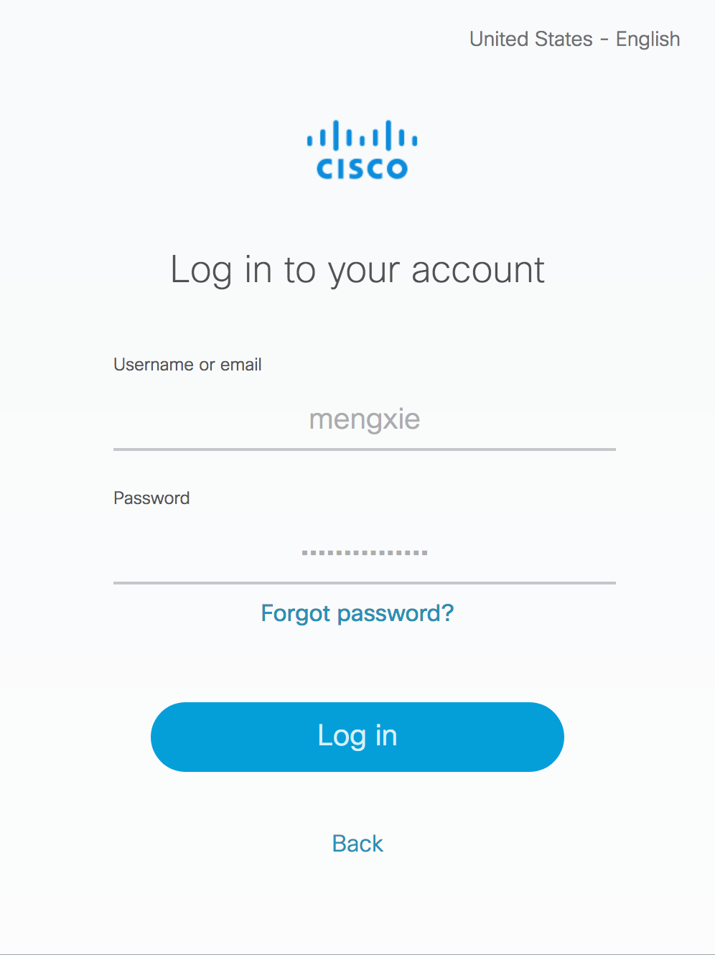
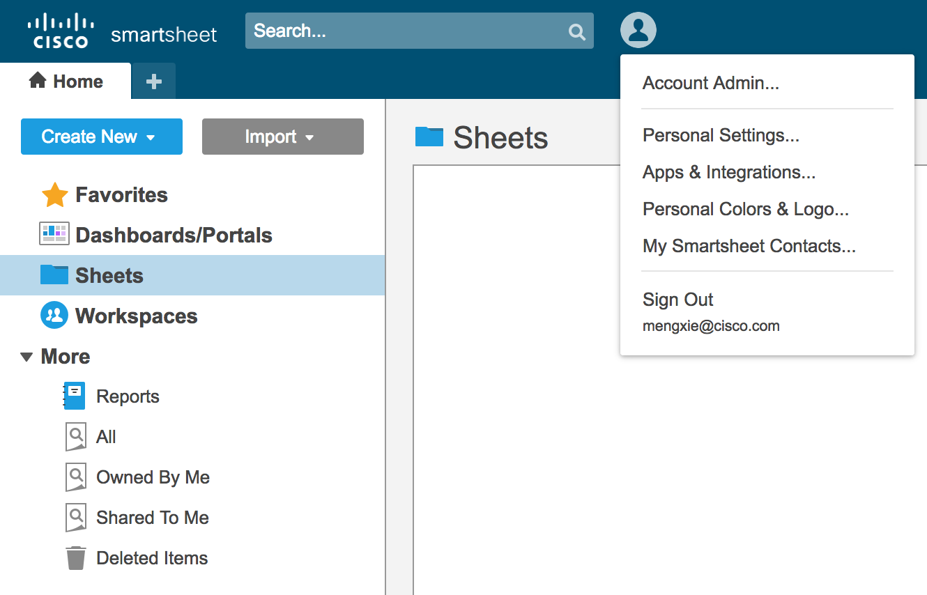
Use Case – Identity System Integration

Slide 14
Why FedInt ?
Traditional
$10+ million
per year
(One Login)
1-hop
Manual Trust Management
Free
Direct Integration
Automated Management
FedInt
Notes:
Compared with old-fashioned way to integrate, we provide a single entry to get integration guides of all companies using FedInt, we don’t need to setup a meeting to understand how to integrate. We provide access control to allow trusted companies to integrate and reject others. Last but not the least, companies are peers on our platform, third party is not required to manage everything.

Slide 15
Business Value
Reduce Effort & Expense
Integrate Anytime, Anywhere
Improve Productivity throughout The Company
Notes:
Not only inter-company integrations but also internal service integrations are accelerated by FedInt. You can build a new product quickly by integrating with existing services.

Slide 16
DEMO

Slide 17
THANKS
Questions and answers

