Slide 1
FedInt
A Mutually Trusted Integration Platform on Blockchain
TEAM SUPER-JUNIOR

Slide 2
CONTENTS
TRENDS
SOLUTION
DEMO
PAIN POINTS

Slide 3
Trends
Product Purchase
Protocol Standardization
Information Security

Slide 4
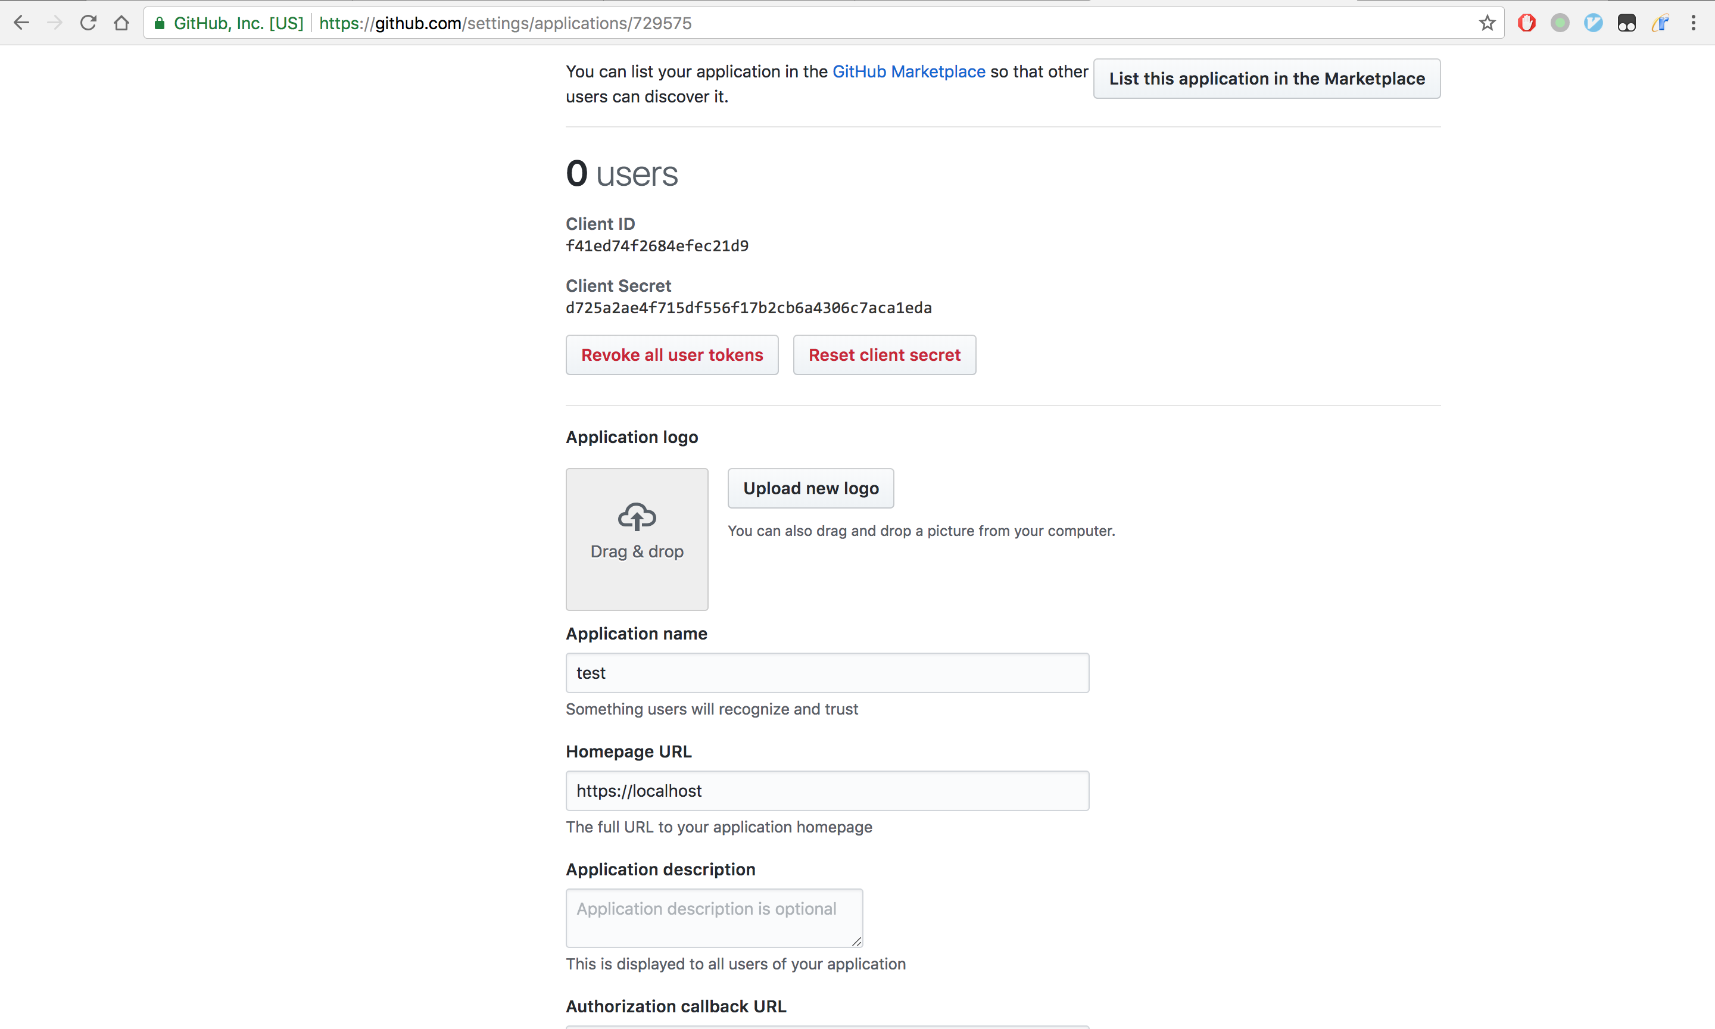
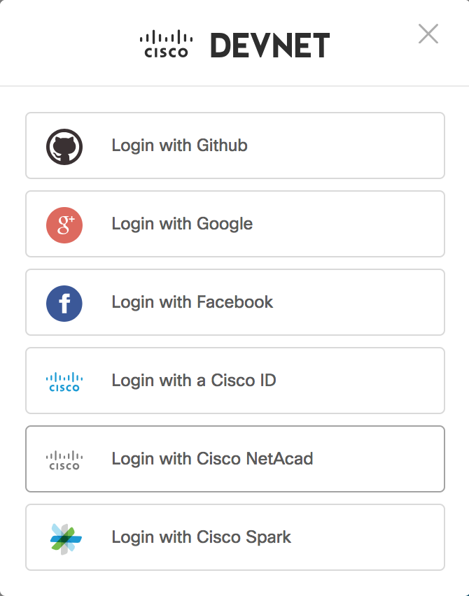
Example – Identity System
https://github.com/settings/developers
No Public Access
Client Justification
High cost in pairwise integrations

Slide 5
Solution
Every company publishes its integration documents
Perform access control to allow limited members to integrate
Store the integration sites and the certificates of each companies on blockchain

Slide 6
Overview of FedInt
Company A
Company B
Admin Agent
Admin Agent
Blockchain
Company D
Company C

Slide 7
Overview of FedInt
Company A
Company B
Integration
Guide
API
Admin Agent
Blockchain

Slide 8
Overview of FedInt
Company A
Company B
Integration
Secret
API Service
Gateway
Cert
CA
CERT
Cert
Admin Agent
CA
Blockchain

Slide 9
DEMO

Slide 10
THANKS
Questions and answers

