Slide 1



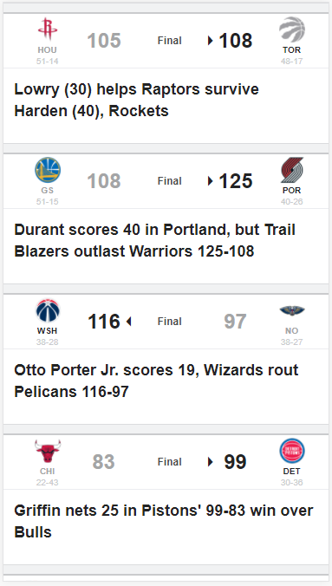
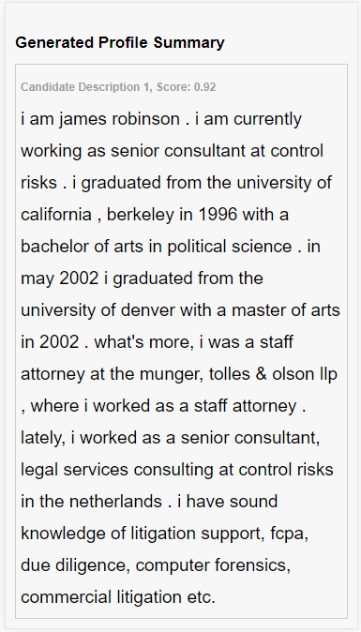
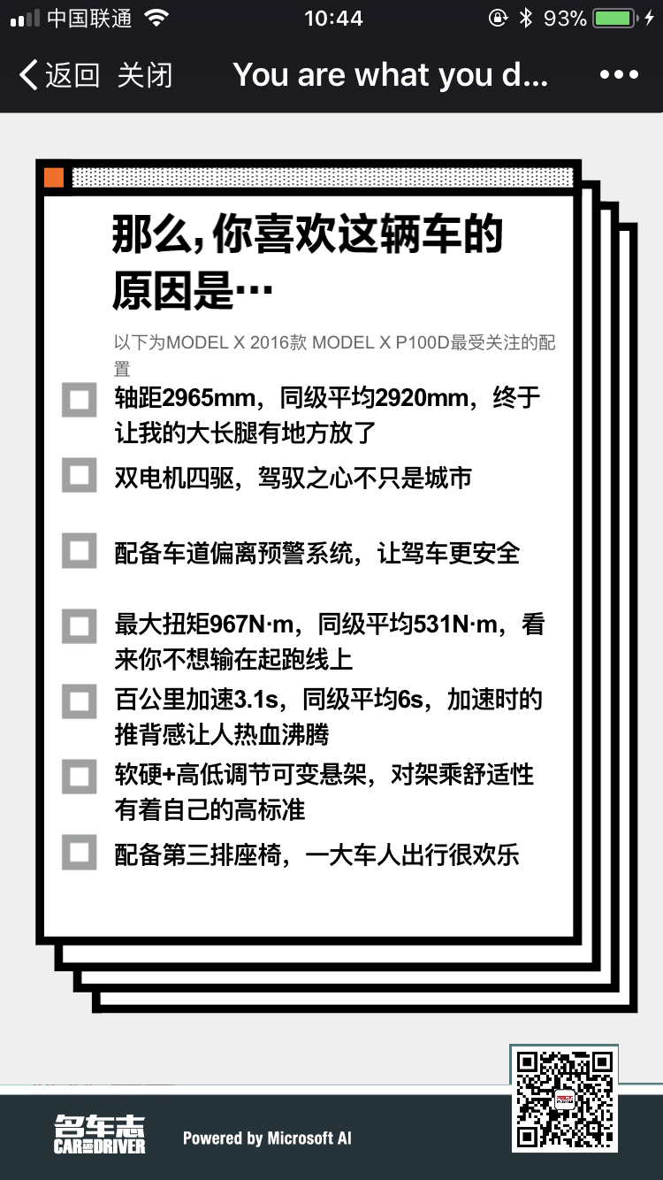
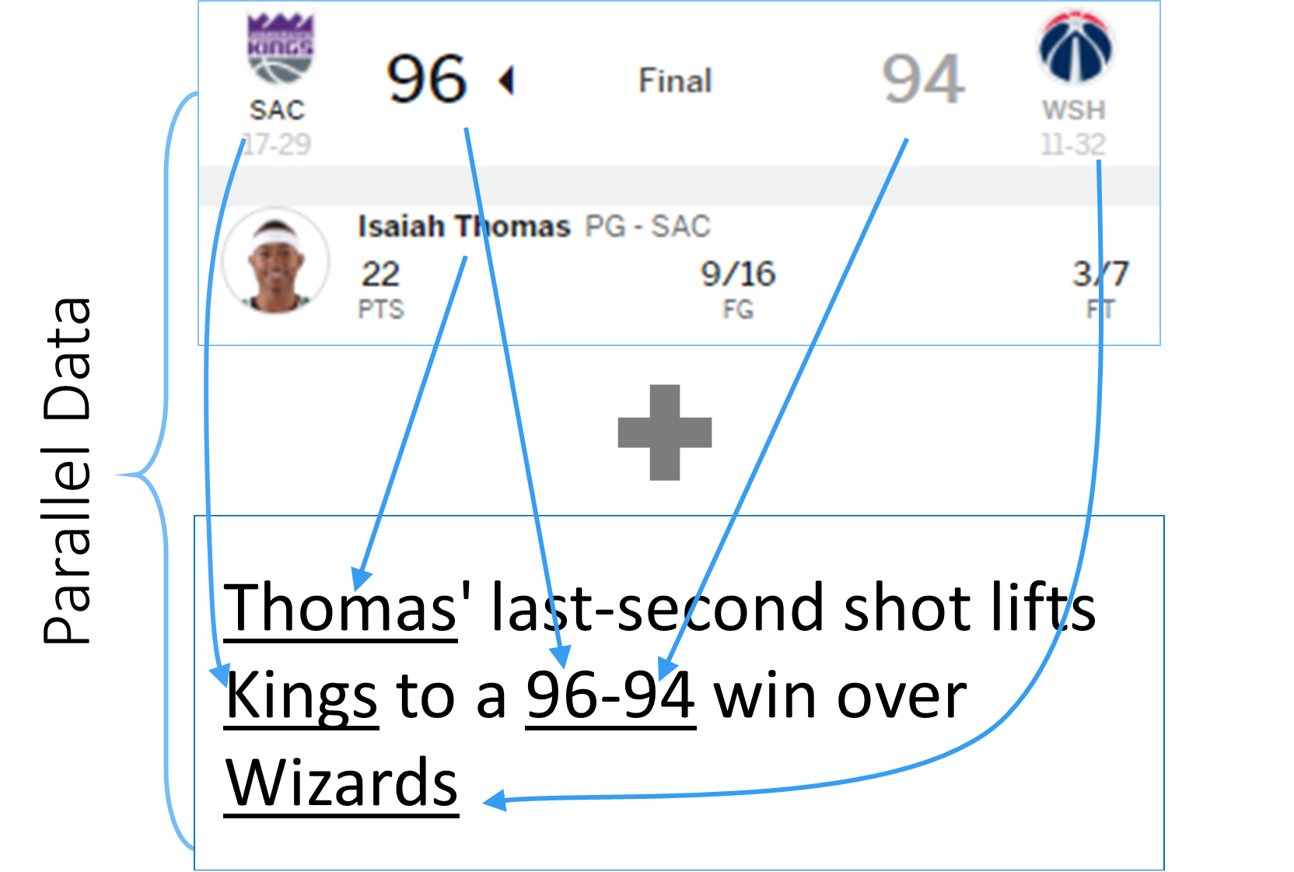
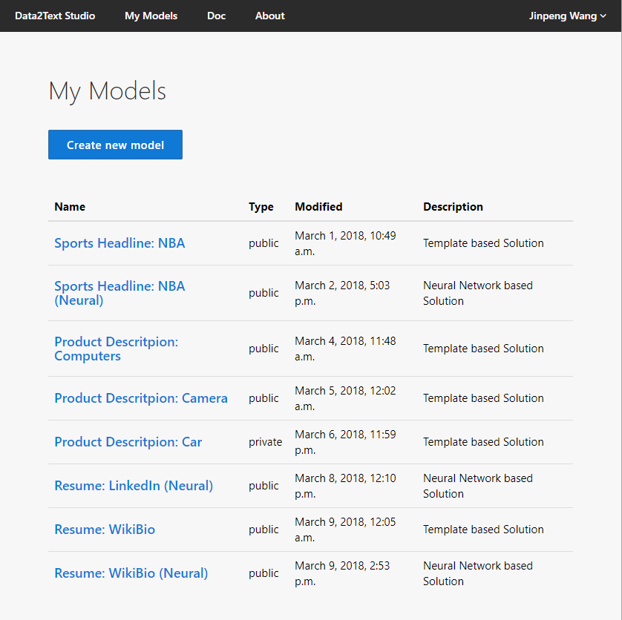
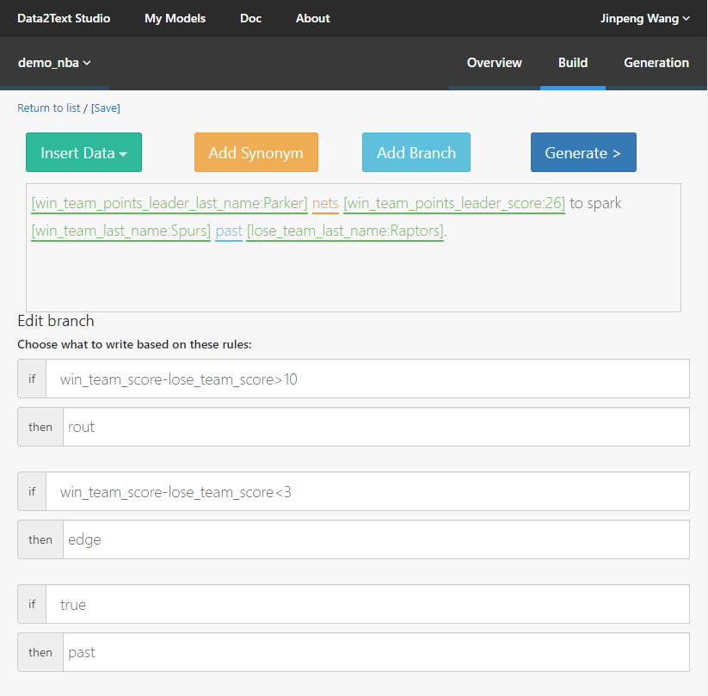
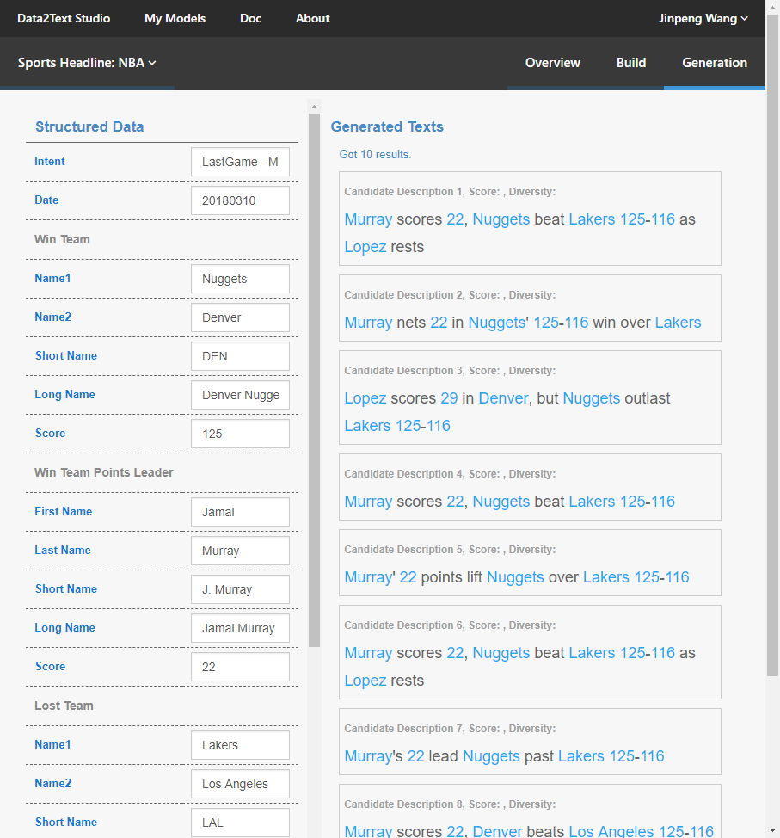
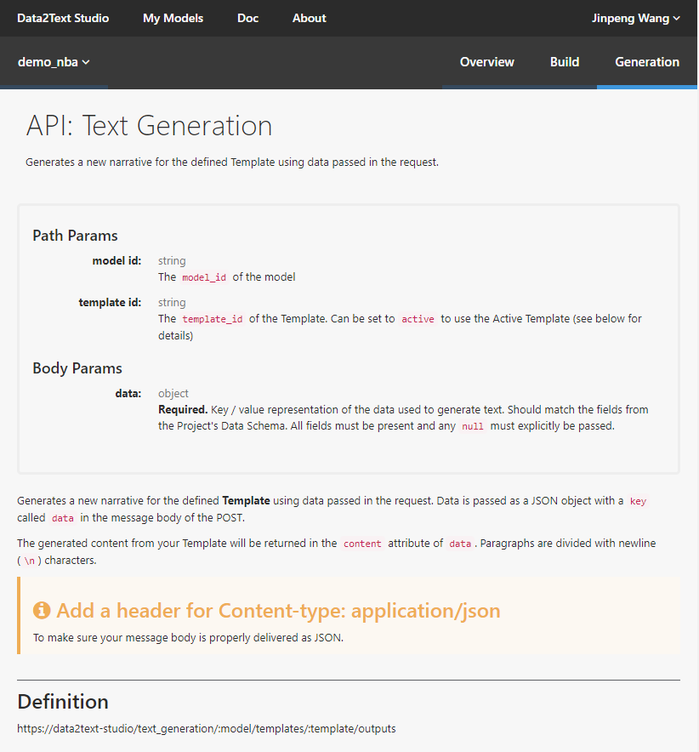
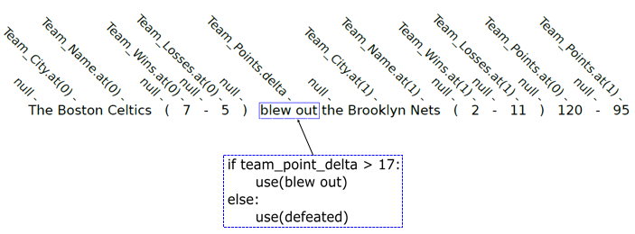
Data2Text Studio
Automated Text Generation from Structured Data
Longxu Dou¹, Guanghui Qin², Jinpeng Wang³, Jin-Ge Yao³ and Chin-Yew Lin³
¹ Harbin Institute of Technology ² Peking University ³ Microsoft Research Asia
Why Data2Text?
Summarize insights of data.
Explain data in natural language.
Empower conversational agents such as Cortana to talk about data.
Assist human writers creating texts faithful to data more efficiently.
Reduce the cost of recurrent text generation tasks such as financial reports, patents, etc.
Wheelbase
4x4
Lane Departure Warning
Power
0-to-60 time
Suspension Sys.
Third-row Seat
Sports Headline Generation
LinkedIn Profile Generation
Car Highlight Generation
Key Technologies
Data2Text Platform
Template based solution: High accuracy and fluency, which can be used directly in business applications
❶ Upload data to train model
❷ Improve model if necessary
Trigger Mechanism: Explicit semantic annotations, which support learning how to use specific phrases under the particular condition.
❸ Preview the generation texts
❹ Call the API to generation texts
Website: http://aka.ms/data2text-studio Contact：jinpwang@microsoft.com

