Slide 1
Transferring Knowledge across Learning Processes
Author: Sebastian Flennerhag, Pablo G. Moreno, Neil D. Lawrence, Andreas Damianou (Amazon UK)
ICLR 2019 Oral
Presenter : Longxu Dou
4/11/2019

Slide 2
Motivation
This paper proposes Leap, a meta-learning procedure that finds better initialization for new tasks.
Leap is based on past training/optimization trajectories and updates the initialization to minimize the expected distance the training process travels on a task's loss surface.
Near Transfer vs. Far Transfer
In general transfer-learning : the two tasks must have a high degree of structural affinity. (Resemble the Parameter)
Leap try to do knowledge transfer between distinct tasks. (Meta Learning)

Slide 3
The bias of MAML(meta-learner)
What cause bias?
Backpropagating through thousands of gradient steps is both impractical and susceptible to instability.
Truncating backpropagation to a few initial steps induces a short-horizon bias
What is bias?
Encourage the learning rate and momentum to decay quickly, so as to achieve the largest gain in the short term, but at the expense of long-run performance.
How to eliminate bias?
When adapting to a new task through a single or a handful of gradient steps, the geometry can largely be ignored.
<Understanding Short-Horizon Bias in Stochastic Meta-Optimization>

Slide 4
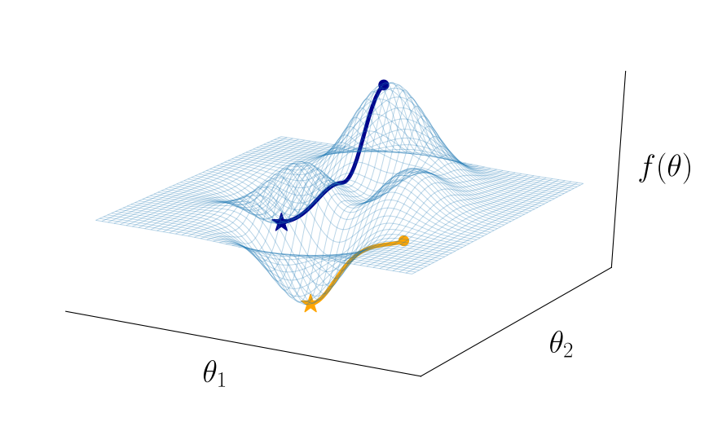

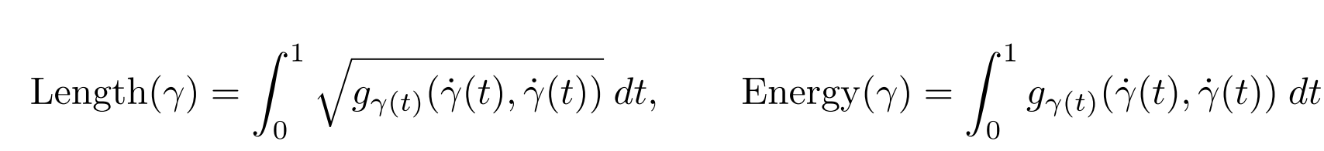
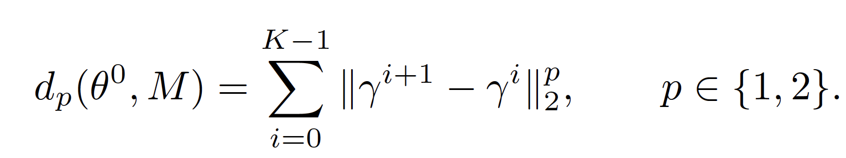
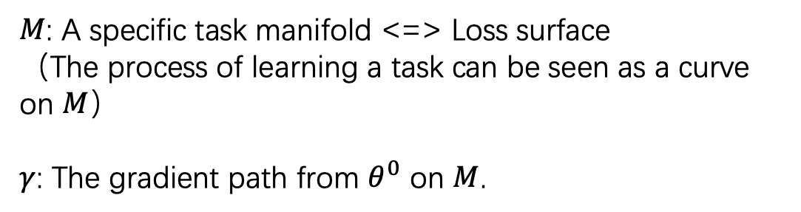
The Distance of Learning Process
$M$: A specific task manifold <=> Loss surface
（The process of learning a task can be seen as a curve on $M$）
$γ$: The gradient path from $θ^{0}$ on $M$.

Slide 5
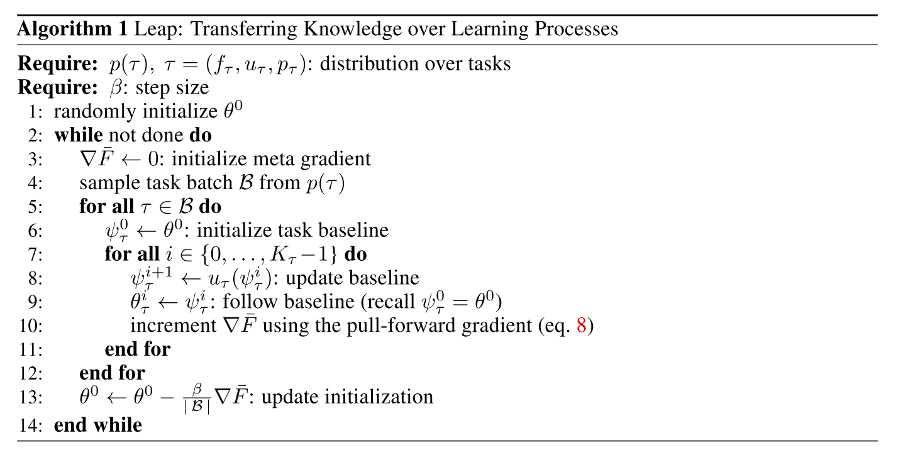
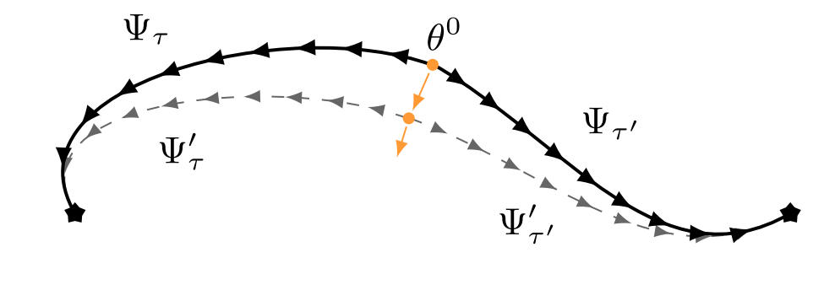
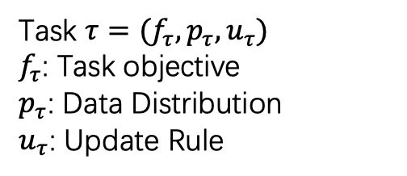
Leap Algorithm
Task $τ=(f_{τ},p_{τ},u_{τ})$
$f_{τ}$: Task objective
$p_{τ}$: Data Distribution
$u_{τ}$: Update Rule

Slide 6
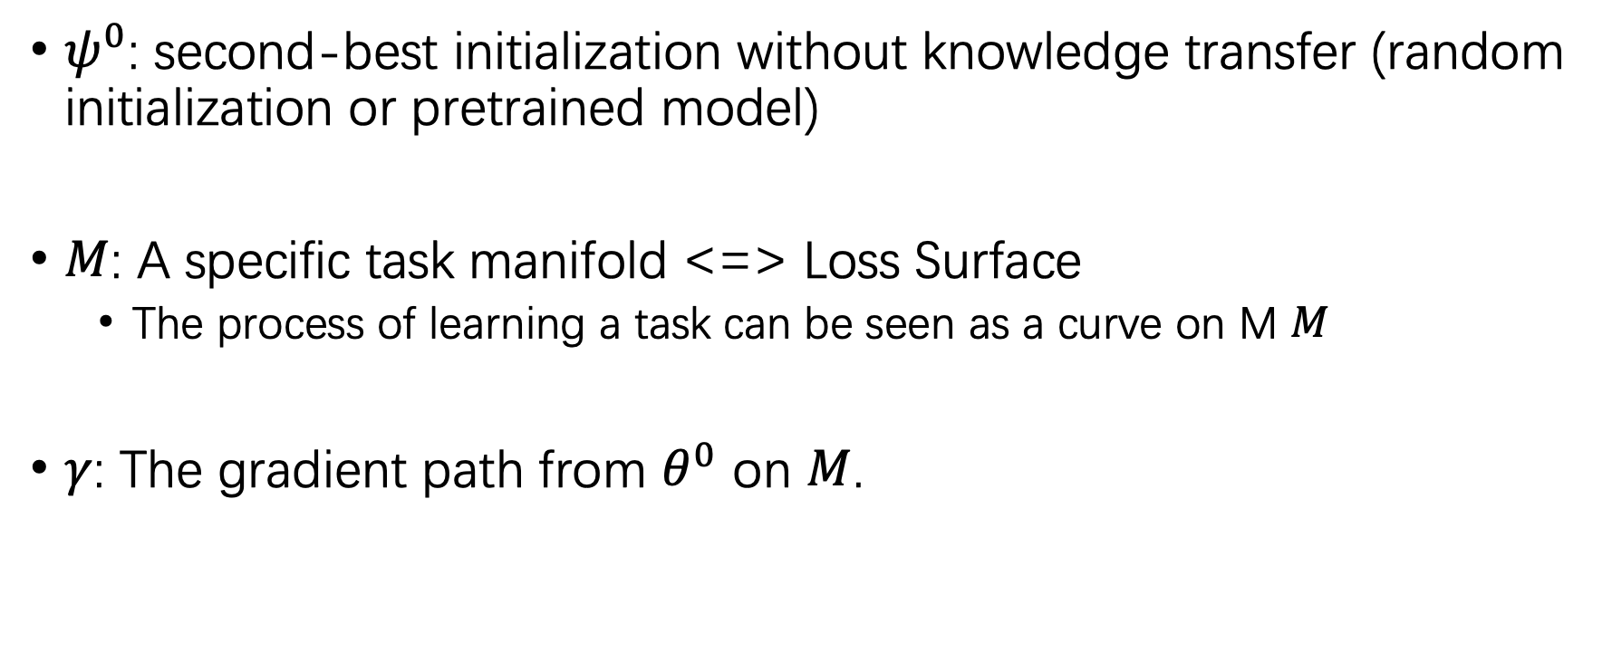
Notation
$ψ^{0}$: second-best initialization without knowledge transfer (random initialization or pretrained model)
$M$: A specific task manifold <=> Loss Surface
The process of learning a task can be seen as a curve on M $M$
$γ$: The gradient path from $θ^{0}$ on $M$.

Slide 7
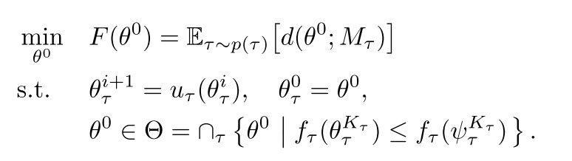
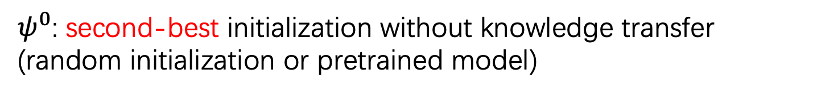
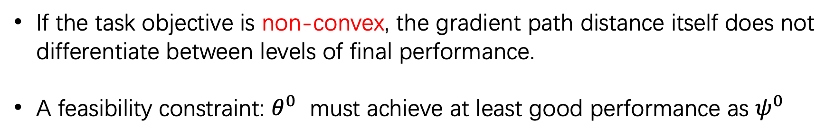
Feasibility Constraint
If the task objective is non-convex, the gradient path distance itself does not differentiate between levels of final performance.
A feasibility constraint: $θ^{0}$ must achieve at least good performance as $ψ^{0}$
$ψ^{0}$: second-best initialization without knowledge transfer (random initialization or pretrained model)

Slide 8
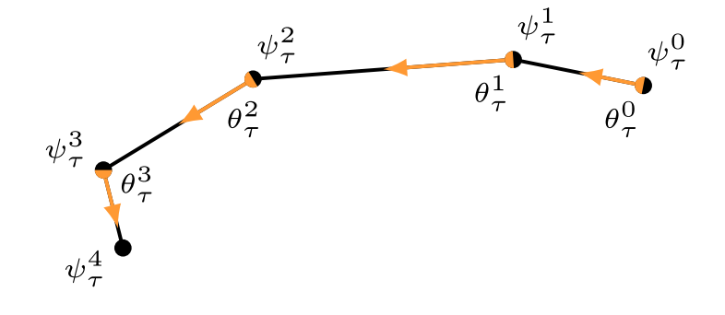
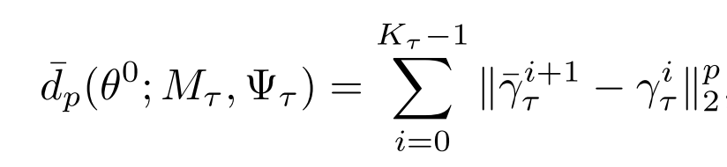


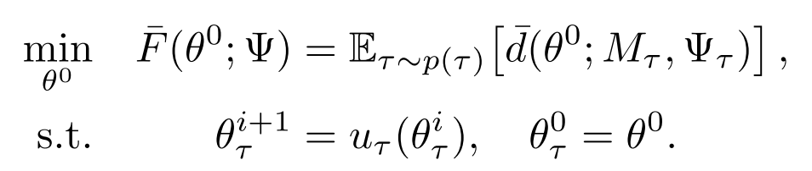
Pull-Forward Objective

Slide 9
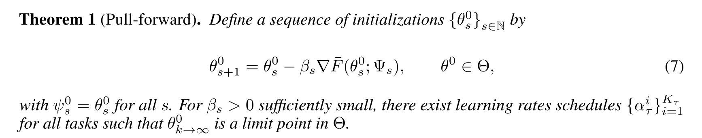
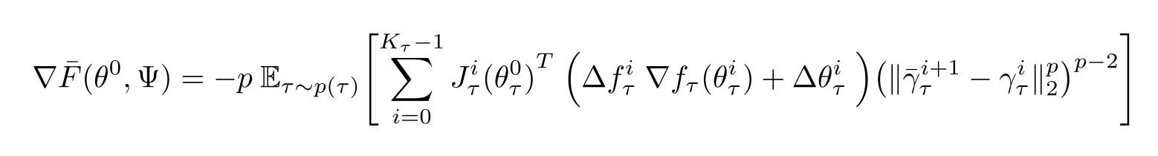
Pull-Forward Objective

Slide 10
Experimental Setting
Omniglot (frequently used in few-shot learning)
Multi-CV (common in various forms of transfer learning)
Atari (difficult transfer learning problem)

Slide 11
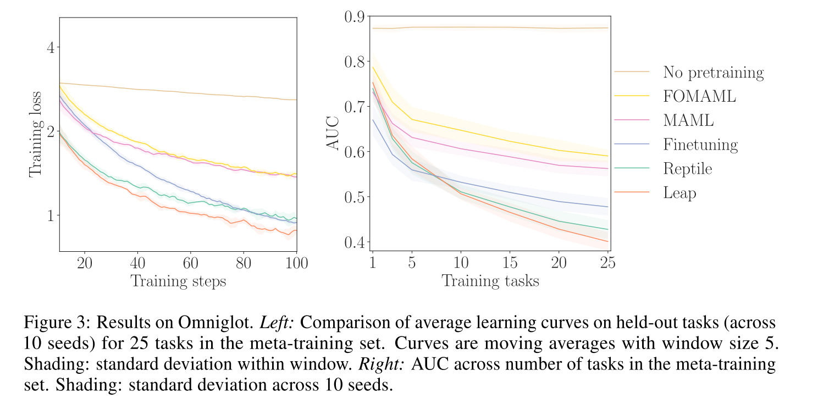
Omniglot
Notes:
We use the same convolutional encoder as in the Omniglot experiment

Slide 12
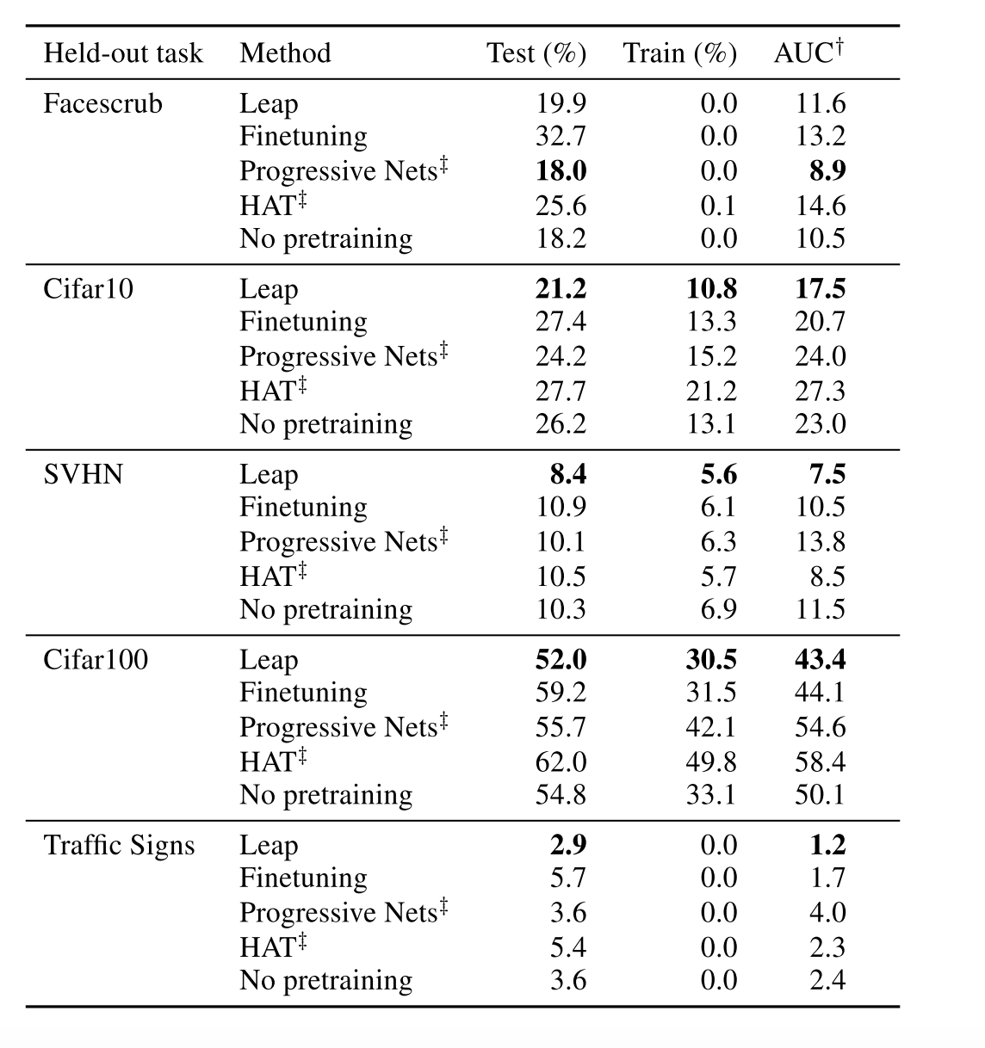
Multi-CV
We pretrain on all but one task , which is held out for final evaluation.
Leap converges faster to optimal performance and achieves superior final performance

Slide 13
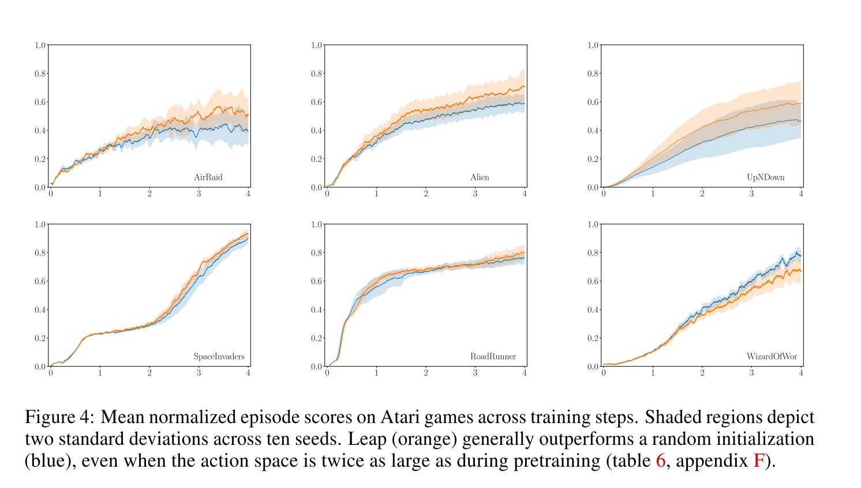
Atari
Training: mini-batches(16) from 27 games (Action:10)
Testing: two games with with similar action space.
Notes:
Leap is applied with respect to the convolutional encoder

Slide 14
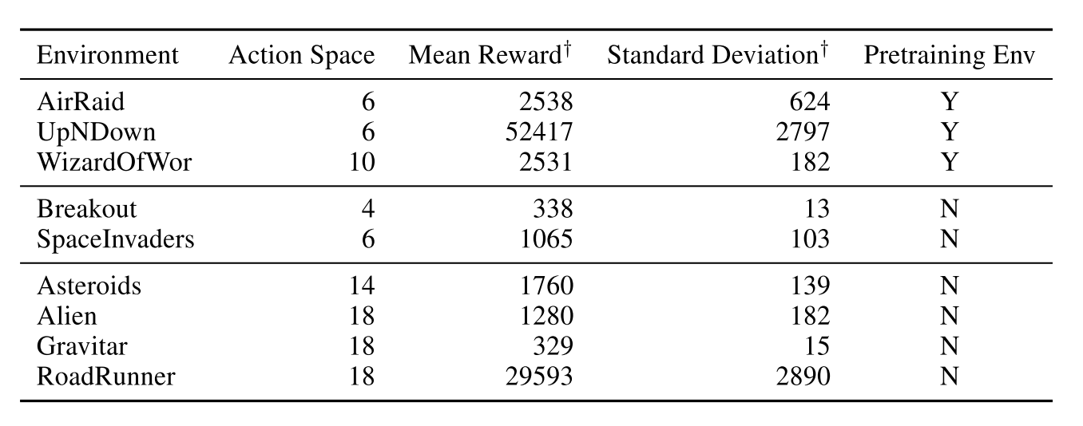
Evaluation environment characteristics

Slide 15


Compare with MAML
Leap: explicitly accounts for the entire path traversed by the model parameters during task-specific fine-tuning
MAML: mainly focusing on the final value attained by the model parameters after fine-tuning.

Slide 16
Tips
The more sophisticated the meta objective, the better Leap performs.
The length metric converges faster, but final performance is largely equivalent.
Adding the loss to the task manifold improves performance, while the stabilizer speeds up convergence.

Slide 17
Conclusion
Transfer learning typically ignores the learning process itself, restricting knowledge transfer to scenarios where target tasks are very similar to source tasks.
By formalizing knowledge transfer as minimizing the expected length of gradient paths, we propose a method for meta-learning that scales to highly demanding problems.
Leap has superior generalizing properties to finetuning and competing meta-learners.

