Slide 1
The State of the Art in Semantic Representation
Omri Abend & Ari Rappoport
The Hebrew University of Jerusalem
ACL 2017 Long Paper
Presenter: Longxu Dou
5/15/2019

Slide 2
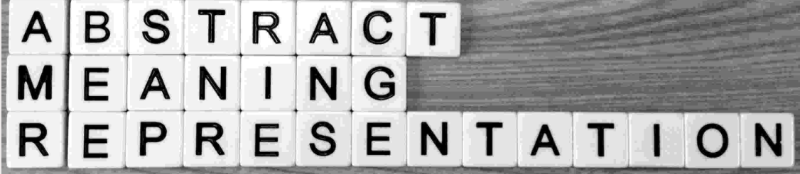

Symbolic Semantic Representation
Semantic Graphbanks:
Abstract Meaning Representation (AMR)
Broad-coverage Semantic Dependences (SDP)
Other CCG-based frameworks
Universal Conceptual Cognitive Annotation (UCCA)
Universal Decompositional Semantics
More Specific Schemes:
Semantic Roles (e.g., PropBank, FrameNet, VerbNet)
Discourse relation (e.g., Penn Discourse Treebank, RST discourse treebank)

Slide 3
Motivation
Little discussion of the commonalities and differences between schemes
An understanding of the achievements and gaps of semantic analysis in NLP is crucial
Scientifically- avoiding fragmented discussion
Practically-
Adopting the best practices from each scheme
Using the resources in conjunction (e.g. joint learning, conversion protocols)

Slide 4
Methodology
Our focus: Schemes for Semantic Representation of Text (SRTs)
Charting various SRT schemes by their content
Content = semantic distinctions, regardless of their form
Reliably and efficiently extractable distinctions
As manual symbolic supervision needed for human-like reliability
->focus on manual symbolic annotation

Slide 5
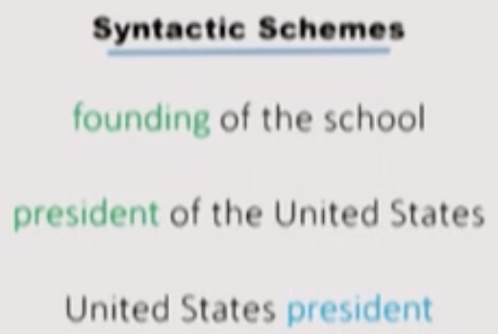
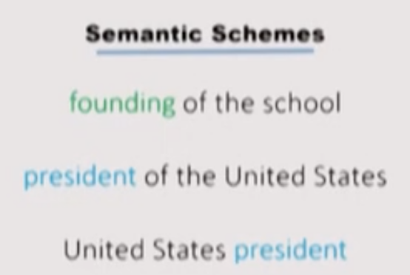
A Word on Syntactic Schemes
What`s the difference between a syntactic and a semantic scheme?
No single answer, but clearly syntactic schemes provide useful semantic information.
In a nutshell: syntactic schemes are generally more committed to distributional considerations.

Slide 6
Outline of Findings
Despite great formal difference between the schemes,
Considerable convergence in terms of the core of the annotation schemes
Three important dimensions in which schemes diverge were identified

Slide 7
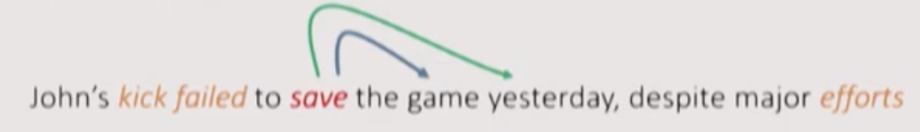
Substantial Convergence on Core Distinctions
SRT schemes normally have:
Events (or frames / scenes / propositions / predicate-argument structures)
Predicates (or frame-evoking elements, or main relations)
Core and non-core arguments (or arguments vs. modifiers / adjuncts), sometimes also anaphoric and implicit arguments.

Slide 8
Major Dimensions of Divergence
Three major architectural choices that considerably affect the semantic distinctions:
Profile of annotators
Relation to syntax
Cross-linguistic applicability

Slide 9

Divergence #1: Profile of Annotators
The entire spectrum of annotator training:
Crowdsourcing (e.g., Universal Decompositional Semantics)
Hired laypeople (e.g., UCCA, QASRL)
Experts had-correcting automatic parses(e.g., Groningen Meaning Bank)
Annotators with extensive training (e.g., AMR)
A mix of the above (e.g., FrameNet)
Affects the type of distinctions the schemes make

Slide 10
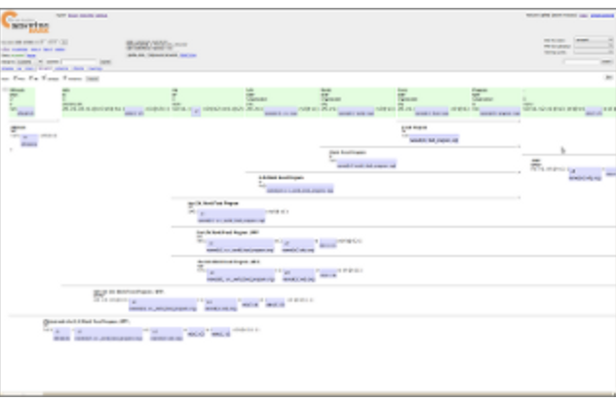
Divergence #2: Relation to Syntax
Schemes differ in their relation to syntax
i.e., their coupling with a theory of the syntax-semantics inference
Approach #1: Semantics is compositionally derived from the syntax
Example: DRT structures used by the Groningen Meaning Bank are compositionally derived based on CCG derivations.

Slide 11
Divergence #2: Relation to Syntax
Schemes differ in their relation to syntax
i.e., their coupling with a theory of the syntax-semantics inference
Approach #2: Syntax defines the skeletal structure of the semantic form
Example: Universal Decompositional Semantics is based on the Universal Dependencies framework

Slide 12
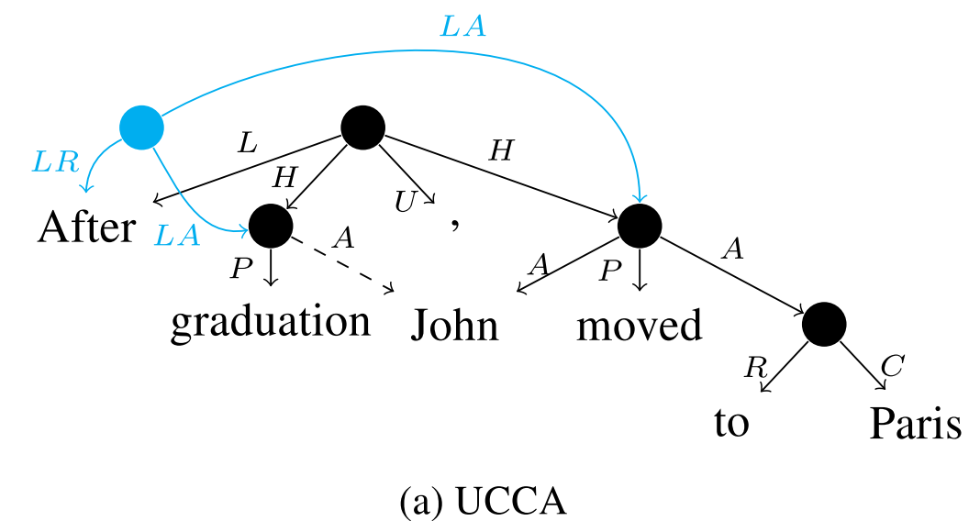
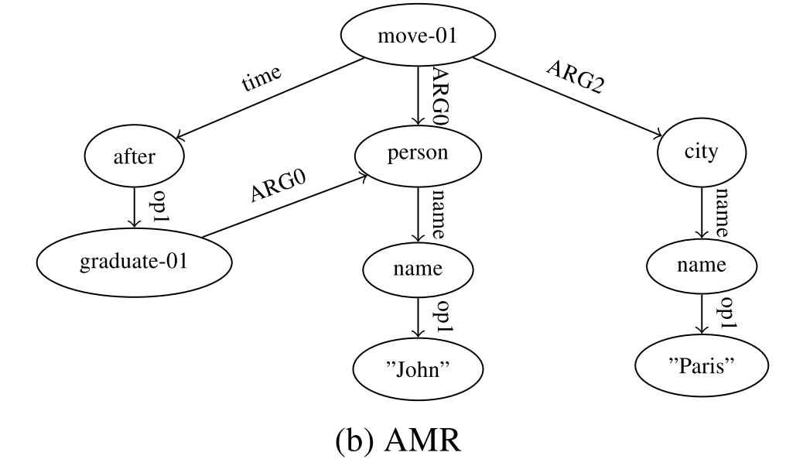
Divergence #2: Relation to Syntax
Schemes differ in their relation to syntax
i.e., their coupling with a theory of the syntax-semantics inference
Approach #3: Assume no syntactic framework
Example: AMR and UCCA

Slide 13
Divergence #3: Cross-linguistic Applicability
Cross-linguistic applicability: one of the great promises of semantic analysis
Criterion #1: Same categories/guidelines across different languages?
Some schemes define their categories by referring to linguistic typology (e.g., Lingo Grammar Matrix, UCCA)
Some schemes (in their current form) are admittedly English-centric (e.g. AMR)

Slide 14
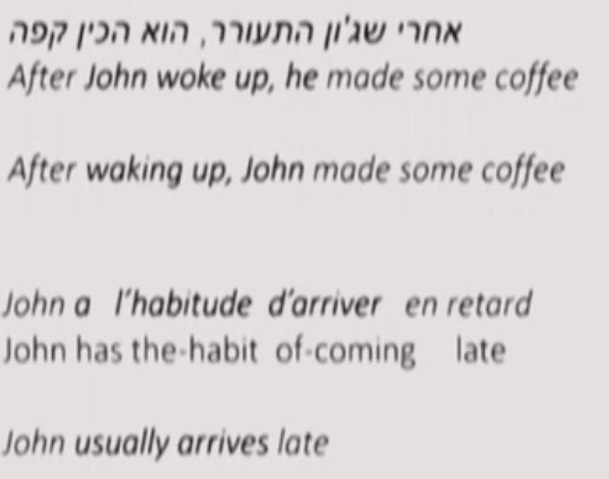
Divergence #3: Cross-linguistic Applicability
Criterion #2: Do translation have the same semantic structure?
Despite syntactic differences:

Slide 15
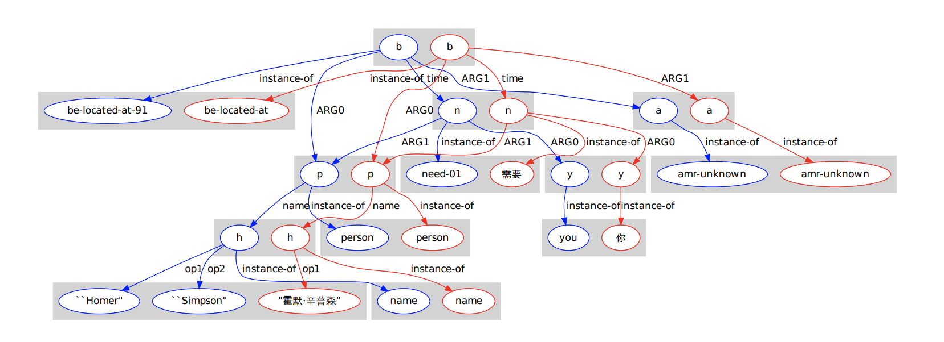
Divergence #3: Cross-linguistic Applicability
Criterion #2 has often been empirically evaluated
Examples: AMR (Xue et al., 2014), FrameNet (Pado and Lapata, 2009), UCCA (Sulem et al, 2015)
<Not an Interlingua, But Close: Comparison of English AMRs to Chinese and Czech> Xue et al., 2014
Notes:
Another common criterion for evaluating a semantic
scheme is invariance, where semantic
analysis should be similar across paraphrases or
translation pairs

Slide 16
Conclusion
We began to chart the semantic content encoded by SRT schemes.
Despite significant formal differences, much convergence in the content distinctions.
Nevertheless, significant differences in three major dimensions:
Coupling with syntax
Profile of annotators
Cross-linguistic applicability
Much to gain from understanding and comparing the different schemes.

