Slide 1
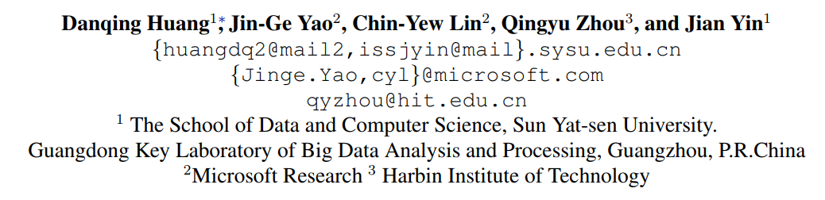
Using Intermediate Representations to Solve Math Word Problems

Slide 2
NL -> Equations
Semantic gap between natural language and equations
The sum of 2 numbers is 18. The first number is 4 more than the second number. Find the two numbers.
$$x+y=18, x=y+4$$
What about “the sum of 100 numbers” that is unseen in training data
-> x+y+.... (100 variables)
Notes:
It requires reasoning with respect to sets of numbers or variables, which is an essential capa- bility in many other natural language understand- ing tasks.

Slide 3
Intermediate Representation
The sum of 2 numbers is 18. The first number is 4 more than the second number. Find the two numbers.
math#sum(cnt: 2) = 18, ordinal(1) = math#more(ordinal(2), 4)
$$x+y=18, x=y+4$$
Generalize to “the sum of 100 numbers” -> math#sum(cnt: 100)

Slide 4
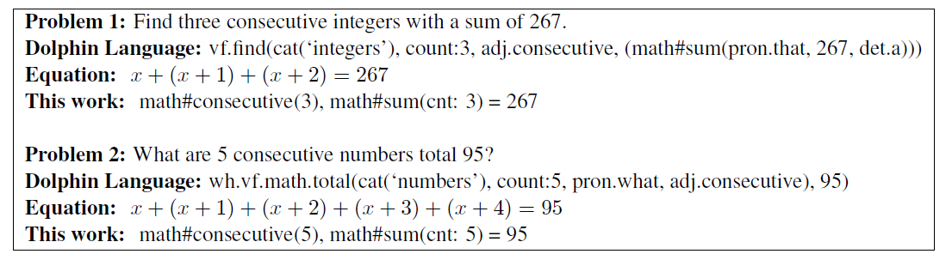
Inspired from Dolphin Language (Shi et al., 2015)
Dolphin language aligns too closely with natural utterances
Our new intermediate form is more compact
math#consecutive(), math#sum(cnt: 5)….

Slide 5
NL -> Logical Form
The sum of 2 numbers is 18. The first number is 4 more than the second number. Find the two numbers.
math#sum(cnt: 2) = 18, ordinal(1) = math#more(ordinal(2), 4)
$$x+y=18, x=y+4$$
Challenge: Intermediate representation is latent

Slide 6
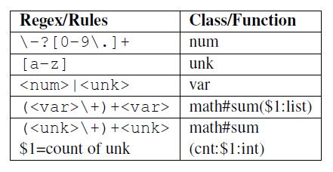
Derive latent forms from equations
Find 3 consecutive integers that 3 times the sum of the first and the third is 79.
3 * (x + (x + 2)) = 79
Which 3 to align?
Which operator to derive?
Predefine rules for derivation
(✓) math#consecutive(3), math#product(3, math#sum(ord(1), ord(3))
(x) math#consecutive(3), math#product(3, math#sum(min(), max()) = 79
Ambiguity in Derivation
Notes:
For one equation system, several latent form derivations are possible. Take the following math problem as an example:

Slide 7
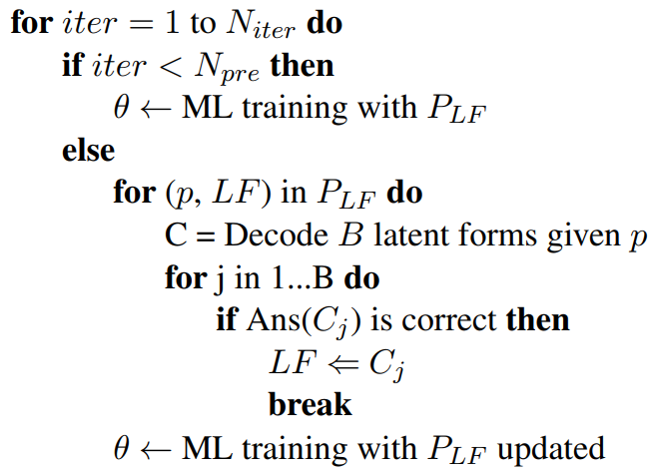
Iterative Labeling
Input
D_{n} = {(p_{i}, E_{pi}, A_{pi})} (problem with equation and answer annotation)
Possible latent forms P_{LF} = {(p₀, LF⁰_{p0}), (p₀, LF¹_{p0}), …, (p_{n}, LF^{m}_{pn})}
Pre-train with all possible LF
(more stable model and faster convergence)
Re-labeling LF in training data
After IL, correct the LF of p₀ to LF¹_{p0}:{(p₀, LF¹_{p0}), (p₀, LF¹_{p0}),
…, (p_{n}, LF^{m}_{pn})}

Slide 8
Example
Iterative Labeling corrects the intermediate forms in training data
Training problem:
Find 2_0 consecutive integers which the first number is 2_1 more than 2_2 times the second number.
1st iteration
(x) math#consecutive(2_0), ordinal(1) = math#sum(2_0, math#product(2_0, max())
50th iteration
(x) math#consecutive(2_0), ordinal(1) = math#sum(2_1, math#product(2_0, ordinal(2))
100th iteration
(✓) math#consecutive(2_0), ordinal(1) = math#sum(2_1, math#product(2_2, ordinal(2))

Slide 9
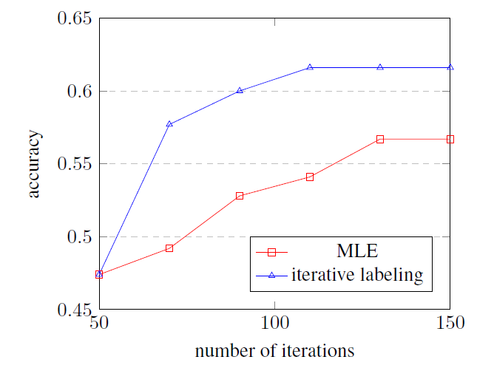
Iterative Labeling & MLE
Iterative labeling:
Better performance
Converge faster
Notes:
we manually sam- ple 100 math problems with derivation ambigu- ity. 78% of them are relabeled with correct latent forms as we have checked.

Slide 10


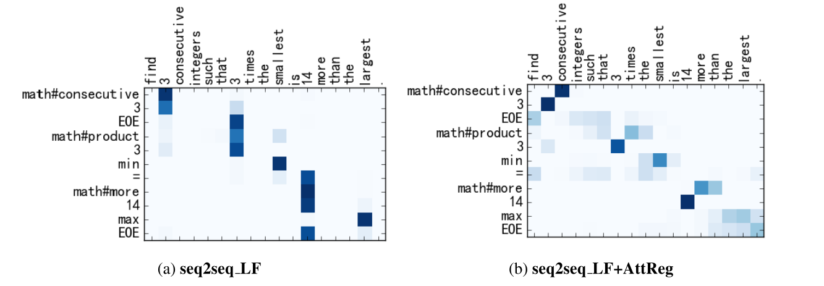
Attention Regularization

Slide 11
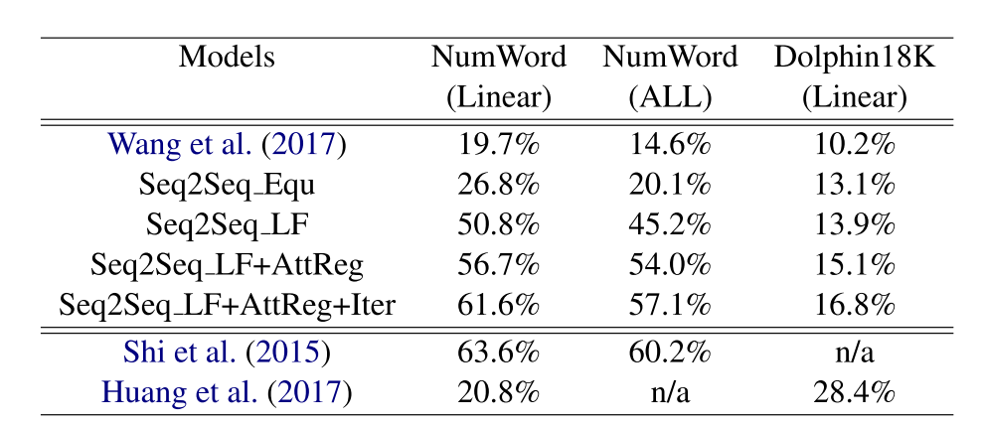
Performance
Logical Form is better than Equation
Iterative Labeling helps
Attention Regularization helps
Notes:
NumWord(2015) Its linear subset (subset of problems that can be solved by linear equation systems) has 986 problems, only involving four basic operations {+, −, ∗, /}
Dolphin18K(2016) ：It contains 18,711 math word problems col- lected from Yahoo! Answers2. Since it con- tains some problems without equations, we only use the subset of 10,644 problems which are paired with their equation systems.

Slide 12
Further Challenge
Natural language variations
“John has 10 apples. How many apples does John have after giving Mary 2 apples?”
“A cat caught 10 fish. It has eaten 2 fish. How many fish are left?” (x = 10 - 2)
Nested operations
“I think of number, double it, add 3, multiply by the answer by 3 and then add on the original number. What is the number now?”
External knowledge
“Find the probability that total scores is 10 or more given at least one dice show 6 if 2 dice red & blue thrown?”

