Slide 1
Overview of Semi-Supervised Learning for DNN

Slide 2
Previous work
Key problem : Use semi-automatically constructed training dataset to extract the high quality template for Data2Text text generation system.
Main target: improve the template extraction accuracy.
Including the following steps:
Using simple rule to align the raw dataset and value set using simple rule.
Observe the baseline Neural-CRF model performance.
Add hand-crafted feature and observe the improvement.
Use classifier to improve the recall of dataset.

Slide 3
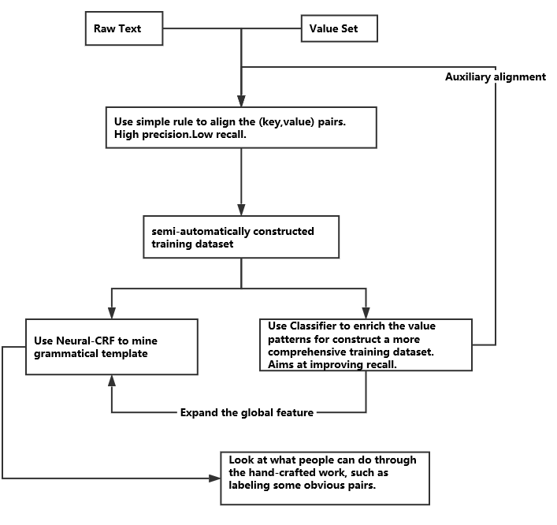
Architecture

Slide 4
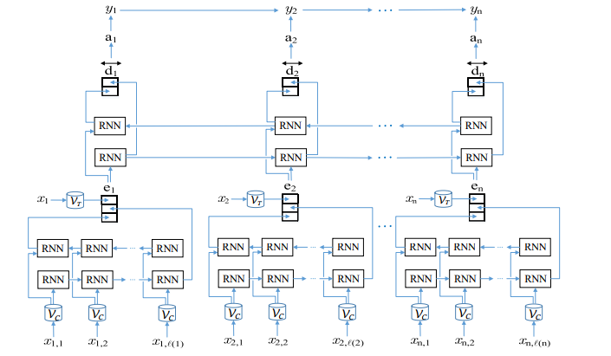
Baseline Bi-LSTM-CRF Architecture
The system is composed of three layers:
Character-enhanced token embedding layer
Label prediction layer
Label sequence optimization layer

Slide 5
Analysis
The problem of short distance supervision for template alignment can be summarized into two steps:
Derive pseudo labels. Our rule based alignment method have do this, but the precision and recall and not good. To improve the performance, we can try to learn some classifiers to do it.
Alignment based on the pseudo labels. The pseudo labels are not perfect, while the full supervision models like CRF treats all the label are correct and produces poor results.

Slide 6
Current task
For step 2:
XiaoLi’s work has proposed this point several years ago (can treated as baseline), but we want to incorporate this ideas with neural network based CRF models which can extract features automatically.
We have two ideas to try:
add regularization term to the existing CRF models, which is a temporary solution
turn to semi-supervision CRF models which treat the pseudo labels as noisy signal but not the final label.

Slide 7
Outline
Training DNN in noisy labels
Entropy Regularization
DAE

Slide 8
Two phases in DNN learning
Unsupervised pre-training
Initialize all layers by a unsupervised way such as DAE.
Fine-tuning
Trained globally with labels us BP in supervised fashion.

Slide 9
Task Formalism (Xiao Li, MSR2009)
Goal: Improve generalization performance using unlabeled/derived labeled data in Fine-tuning phrase.
Different dataset sources
Manual labeled : rare, expensive, accurate
Derived labeled : semi-constructed, partial label/incorrect label
Unlabeled : raw text, rich in website

Slide 10
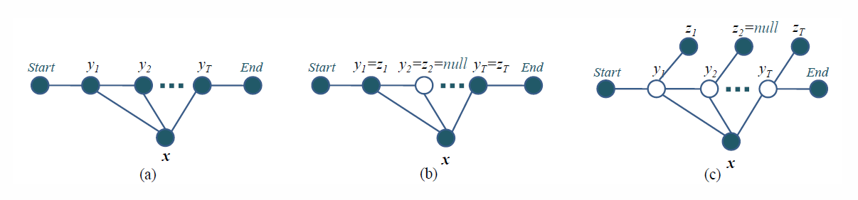
Three training settings in CRF (Xiao Li, MSR2009)
manual labeled: initialize the model by supervised learning, testing
derived labeled: hard evidence (treated same as the manual label)
derived labeled: soft evidence (view the entire state as hidden variables)

Slide 11






Derived labels as Soft Evidence(Xiao Li, MSR2009)
Objective: optimizes an expected conditional likelihood:
Second term : model maximum likelihood in derived labels
Posterior probability: compute in E-step using Forward-Backward algorithm
Soft evidence feature: incorporate the information of derived labels

Slide 12
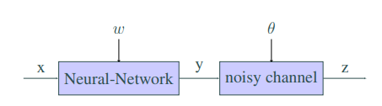
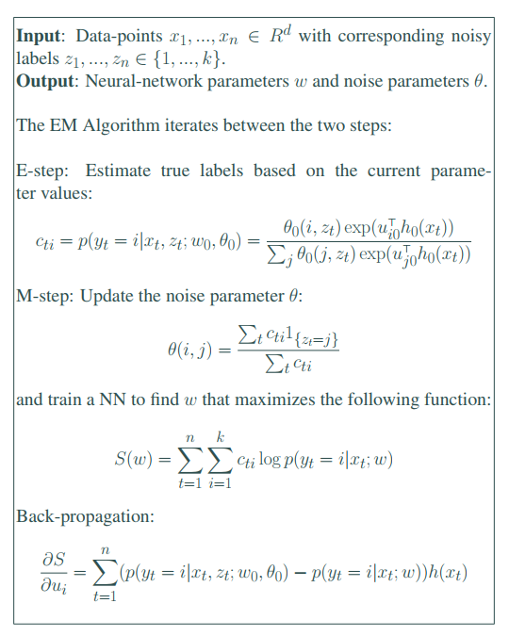
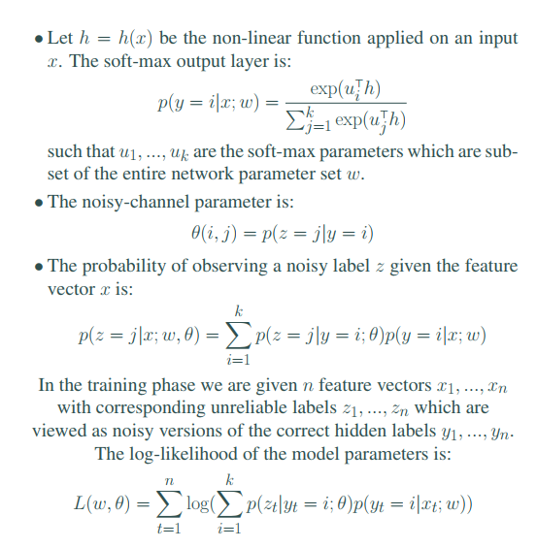
EM Algorithm in (Alan Joseph Bekker, 2016)
Posterior probability
Jensen inequality
Derive the low-bound of this likelihood

Slide 13
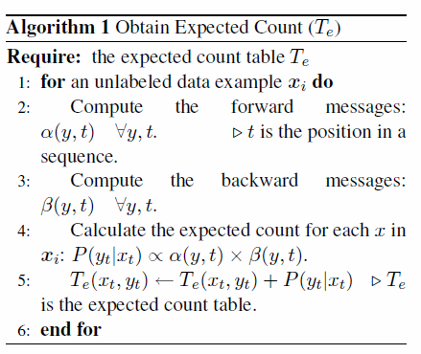



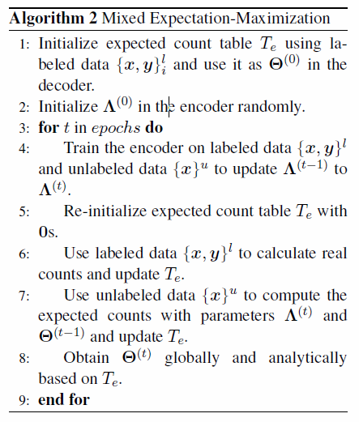
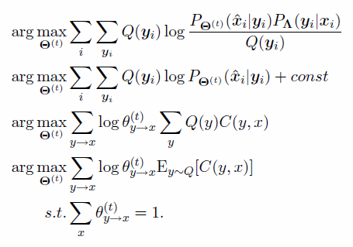
EM Algorithm in (Xiao Zhang, 2017)
Encoder
Decoder
These 2 parts are constant.
The above is because we fix the encoder during training decoder.
The below is because the sum of log is 1.

Slide 14
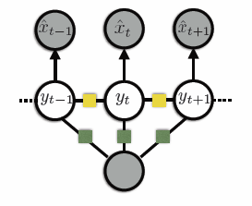
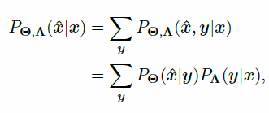






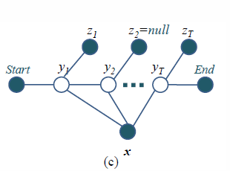

Model comparison
Objective
Inference
Data : labeled + unlabeled
17 EMNLP: structured prediction using CRF-Autoencoder
Their Q-function/likelihood in E-step are different. This is due to their goal.
The above want to maximum both encoder and decoder.
The below just to get a regularization between hidden state(true label) and observed state (derived label) .
Objective
Inference
Data : labeled + semi-labeled
09 MSR: semi-supervised CRF

Slide 15
Outline
Training DNN in noisy labels
Entropy Regularization
DAE

Slide 16
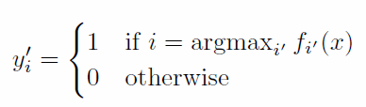
Definition
Pseudo-label: target classes for unlabeled data which has maximum predicted probability.
Cluster assumption:
the decision boundary should be low-density

Slide 17

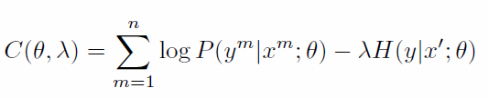
Entropy Regularization
Minimize the conditional entropy of class probabilities for unlabeled data. Don’t need to model the density.
MAP estimate: (one term for labeled data, one term for unlabeled data)

Slide 18
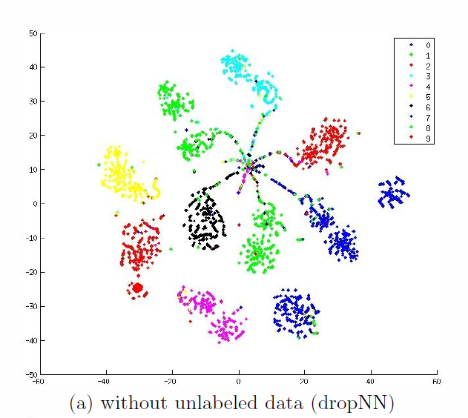
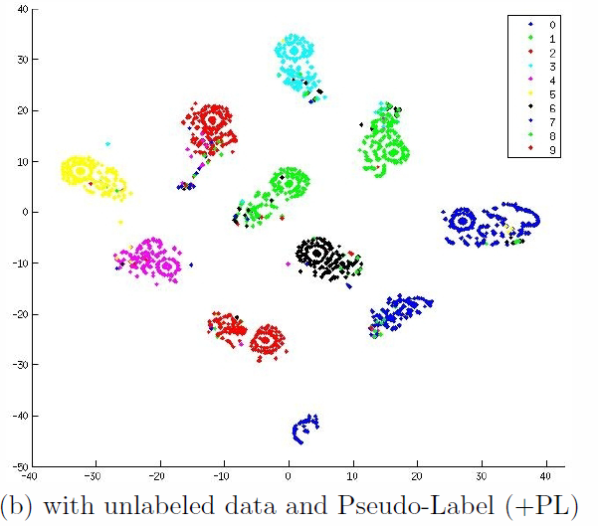
Performance

Slide 19
Outline
Training DNN in noisy labels
Entropy Regularization
DAE

Slide 20

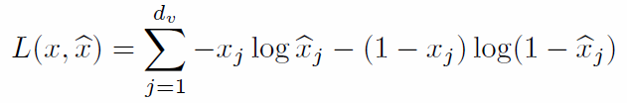
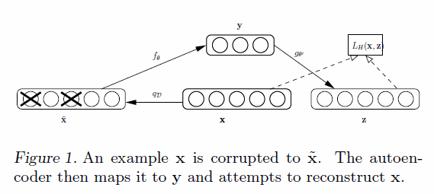
Denoising Auto-Encoder
Motivation: Useful intermediate representations helps DNN learning
Goal: Make the learned representations robust to partial corruption of the input.
Autoencoder objective function:
Loss function in Pseudo-Label work:

Slide 21
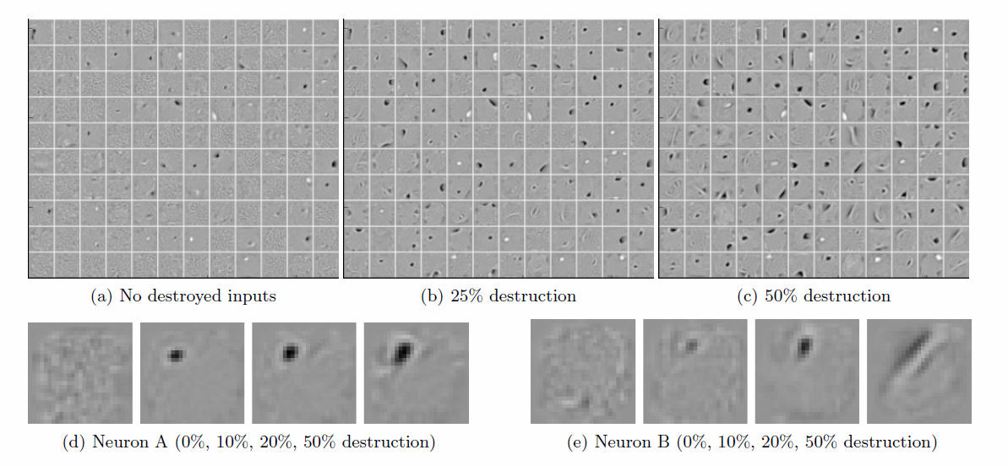
Filters
Increase the noise level to encourage the filters to capture more distinctive features.

Slide 22
Involved paper
Training DNN in noisy labels
<Extracting Structured Information from User Queries with Semi-Supervised Conditional Random Fields> Xiao Li
<Pseudo-Label : The Simple and Ecient Semi-Supervised Learning Method for Deep Neural Networks> Dong-Hyun Lee
<TRAINING DEEP NEURAL NETWORKS ON NOISY LABELS WITH BOOTSTRAPPING> Scott E. Reed & Honglak Lee
<TRAINING DEEP NEURAL-NETWORKS BASED ON UNRELIABLE LABELS> Alan Joseph Bekker
Entropy Regularization
<Extracting and Composing Robust Features with Denoising Autoencoders> Pascal Vincent
DAE
<Semi-Supervised Structured Prediction with Neural CRF Autoencoder> Xiao Zhang

