Slide 1
Strategies For Pre-training Graph Neural Networks
Weihua Hu, Bowen Liu, Joseph Gomes, Marinka Zitnik, Percy Liang, Vijay Pande, Jure Leskovec
ICLR 2020 Oral

Slide 2

作者介绍
Weihua Hu
2-nd year Ph.D at Stanford
B.E and M.S from U.Tokyo
Jure Leskovec
Associate Professor at Stanford
Chief Scientist at Pinterest
Percy Liang
Associate Professor at Stanford
< Open Graph Benchmark: Datasets for Machine Learning on Graphs>
< How Powerful are Graph Neural Networks>

Slide 3
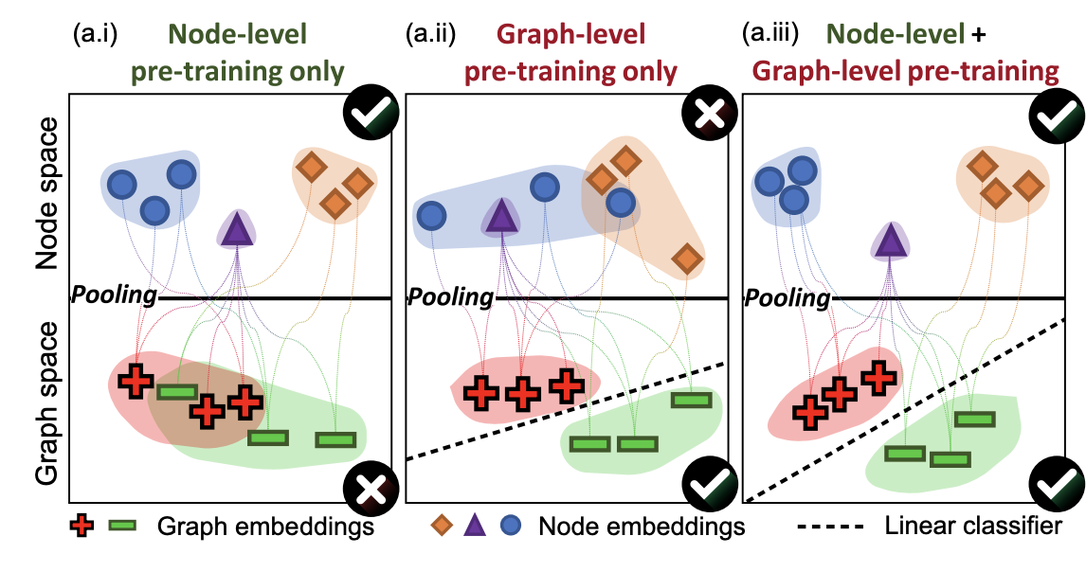
只进行训练node级别的预训练
Graph embeddings that are created by pooling node-level embeddings are not separable.

Slide 4
只进行graph级别的预训练
The embeddings of individual nodes do not necessarily capture their domain-specific semantics.

Slide 5
Node级别+graph级别的预训练

Slide 6
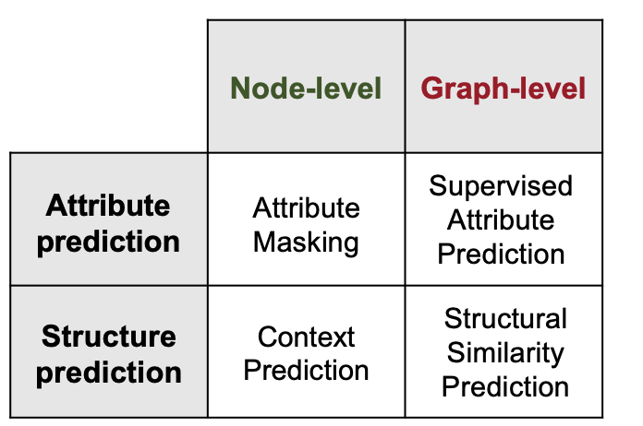
预训练概括
﻿1.node-level self-supervised pre-training
﻿2.graph-level multi-task supervised pre-training
3.﻿fine-tune the pre-trained GNN model

Slide 7
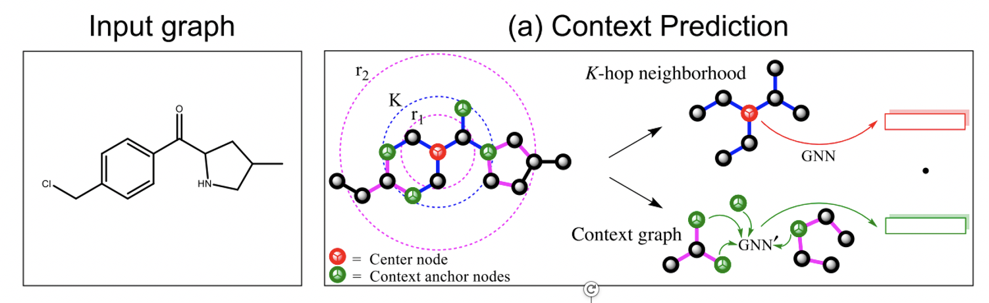
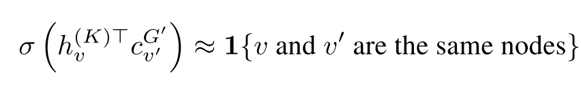
Node-level Pretraining : Context Prediction
K-hop neighborhood: 距离v至多为K的邻居
Context-graph：一个r2 − r1宽度的环
R1<K: 保证衔接处的结点表示共享
本例子中: K=2, r1=1, r2=4

Slide 8
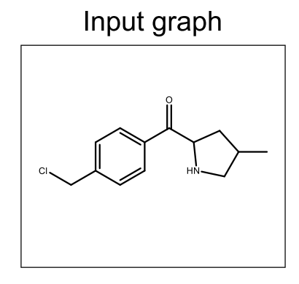
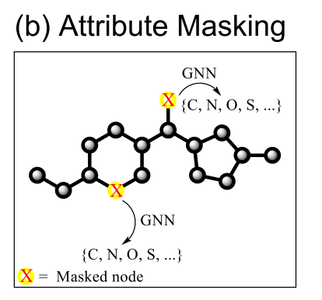
Node-level Pretraining : Attribute Masking
Mask node/edge attribute
Edge表示：
由边两端的结点表示得到
以﻿molecular graph(分子图)为例:
Node attribute: atom type->valency
Edge attribute: ﻿a pair of proteins

Slide 9
Graph-level Pretraining
﻿Supervised Graph-level Property Prediction
例：预测蛋白质是否有某种特性
问题：大量的﻿multi-task supervised pre-training可能会损害下游任务性能
原因：只提供了graph-level的监督信号
解决方法：
A：利用专家知识甄别有益的任务
B：先进行node-level预训练，会使得graph-level的预训练更鲁棒
﻿Structural Similarity Prediction
难点：
﻿ground truth graph distance values is a difficult problem
﻿quadratic number of graph pairs
留到未来工作

Slide 10
实验部分：数据集
化学领域：分子特性预测 node-prediction
生物领域：蛋白质功能预测 graph-prediction
数据集 | Node-level | Graph-level
化学 | 2000K | ﻿456K/1310 tasks
生物 | 395K | 88K/5000 tasks

Slide 11
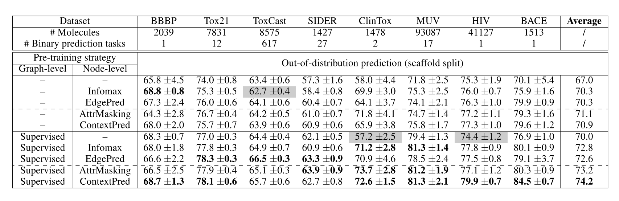
实验部分：化学Benchmark结果
Infomax：﻿maximizes mutual information between local node representations and a pooled global graph representation.
EdgePred：﻿reconstruct a graph’s adjacency matrix

Slide 12
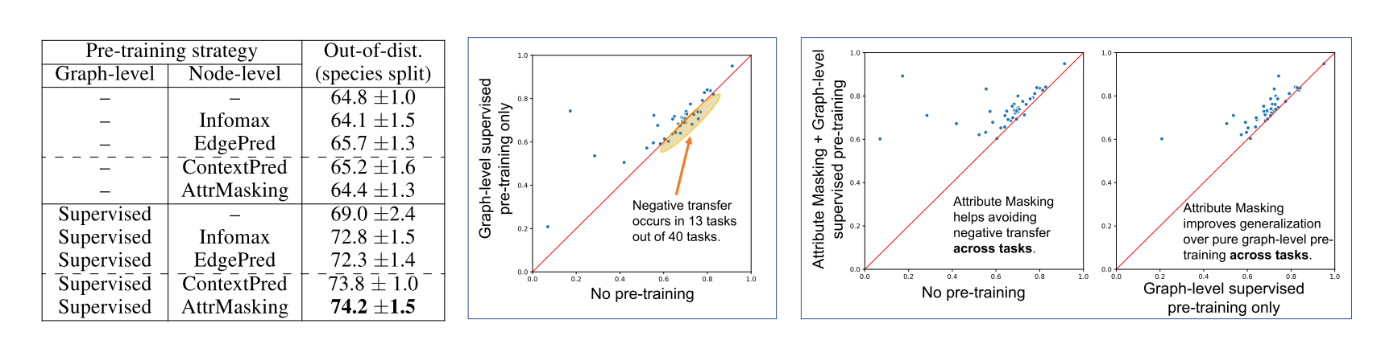
实验部分：生物Benchmark结果

Slide 13
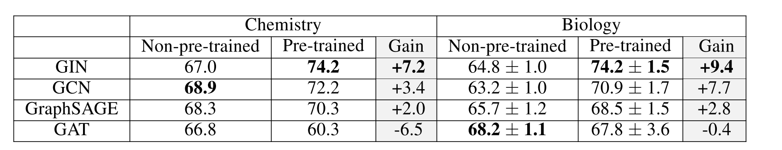
实验部分：不同图网络
表达力最强的GIN+pretrain达到了最好的结果
﻿using an expressive model is crucial to fully utilize pre-training

Slide 14
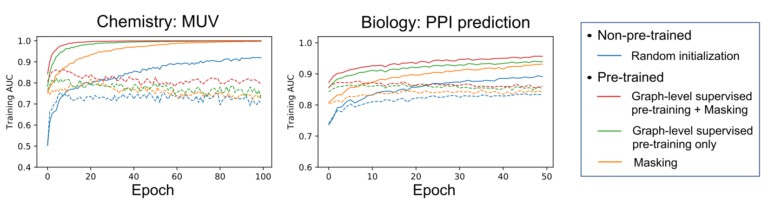
收敛曲线

Slide 15
论文总结
论文贡献：
同时从node-level和graph-level预训练图表示
提出了两个大规模数据集用做graph pretrain
优点：
写作好
扩展到了实际领域

